Slide 1



Enterprise Asset Management
Proposal to Expand AiM :
Phase 2 Operations & Maintenance
June 2017

Slide 2

Agenda
Why is this important
Vision for the future
What we’ve done so far
What we propose
How it helps campuses
Cost and potential savings

Slide 3

Are your facilities the best they can be?

Slide 4

No Data
Good, fair or really bad?
Financial benefits of good facilities management?
Reducing Utility costs?
Ideal preventative maintenance levels?

Slide 5

Better Data is needed
Optimize day to day operations
Decide where to invest
Benchmarking
Sharing best practices

Slide 6

Vision for 2025
Ideal state of repair
Excellent energy efficiency
Reduced energy costs
Capital investment targeted to programming
Students, faculty and staff in abundance

Slide 7


AiM: Modules
Fleet and Fuel
Integrated Workplace
Property Risk Management
Currently - Property, Space and Asset Life Cycle Management
Next - Work Order Management
Property, Space and Asset Life Cycle
Construction Management
Surplus Management
Parking Management
Field Service Solutions
Energy Management
Asset and Inventory

Slide 8

Property & Space
Property and Space Utilization
Asset Renewal Needs
O&M
Real Time Validation
Official Data of Record
Easy Reporting
Improved Asset Management

Slide 9
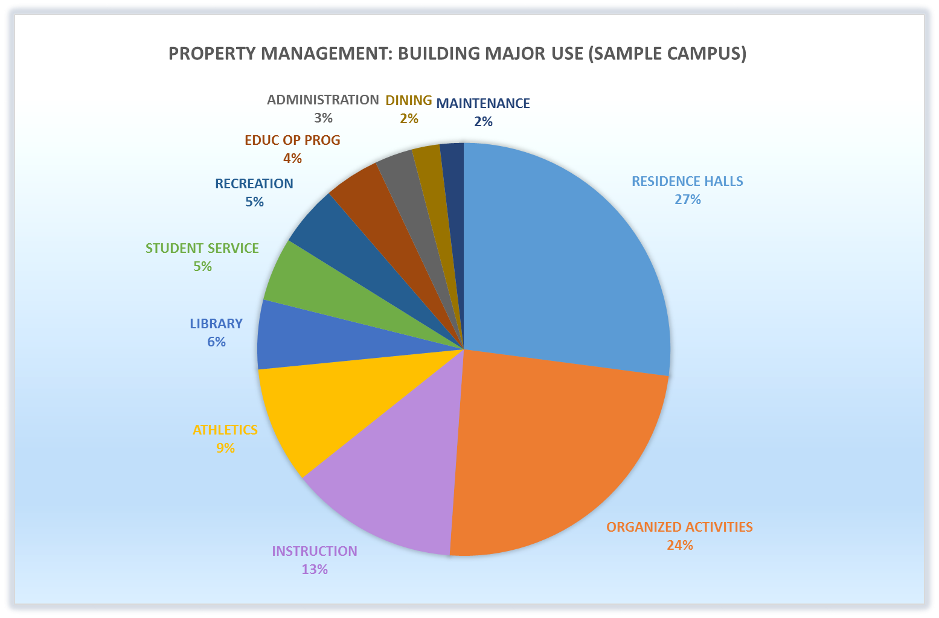
NACUBO Standards

Slide 10
Life Cycle Management
Property and Space Utilization
Asset Renewal Needs
O&M
Comprehensive Inventory
Component Life Cycle Data
Quantifiable backlog
Critical to Capital Budget Request
Improved Asset Management

Slide 11
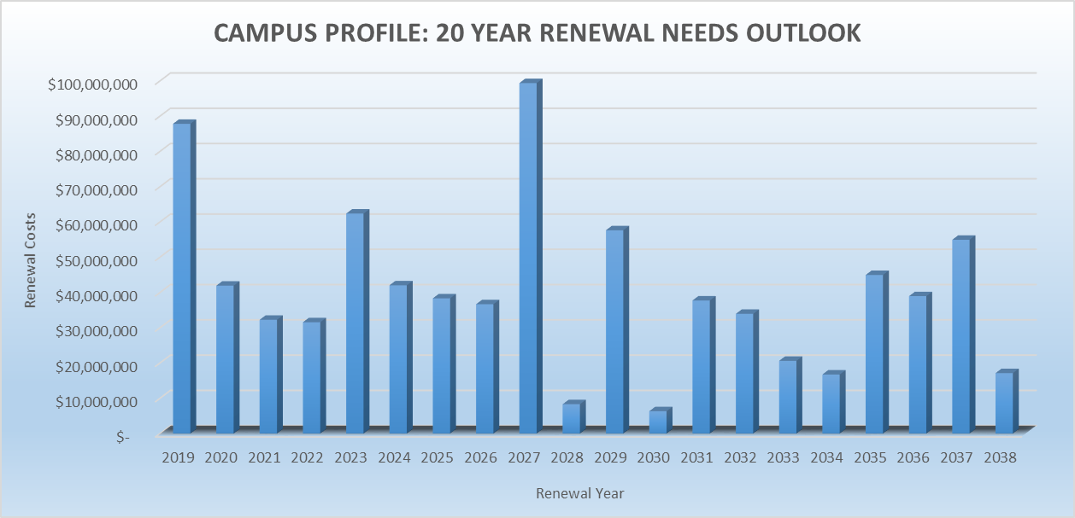
Campus Renewal Needs

Slide 12
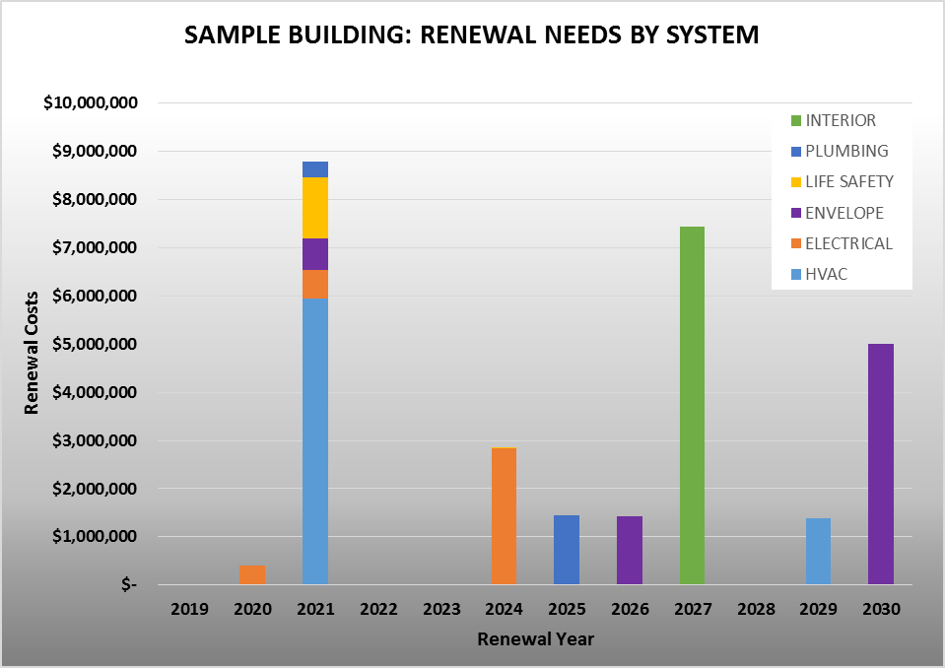
Building Renewal Needs

Slide 13

Expand existing modules to unlimited licensing
Purchase and implement AiMCAD
Expand AiM to include Work Order Management

Slide 14
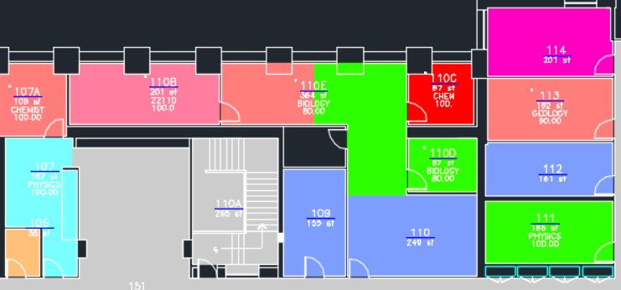
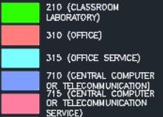
FICM Space Type
Determine and plan for departmental space needs
Space Planning

Slide 15
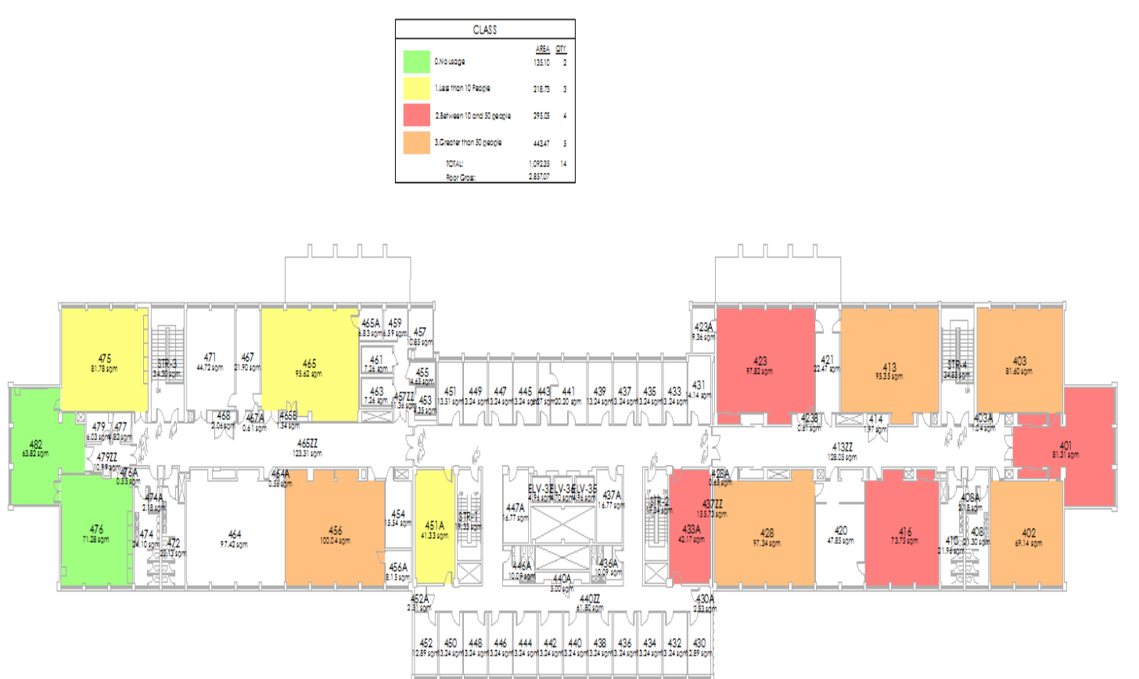
Determine cleaning needs based on daily use as measured by supplemental people counters installed at doorways
No usage
Less than 10
10 to 50
> 50
Reporting: Space

Slide 16
Operations and Maintenance
Property and Space Utilization
Asset Renewal Needs
O&M
Integrate O&M with property and space
Enterprise license
Properly manage PM
Improved Asset Management

Slide 17

Current Status
O&M Current Status
20 commercial programs
6 homegrown solutions
1 with no system
1 uses Word
21 near or at enterprise level

Slide 18
O&M Current Status (cont.)
  Some campuses generally satisfied with current product
  Many campuses dissatisfied with current solution
  Data benchmarking across campuses not possible
  Contractual collection of Preventative Maintenance data is difficult because of diverse systems

Slide 19
Benefits of Comprehensive Solution
  Eliminate multiple datasets: building and room data
  Bonus features enhance management
  Work Order Management
  Materials Purchasing
  Environmental Health & Safety
  Preventive Maintenance
  Warehouse Inventory
  Key Control
  Fleet management and more…….

Slide 20

Cost for Phase 2
To purchase AiM O&M software, there are three options:
Purchase cost includes estimate for professional services.
Annual Maintenance includes cost for three existing modules, maintenance of the new modules, plus System Administration server costs, $10,000 in general OTPS, and a System Administration indirect cost charge at 2.64%

Slide 21

Cost Details
Annual campus cost for Phase 1 ranges $149 – 8,259
Annual campus cost for Phase 1 & 2 enterprise space management ranges $236 – 13,066
If sufficient campuses sign up for Phase 2, Fund capital will be used for licenses, implementation and first year maintenance
Consideration for hiring a dedicated staff member for O&M is put aside for now

Slide 22
Campus Cost Impact
Potential savings $236,145
Potential savings $16,432

Slide 23
Campus Cost Impact
Potential savings $157,764
Potential savings $31,461
Potential savings $25,774
Potential savings $20,957
Potential savings $16,432

Slide 24
Campus Cost Impact
Research/
Doctoral:
$12,641
Comprehensive:
$7,941
Technology:
$6,525
Community
Colleges:
$2,995

Slide 25

Goal

Slide 26


Share this presentation with all interested campus constituents
Express interest in program with email to Karren Bee-Donohoe
Determine all current costs being incurred for these functions
Receive from System the actual cost based on total participants
Formally commit and participate in the implementation

