Slide 1
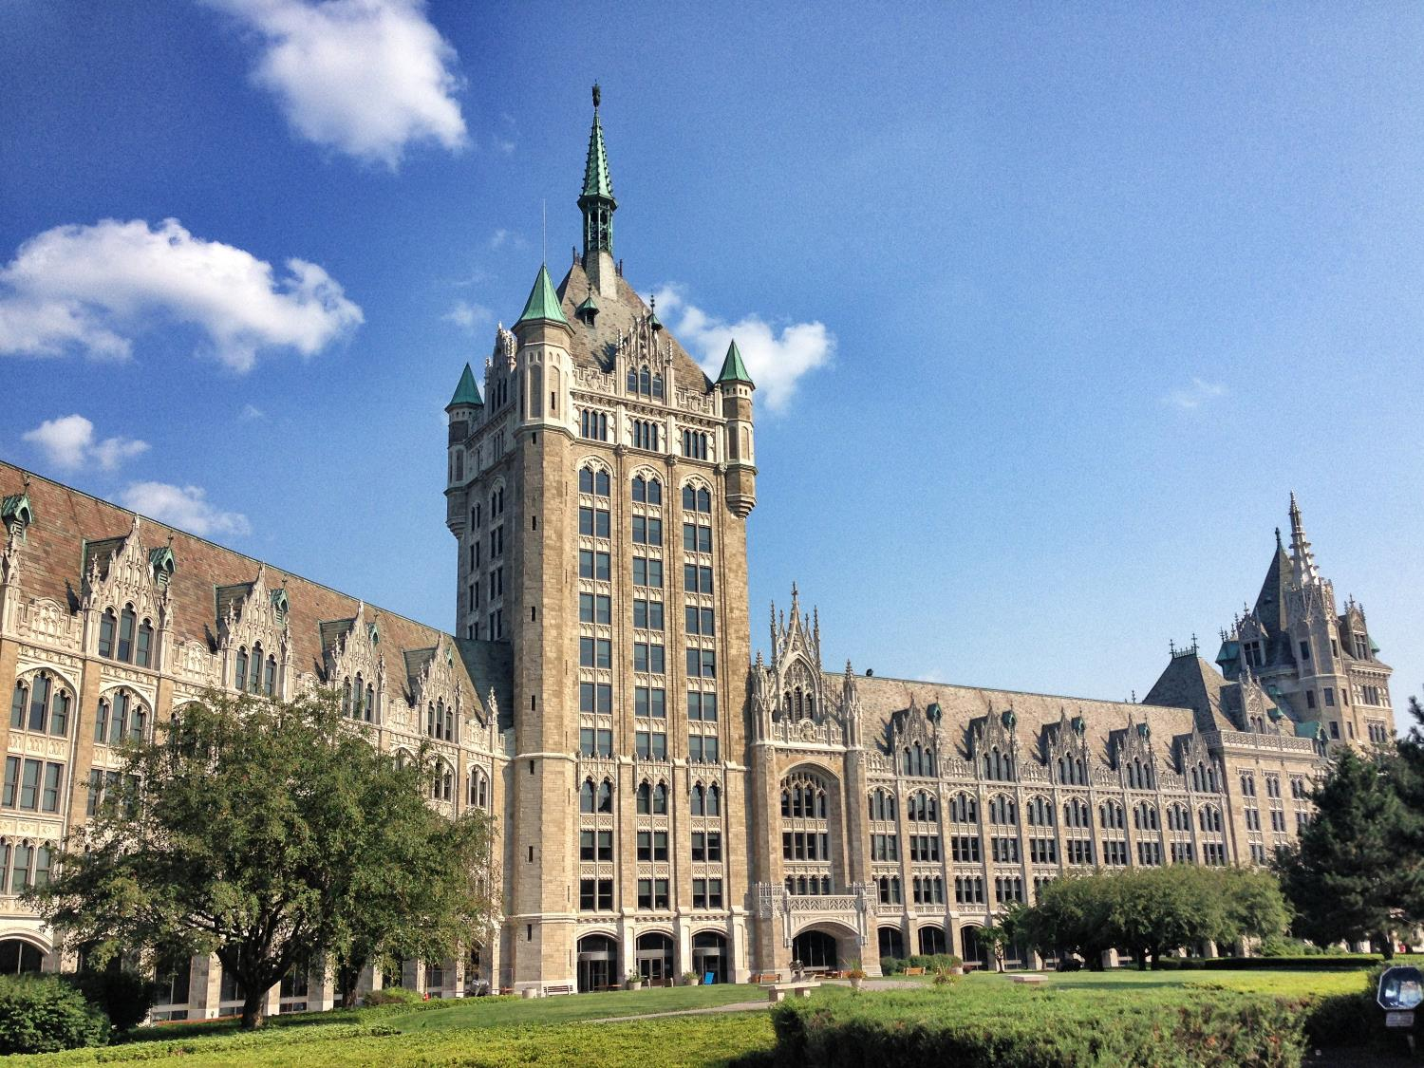

An Introduction to Campus Let Contracts
For State Operated Campuses
Webinar Series
December 2023

Slide 2

Course Objectives
Increase knowledge and understanding of:
Financial Management of Capital Funds
Procurement Requirements
Consultant Selection

Slide 3

Office for Capital Facilities
Visit our Website
To be added to the CLC listserv email jessica.miller@suny.edu
Guidance Documents
Newsletters
Listservs
  Campus Let Contracts Program
  Community College Capital Program
  Energy Procurement and Utility Regulatory Affairs
  Residence Hall Capital Program

Slide 4
Campus Let Contracts
Guidance Documents
  CLC-1 Construction Bonds
  CLC-2 Temporary Services
  CLC-3 Construction Authority
  CLC-4 Contract Threshold Chart
  CLC-5 Division of Budget Approval B-1184
  CLC-6 Debriefing
  CLC-7 Single/Sole Source, Specific Allowances
  CLC-8 Field Orders
  CLC-9 Furniture, Fixtures and Equipment
  CLC-10 Insurance Limits
  CLC-11 Approval of Real Property Transactions
  CLC-12 Telecommunications Site Manager Agreement
  CLC-13 Facilities Procurement Purchase and Install and Service Contracts
  CLC-14 Leases and Revocable Permits
Visit our Website

Slide 5



Campus Let Contracts
Session 2:
Procurement Requirements

Slide 6
Learning Objective
Increase knowledge and understanding of:
  The state procurement requirements that the State University of New York (SUNY) is required to follow for construction and construction related consultant services contracts

Slide 7

Procurement Requirements

Slide 8






Construction Authority and Funding
New York State Education Law (§355 and §376) establishes the authority for design, construction and rehabilitation of SUNY facilities on SUNY property
Who has that authority?

Slide 9



Construction Authority and Funding
Who does NOT have the authority to hold contracts or engage in construction work on state-owned properties?
        Research Foundation
        Campus Foundation
        Auxiliary Service Corporation
        Campus-affiliated corporations
        3rd party occupants (Barnes & Noble,
        Sodexo, Marriott, Starbucks, Dunkin)

Slide 10
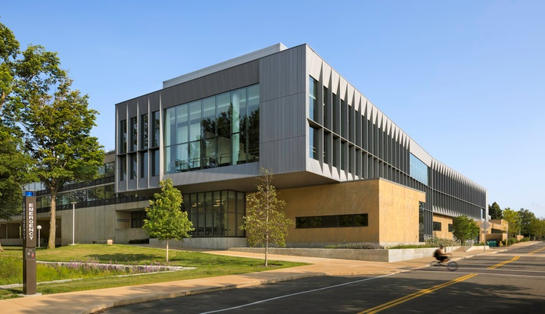
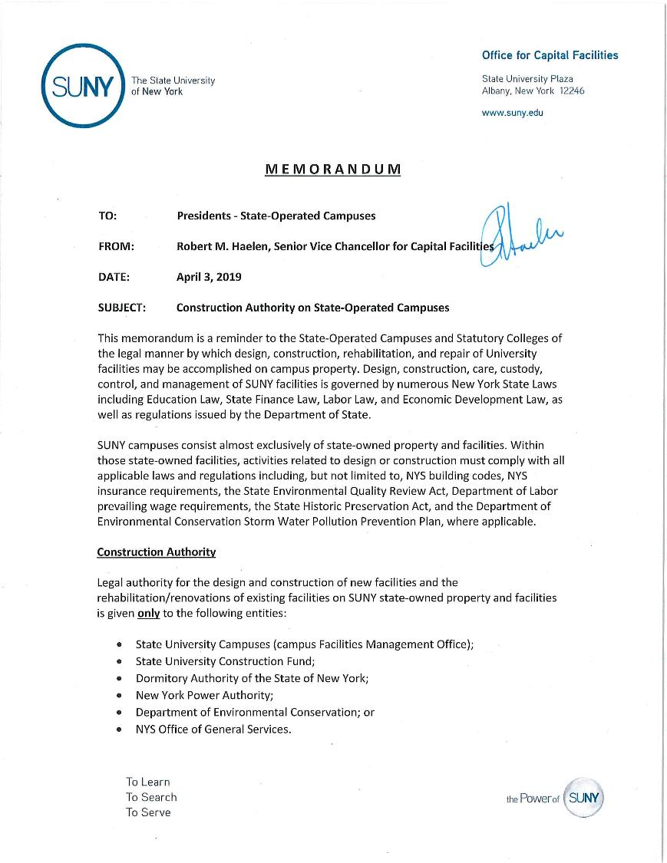
Construction Authority and Funding
Learn more, see
Guidance Document CLC-3

Slide 11

Design Authority
  Campus - procure design services
  Campus - self perform design
  Affiliated entities – procure pre-construction design services
    Requires a revocable permit or lease >2 years remaining
    Requires a contract between the campus and the design firm for construction administration (a procurement or single source and approval by campus counsel are required )
    MWBE requirements apply

Slide 12
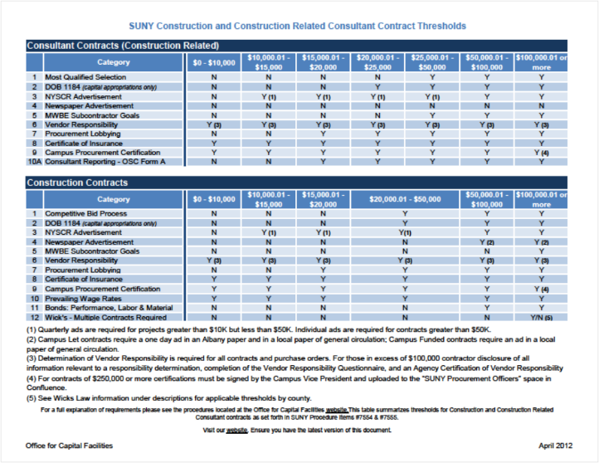
Procurement Requirements
    Polices and Procedures
    7553 – Purchasing
    7552 – Procurement Lobbying
    7554 – Construction
    7555 –Consultants
    7556 and 7557 – MWBE

Slide 13

Procurement Types
We’ve got FOUR buckets; each procurement will be in one of them:
Commodities – Procedure 7553
Services – Procedure 7553
Construction – Procedure 7554
Construction related Consultants – Procedure 7555

Slide 14
Campus Let Project
Identify Estimates, Budget, Funding Source
B-1184,
MWBE Goal Setting,
Wicks Waiver (Const)
Develop RFQ (Design) or IFB (Const)
Advertise: NYSCR,
Newspaper (Const)
Consultant Selection
Or
Bid Opening (Const)
Procurement Requirements:
Procurement Lobbying, Vendor Responsibility Insurance, Consultant Reporting, Consultant Fee Negotiation,
Construction Bonds
Contract Award
Campus Certification
Design Only
Construction Only

Slide 15
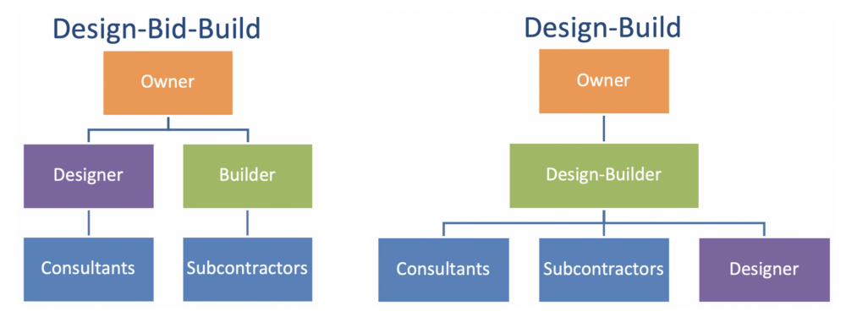
Delivery Mechanisms
  SUNY campuses and the Fund are authorized to utilize Design-Bid-Build procurements
  Effective with legislation enacted in 2020, the Fund (but not SUNY campuses) is authorized to enter into Design/Build contracts for projects of $10 million or more.

Slide 16
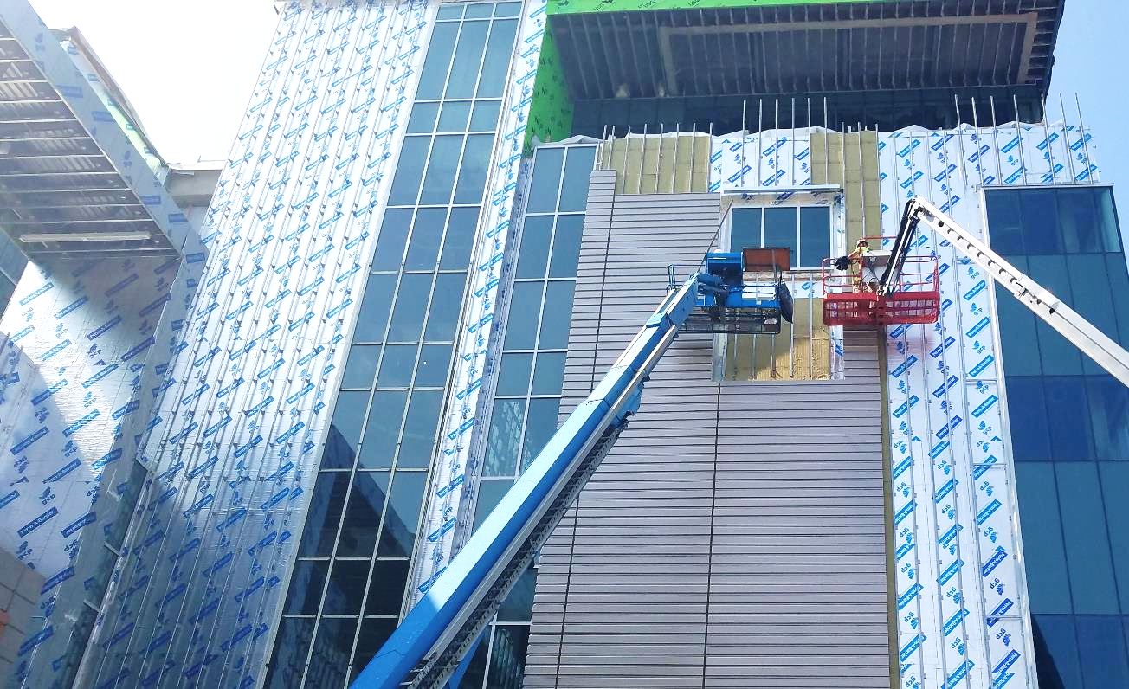
Methods of Award
Construction
Awards made by public letting to the lowest qualified bidder
Public bid opening required
Invitation for Bid (IFB)
Construction Related Services
Awards are made on the basis of qualifications, price is NOT a factor
Contracts are negotiated with the most qualified consultant
Request for Qualifications
Fund Managed

Slide 17

Construction
Awards made by public letting to the lowest qualified bidder
Public bid opening required
Invitation for Bid (IFB
Applicability: >$20,000
SUNY Procedure #7554
NYS Education Law §376

Slide 18

Construction Related Consultants
Architecture, engineering, landscape architecture or surveying
Contracts are negotiated with the most qualified consultant
Request for Qualifications (RFQ)
Applicability: >$25,000
SUNY Procedure #7555
NYS Finance Law §136-A

Slide 19

State Finance Law §136-a
It is the policy of New York state to negotiate contracts for architectural and/or engineering services and/or surveying services on the basis of demonstrated competence and qualification for the type of professional services required and at fair and reasonable fees.
Most Qualified
Negotiate

Slide 20

Funding
Campus Let Projects
Campus managed construction projects funded by capital appropriations through the Fund
Campus Administered Procedures apply
Campus Funded Projects
Campus managed construction projects funded by SUNY appropriations or other funds such including those from the Foundation, Research Foundation, Auxiliary Service Corporation, Alumni Association, Income Fund Reimbursable (IFR) accounts or Grants.
Funding Source
Campus Let vs.
Campus Funded

Slide 21

Campus Let vs. Campus Funded
Campus Let
(Campus Administered)
Campus Funded
  Capital Appropriation, including 384
  Project Initiation: Campus Administered Procedures apply
  Eligible for Wick’s Waiver
  Advertisement in Albany paper and a paper of general circulation
  Operating Appropriation and other campus funding
  Project initiation and funding: Campus process applies
  Subject to Wick’s (waiver not an option)
  Advertisement in a paper of general circulation

Slide 22
Capital Projects Fund
Capital Projects Fund (384)
Appropriation authority to support capital projects with revenues from other sources
Funding can be transferred to the Capital Projects Fund, so that it may be treated as capital
Allows access to the Fund’s Wick’s Waiver
Capital Projects Request Fund

Slide 23
Campus Let Contracts
Projects funded with Capital, follow the Campus Administered Procedures:
  Capital Project Request
  B-1184 Approval - Division of Budget
  Project Funding Request
Project Funding Requests must be approved by the Fund
prior to placing an advertisement
Campus Administered Procedures

Slide 24
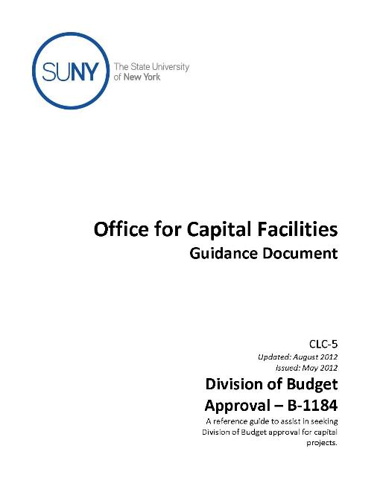
DOB Approval
B-1184
Learn more, see
Guidance Document CLC-5
Division of Budget’s authorization to spend capital funds
Done online through the Agency Spending Controls Application (ASCA)
Does NOT apply to professional staff and site reps
  Include contingency in the budget
  Applicability: Capital projects >$100,000 – MWBE, ESD Approval
  >$1,000,000 – DOB, ESD, and Governor’s Office Approval
Division of Budget Bulletin 1184

Slide 25
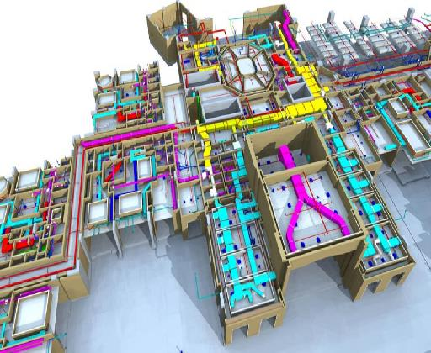
Wicks Law (Construction)
Contracts over the threshold require separate specifications and bids for;
  General Contracting
  Mechanical: steam heating, hot water heating, ventilating and air conditioning apparatus
  Electrical: electric wiring and standard illuminating fixtures
  Plumbing: plumbing and gas fitting
In design: four sets of bid documents are required

Slide 26
Wicks Law (Construction)
Wick’s Applicability thresholds by county
  >$3M in Bronx, Kings, NY, Queens, and Richmond
  >$1.5M in Nassau, Suffolk, and Westchester
  >$0.5M in all other counties within the state

Slide 27

Wicks Law (Construction)
Campus Let
(Campus Administered)
Campus Funded
Campuses may apply for a Wick’s Waiver with the Fund
Construction must be funded entirely with capital appropriations made to the Fund (includes Capital Projects Fund / 384)
Construction Contracts funded by operating or other funds are not eligible for a Wick’s Waiver
Contracts under the applicable thresholds must have bidders submit with their bid a separate sealed list that names each subcontractor.

Slide 28

Minority and Women Owned
Business Enterprise (MWBE) Participation
Assign Goals
Applicable on contracts >$100,000 for construction; >$25,000 for commodities, services and construction related services
Set Goals using the Goal Setting Methodology
Governors Aspirational Goals: 30%
SUNY - Supplier Diversity
Rodney Smith
Director
Rodney.Smith@suny.edu
Kate Vaccariello
Assistant Director
Kate.Vaccariello@suny.edu
SUNY Procedure 7557

Slide 29

Service Disabled Veteran Owned Business (SDVOB) Participation
Assign Goals
Applicable on contracts >$100,000 for construction; >$25,000 for commodities, services and construction related services
Assess contract for SDVOB participation
State-wide goal is 6%
SUNY Procedure 7564

Slide 30

Prevailing Wage Rates
Applicability: All contracts and purchase orders
Provide a copy to the prime contractor and incorporate it into the contract
Primes provides schedules to subcontractors
Prime provides copies of certified payroll to the campus
Request a wage schedule from the Department of Labor website
NYS Labor Law, Article 8 & 9

Slide 31

New York State Contract Reporter
Advertisement for at least 15 business days prior to the bid due date
Individual ad for contracts in excess of $50,000
Quarterly ad for anticipated contracts >$10,000 but <$50,000
NYSCR Website
NYS Economic Development Law (§142)

Slide 32
Emergency Procurements and Exemption from Advertising
Declaration of the emergency and waiver of competitive bidding, signed by a senior campus officer
If applicable, under SUNY Procedure 5608 Emergency Notification Protocol Requirements, notify System Administration
Notify your Fund Program Manager
Establish reasonableness of price by obtaining a minimum of three verbal or written quotes
A waiver for publication in the NYSCR is required from OSC prior to contract award
Procedure for Declaring a Construction Emergency

Slide 33

Newspaper Advertisement (Construction)
Campus Let contracts require a one day ad in an Albany paper and in a local paper of general circulation
Campus Funded contracts require an ad in a local paper of general circulation
Contact a reasonable number of local contractors, a minimum of 5, if feasible
  Applicability: >$50,000
NYS Education Law (§376) and Public Building Law (§8)
Albany Paper = Times Union

Slide 34
Campus Let vs. Campus Funded
Campus Let
(Campus Administered)
Campus Funded
  Capital Appropriation, including Capital Projects Fund / 384
  Project Initiation: Campus Administered Procedures apply
  Eligible for Wick’s Waiver
  Advertisement in Albany paper and a paper of general circulation
  Operating Appropriation and other campus funding
  Project initiation and funding: Campus process applies
  Subject to Wick’s (waiver not an option)
  Advertisement in a paper of general circulation

Slide 35

Procurement Lobbying Act
Limits communications during the Restricted Period – from Contract Reporter Ad to Contract Execution
All inquires must be directed to the Designated Contact
Requires vendor affirmation, certification and disclosure of compliance
Applicability: >$15,000
SUNY Procedure #7552
NYS State Finance Law § 139-j

Slide 36
Procurement Lobbying Act
"Restricted period" means from the earliest written notice, advertisement or solicitation of a request for proposal, invitation for bids, or solicitation of proposals, or any other method for soliciting a response from offerers intending to result in a procurement contract
“Contact” means an oral, written or electronic communication to SUNY related to the procurement by or on behalf of the Offerer during the Restricted Period that could be inferred as intending to influence the procurement
For more, read Procedure 7552

Slide 37
Project Sunlight
SUNY is required to report 'appearances' by individuals/firms who 'appear' before State decision-makers or persons who advise decision-makers.
An ‘appearance’ is a substantive interaction, in person or over video conference, that is meant to have an impact on decision making process of the state entity.
The Project Sunlight database, hosted by the NYS Office of General Services, aggregates the inputted data and makes it available to the public for viewing.
For more, see SUNY’s compliance website

Slide 38

Vendor Responsibility
For all contracts vendors and contractors must be deemed responsible
Profile – regardless of dollar value
Contracts >$100,000 require Vendor Responsibility Questionnaire using VendRep
OSC requires Vend Rep Questionnaire for Subcontracts of $100,000 or more
  Agency certification of Vendor Responsibility
OSC Guide to Financial Operations, Section XI.16 Vendor Responsibility
NYS State Finance Law §163

Slide 39

Updates
coming
Certificate of Insurance
Required for ALL contracts and purchase orders
At a minimum, insurance limits must equivalent to the limits in the construction and consultant agreements
General Liability
Auto
Workers Comp and Disability
Owners and Contractors Protective Liability (const)
Builders Risk (const)
Professional Liability (design)

Slide 40
Updates
coming
Required Forms
ACORD 25 - Certificate of Liability Insurance
NYS Workers’ Compensation Form
    Generally, form C-105.2
NYS-required Disability Insurance Form
    Generally, form DB-120.1
SUNY Insurance Checklist (internal)
For more information see:
CLC-10 Insurance and the Council of Contracting Agencies Insurance Guidelines

Slide 41

Bonds
Construction Bonds
Applicability: >$50,000
Performance Bonds
  May be waived when only one (1) payment is made to the contractor upon successful completion of the work
Labor & Material Bonds cannot be waived
Multiple contracts for project - the entire project value must be fully bonded
Consider updates to procedure, increase threshold
Learn more, see
Guidance Document CLC-1
NYS State Finance Law § 139-f

Slide 42
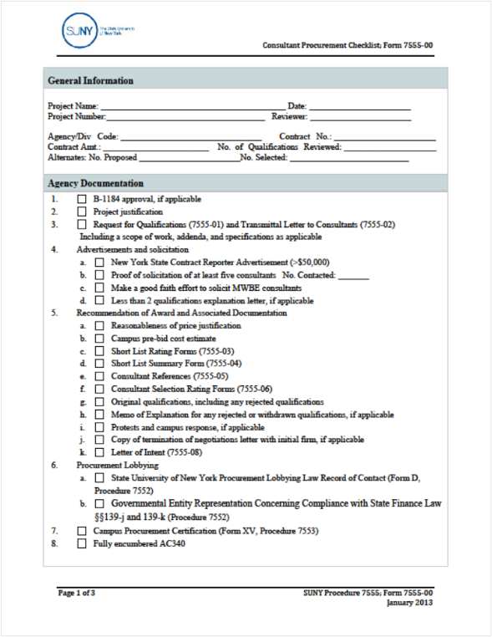
Procurement Checklists
SUNY Procurement Checklists
Construction - Form 7554-01
Construction Related Consultants - Form 7555-01
Required regardless of dollar value

Slide 43
External Agency Approvals
Attorney General and Office of the State Comptroller approval is required for contracts (informally or formally procured) for goods, services, construction, and construction related services at the following values:
Procurements | AG & OSC Approval
Campuses | $75,000
Hospitals | $150,000
OGS centralized contracts | $200,000

Slide 44
External Agency Reviews
While there are no changes to SUNY’s discretionary purchasing thresholds, any discretionary purchases of $75,000 or more require OAG and OSC review and approval.
Type | Value | Procedure | Comments
Construction | $20,000 | 7554
Construction-related services | $25,000 | 7555
Commodities and Services | $125,000 | 7553 | Includes construction items & equipment

Slide 45
AG Submittal
Submitted electronically to contractapproval@ag.ny.gov
Include an agency cover letter
Place the OSC contract number, agency initials, along with the Contractor’s name in the email subject line.
Fund Managed

Slide 46
AG Submittal
Scans must be exact replicas of the fully executed contract including any and all attachments.
Construction Agreement Definitions
  Contract Documents: The Agreement, Exhibits A and A-1, Bidding Documents, Bonds, Specifications, Project Manual, Drawings, Addenda issued prior to the opening of bids and Change Orders issued after award of the Contract.
  Bidding Documents: Notice to Bidders, Information for Bidders and Proposals

Slide 47
OSC Submittal
Submitted electronically through EDSS
All documents listed in the OSC Checklist & the SUNY Checklist
25MB file size limit, files categorized as:
  Transaction Identifying Documents
  Amendment
  Supporting Documents
  Vendor Responsibility and Integrity
eLearning Training on EDSS is available online
  Electronic Documents Submission System (EDSS) Video Library - Procurement Contracts and Amendments

Slide 48

OSC Audit

Slide 49
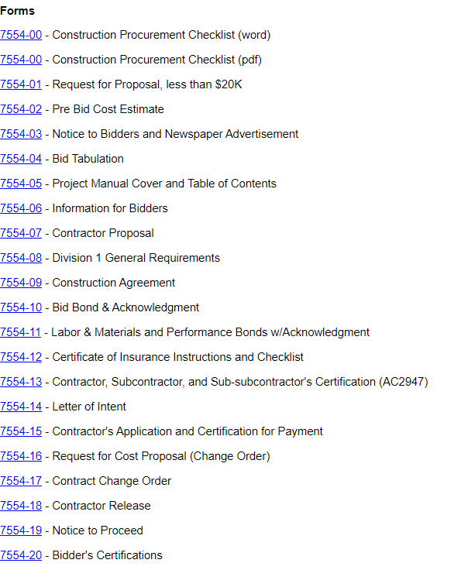
Procedure 7554
Construction Contracting
Access documents online to be sure you have the latest version

Slide 50
Construction Change Orders
A contract amendment must be submitted to the New York State Office of the State Comptroller’s (OSC) Bureau of Contracts (BOC) for review if the original contract was subject to OSC review and if any terms and conditions are modified by the amendment. Following are examples of terms and conditions that when modified would result in an amendment transaction that is subject to OSC review:
Begin Date
Expire Date
Contract Maximum Amount
Budget adjustments (refer to SFL Article 11-B for Grant budget adjustments)
Scope changes
Contract provisions
Amendments that result in changes not contemplated in the original agreement may require additional justification, supporting documentation and/or a contract reporter exemption request, depending on the scope of changes.
OSC Guide To Financial Operations

Slide 51
Construction Change Orders
Contracts that were executed prior to March 17, 2023, and prior to the effectuation of Chapter 17 of the Laws of 2023 are considered pre-existing contracts. Therefore, change orders and amendments to these pre-existing contracts do not fall under the requirements of the new law.
Campuses are instructed to use the following response to questions from OSC related to review of a contract placed prior March 17, 2023, which was therefore not sent to OSC for pre-award audit review:
“This contract was executed under the $250,000 contract pre-approval threshold established by the 2019 Procurement MOU between SUNY and the Comptroller’s Office and prior to the effectuation of Chapter 17 of the Laws of 2023.”

Slide 52
Construction Change Orders
When is it a change? When should it be a new contract?
What was the scope, schedule and budget of the original contract?
At the end of the contract, did we buy what we bid out?
We must be able to support that change order work could have been reasonably contemplated as part of the original scope
Reasonableness of price: include a justification in the submittal to OSC

Slide 53

Field Orders
To address a field condition or barrier to accessing the construction site
To clarify the specification, address the technical execution of a problem or update contract documentation
To address an omission
Learn more, see
Guidance Document CLC-8

Slide 54
Change Orders
A program change
A substitution
A bond premium and/or insurance adjustment
A time extension not resulting from a field order condition
An allowance adjustment
To address an error

Slide 55



Pre Solicitation
Scope
Budget
Schedule

Slide 56
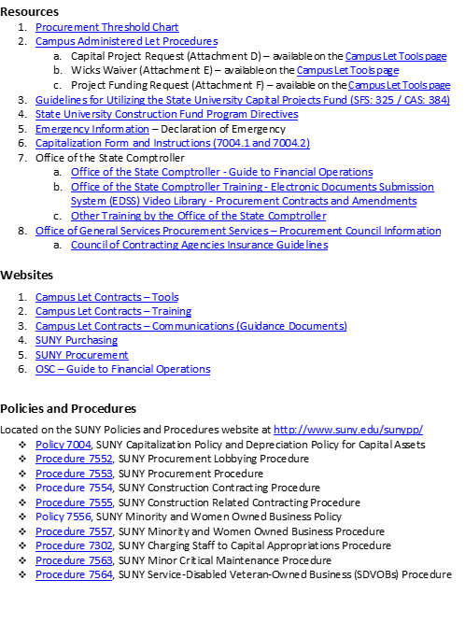
Resources

Slide 57
Procurement Requirements
    Polices and Procedures
    7553 – Purchasing
    7552 – Procurement Lobbying
    7554 – Construction
    7555 –Consultants
    7556 and 7557 – MWBE

Slide 58
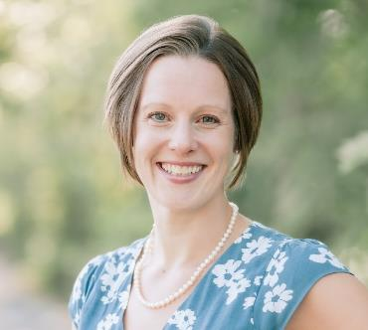
Jessica R. Miller
Campus Let Contracts
jessica.miller@suny.edu
518-320-1129

Slide 59


