Slide 1
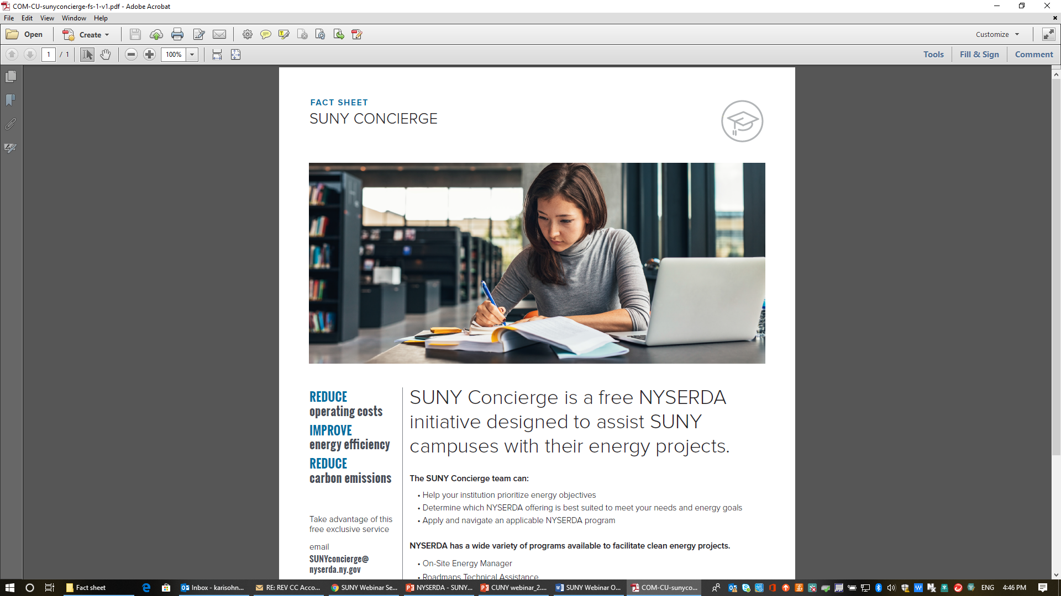

Achieving Your Energy
Goals through NYSERDA's SUNY Concierge
July 17, 2019
SUNY PPAA Summer Conference

Slide 2
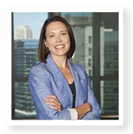

SUNY – NYSERDA Partnership

Slide 3
Partnership Objectives
Encourage clean energy projects across the campuses
Support NYSERDA programs and other funding mechanisms in state
Provide central point of contact for advice and guidance on NYSERDA programs
Connect SUNY with NYSERDA technical assistance programs

Slide 4
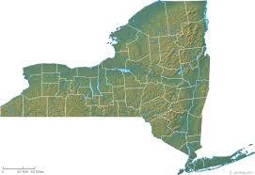


NYSERDA CONCIERGE Service
For SUNY Central & Eligible Electric SBC Paying Campuses
Flex Tech
Utility Programs
On-Site Energy Manager
REV Campus Challenge
NYPA
Programs
Membership
Roadmap
Energy experts connecting you to the energy savings program that is right for your project, your campus

Slide 5
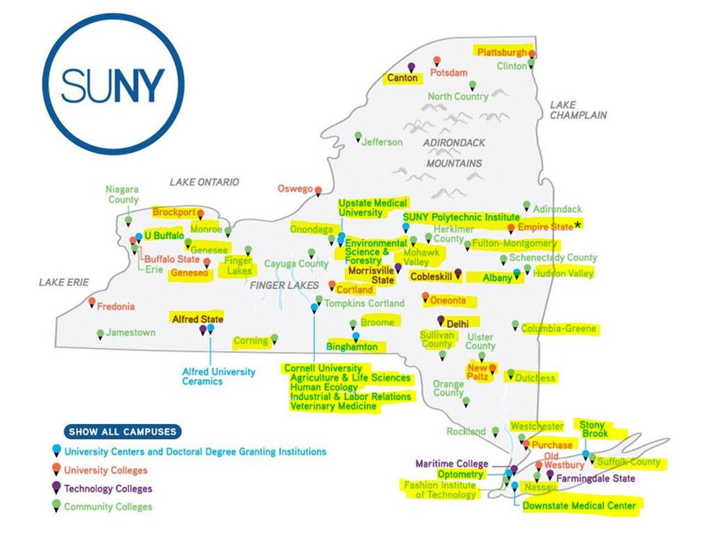
SUNY Concierge assisted campuses

Slide 6
2019 NYSERDA Funding Opportunities

Slide 7
Open program opportunities
Roadmaps Technical Assistance Program
On-site Energy Manager (OsEM)
On-the-Job Training for Clean Energy
Retail Energy Storage Incentive Program
Charge Ready NY
NY-SUN
FlexTech
Commercial New Construction Program
Workforce Training – Building O&M
Real Time Energy Management (RTEM)
Clean Energy Internship Program
Energy Efficiency & Clean Tech Training
Renewable Heat NY
Ground Source Heat Pump Rebate
Air Source Heat Pump Rebate
REV Campus Challenge
SUNY Concierge

Slide 8
Reforming the Energy Vision (REV) Campus Challenge: Colleges & Universities
Governor Cuomo's REV initiative to build a cleaner, more resilient, and affordable energy system for all New Yorkers
NYS colleges and universities are centers of clean energy innovation, leading by example and training the next generation of clean energy leaders
The REV Campus Challenge aims to help NYS colleges and universities reduce GHG emissions and set and achieve ambitious clean energy goals

Slide 9
The REV Campus Challenge Mission
Promote and support C&Us in NYS that:
Invest in clean energy and GHG reductions
Educate by integrating clean energy into the curriculum and supporting cleantech R&D
Engage the campus and off-campus communities to promote clean energy and sustainability
On campus, in the classroom, in the community

Slide 10
















































































































114 Members!

Slide 11














Join Your Peers!
39 SUNY Members and Growing

Slide 12
SBC Agnostic Member Benefits
Marketing Collateral Assistance
REV Campus Challenge Website
Social Media
Email Marketing
Conferences & Events
Personalized Certificates
Targeted
Recognition

Slide 13
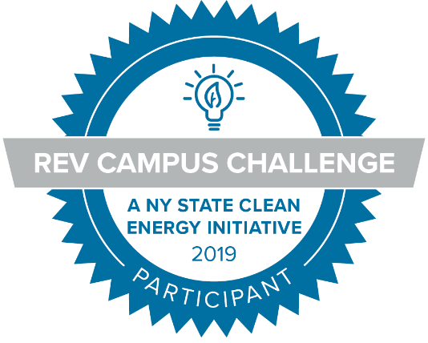
REV Campus Challenge –
YOUR Network for Success
ALL NYS colleges and universities
ALL levels of clean energy expertise
Integrates with existing goals, commitments
No fees
No carbon or energy commitment
No arduous application process or reporting requirements

Slide 14

Current SUNY REV Campus Challenge Membership
65% SUNYs
are members
36% are Community Colleges

Slide 15

Referral Program
Easy as 1-2-3
Refer non-member friend
Friend becomes member
Win SoNY Sustainability Conference tickets!
Member list: https://www.nyserda.ny.gov/All-Programs/Programs/REV-Campus-Challenge/Membership-Information/REV-Members

Slide 16
Data Driven
Decision Making

Slide 17
Roadmaps Technical Assistance Program (PON 3438)
Member-exclusive program available through end of 2019
$1.3 million in funding still available
50-100% cost share to work with consultant of your choice
Evaluate existing campus energy conditions, identify energy saving opportunities, and establish an action plan for managing campus energy needs
Funding capped at $150,000 per member
  $4,000 bonus for student intern

Slide 18
Roadmaps Technical Assistance Program (PON 3438)
Typical project cost: $150,000
Typical incentive:
$112,000
75% of project funding provided by NYSERDA

Slide 19
Roadmaps Technical Assistance Program (PON 3438)
Activity
# of REV CC Members

Slide 20
Roadmaps Technical Assistance Program (PON 3438)
Who has participated in Roadmaps so far?
  25 projects
  Participants, Achievers, and Leaders
  6 community colleges, 12 SUNYs, and 13 private institutions

Slide 21

Flexible Technical Assistance Program (PON 1746)
Targeted energy studies, such as
  ASHRAE Level 2 or 3 energy audits
  Feasibility studies with financial assessment
    CHP, Energy Storage, Clean Heating & Cooling, Net Zero, Retrocommissioning
50% cost share** to work with a consultant of your choice
Funding capped at lesser of $500,000 per project*** or 10% of annual utility spend
Available through end of 2019
** 75% cost share in some instances *** $100,000 cap in some instances

Slide 22

Commercial New Construction (PON 3609)
Tiered Levels of Support: Open Enrollment
1- Technical Assistance: Design Review – no cost
2- Tech Assistance: Energy Model – cost shared
3- Technical Assistance & Incentives: Deep Energy Savings, Smart Buildings & Net Zero Energy projects – cost shared + incentives
Increased Incentive Cap Opportunities
Natural Gas Utility Moratorium Areas
Primary Energy Consultants
Provide project-specific technical assistance

Slide 23
Staff Training,
Capacity Building,
Career Development

Slide 24

Workforce Training – Building O&M (PON 3715)
Goal: reduce building energy use and operations by improving skills of workers in building O&M across New York State
  Applicants propose a training curriculum to improve energy management and O&M skills among buildings staff
  Funding capped at $400,000 per proposal and requires minimum cost-share of 50%

Slide 25
Workforce Training – Building O&M (PON 3715)
Eligibility requirements
  Applications accepted until May 26, 2021 (or until funding is exhausted)
  Proposals must involve buildings or groups of buildings with total annual energy expenditures of $1 million or more
  College/university can be the lead proposer (or a training provider can submit proposal)

Slide 26
Workforce Training – Other opportunities
Energy Efficiency and Clean Technology Training
- PON 3981 - $7 million available
- Training for future and existing clean energy workers
Energy Efficiency & Clean Technology On-the-Job Training
- PON 3982 - $10 million available
- Only for clean energy business workers
Clean Energy Internship Program
- PON 4000 - $10.5+ million available
- Only for clean energy business interns

Slide 27
On-Site Energy Manager (OsEM – PON 3701)
NYSERDA funds up to 75% of an on-site energy manager (min 20 hrs/week), with potential for bonus payments
On-site energy manager suggests facility improvements, engages in strategic planning, conducts feasibility studies, and drives behavioral changes
Applicant college/ university lacks existing full-time energy manager

Slide 28
On-Site Energy Manager (OsEM – PON 3701)
Previously open only to industrial facilities, opened up to commercial buildings (including colleges and universities) in late 2017
Open enrollment solicitation through December 2019
Applicants can opt for full or part time On-Site Energy Manager
  ≥0.5 Full Time Equivalent (20 hours per week)
Applicant cannot have an existing dedicated full time energy manager on-site (determined by responsibilities, not title)
Applicants can seek support for their On-Site Energy Manager via new hire, contracted staff, or hybrid of supplementing permanent staff with contract staff

Slide 29
On-Site Energy Manager (OsEM – PON 3701)
Facility Consumption (aggregated) | OsEM Cost-share* (initial 12 to 24** month term) | 1st Bonus: 12 months after initial term | 2nd Bonus: 24 months after initial term
>$1 million annual energy spend | Up to 75%, not to exceed $200,000 | $7,000 | $7,000
<$1 million annual energy spend | Up to 75%, not to exceed $100,000 | $5,000 | $5,000
Use funds for services only; not for implementation or equipment purchases
* Must include minimum 25% cost-sharing in form of cash support from customer
**Minimum 12 month OsEM initial term (at minimum 20 hours/week)

Slide 30
Technology Incentives

Slide 31
Real Time Energy Management (RTEM – PON 3689)
Continuously monitor building system data in real time
Monitoring and metering of energy at the device, equipment, and/or system-level
Pushing that data to cloud based software
Turning that data into actionable insights
Providing you with those insights

Slide 32
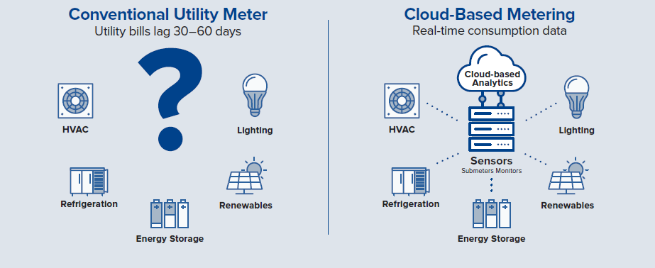
RTEM is a Paradigm Shift

Slide 33
Real Time Energy Management (RTEM – PON 3689)
Open enrollment solicitation through June 2021
Must pay into the electric System Benefits Charge (SBC)
Cost share up to 30% of overall RTEM project costs (up to $300,000) for system installation and first 3 years of service
Qualified list of vendors with wide ranging capabilities and specialties
RTEM Advisor provides tools and support to customers

Slide 34

Charge Ready NY (PON 3923)
NYSERDA Level 2 EVSE Incentive - $5M available
Up to $4,000 per port (30% to 80% savings – total installed cost ranges from $5,000 to $15,000)
Can’t stack w/ other NYS rebates but can stack w/ NYS tax credit
Eligible Locations:
  Public
  Workplace (> 15 employees)
  Multi-Unit Dwellings (MUDs) > 5 units
Public, private, or non-profit organizations can apply

Slide 35
Charge Ready NY (PON 3923)
Prequalified equipment and networks
  Public and workplace stations must be networked, MUDs can be non-networked
  Equipment purchasers can use any installer
Equipment owners apply online through NYSERDA website.
Two options:
  Apply before starting project; get 180 days to install after pre-application is approved
  Apply after installation within 90 days
More info at https://www.nyserda.ny.gov/Charge-Ready-NY

Slide 36
Retail Energy Storage Incentive
Ignore the “retail” – Higher ed can use this!
Storage incentives can be accessed two ways, incentive is the same regardless:
  1. Retail Energy Storage Incentive Program (PON 4112)
    New energy storage installed alone, or retrofit to a completed DER system
  2. NY-Sun Incentive Program’s Storage Adder (PON 3082)
    New or approved, but not yet completed, solar PV installations in the NY-Sun Program that are paired with energy storage
Funding is available for new, permanent, grid-connected energy storage systems up to 5 MW of alternating current, either BTM or FTM on the distribution system
2025
3000 MW

Slide 37
Energy Storage Incentive Structure
$130 Million available
Incentive based on usable installed storage capacity in kWh.
  Will pay for up to 15 MWh per project
NYSERDA’s dashboard shows available incentive nyserda.ny.gov/retailstorage
Current Rates | Rest of State IOUs |  | New York City
 | Incentive | $ Budget | Incentive | $ Budget
Block 1 | $350/kWh | Closed | $350/kWh | Closed
Block 2 | $250/kWh | $31M | $300/kWh | $18M
Block 3 | $200/kWh | $30M | $240/kWh | $15.6M

Slide 38
Energy Storage Feasibility Studies
Through FlexTech program
  Up to 75% of study costs, up to $100,000
Technical (sizing/potential) and economics examined
Commercially available technology
Managing customer load, deferring distribution system upgrades, or pairing with other DERs
Contact NYSERDA: energystorage@nyserda.ny.gov
Join NYSERDA’s energy storage email distribution list

Slide 39
Clean Heating and Cooling

Slide 40
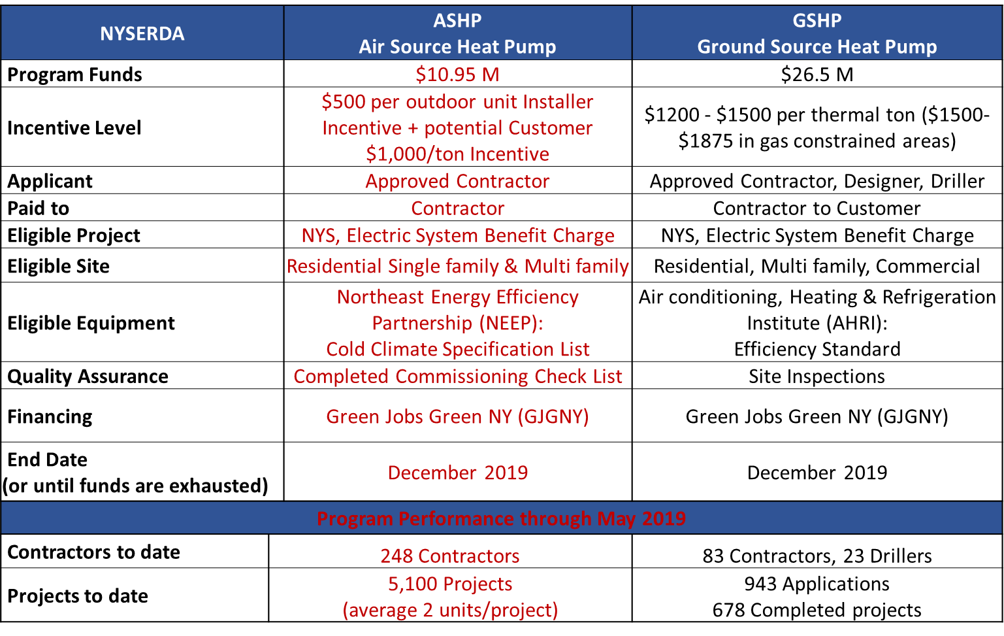
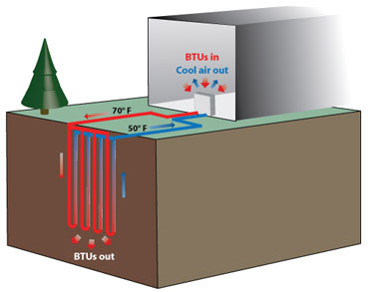
Ground Source Heat Pump Program
Vertical closed-loop system working in cooling mode

Slide 41

Renewable Heat NY
Provides support toward the installed costs of high-efficiency, low-emission wood heating systems.
Funding for pellet boilers with thermal storage

Slide 42
Renewable Heat NY
Large Biomass Boiler Program (PON 3010)
Eligible pellet boiler projects receive free site assessment
Approved projects receive technical support for system design and commissioning from a NYSERDA technical consultant
System Type / Technology (>300,000 Btu/h) | Incentive amount
Large Pellet Boiler with Thermal Storage | 65% of total installed cost up to $325,000
Tandem Pellet Boiler with Thermal Storage | 75% of total installed cost up to $450,000

Slide 43
Program Resources – Open opportunities
Roadmaps Technical Assistance Program
On-site Energy Manager (OsEM)
On-the-Job Training for Clean Energy
Retail Energy Storage Incentive Program
Charge Ready NY
NY-SUN
FlexTech
Commercial New Construction Program
Workforce Training – Building O&M
Real Time Energy Management (RTEM)
Clean Energy Internship Program
Energy Efficiency & Clean Tech Training
Renewable Heat NY
Ground Source Heat Pump Rebate
Air Source Heat Pump Rebate
REV Campus Challenge Program

Slide 44
Program Resources – Open opportunities
Roadmaps Technical Assistance Program
On-site Energy Manager (OsEM)
On-the-Job Training for Clean Energy
Retail Energy Storage Incentive Program
Charge Ready NY
NY-SUN
FlexTech
Commercial New Construction Program
Workforce Training – Building O&M
Real Time Energy Management (RTEM)
Clean Energy Internship Program
Energy Efficiency & Clean Tech Training
Renewable Heat NY
Ground Source Heat Pump Rebate
Air Source Heat Pump Rebate
REV Campus Challenge Program
SUNY CONCIERGE

Slide 45

What NYSERDA opportunities are available to me?
How do I become a REV CC member?
Are there any utility-based incentive programs I could be using?
SUNY Concierge is here for you!

Slide 46
SUNY Concierge Team
Contact information
Hotline: 833-476-2869
Email: SUNYconcierge@nyserda.ny.gov
Karys Arisohn, ERS
Lindsay Holle, NYSERDA
Phone: (518)288-0141

