Slide 1
Construction Fire Safety
SUNY PPAA Winter 2012 Conference
Barbara Boyle, SUNY
Bill Held, SUCF

Slide 2
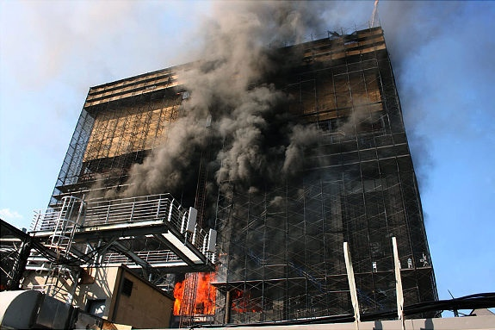
Deutsche Bank

Slide 3
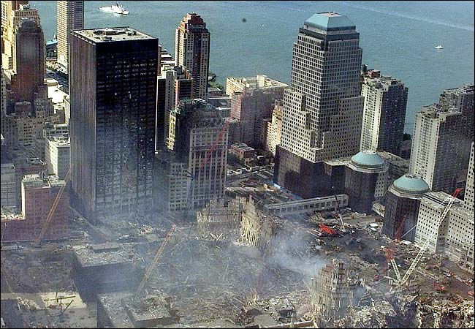

Slide 4
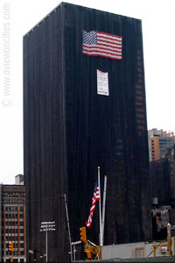

Slide 5
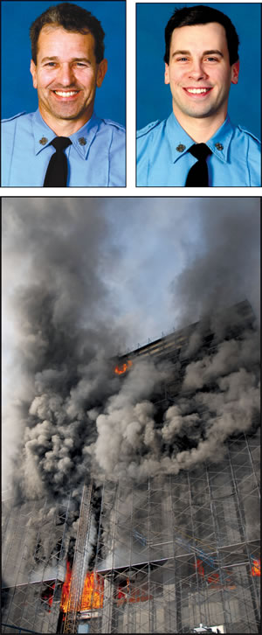
August 2007 Fatal Fire
Robert Beddia, 53
Joseph Graffagnino, 33

Slide 6
3 contractor supervisors criminally indicted
Department of Building staff shuffle
Public rallies calling to improve building codes and their enforcement
NYFD accused of cover up
Changes to NYFD policies, training, SCBA use, crew integrity, communication, etc.

Slide 7
NIOSH investigators identified the following items as key contributing factors in this incident that led to the fatalities:
Delayed notification of the fire by building construction personnel
Standpipe and sprinkler system inoperable
  Delay in establishing water supply
  Inaccurate information about standpipe

Slide 8
Unique building conditions with both asbestos abatement and deconstruction occurring simultaneously
  Blocked stairwells preventing fire fighter access and egress
  Maze-like interior conditions from partitions and construction debris
  Extreme fire behavior; uncontrolled fire rapidly progressing and extending below the fire floor
  Heavy smoke conditions causing numerous fire fighters to become lost or disoriented

Slide 9
Failure of fire fighters to always don SCBAs inside structure and replenish air cylinders
Communications overwhelmed with numerous Mayday and urgent radio transmissions
Lack of crew integrity

Slide 10
Recommendation 14:
Municipalities should ensure that construction and/or demolition is done in accordance with NFPA 241: Standard for Safeguarding Construction, Alteration, and Demolition Operations.

Slide 11
7.6 ―Fire Protection: Standpipes
10.8.4 ―Safeguarding Construction and Alteration Operations: Standpipes
10.4 ―Safeguarding Demolition Operations: Smoking
10.8.2 ―Safeguarding Construction and Alteration Operations: Fire Protection During Demolition, System Operation

Slide 12
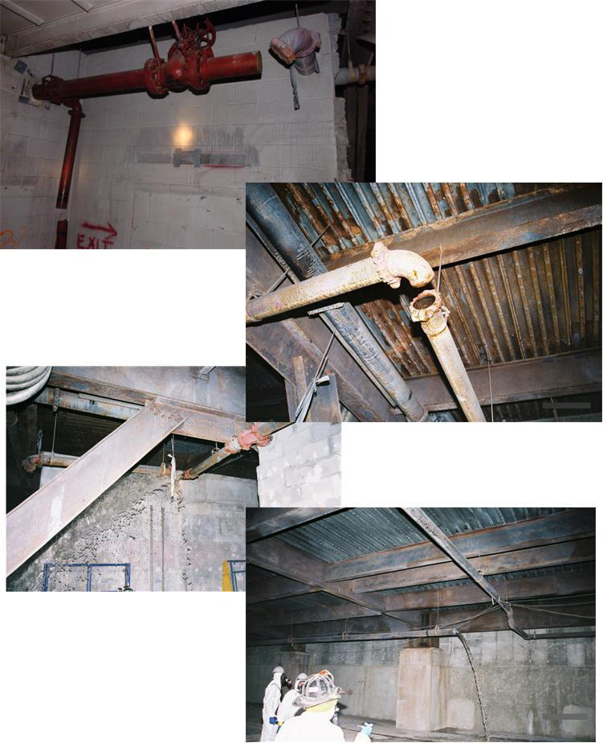
Photo 4. Standpipe system was inoperable due to missing sections of pipe.
(Photos courtesy of fire department/NIOSH report.)

Slide 13
Recommendation 15:
Municipalities should develop a reporting system to inform the fire department of any ongoing, unique building construction activities (such as deconstruction or asbestos abatement) that would adversely affect a fire response.

Slide 14
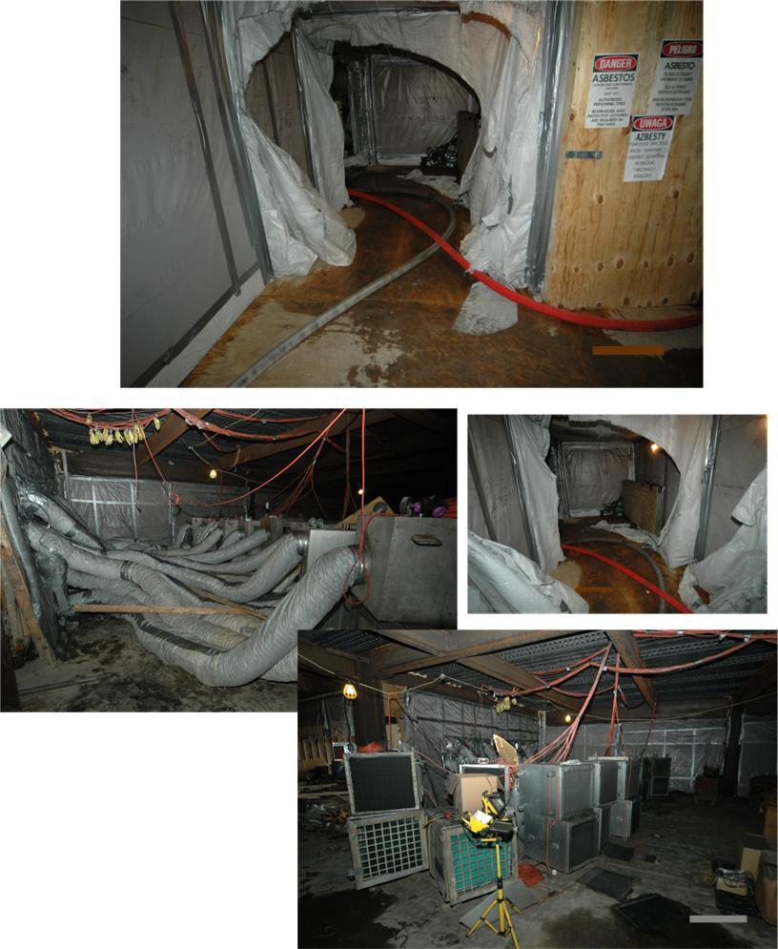
Photo 5. Plastic sheeting, ductwork and fans used for asbestos abatement.
(Photos courtesy of fire department/NIOSH report.)

Slide 15
Recommendation 16:
Municipalities should establish a system for property owners to notify the fire department when fire protection/suppression systems are taken out of service.

Slide 16
Hmmm……
Deutsche Bank news releases
OFPC 2011 presentation at Cooperstown
NIOSH reports

Slide 17
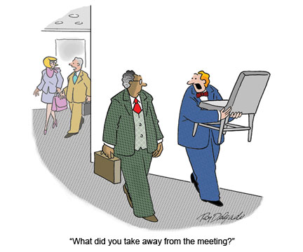

Slide 18
NYS Fire Code Chapter 14
Fire Safety During Construction and Demolition

Slide 19
1401 General
  Applies to structures in the course of construction, alternation, or demolition.
  Prescribes minimum safeguards to provide reasonable safety to life and property from fire.
  Compliance with NFPA 241 is required for items not specifically addressed herein.

Slide 20
1402 Definitions
1403 Temporary Heating Equipment
  Listed and labeled/clearances/refueling
1404 Precautions Against Fire
No smoking
Debris removal each shift
Fire watches

Slide 21
1405 Flammable and Combustible Liquids
1406 Flammable gases
  → Chapter 36
1407 Explosive Materials
  → Chapter 33

Slide 22
1408 Owners Responsibility for
Fire Protection

Slide 23
§F1408.1 Program superintendent
The owner shall designate a person to be the Fire Prevention Program Superintendent who shall be responsible for the fire prevention program and ensure that it is carried out through completion of the project.
  the authority to enforce … provisions as necessary to secure the intent of this Chapter.

Slide 24
Fire Prevention
Program Superintendent

Slide 25
§F1408.2 Prefire plans
The fire prevention program superintendent shall develop and maintain an approved prefire plan in cooperation with the fire chief.

Slide 26
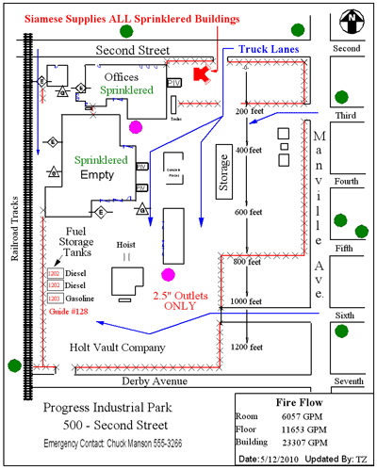

Slide 27
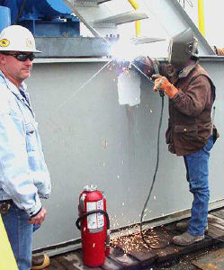
§F1408.3 Training
Training of responsible personnel in the use of fire protection equipment shall be the responsibility of the fire prevention program superintendent.

Slide 28
§F1408.4 Fire protection devices
The fire prevention program superintendent shall determine that all fire protection equipment is maintained and serviced in accordance with this code.
The quantity and type of fire protection equipment shall be approved.

Slide 29
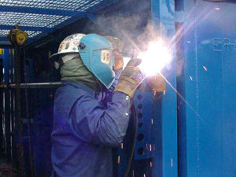
§F1408.5 Hot work operations
The fire prevention program superintendent shall be responsible for supervising the hot work operations in accordance with Chapter F26.

Slide 30
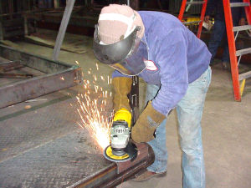
Hot Work Basics
Welding, cutting, brazing
Posted Permit
  Authorizing party
  Authorized time
  Authorized location
  Daily inspections

Slide 31
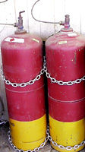
Sprinklers functioning
Equipment in good repair
Cleared or covered 35 ft
Opening protected
Floors are kept clean

Slide 32
Fire watches
  During and minimum 30 minutes (longer period may be required)
  Trained person, sole function
  Fire extinguisher
  Communication means

Slide 33
§F1408.6 Impairment of fire protection systems
§F1408.7 Temporary covering of fire protection devices

Slide 34
1409 Fire Reporting
Emergency telephone
  readily accessible emergency phone facilities
  approved location at the construction site
  street address of site and the emergency phone number must be posted adjacent to the telephone.

Slide 35
1410 Access for Fire Fighting
Required access
  Approved temporary or permanent roads, capable of supporting vehicle loading under all weather conditions
    Within 100 feet of temporary or permanent fire department connections
Key boxes
  Key boxes shall be provided as required by Chapter F5.

Slide 36
1411 Means of Egress
Stairways required
  greater than 50 feet or four stories
  at least one temporary lighted stairway shall be provided, unless one or more of the permanent stairways are erected
Maintenance of Egress
  Required means of egress shall be maintained during construction and demolition, remodeling or alterations and additions.
Stairway floor number signs
  Temporary stairway floor number signs shall be approved

Slide 37
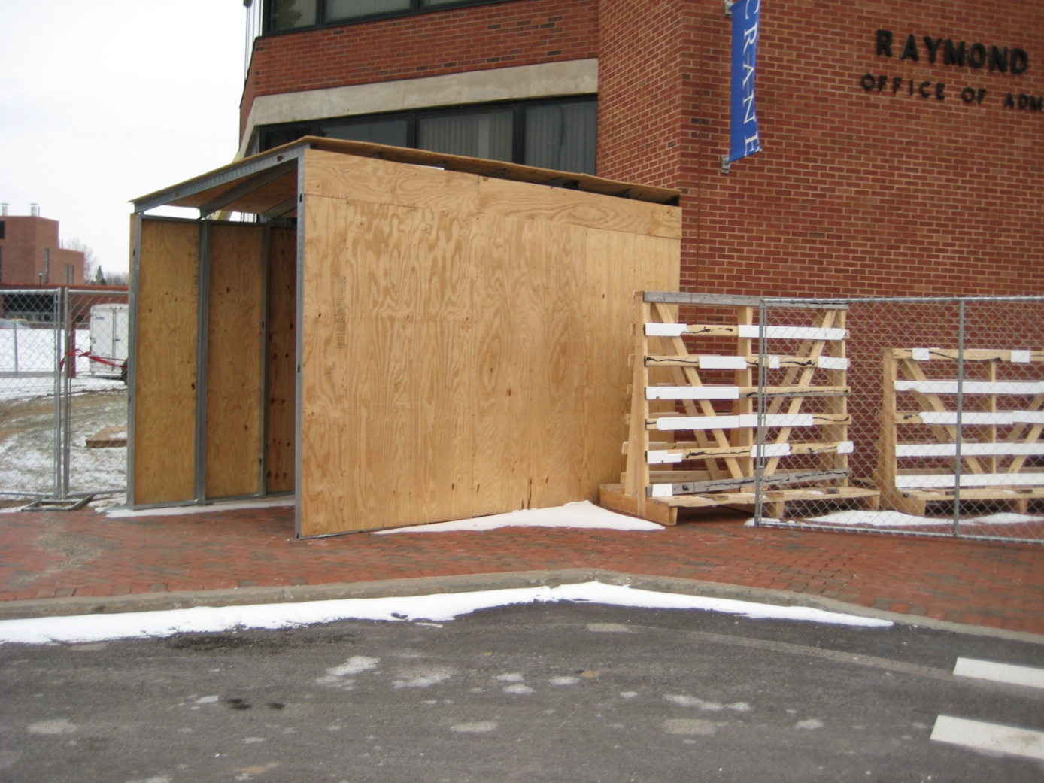

Slide 38
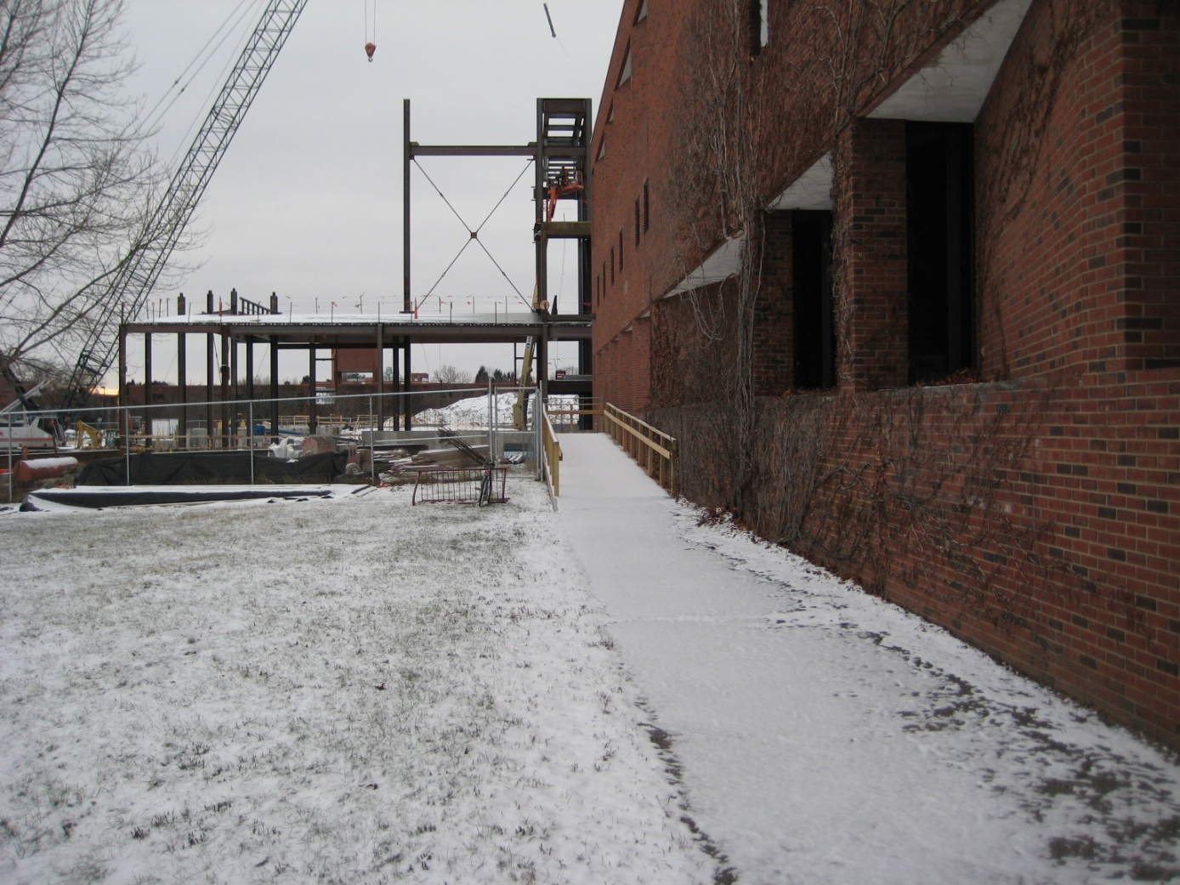

Slide 39
1412 Water Supply for Fire Protection
When required
  An approved water supply for fire protection, either temporary or permanent, shall be made available as soon as combustible material arrives on the site.

Slide 40
1413 Standpipes
§F1413.1 Where required
  four or more stories in height
  fire department hose connections at accessible locations adjacent to usable stairs
  Such standpipes are to be be extended (taken down) as construction (demolition) progresses to within one floor.

Slide 41
1414 Automatic Sprinkler Systems
1415 Portable Fire Extinguishers
  Each stairway on all floor levels
  Every storage and construction shed
  To address hazards
1416 Motorized Hazards
1417 Safeguarding Roofing operations

Slide 42


Slide 43
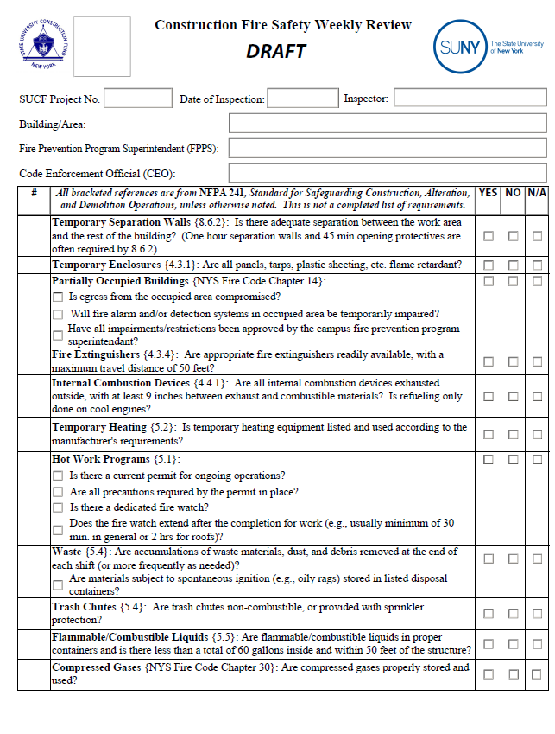

Slide 44
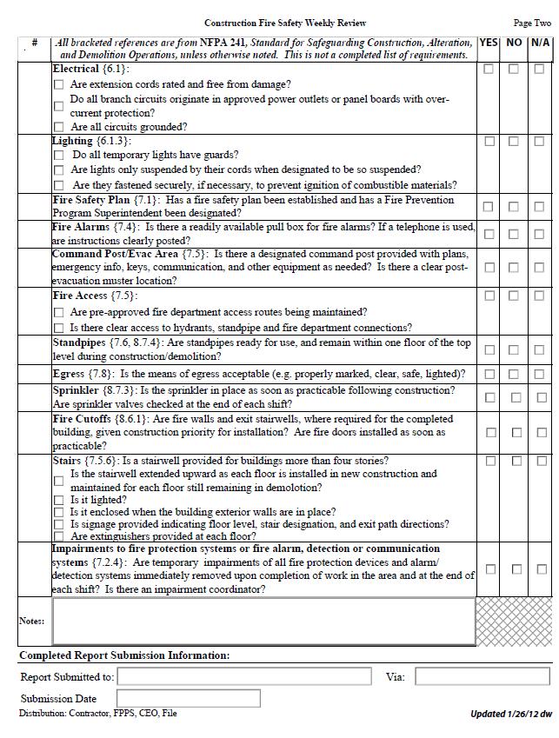

Slide 45
Weekly Inspections
Checklist Tool
Expectations
Prime players
Lines of responsibilities
Lines of communication
Training

Slide 46
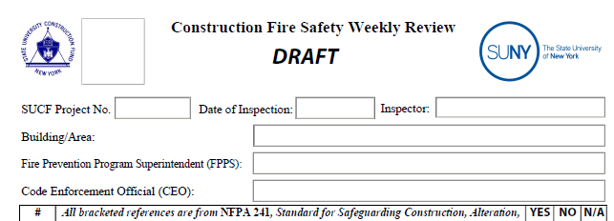

Slide 47
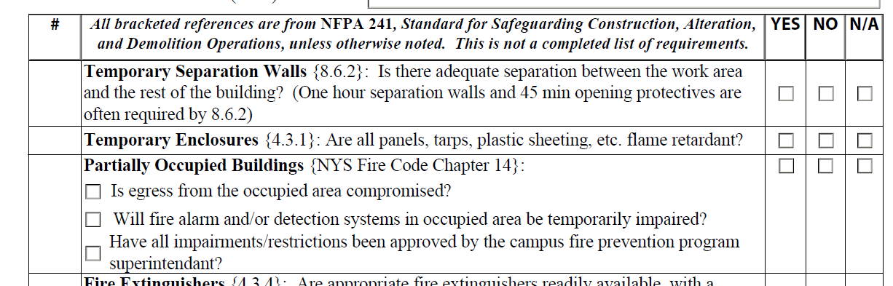

Slide 48
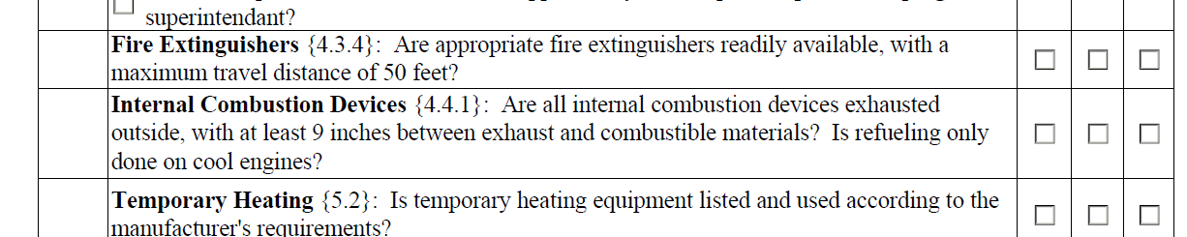

Slide 49
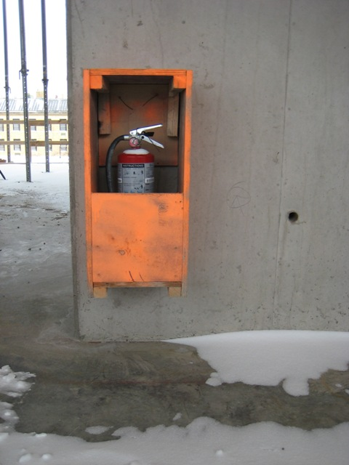

Slide 50
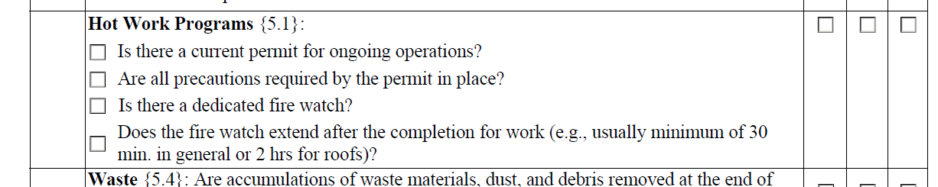

Slide 51
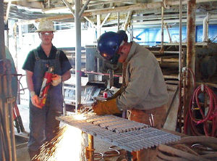

Slide 52
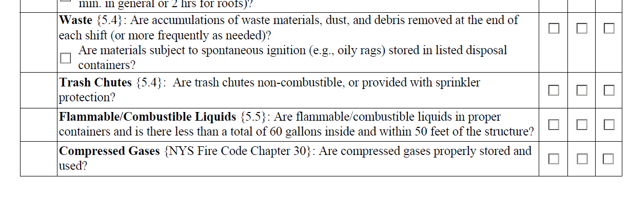

Slide 53
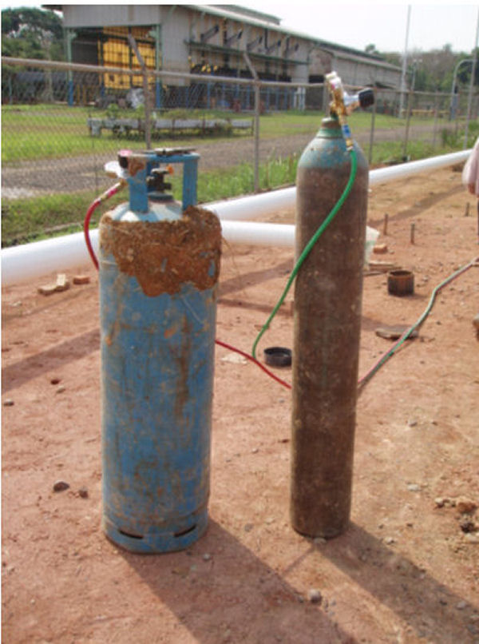

Slide 54
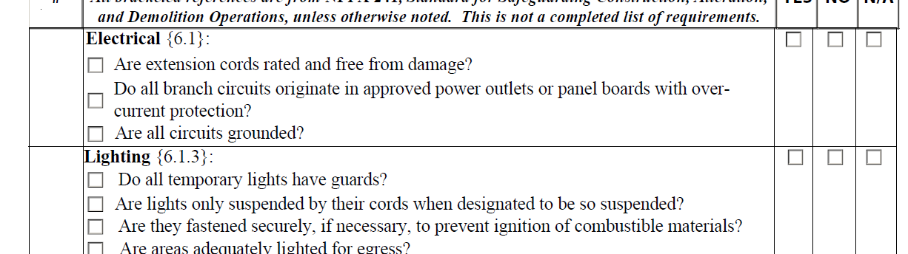

Slide 55
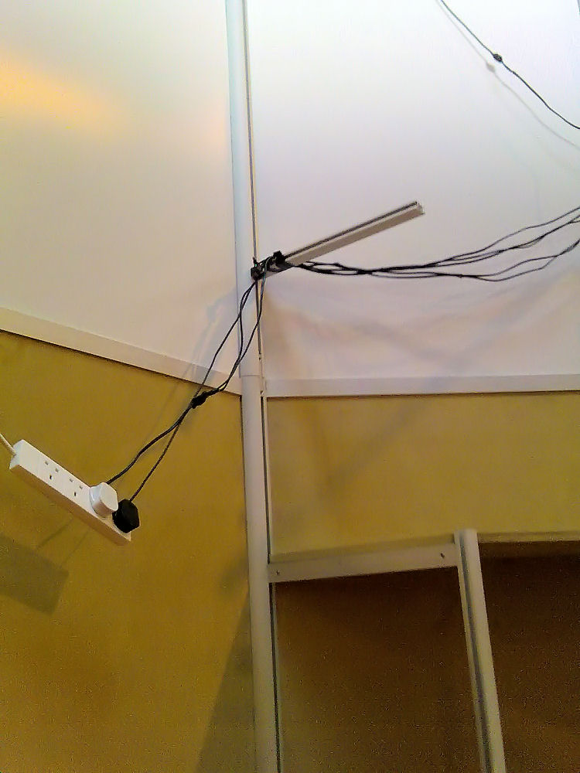

Slide 56
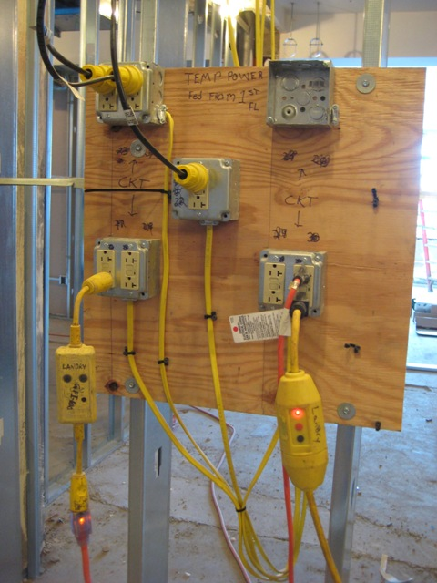

Slide 57
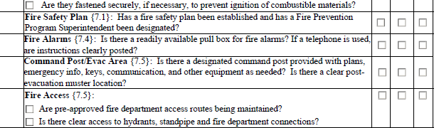

Slide 58
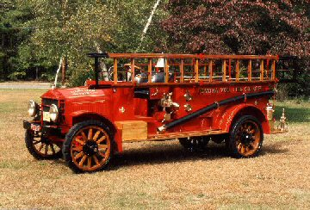

Slide 59
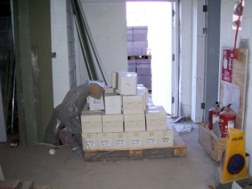

Slide 60
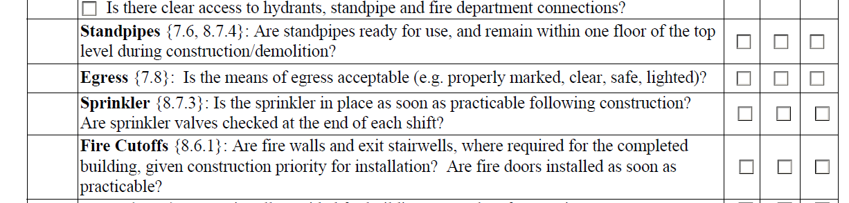

Slide 61
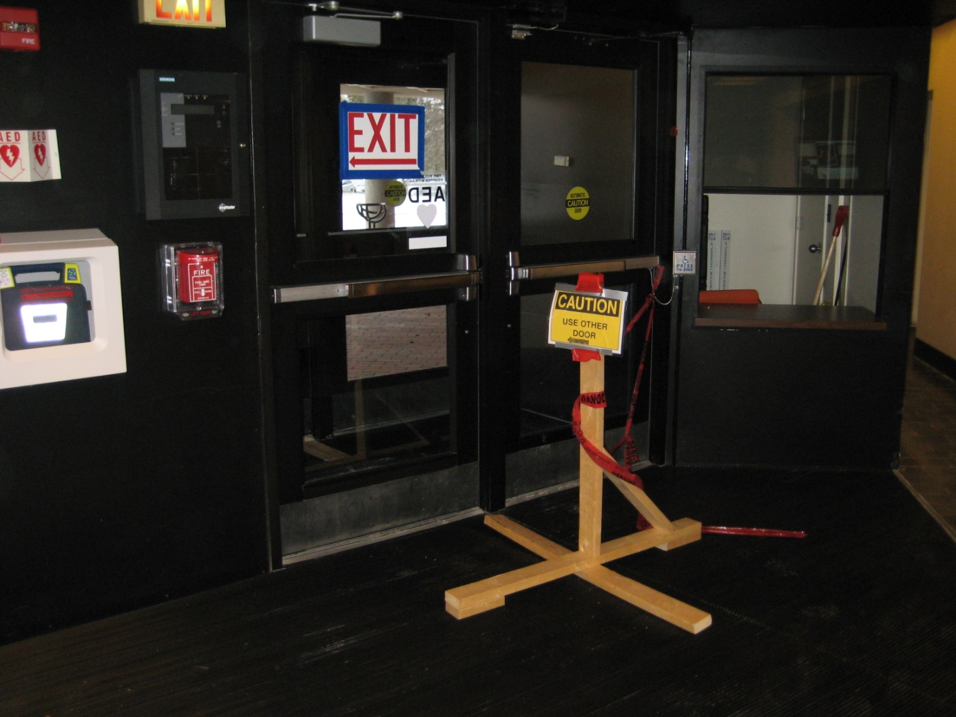

Slide 62
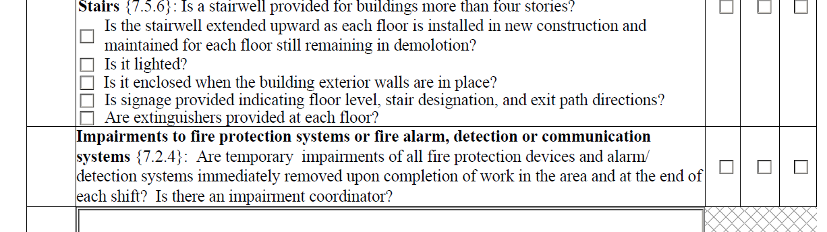

Slide 63
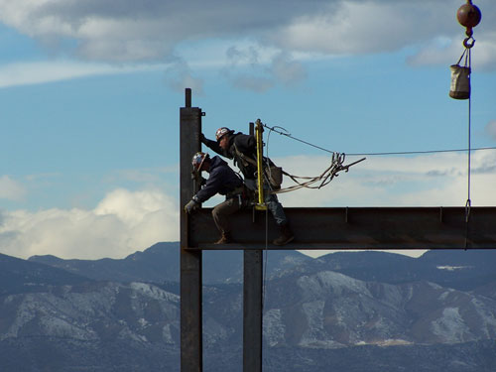

Slide 64
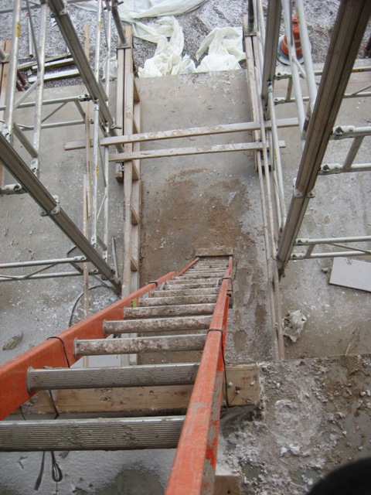

Slide 65
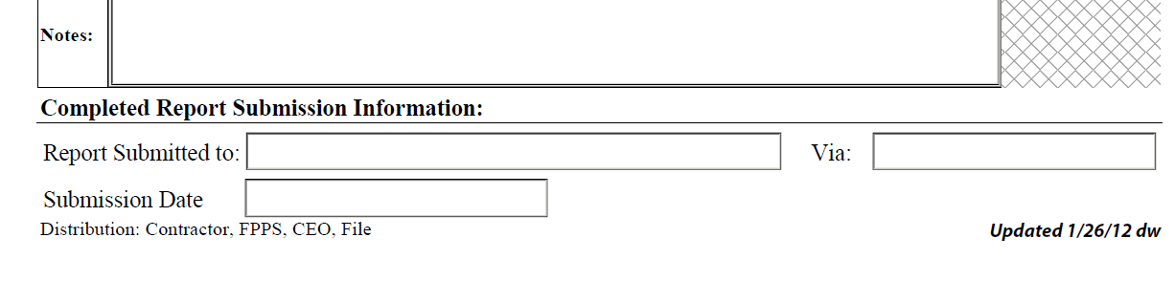

Slide 66
Work in Progress…..
Improve Fire Safety
Improve Communication between various groups
Training outreach
Better document the processes in place
Better manage the risks

