Slide 1


State University of New York
Physical Plant Administrators Association
2018 Winter Conference
January 30 – 31, 2018
The Otesaga Resort, Cooperstown, NY
Stephen D. Curro, P.E.
Managing Director Construction
Paul T. Williams, Jr. President
January 30, 2018

Slide 2
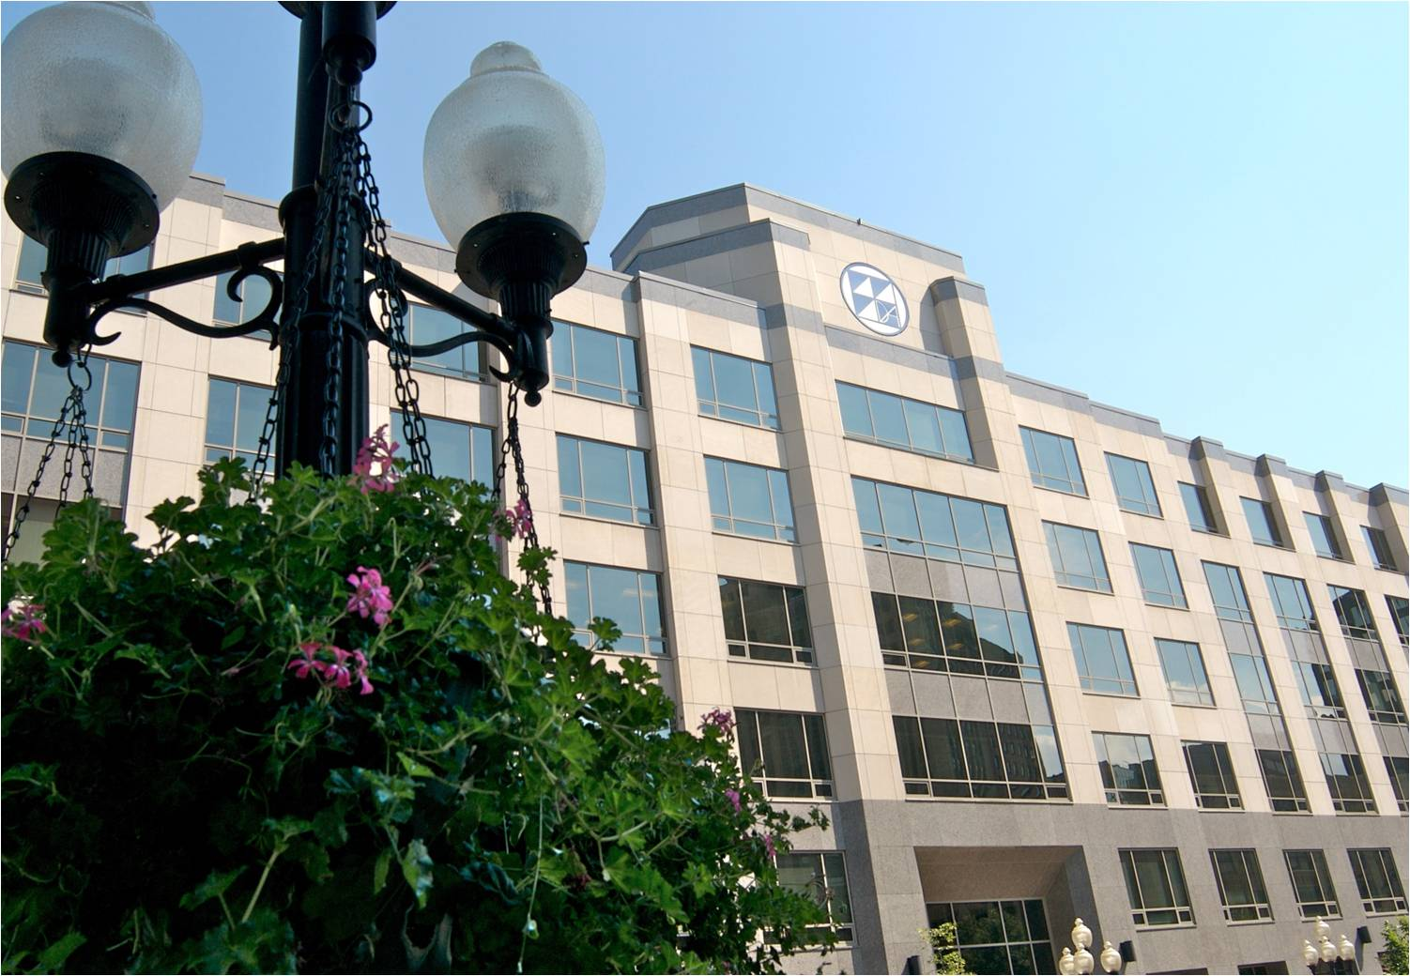
Agenda
DASNY Corporate Update
SUNY Residence Hall
Program Statistics
2017 Looking Back
2018 Looking Forward
Residence Hall Program
Delivery Methods
Closing Thoughts

Slide 3
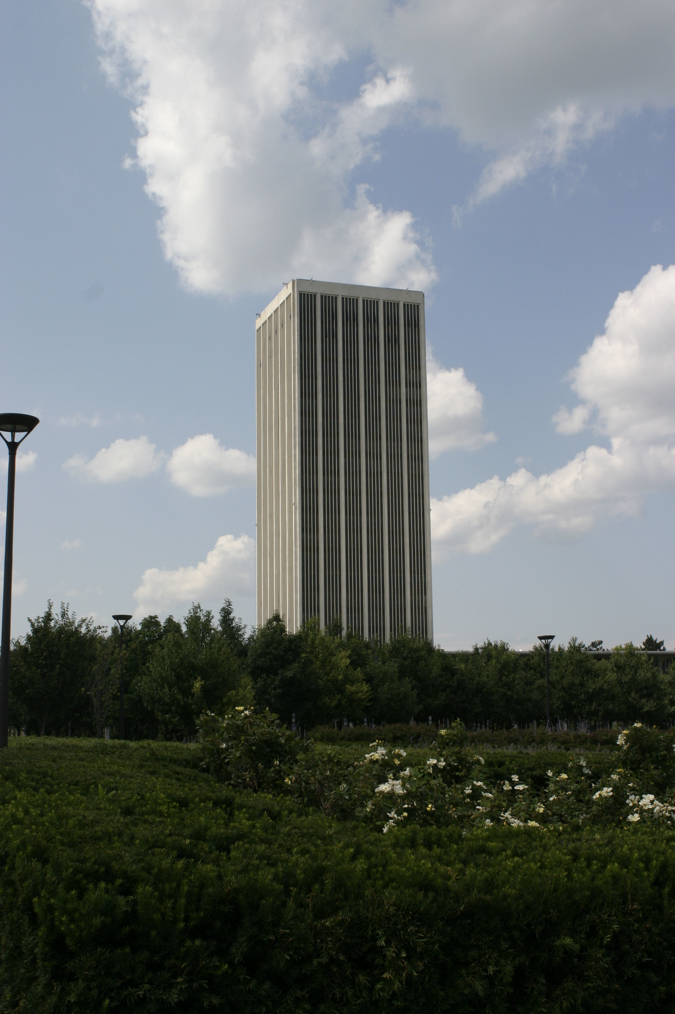
DASNY Corporate Update
EY Corporate Review
One DASNY
Contract Manager Replacement
Alternative Delivery
Technology
2018 – 2019 NYS Budget
Albany
Project: $1.9m – Tower Sealer Program
Architect: Bell & Spina Architects
General Contractor: Debrino Caulking Assoc. Inc.

Slide 4
DASNY-Managed Project Expenditures
SUNY Residence Hall and total DASNY construction expenditures by fiscal year
(in $ hundreds of millions)

Slide 5
2017 SUNY Construction Statistics
2017 SUNY Summer Renovation Projects
Number of SUNY 2017 summer projects: 34
Dollar value of SUNY 2017 summer projects: $29.1m
Average cost per summer project: $865k / project
Average project duration: 90 days
2017 SUNY Residence Hall Capital Projects
Renovations New Builds
Number of renovation / new build projects: 6 0
Associated number of beds: 1,083
Associated dollar value: $78.7m
Associated aggregate cost / project: $13m / project
Associated aggregate average cost / bed: $73k / bed
Average project duration: 5 projects – 12 months; 1 project – 8 months

Slide 6
Capital Projects 2017 Completed
Campus | Project Name | Projected Total Cost (millions) | Construction Complete
Albany | Herkimer Hall Renovation | $10.3 | 08/17
Alfred | MacKenzie Hall Renovation | $17.5 | 12/17
Canton | Mohawk East Wing Renovation | $3.9 | 08/17
New Paltz | Bevier Hall Renovation | $19.1 | 08/17
Oswego | Scales Hall Renovation | $13.1 | 08/17
Plattsburgh | Wilson Hall Renovation | $14.8 | 08/17
 | TOTAL | $78.7m

Slide 7
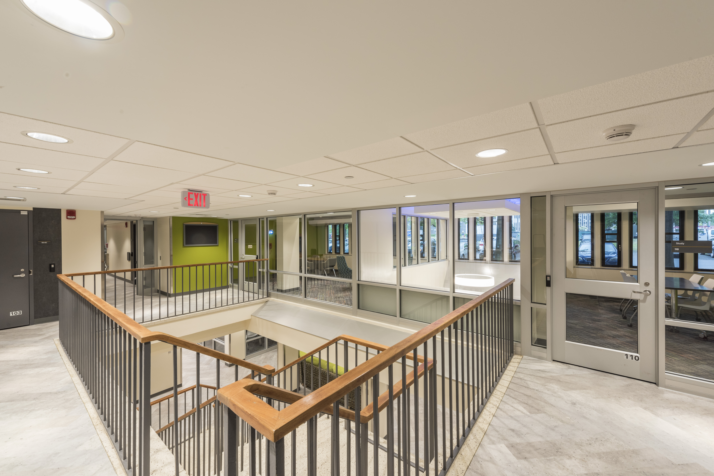
2017 Residence Hall Capital Projects
Albany
Project: $10.3M – Herkimer Hall
Architect: Architecture +
General Contractor: Bunkoff General Contractors Inc.

Slide 8
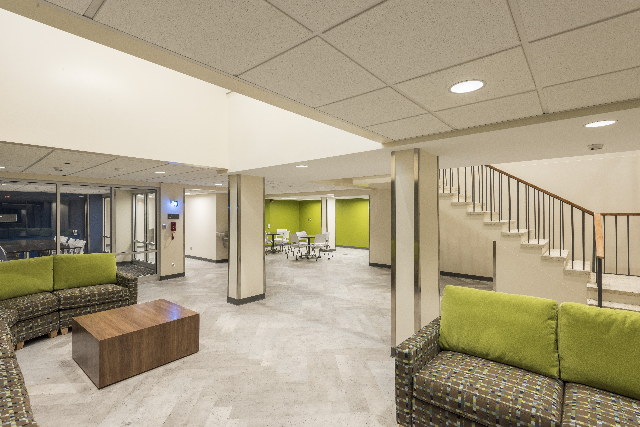
2017 Residence Hall Capital Projects

Slide 9
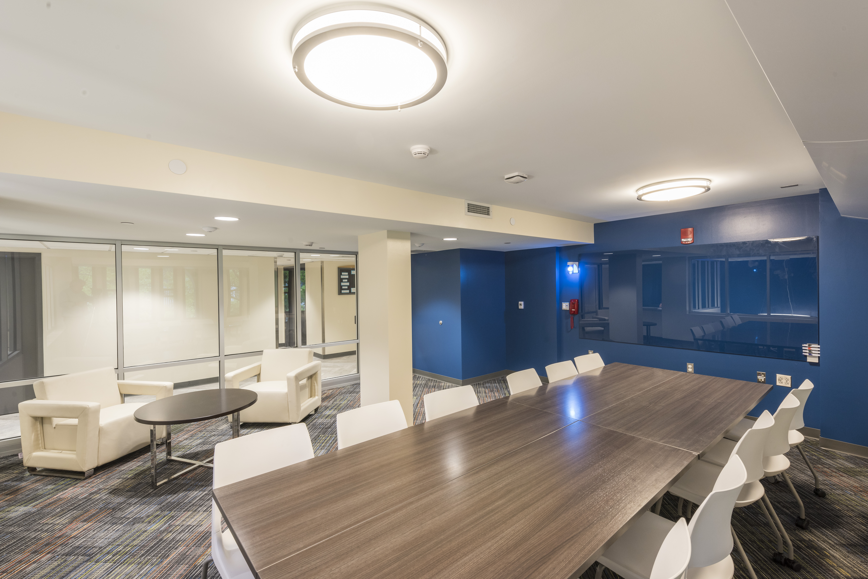
2017 Residence Hall Capital Projects

Slide 10
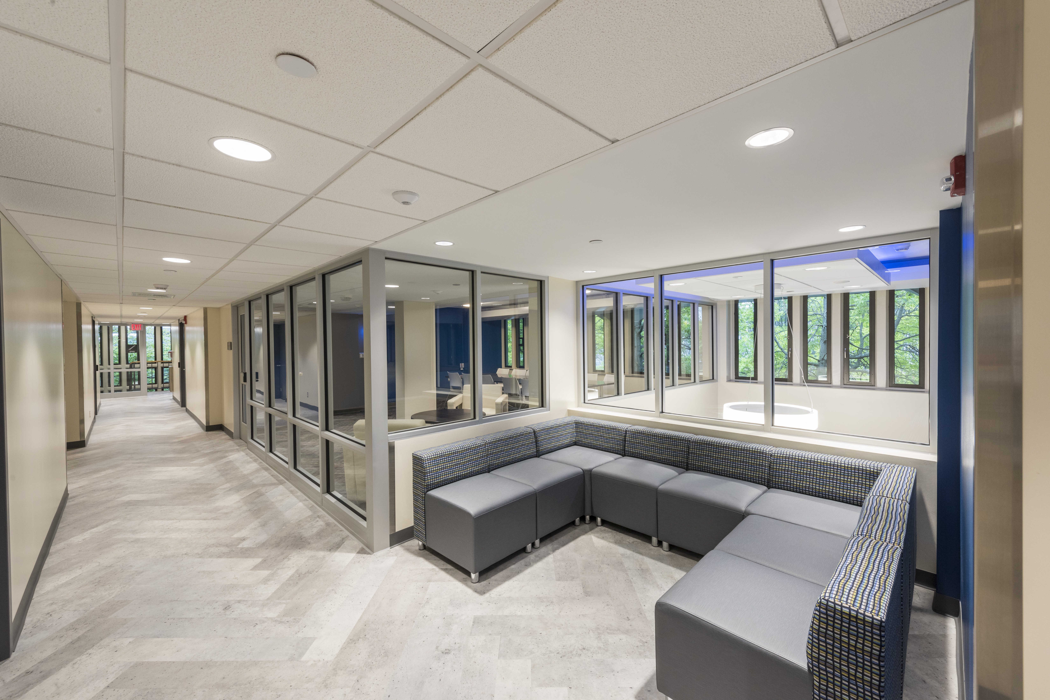
2017 Residence Hall Capital Projects

Slide 11
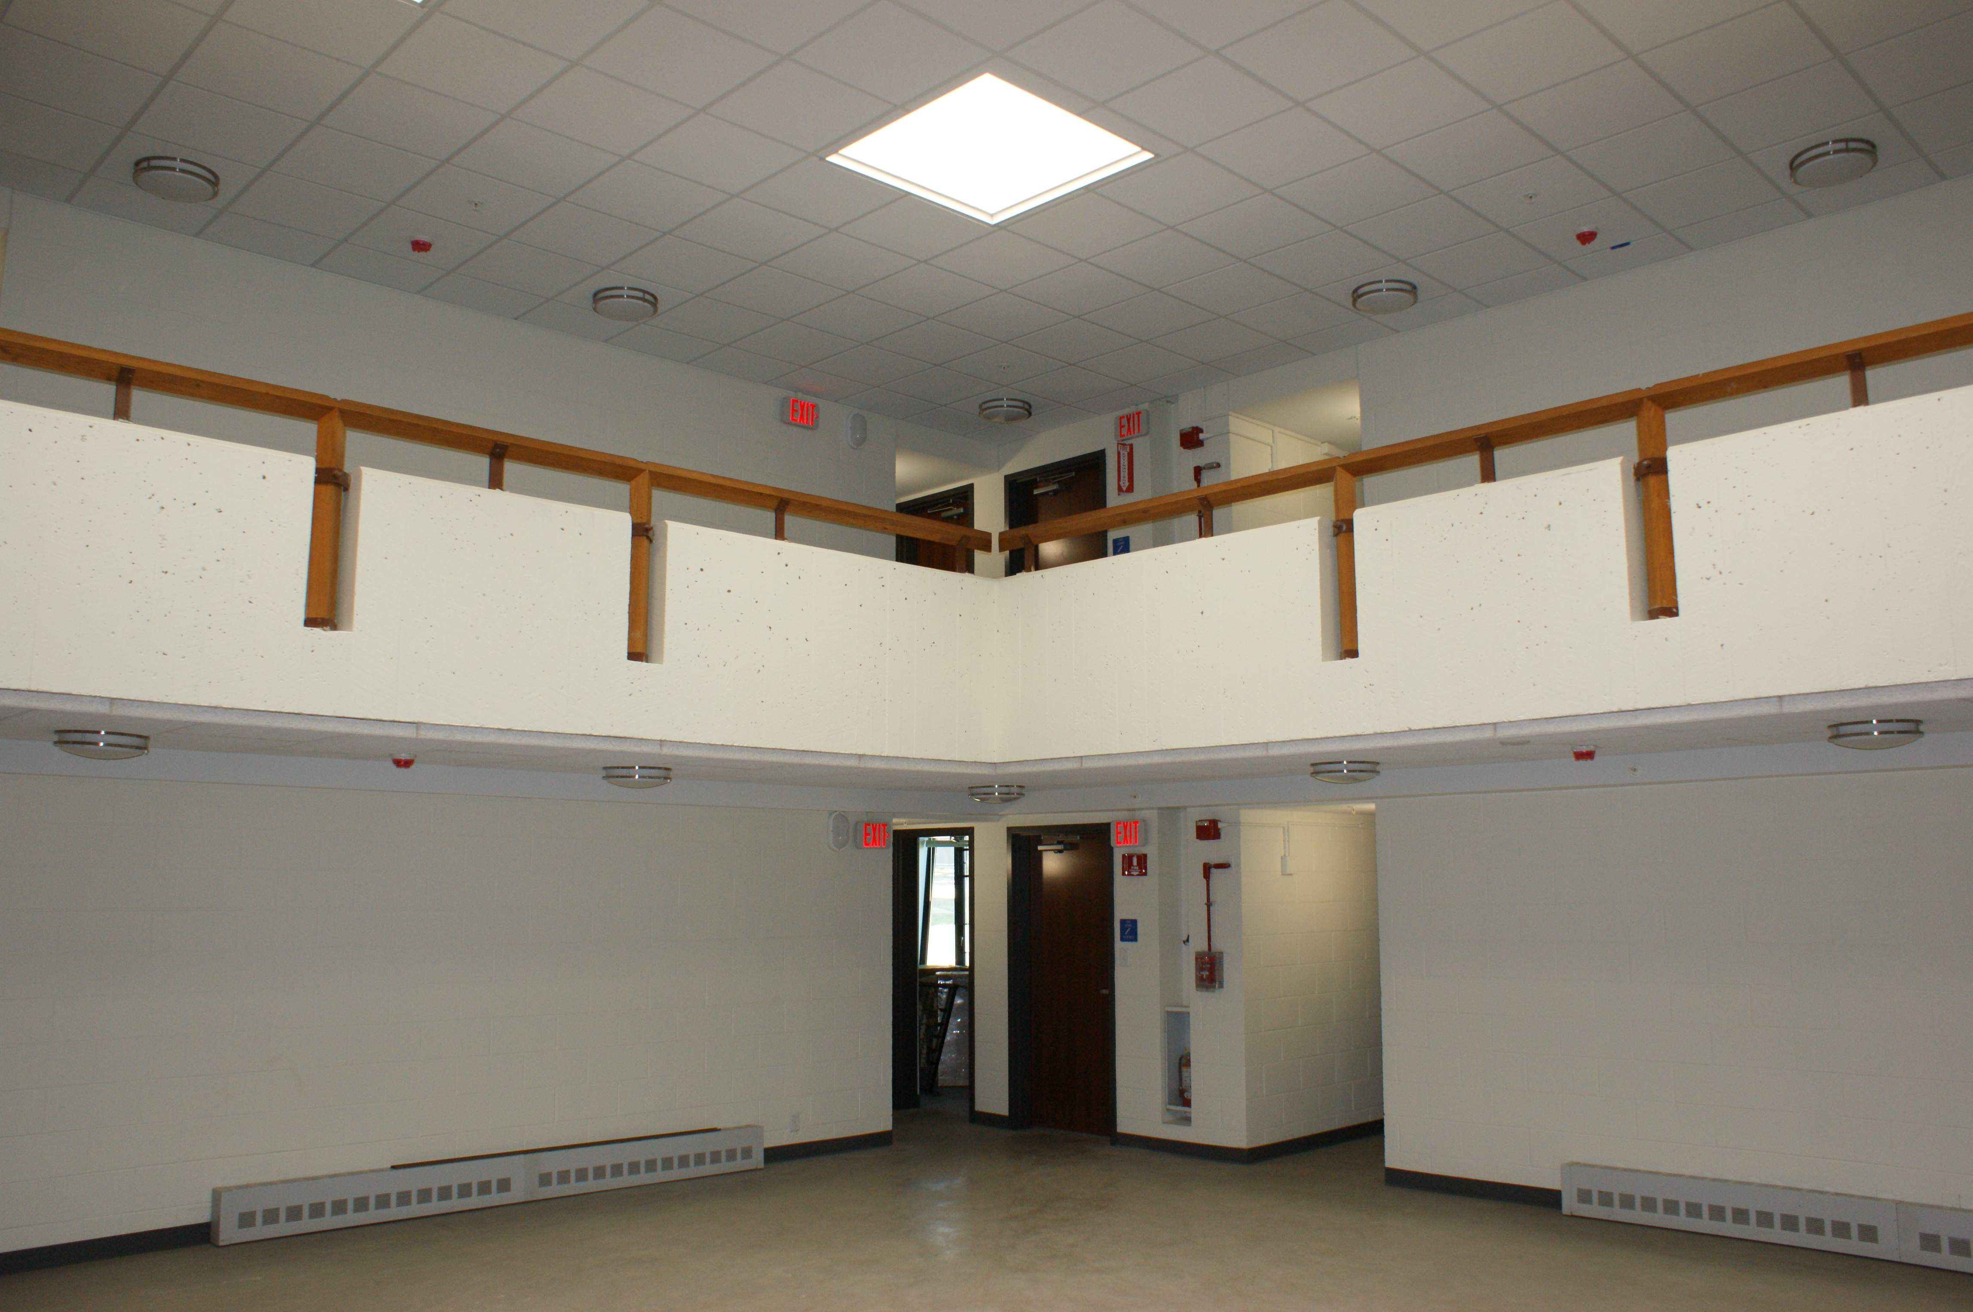
2017 Residence Hall Capital Projects
Canton
Project: $3.9m Mohawk East Wing Renovation
Architect: C & S Engineers
General Contractor: Bette & Cring Construction Services

Slide 12
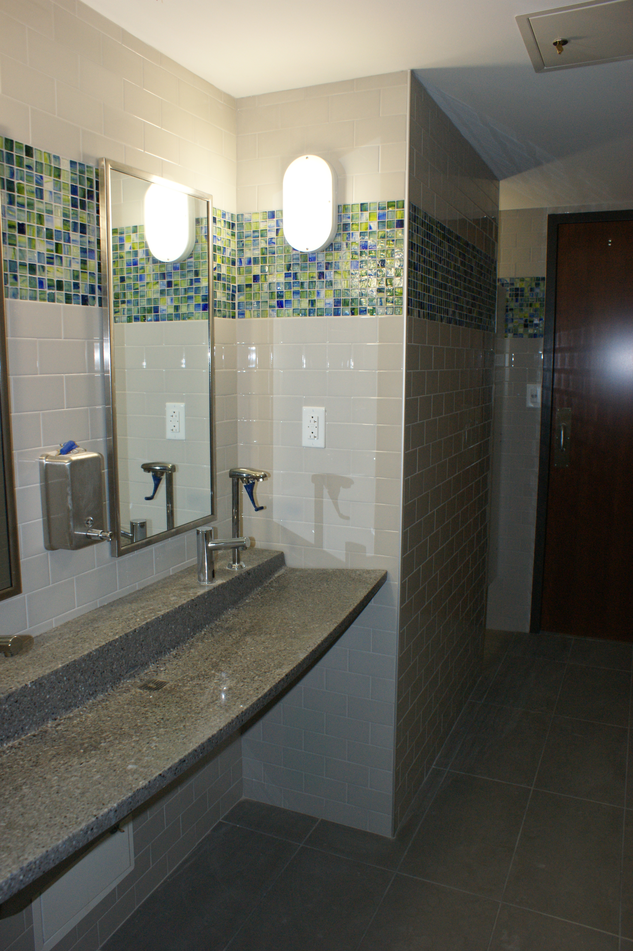
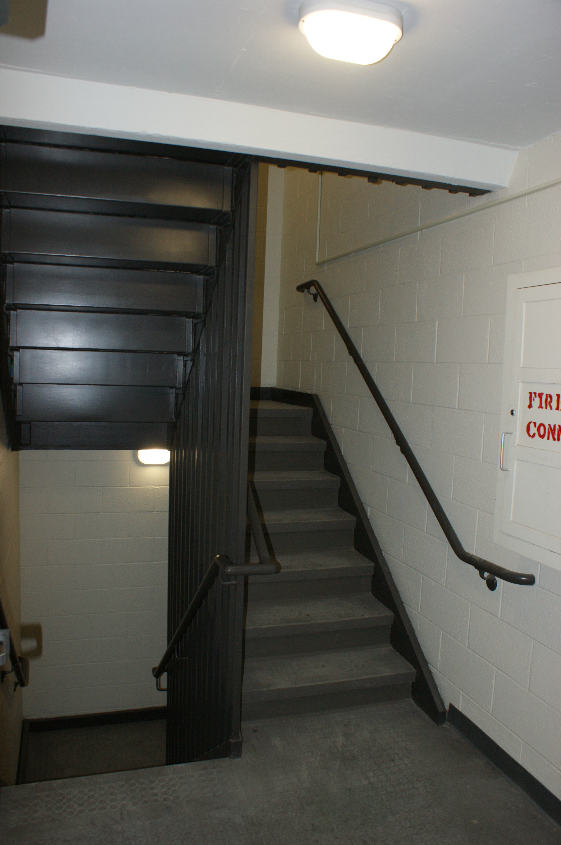
2017 Residence Hall Capital Projects

Slide 13
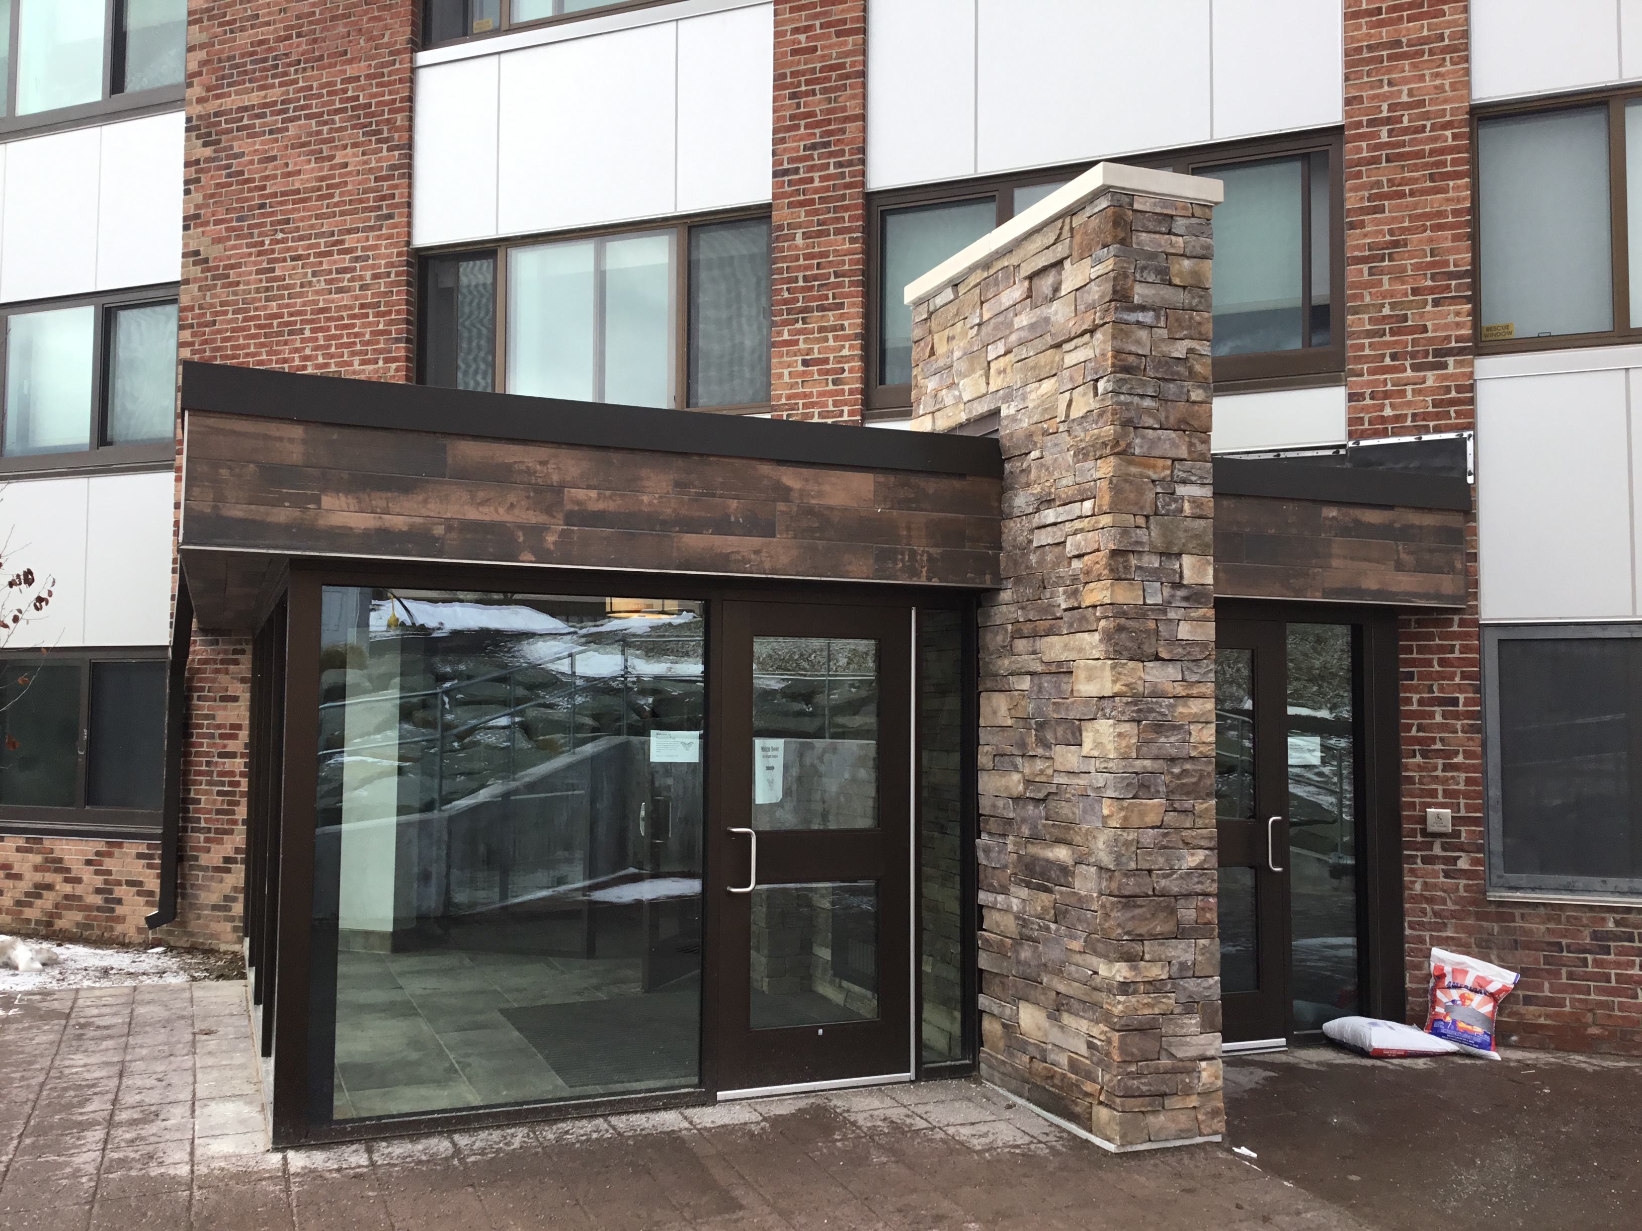
2017 Residence Hall Capital Projects
Alfred
Project: $17.5M – McKenzie Hall
Architect: Mach Architecture & Engineering
General Contractor: LeChase Construction Services

Slide 14
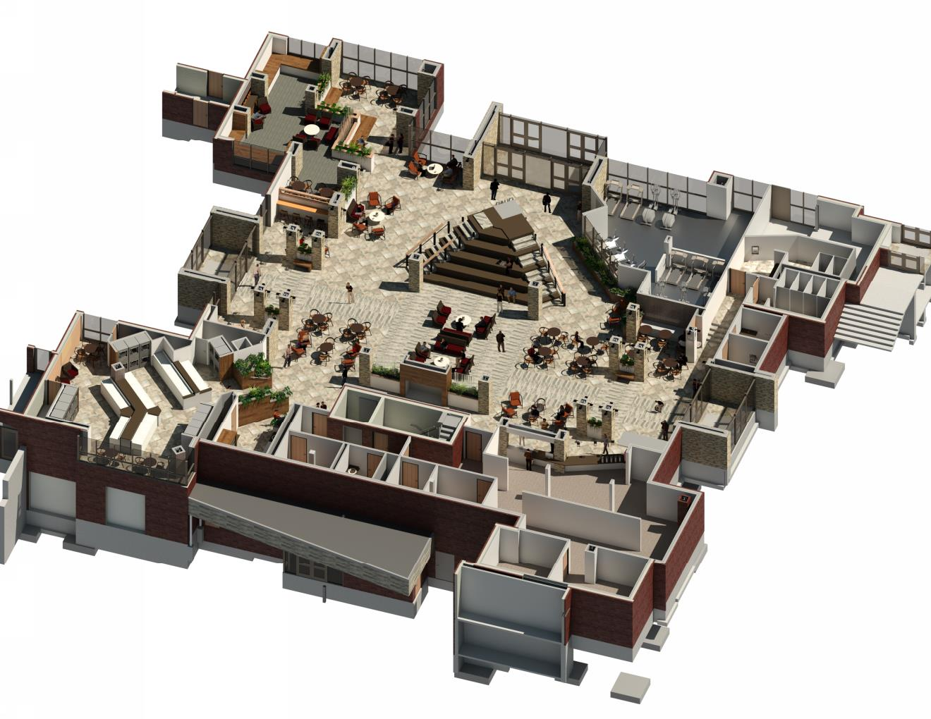
2017 Residence Hall Capital Projects

Slide 15
2017 Residence Hall Capital Projects

Slide 16
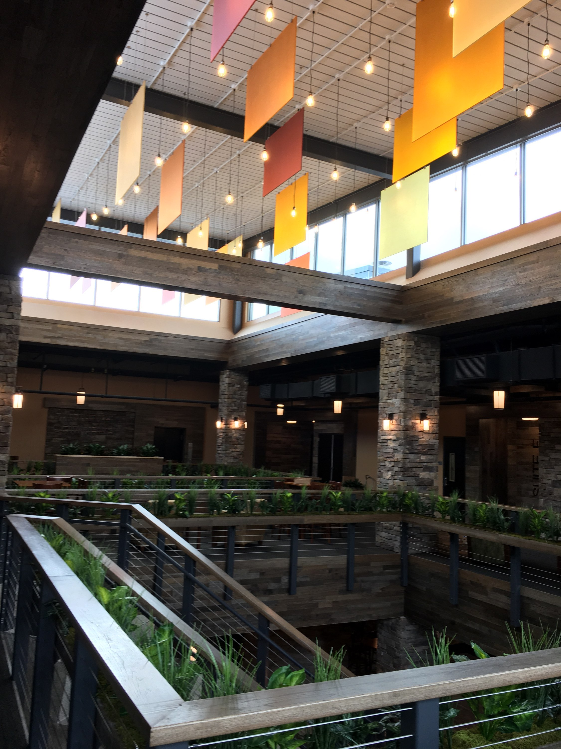
2017 Residence Hall Capital Projects

Slide 17
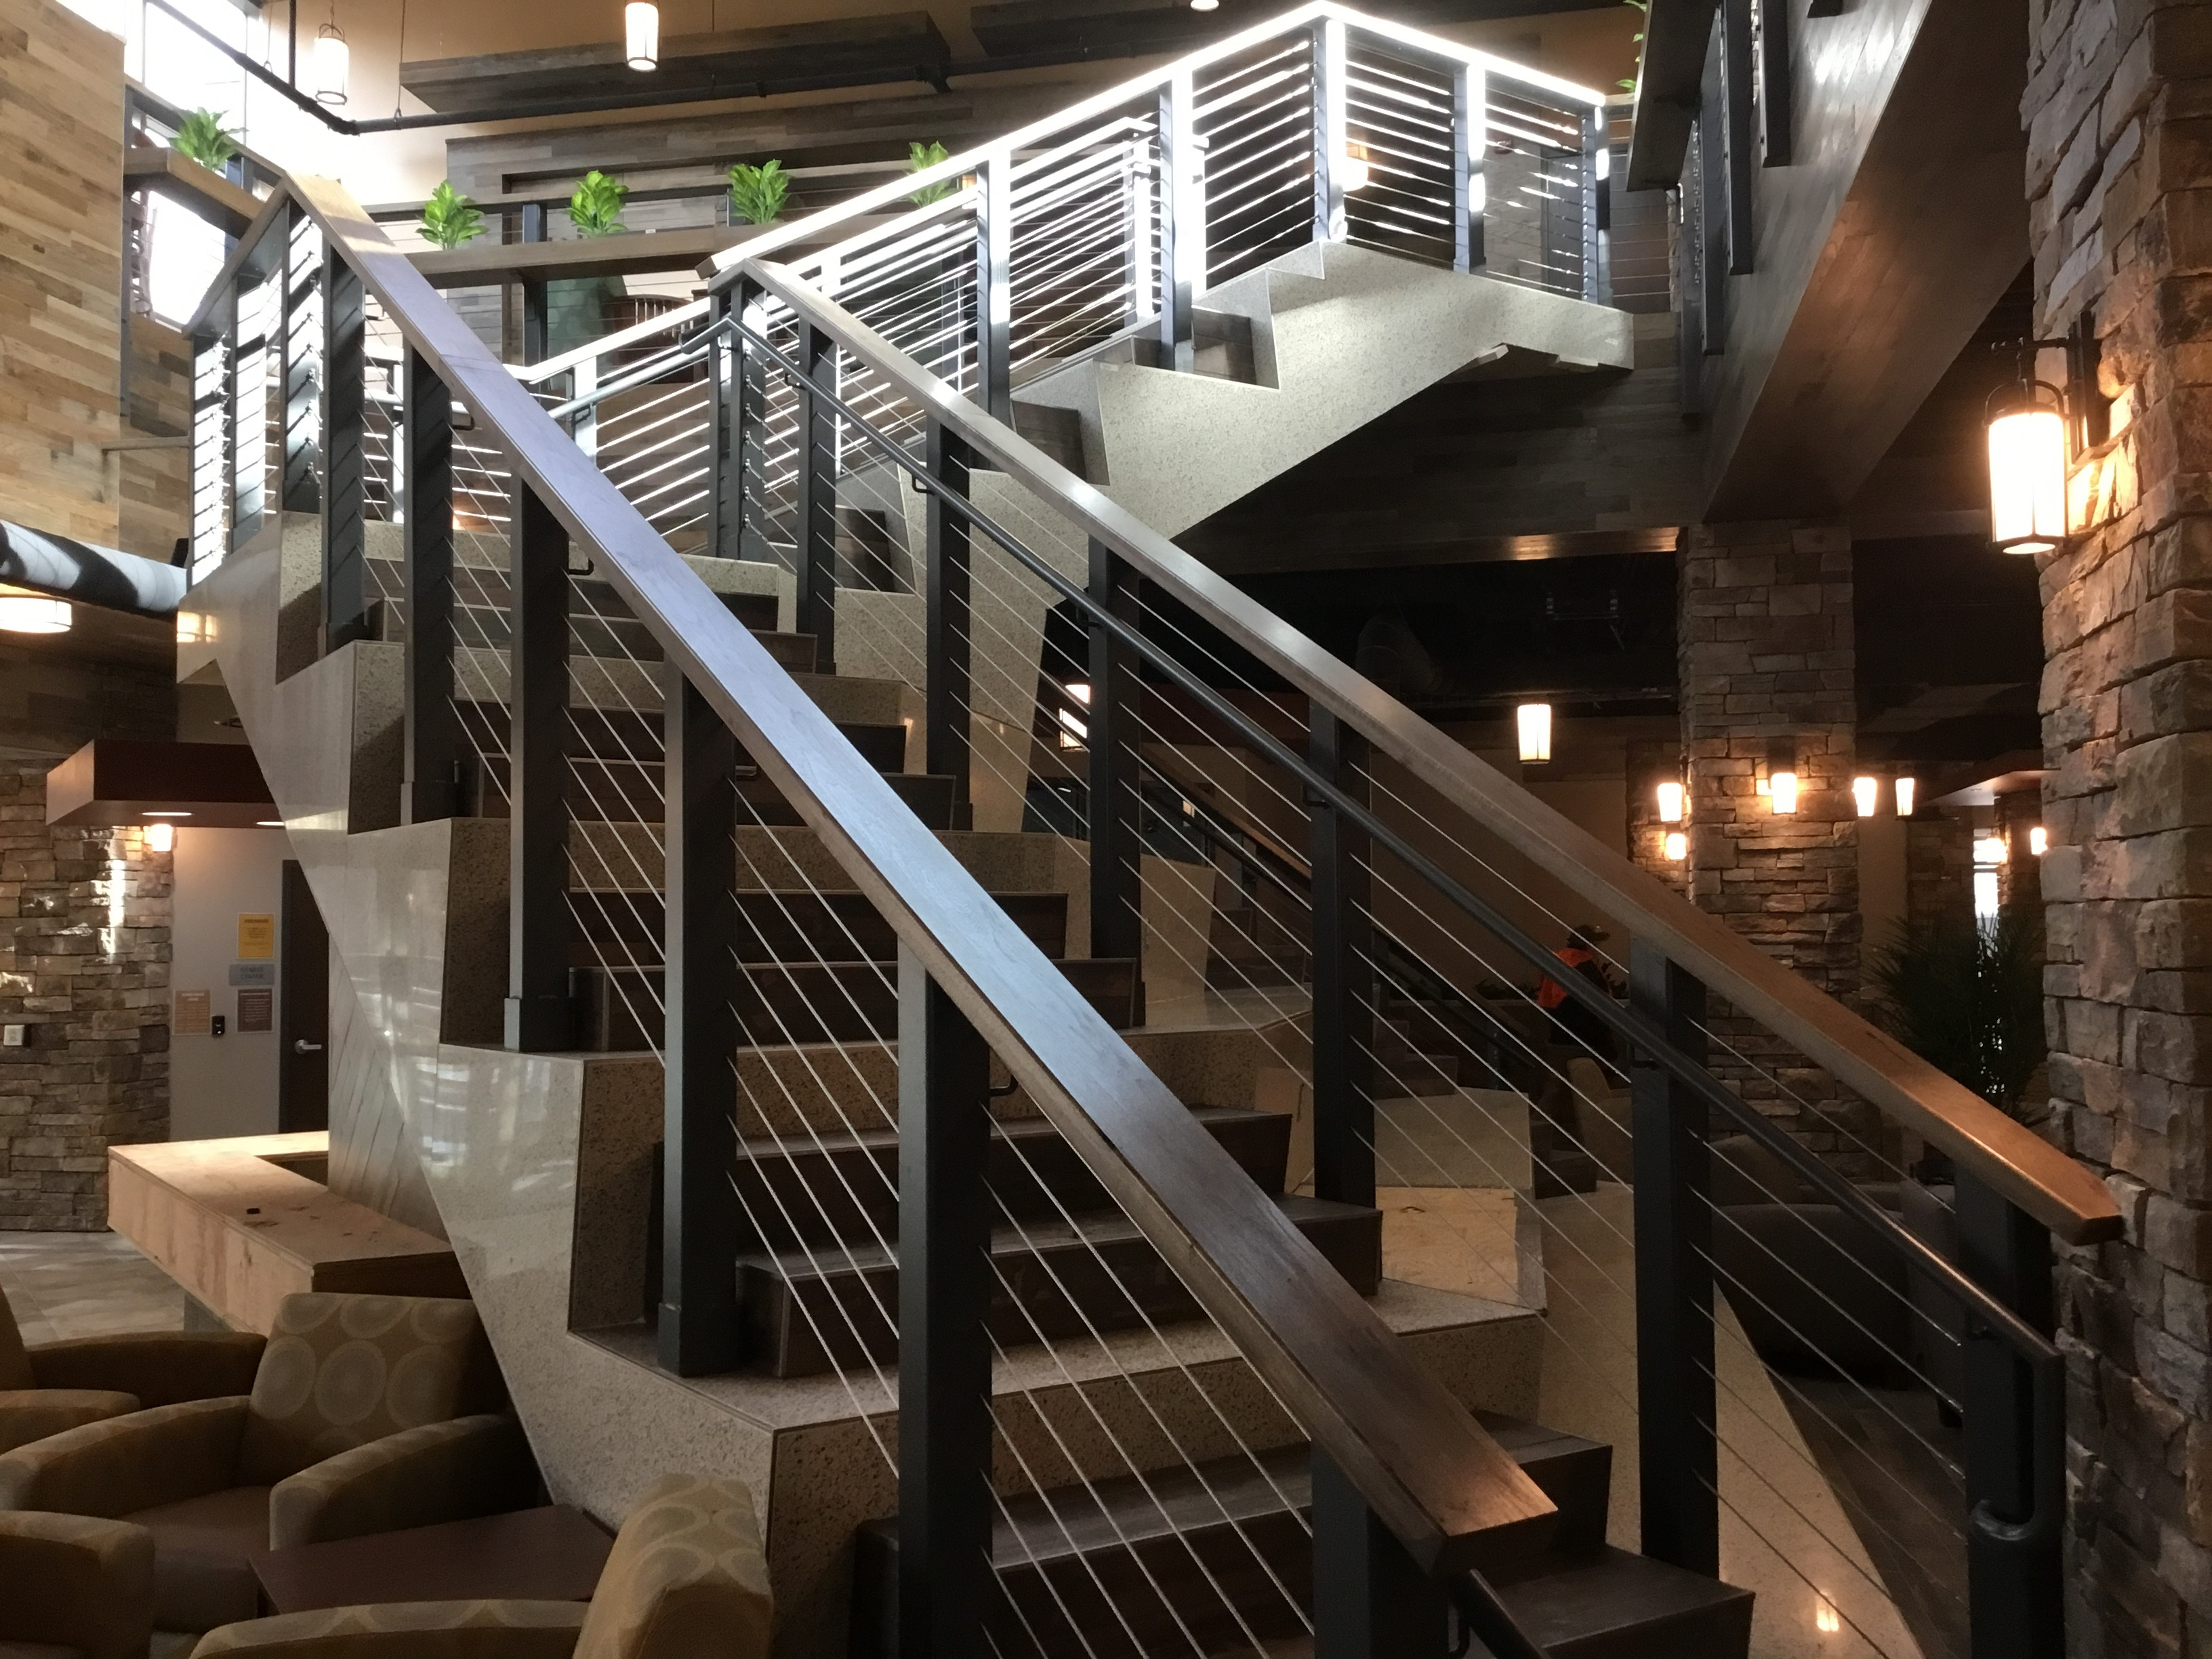
2017 Residence Hall Capital Projects

Slide 18
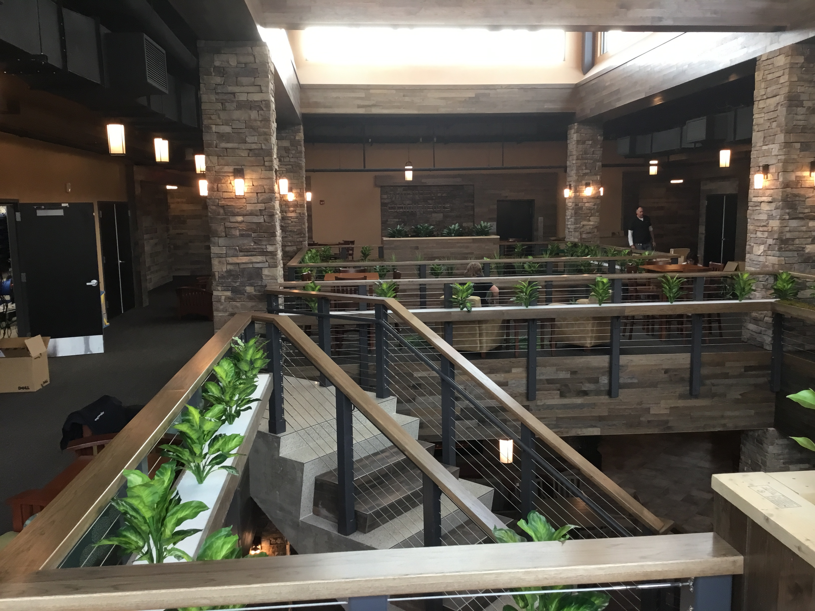
2017 Residence Hall Capital Projects

Slide 19
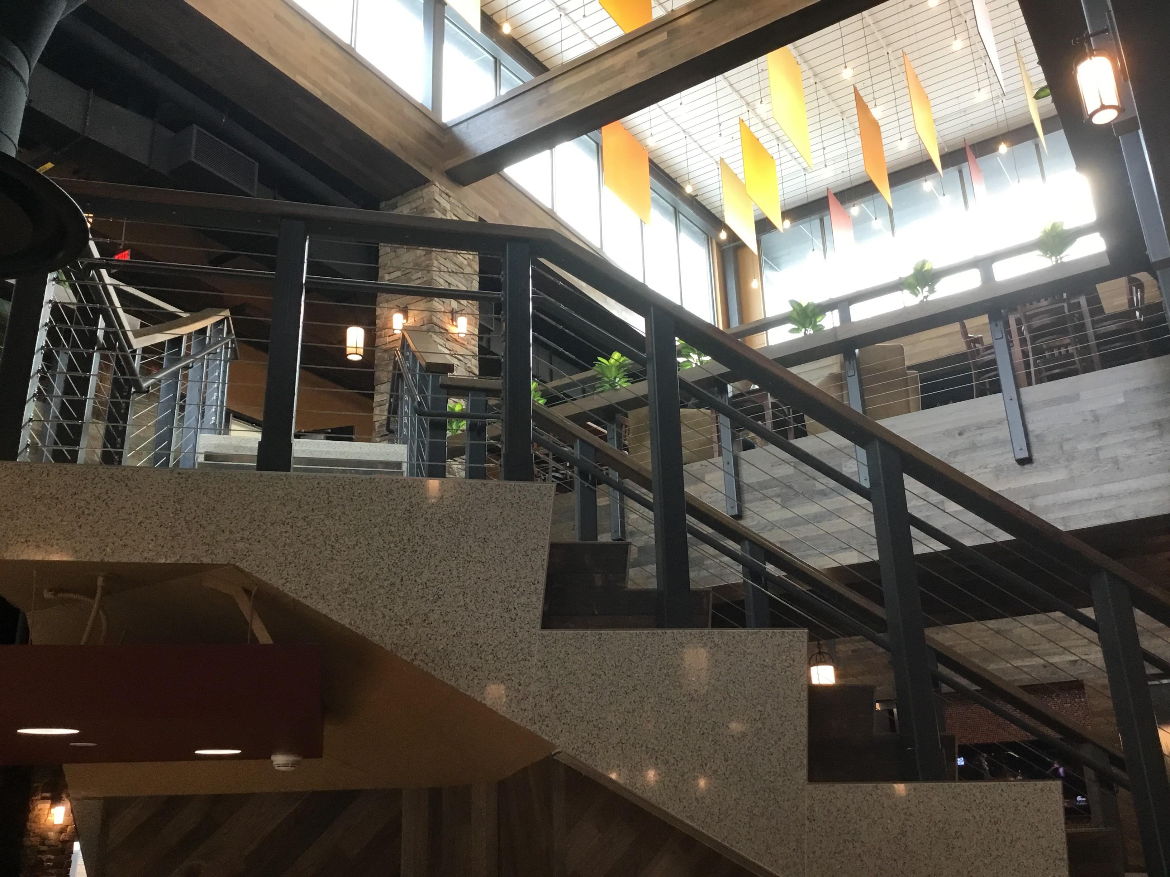
2017 Residence Hall Capital Projects

Slide 20
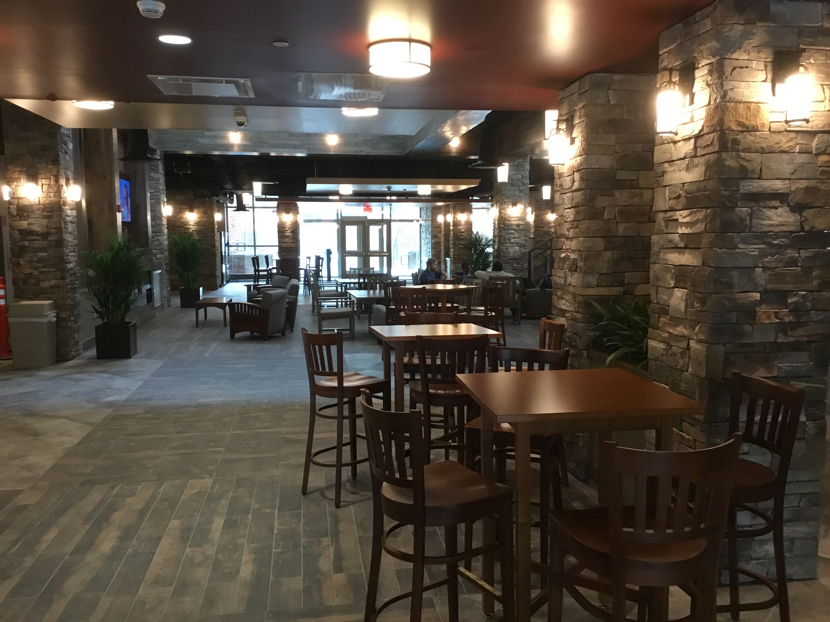
2017 Residence Hall Capital Projects

Slide 21
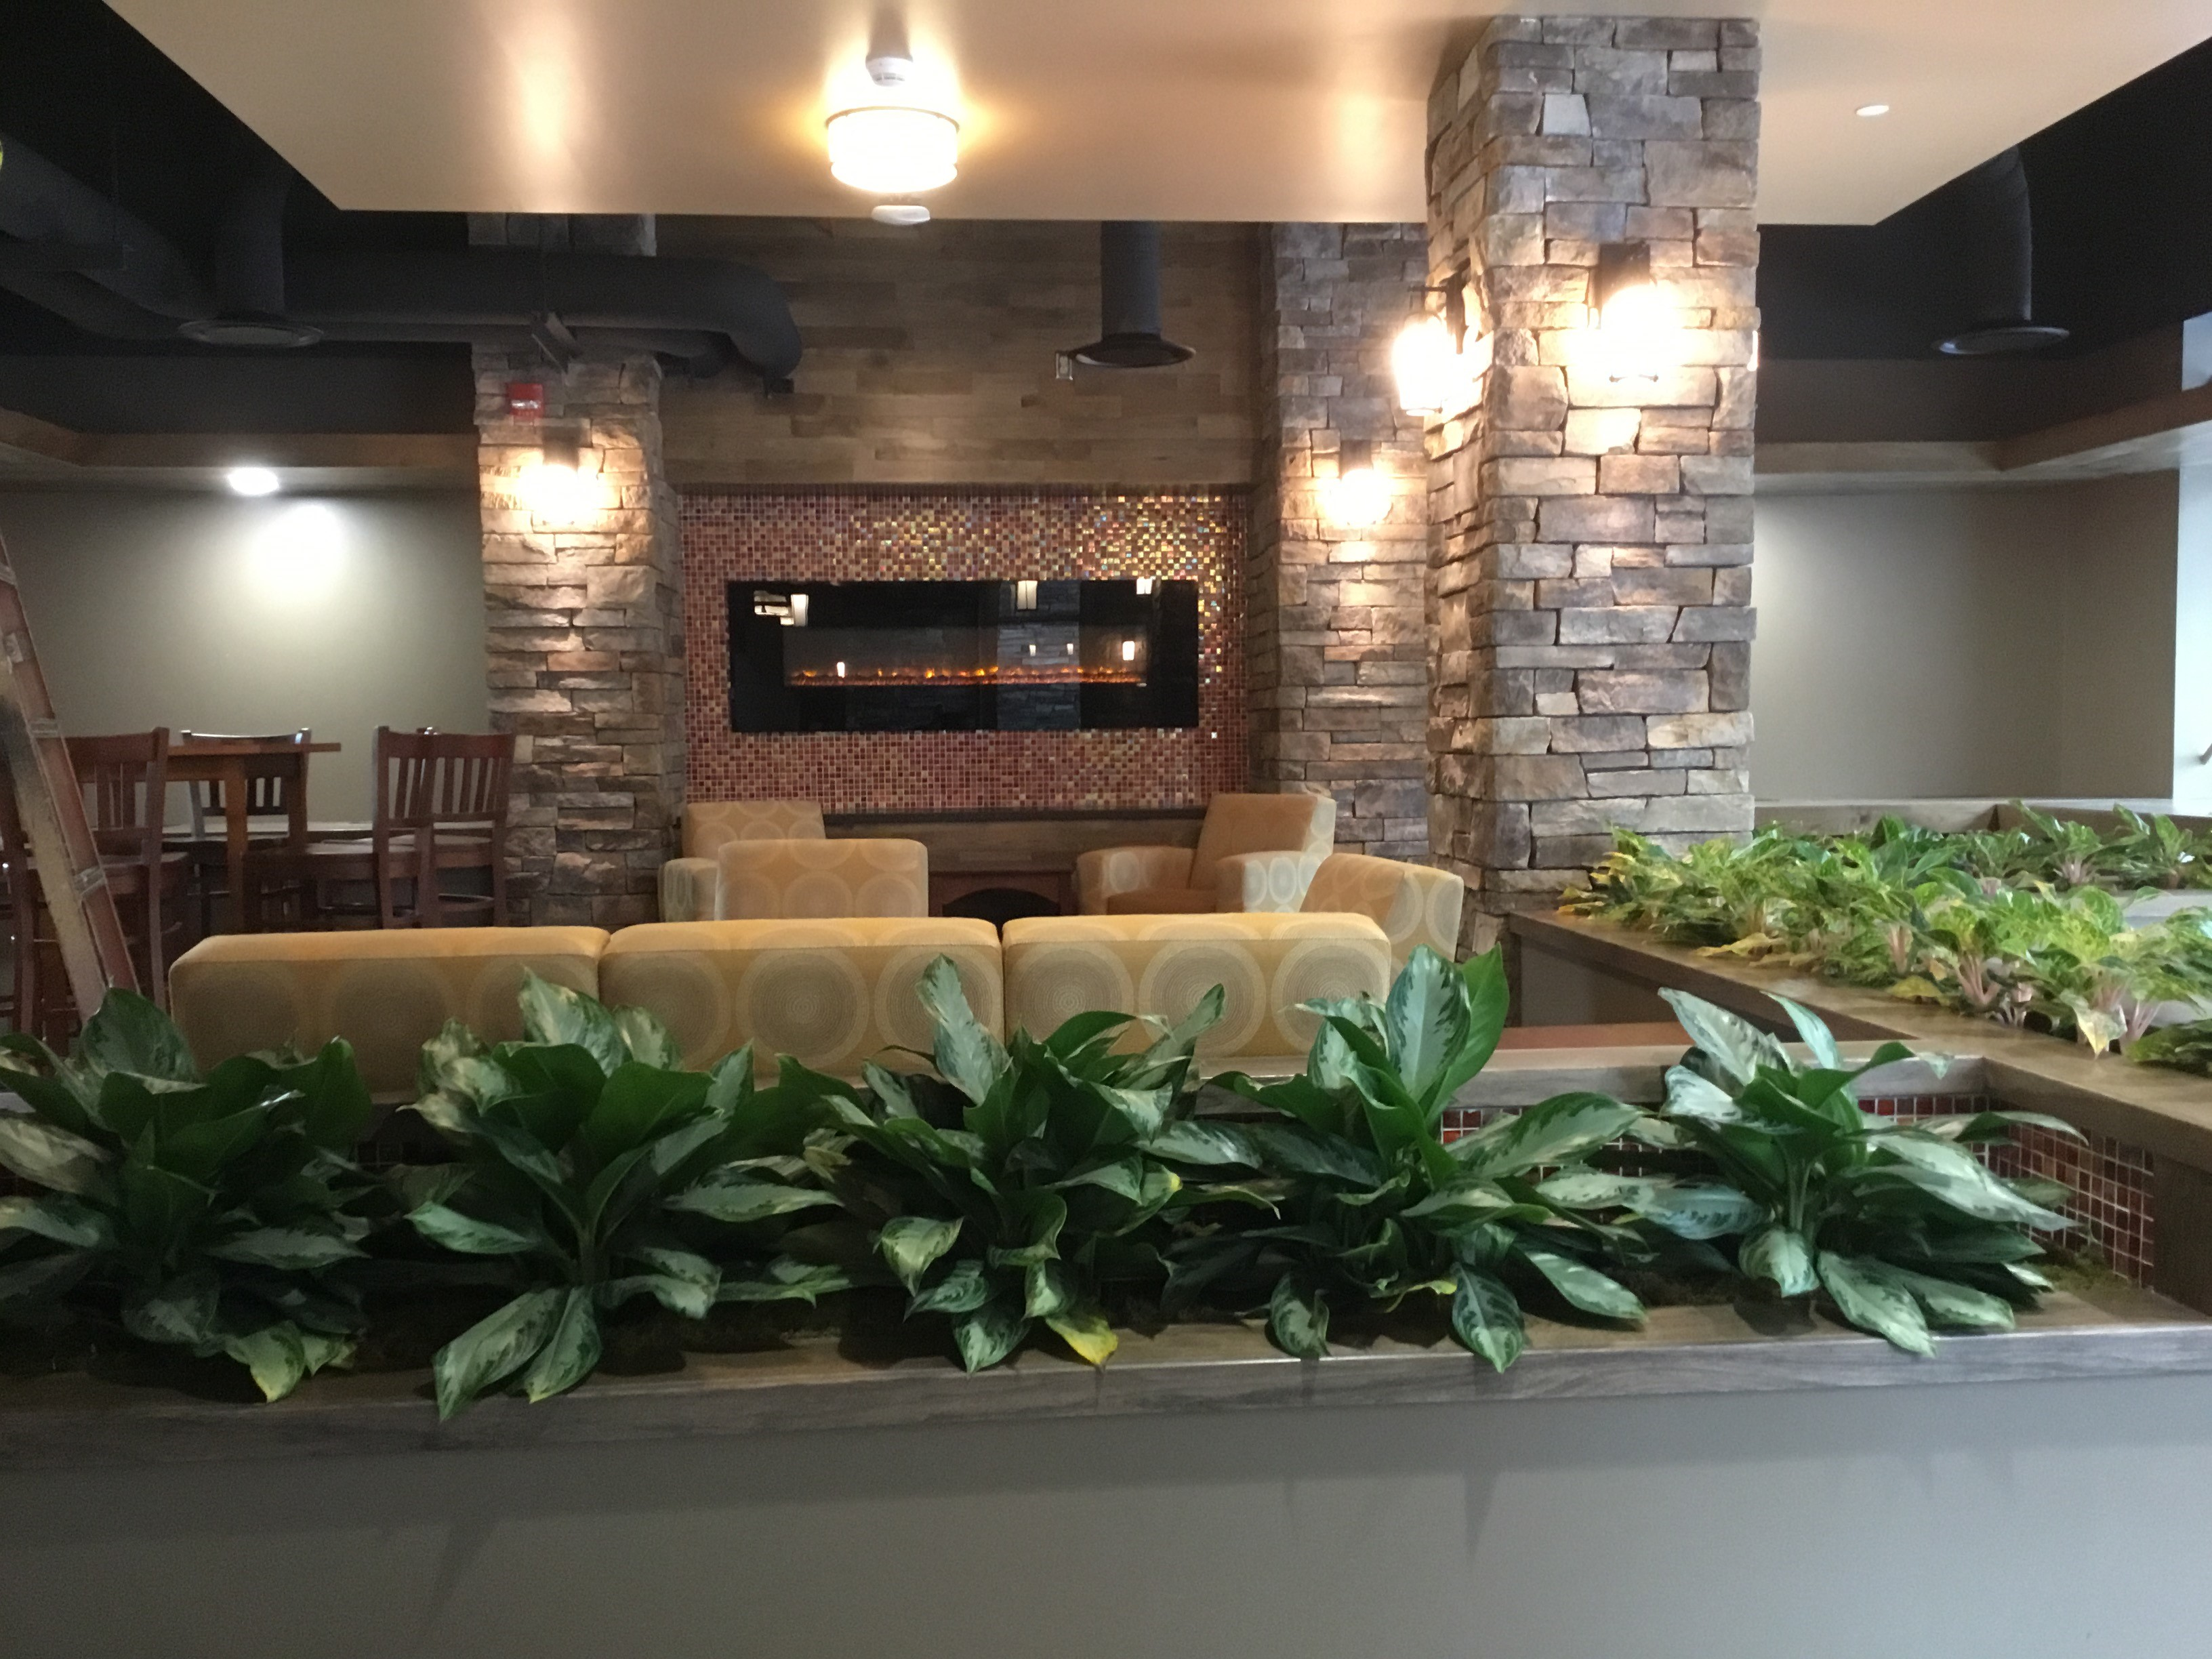
2017 Residence Hall Capital Projects

Slide 22
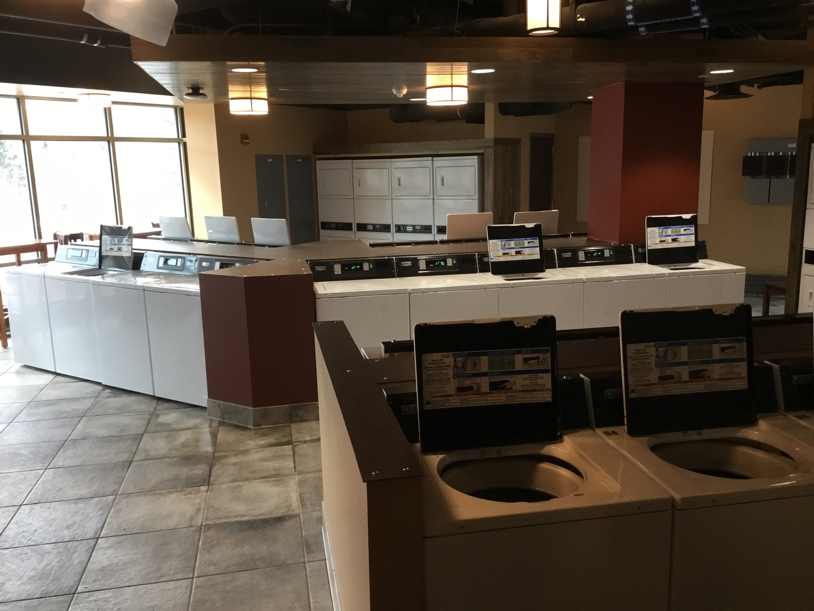
2017 Residence Hall Capital Projects

Slide 23
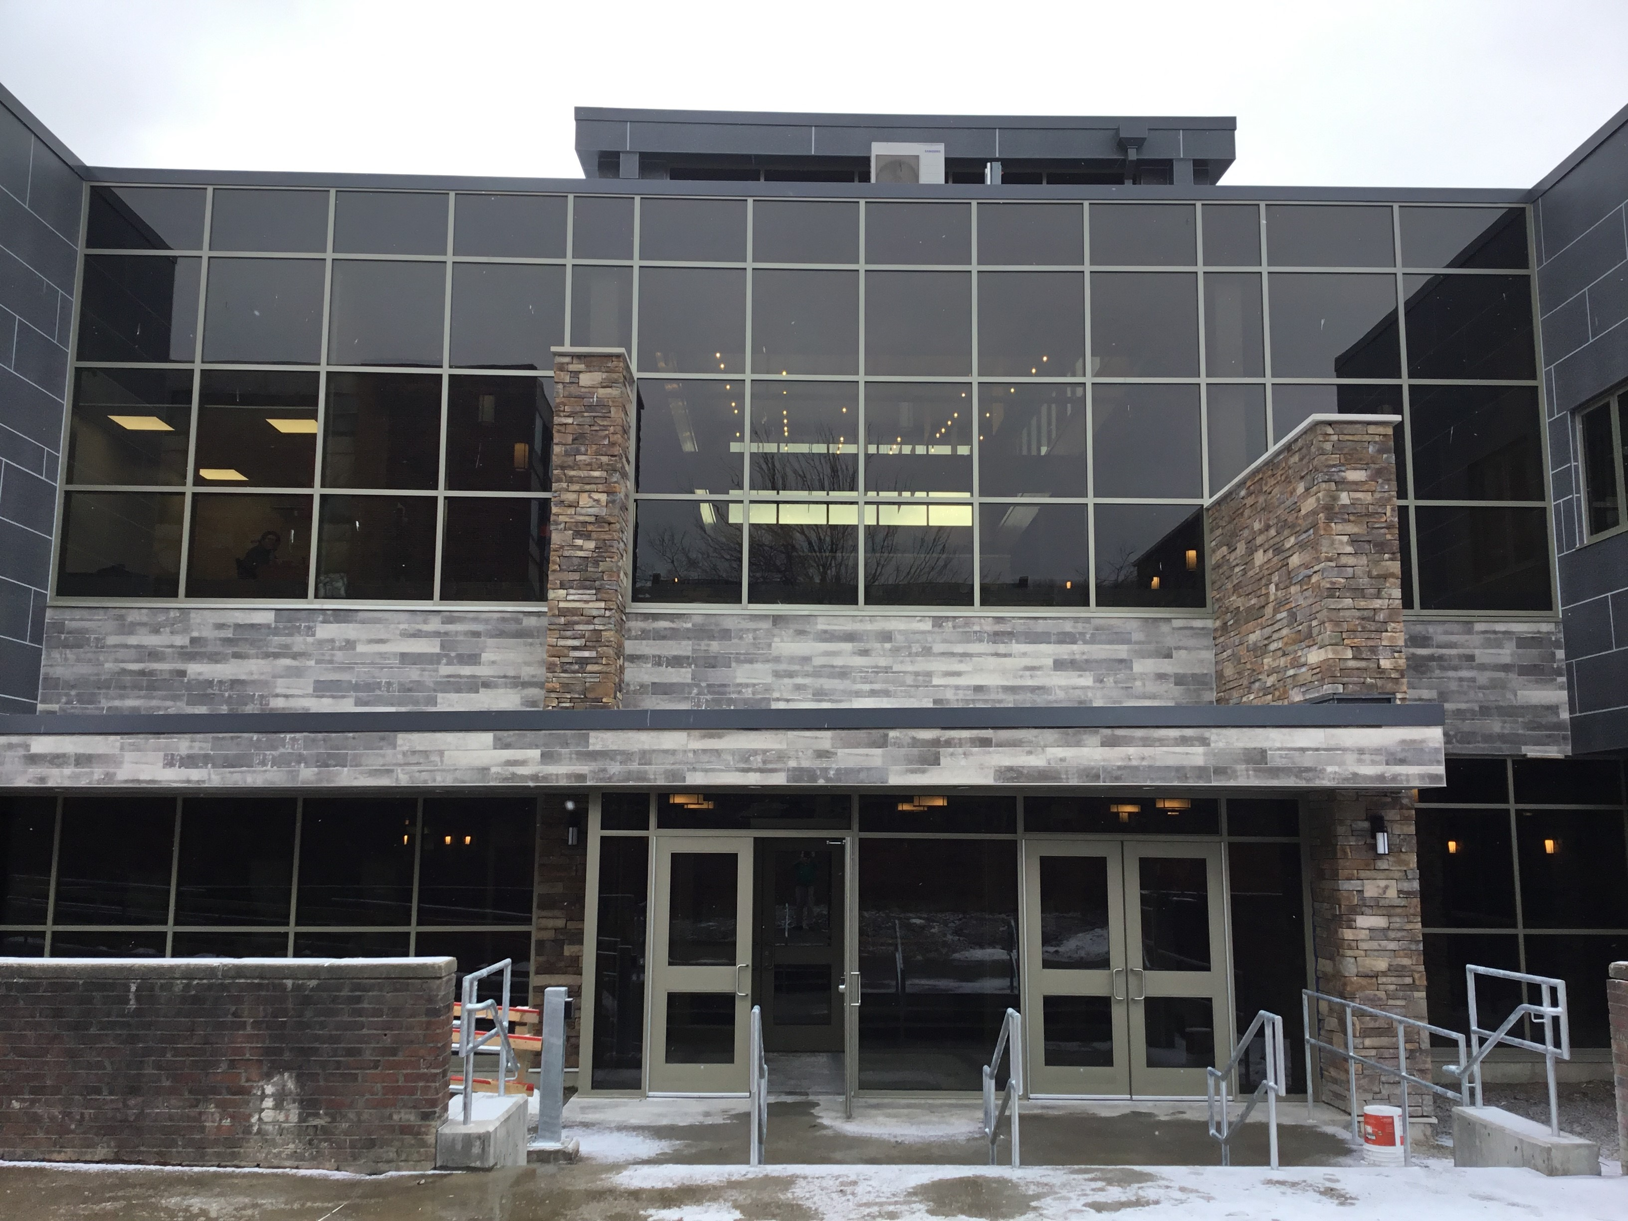
2017 Residence Hall Capital Projects

Slide 24
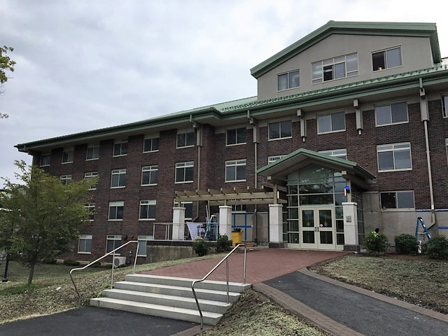
2017 Residence Hall Capital Projects
New Paltz
Project: $19.1M – Bevier Hall
Architect: Architecture +
General Contractor: PC Construction Company

Slide 25
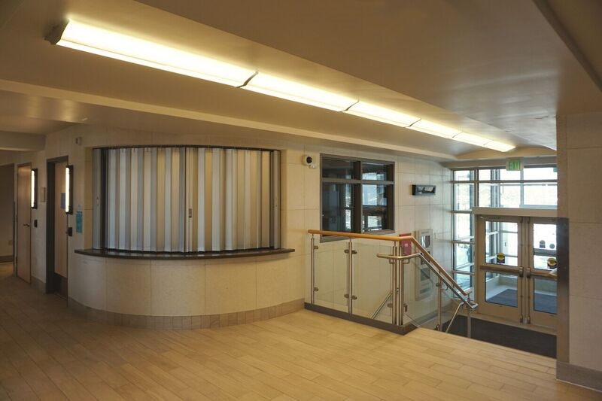
2017 Residence Hall Capital Projects

Slide 26
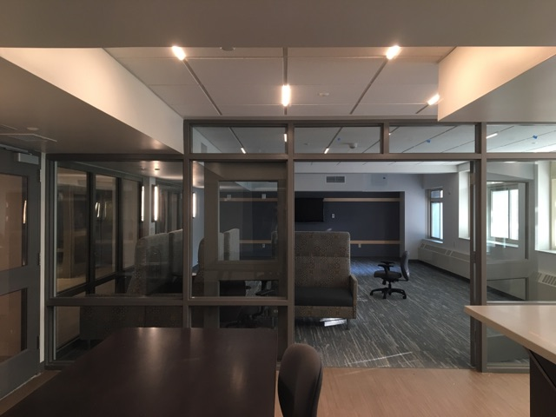
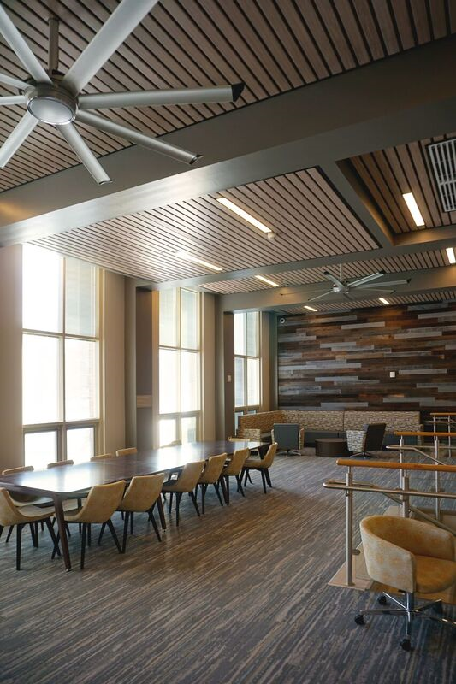
2017 Residence Hall Capital Projects

Slide 27
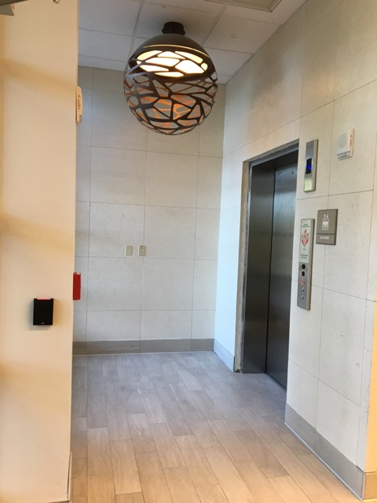
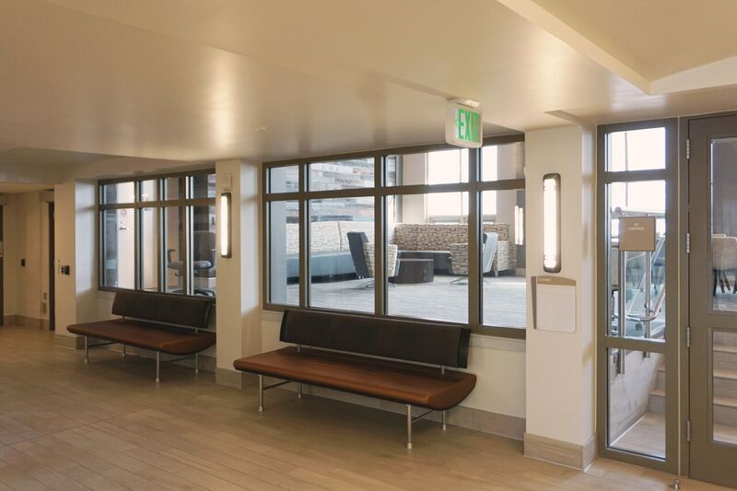
2017 Residence Hall Capital Projects

Slide 28
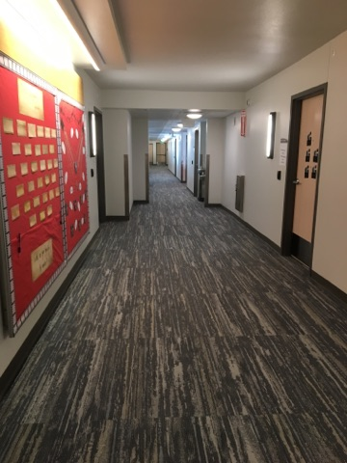
2017 Residence Hall Capital Projects

Slide 29
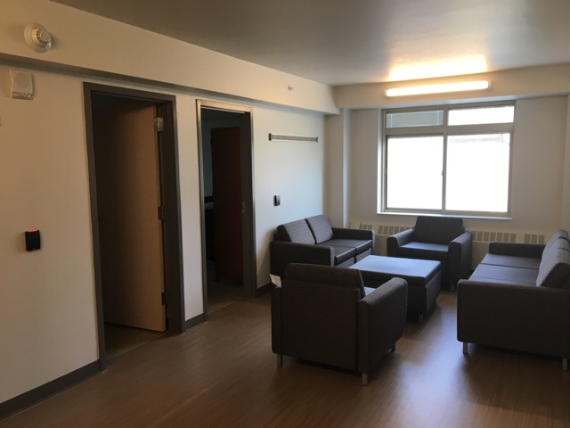
2017 Residence Hall Capital Projects

Slide 30
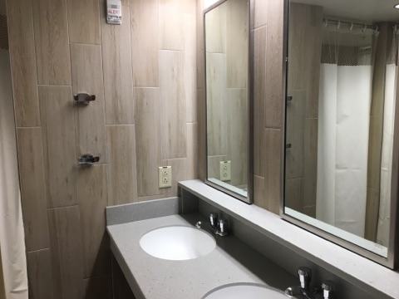
2017 Residence Hall Capital Projects

Slide 31
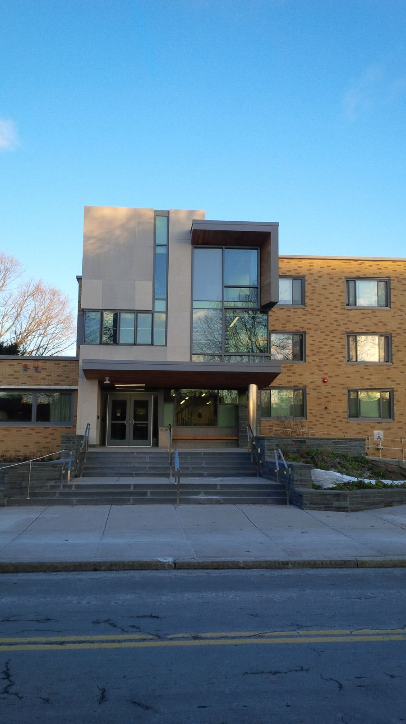
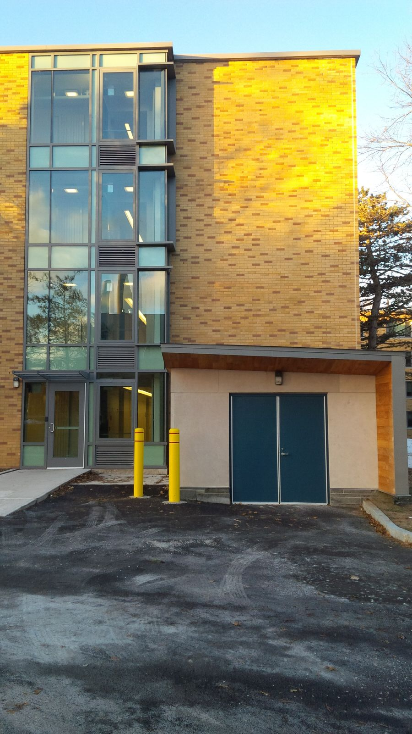
2017 Residence Hall Capital Projects
Oswego
Project: $13.4M – Scales Hall Complete Renovations
Architect: King & King Architects
General Contractor: PAC & Associates

Slide 32
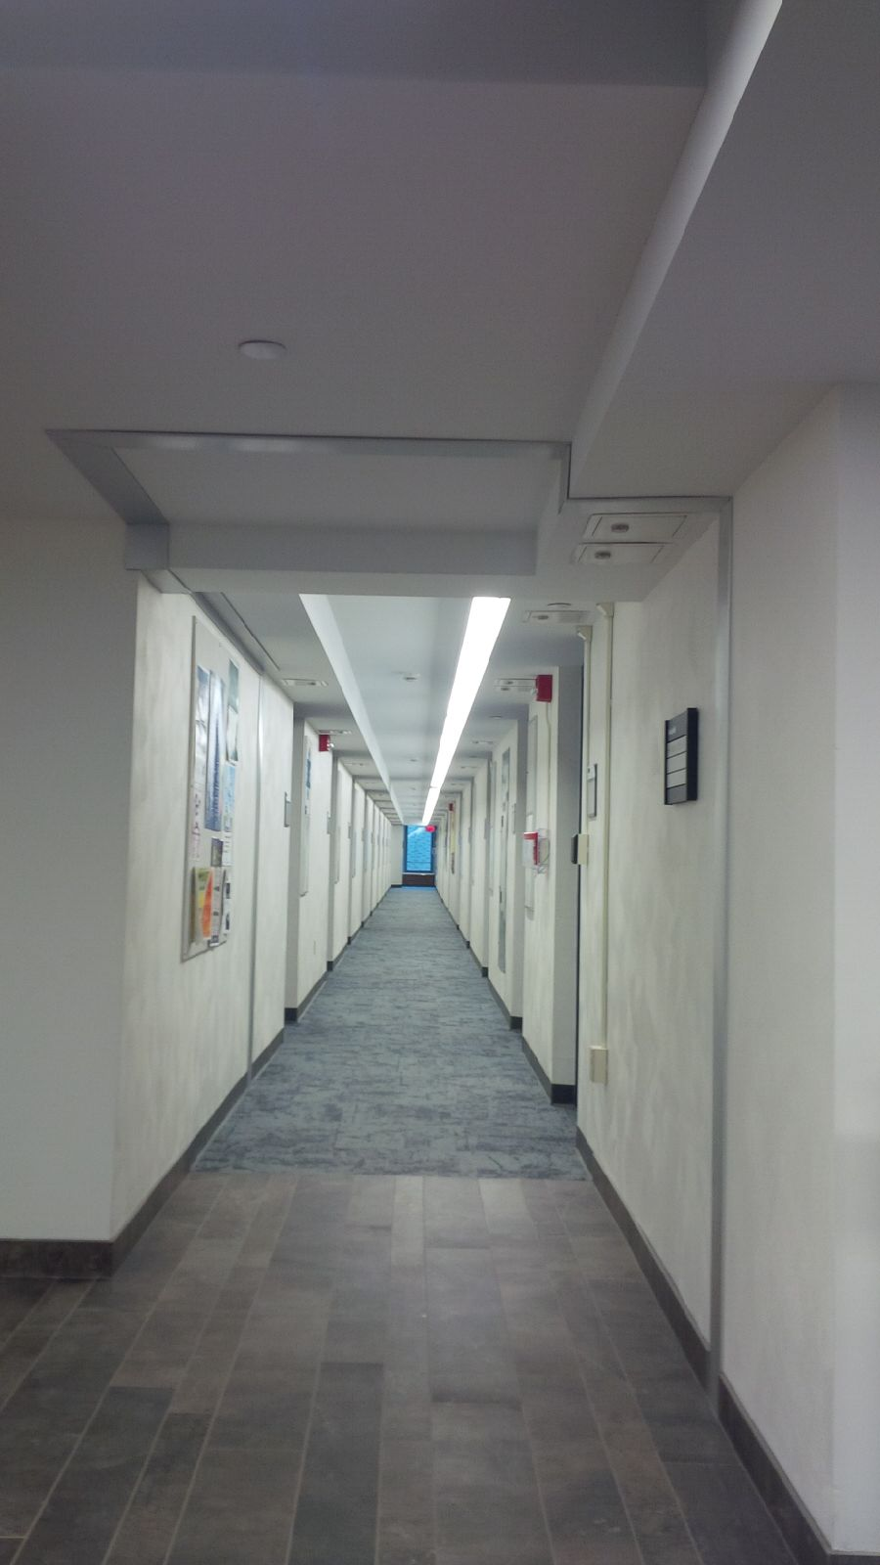
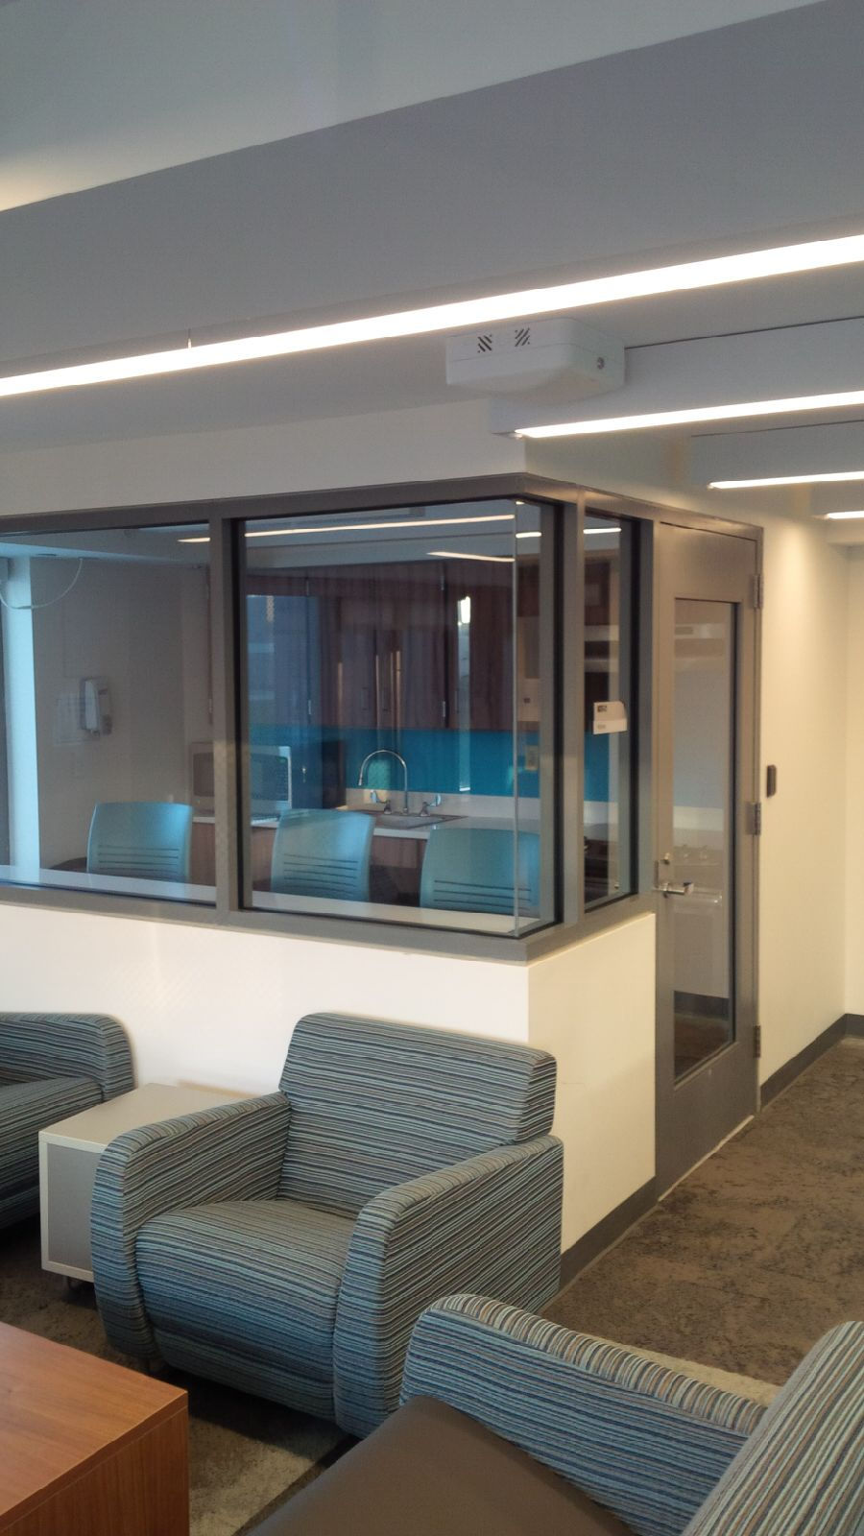
2017 Residence Hall Capital Projects

Slide 33
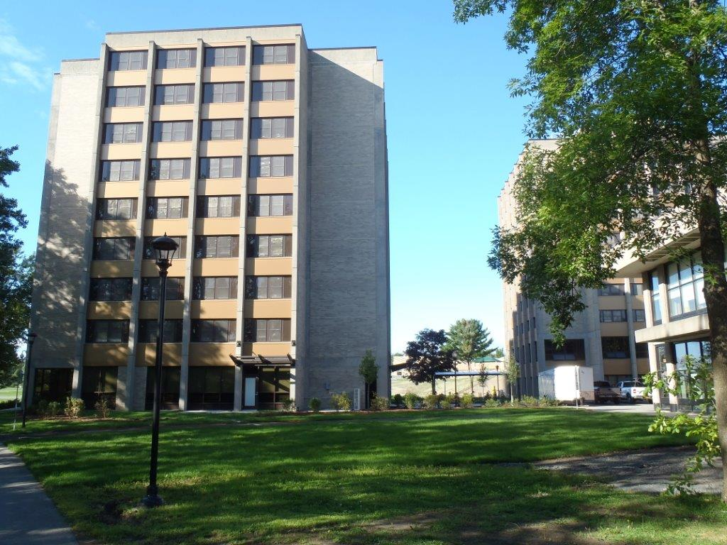
Capital Projects 2017 Completed
Plattsburgh
Project: $14.8M – Wilson Hall
Architect: JMZ Architects and Planners
General Contractor: Murnane Building Contractors Inc.

Slide 34
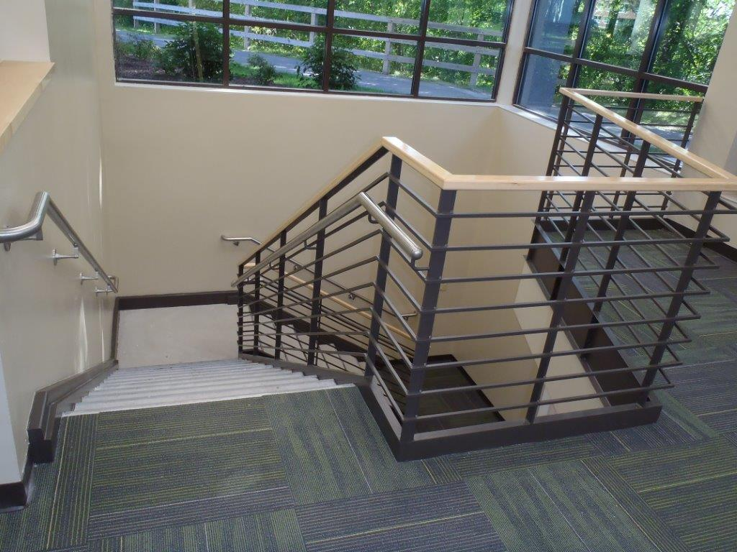
2017 Residence Hall Capital Projects

Slide 35
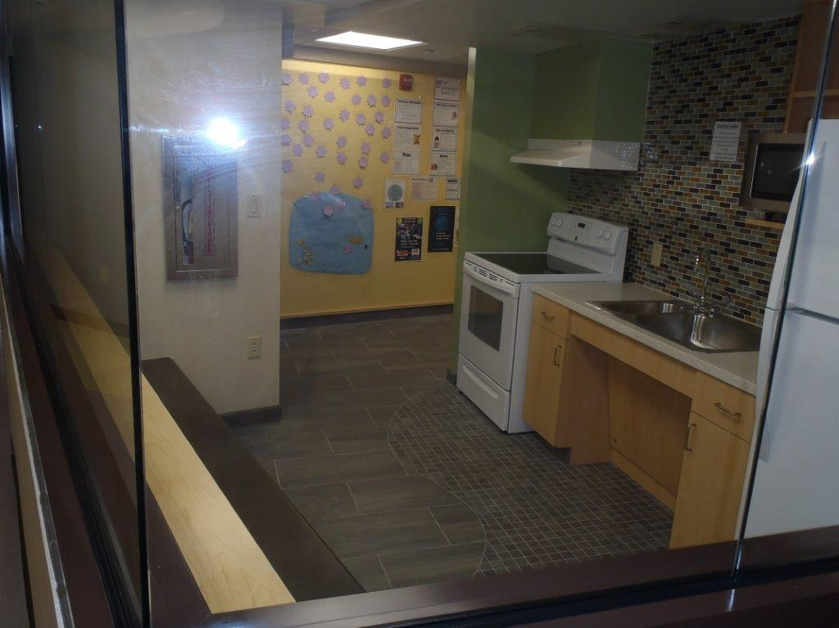
2017 Residence Hall Capital Projects

Slide 36
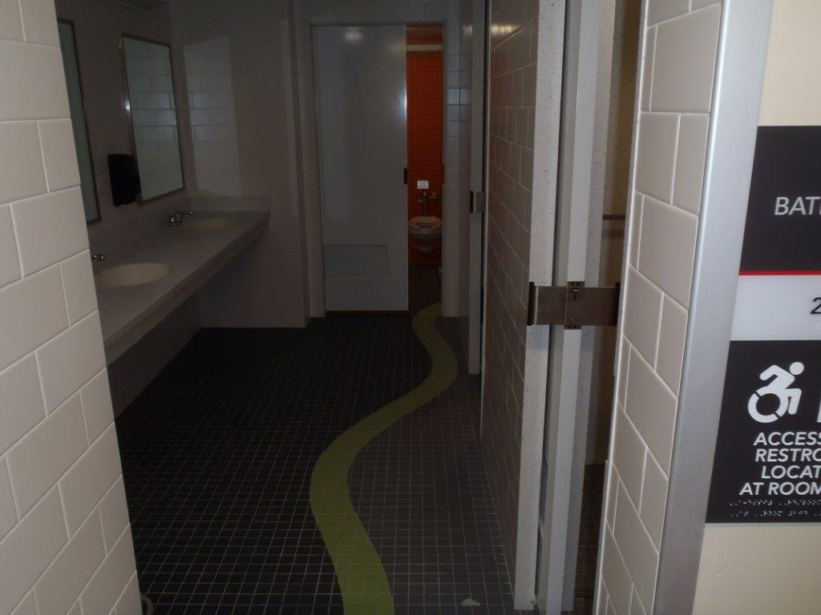
2017 Residence Hall Capital Projects

Slide 37
2017 Summer Rehabilitation Projects
Campus | Project Name | Total Projected Cost | Construction Start | Construction Completion
Albany | Elevator Modernization Eastman, Livingston & Stuyvesant Towers | $1,855,013 | 1/16 | 8/18
Albany | Alumni Quad | $1,300,000 | 7/16 | 8/17
Albany | Roof Replacements at VanRensselaer & Ryckman On Dutch Quad | $200,000 | 4/17 | 7/17
Albany | Tower Sealer Program | $1,963,729 | 5/17 | 8/20
Alfred | MacKenzie Boilers | $2,700,000 | 11/16 | 7/17
Brockport | Townhomes Attic Vent | $330,000 | 5/17 | 8/17
Brockport | Entry Doors – Perry Hall | $279,960 | 5/17 | 8/17
Brockport | Bathroom Upgrades –Mortimer Hall | $500,000 | 5/17 | 8/17
Brockport | Masonry Repairs –Perry Hall | $1,000,000 | 5/17 | 8/17
Buffalo State | Kitchen Upgrades & Bathroom Upgrades | $780,000 | 5/17 | 8/18
Buffalo State | Masonry parapet Screen wall repairs Tower 2,3 & 4 | $575,000 | 5/17 | 8/18
Buffalo State | Tower 3 Window Replacement | $2,100,600 | 5/17 | 8/17
Buffalo State | Tower 2 Asbestos Abatement Ph II | $1,480,200 | 5/17 | 8/17

Slide 38
2017 Summer Rehabilitation Projects
Campus | Project Name | Total Projected Cost | Construction Start | Construction Completion
Buffalo Univ | Red Jacket Exterior Stairs | $500,000 | 6/17 | 8/17
Buffalo Univ | Phase 2 of 5 – Renovations of 22 Bathrooms | $2,402,687 | 5/17 | 8/17
Delhi | Dubois Hall Kitchen | $245,450 | 5/17 | 8/17
Delhi | Murphy Hall Roof | $680,000 | 5/17 | 8/17
Delhi | Replace Heating Systems Russell & Dubois | $1,375,000 | 5/17 | 8/18
New Platz | Esopus Roof Replacement | $1,213,500 | 6/17 | 8/17
New Paltz | Bouton & Gage Roof Replacement | $1,154,000 | 5/17 | 8/17
Oneonta | 2017 Transformer Inspection & Cleaning | $50,000 | 4/16 | 5/17
Oneonta | Upgrade Controls Curtis / MacDuff Hall | $15,054 | 5/17 | 8/17
Oneonta | Medium Temp Water System Upgrades | $46,212 | 5/17 | 8/17
Oneonta | Replace domestic waterline Huntington Hall | $49,279 | 5/17 | 8/17

Slide 39
2017 Summer Rehabilitation Projects
Campus | Project Name | Total Projected Cost | Construction Start | Construction Completion
Oneonta | Hayes Hall Sisal | $320,000 | 5/17 | 8/17
Oneonta | Wilber Hall WiFi | $130,000 | 5/17 | 8/17
Oneonta | FA Panel Replacements | $140,000 | 5/17 | 8/17
Oneonta | Huntington Hall Roof Replacement | $320,000 | 5/17 | 8/17
Potsdam | Lehman Hall Bathrooms | $120,000 | 5/17 | 8/17
Purchase | Olde Exterior Rehab Phase 1 | TBD | 5/17 | 8/17
Purchase | Outback Bathroom Rehab | $202,400 | 5/17 | 8/20
Purchase | Big Haus Bathroom Rehab and Room | $2,700,000 | 5/17 | 8/17
Purchase | Fort Awesome Masonry Repairs | $1,389,056 | 5/17 | 8/18
Utica/Rome | Adirondack Hall Roof Replacement | $995,500 | 5/17 | 8/17
 | Total | $29,112,640

Slide 40
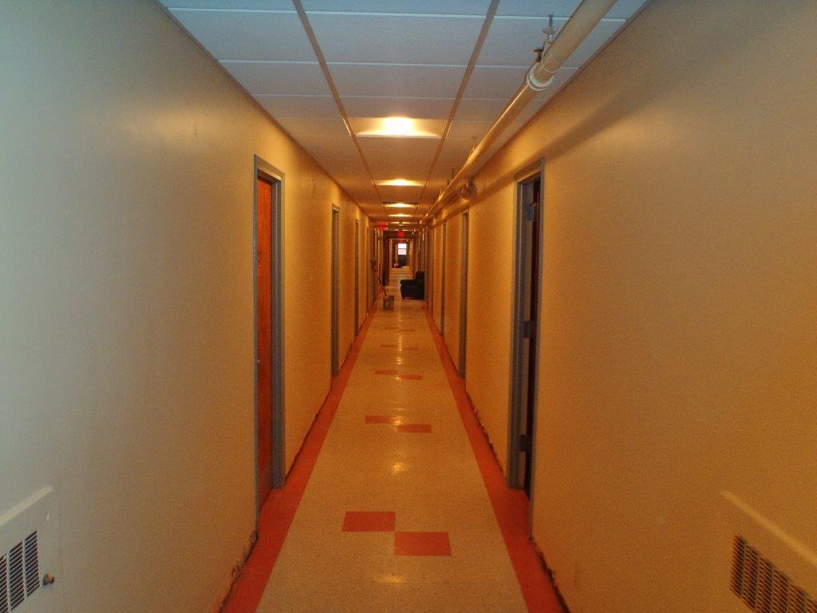
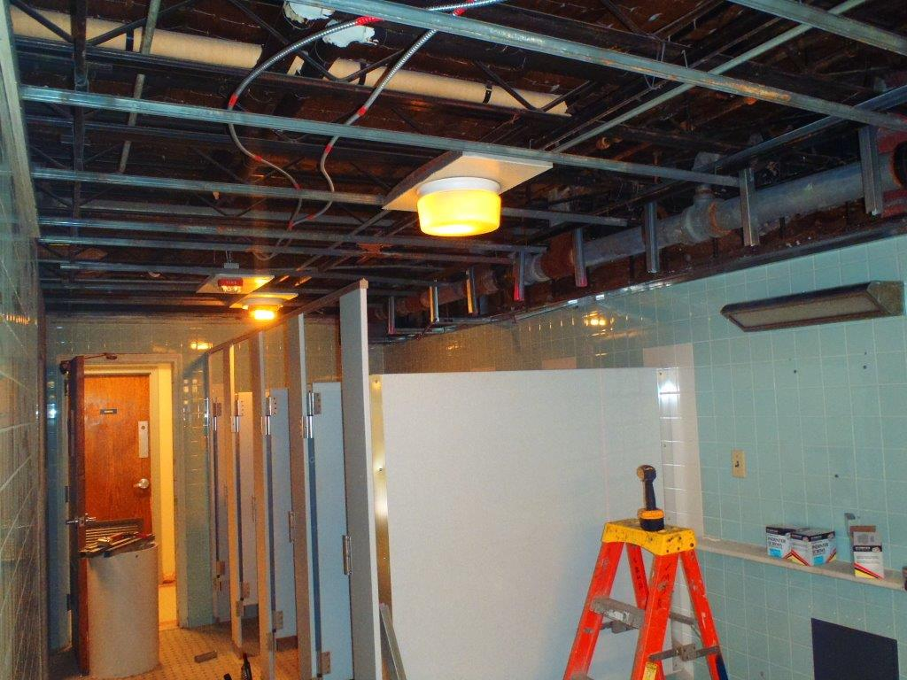
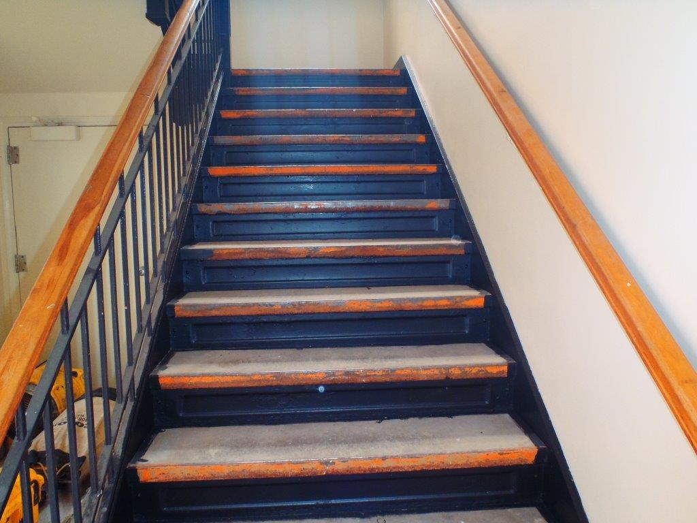
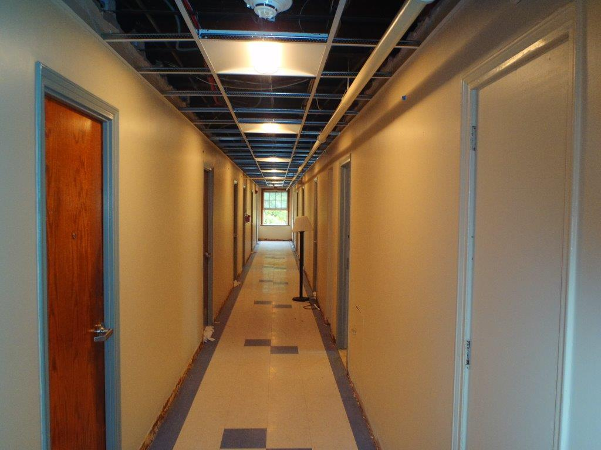
Albany – Alumni Quad
Albany
Project: $1,300,000 Alumni Quad Upgrades
Designer: Trudeau Architects
General Contractor: VMJR Companies LLC

Slide 41
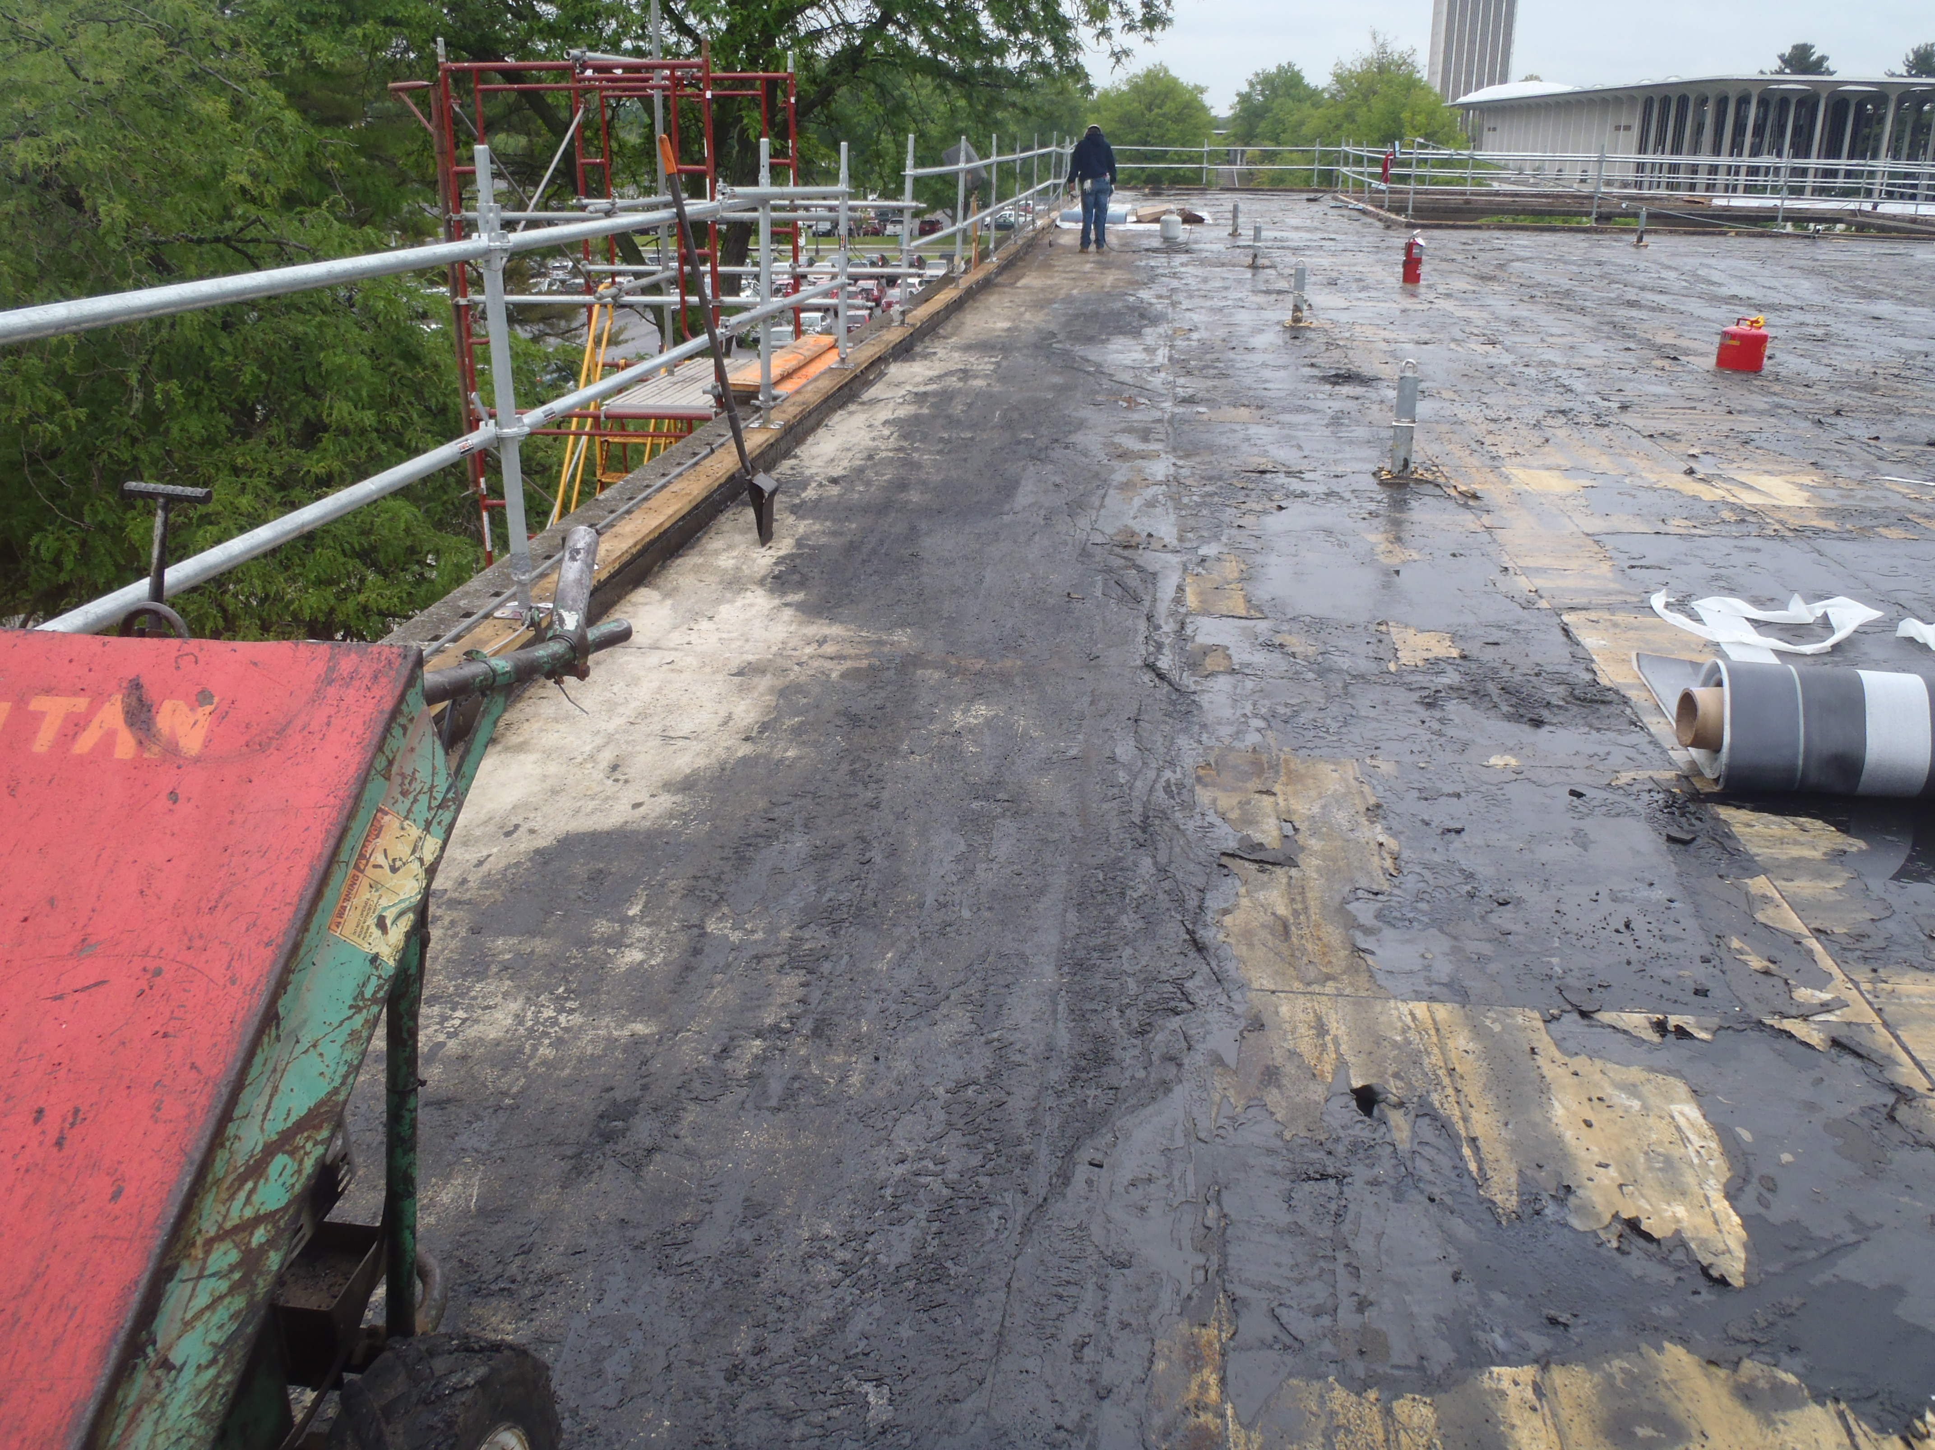
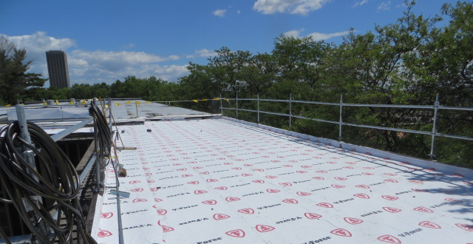
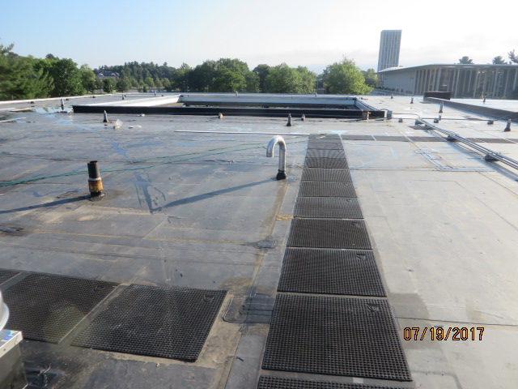
Albany – Dutch Quad
Albany
Project: $200,000 Dutch Quad Roof Replacement
Designer: Architecture +
General Contractor: Titan Roofing Inc.

Slide 42
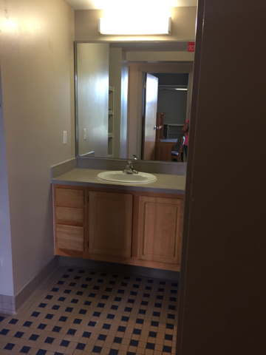
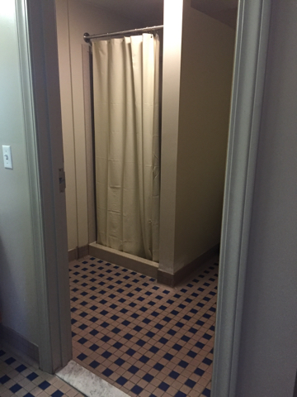
Buffalo State – Moore Hall
Buffalo State
Project: $780,000 Moore Bathroom Upgrades
Designer: Kideney Architects PC
General Contractor: Sicoli ConstructionServices

Slide 43
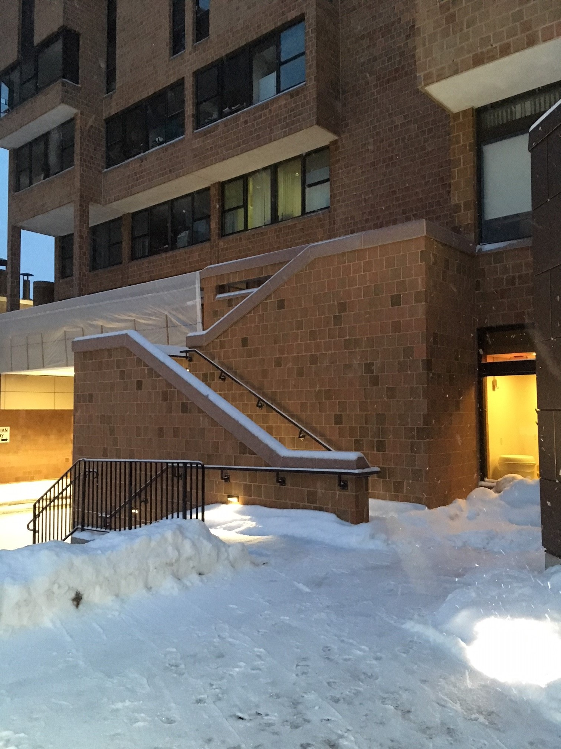
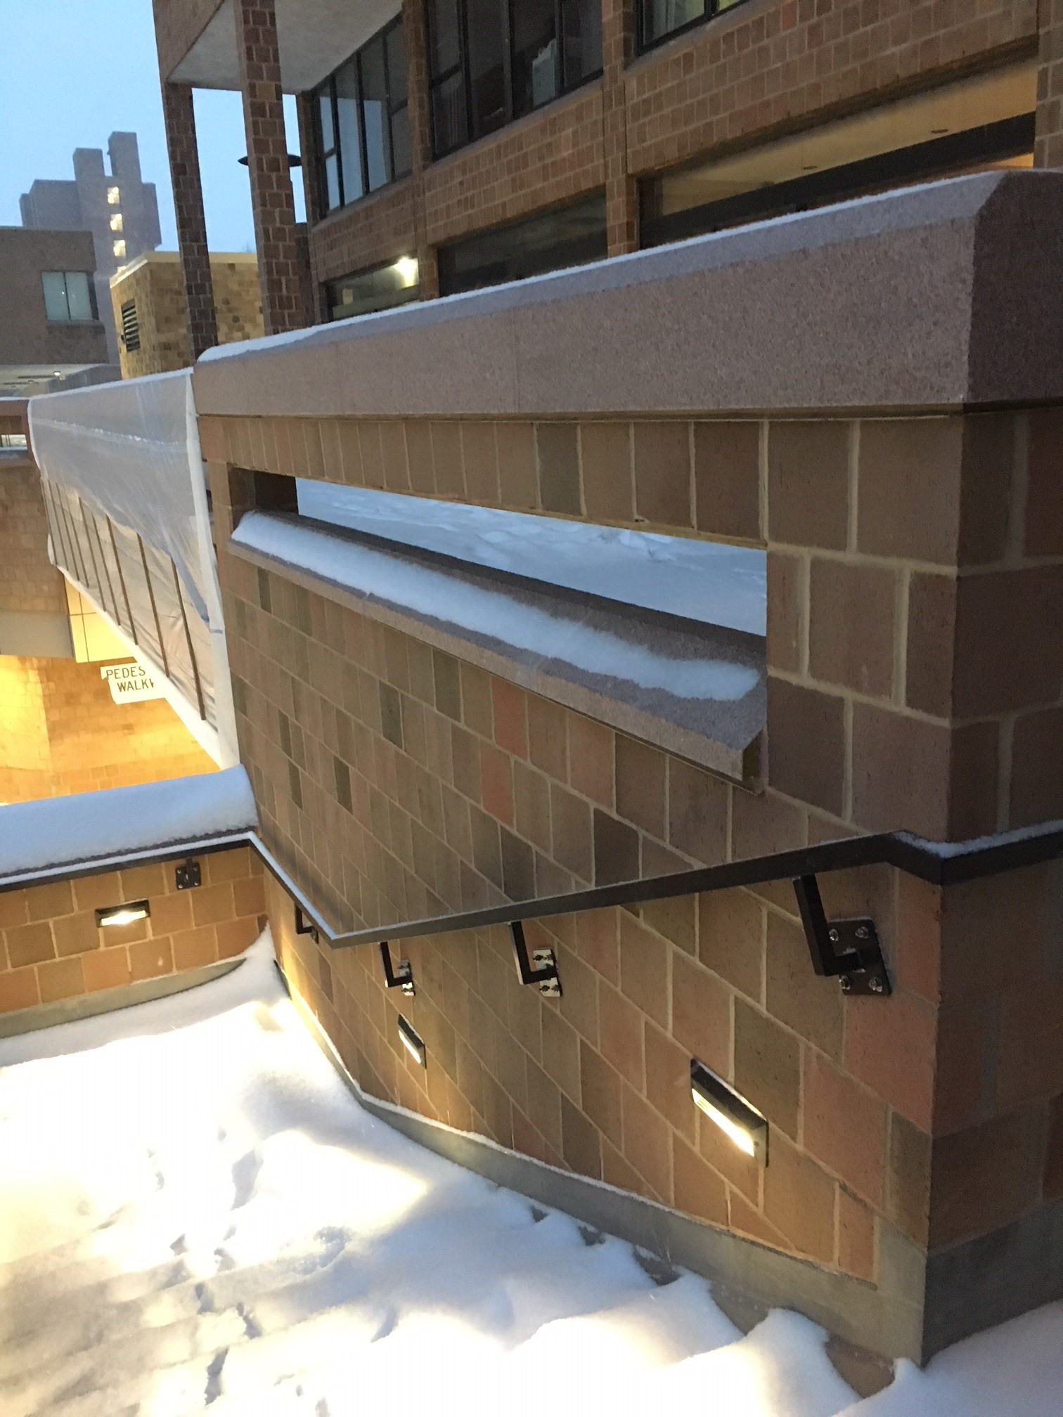
SUNY Buffalo – Red Jacket Hall
SUNY Buffalo
Project: $780,000 Red Jacket Exterior Stairs
Designer: DiDonato Engineering & Architects
General Contractor: Highland Masonry & Restoration

Slide 44
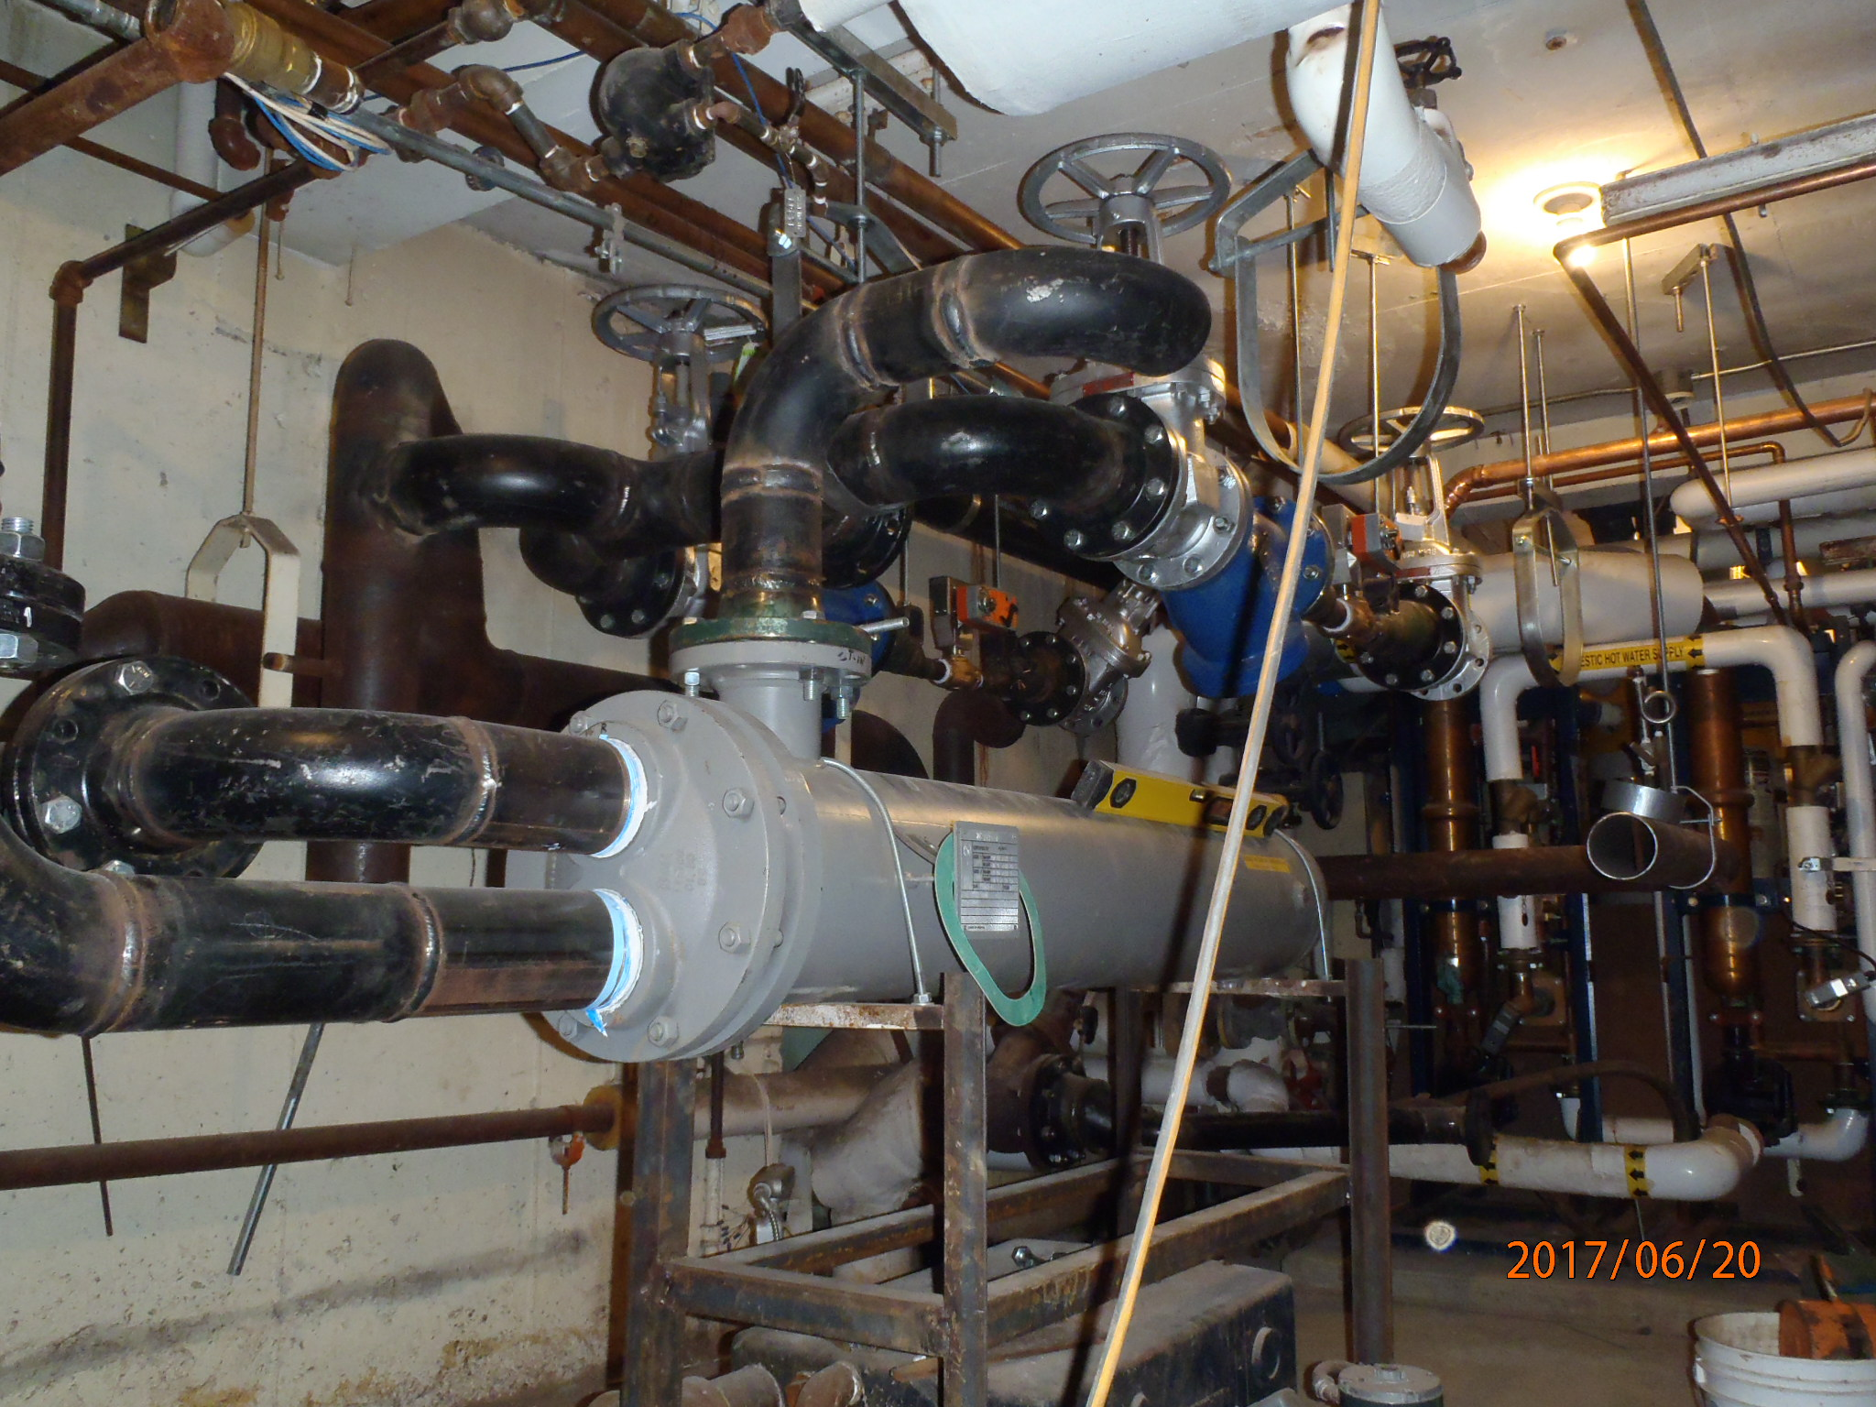
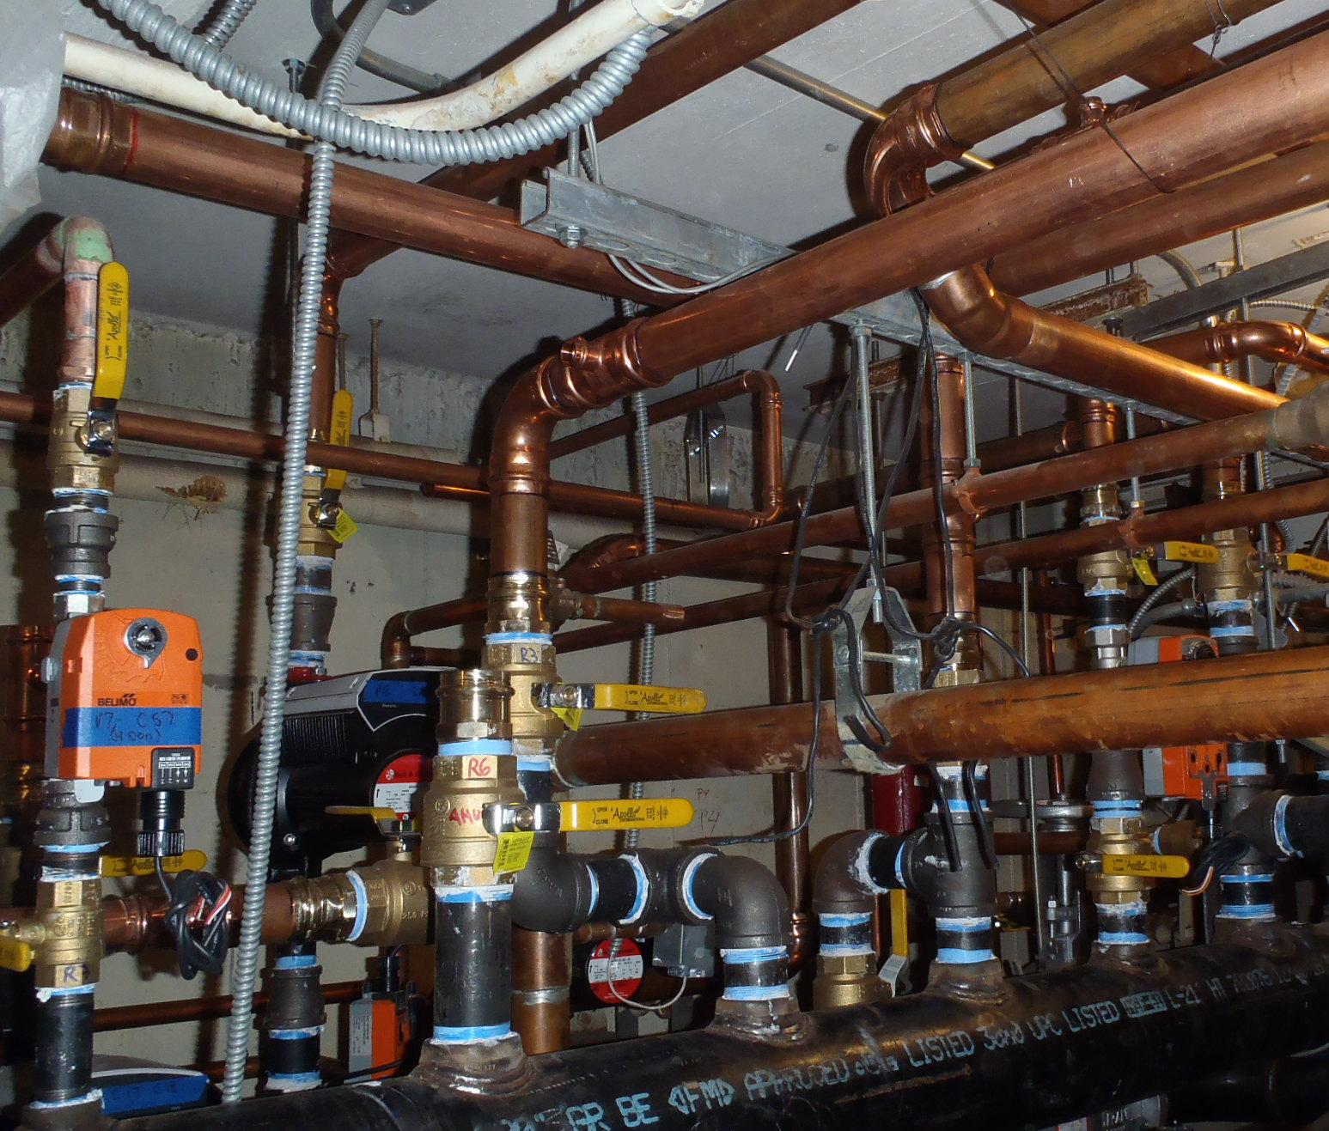
Delhi – Dubois Hall
Delhi
Project: $1,375,000 Dubois Hall Heating System Replacement
Designer: SMRT Architects & Engineers
General Contractor: Wilkins Mechanical Inc.

Slide 45
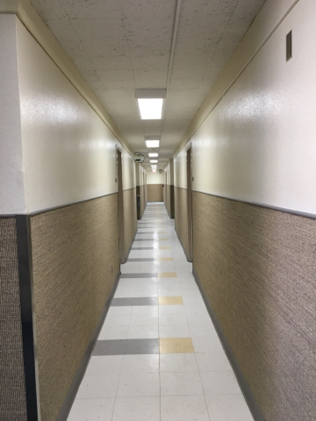

Oneonta - Hayes Hall
Oneonta
Project: $320,000 Hayes Hall Sisal Floor Replacement
Designer: Architecture +
General Contractor: Aktor Corporation

Slide 46




Utica / Rome – Adirondack Hall
Utica / Rome
Project: $995,500 Adirondack Hall Roof Replacement
Designer: DASNY
General Contractor: Mattoon Construction Services

Slide 47



Potsdam – Lehman Hall
Potsdam
Project: $120,000 Lehman Hall Bathrooms
Designer: Nelson Associate Architects
General Contractor: Northern Tier Contracting Inc.

Slide 48
2018 SUNY Construction Statistics
2018 SUNY Summer Renovation Projects
Number of 2018 summer projects: 30
Dollar value of SUNY 2018 summer rehab projects: $29.4m
Average cost per summer project: $980k / project
Average project duration: 90 days
2018 SUNY Residence Hall Capital Projects
Number of renovation projects: 3
Associated dollar value: $35.8m
Associated number of beds: 512
Associated aggregate cost / project: $12m / project
Associated aggregate average cost / bed: $70k / bed
Average project duration: 2 projects – 12 months; 1 project – 8 months
Number of new construction projects: 1
Associated dollar value: $23.8m
Associated project cost / bed: $93k/bed; Associated construction cost / bed: $81k/bed

Slide 49
2018 Residence Hall Capital Projects
Campus | Project Name | Projected Total Cost | Anticipated Construction Complete
Brockport | New 250 Bed Residence Hall | $23.8 | 06/18
Buffalo State | Bishop Hall Renovation | $16.1 | 06/18
Canton | Rushton Hall East Wing Renovation | $4.4 | 06/18
Plattsburgh | McComb Hall Renovation | $15.3 | 06/18
 | TOTAL | $59.6

Slide 50

New Building Schedule
Duration: 39 Months

Slide 51

SUNY Brockport New DB Residence Hall

Slide 52
SUNY Brockport New DB Residence Hall
Customer Request
June 14, 2016
June 24, 2016
DB Team Selected
December 20, 2016
May 22, 2017
October 1, 2016
Bridging Consultant Engaged
Construction Start
Design Complete
August 18, 2017
Substantial Completion
Projected July 3, 2018
July 14, 2016
DB Team Advertisement
DB Proposals Received
November 30, 2016
Bridging Documents Complete
DB Contract Executed
March 22, 2017
Duration: 25 Months

Slide 53



SUNY Brockport New DB Residence Hall
Brockport
Project: $23.8m New 256 Bed Residence Hall
Design Builder: Purcell Construction / Mach Architects

Slide 54

SUNY Brockport New DB Residence Hall

Slide 55

SUNY Brockport New DB Residence Hall

Slide 56

SUNY Brockport New DB Residence Hall

Slide 57

SUNY Brockport New DB Residence Hall

Slide 58

SUNY Brockport New DB Residence Hall

Slide 59

SUNY Brockport New DB Residence Hall

Slide 60

SUNY Brockport New DB Residence Hall

Slide 61

SUNY Brockport New DB Residence Hall

Slide 62

SUNY Brockport New DB Residence Hall

Slide 63

SUNY Brockport New DB Residence Hall
January 30, 2018

Slide 64
Dormitory Authority Contacts
Stephen D. Curro, P.E. Managing Director, Construction
Phone: (518) 257-3271 Email: scurro@dasny.org
Paul G. Koopman Senior Managing Director, Construction
Phone: (518) 257-3343 Email: pkoopman@dasny.org
Louis R. Cirelli, P.E. Director, Procurement
Phone: (518) 257-3276 Email: lcirelli@dasny.org
Sandra L. Daigler, R.A. Director, Planning, Design & QA - Upstate
Phone: (518) 257-3275 Email: sdaigler@dasny.org
Stephen J. Rosenthal R.A. Director, Planning, Design & QA - Downstate
Phone: (212) 273-5085 Email: srosenth@dasny.org
Timothy P. McGrath Director, Construction – Upstate
Phone: (518) 257-3198 Email: tmcgrath@dasny.org
Michael N. Stabulas P. E. Director, Construction – Downstate
Phone: (212) 273-5090 Email: mstabula@dasny.org

Slide 65

DASNY Website – www.dasny.org

Slide 66

Questions
PICTURE
Thank You

Slide 67


