Slide 1
EH&S Update
Physical Plant Administrators Association
Barbara A. Boyle
SUNY Office for Capital Facilities
January 29, 2014

Slide 2
Regulatory Agendas (DEC, DOL, DOS)
Training Grant Opportunities
Emergencies
Vermiculite
Air Regs
Trenching

Slide 3
Regulatory Agenda - DEC
More air changes to adopt federal regulations
Emissions standards for motor vehicles to match with CA
Pesticides
  Federal requirements
  Worker Protection Rules
  May remove some “minimal risk pesticides”
Chemical bulk storage revamp
Petroleum bulk storage revamp

Slide 4
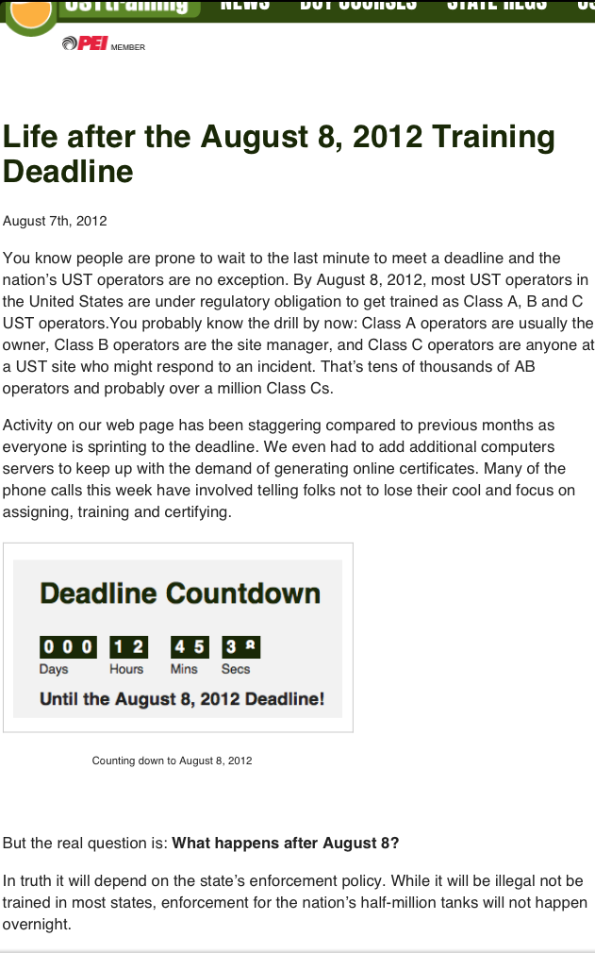
Petroleum Bulk
Storage
New rules are on the
horizon, but despite
all sort of marketing,
they are not in NYS yet…..

Slide 5
NYS is Revising all PBS and CBS Rules
Operator classes and training
Definition of petroleum
Tank operators vs property owners
Prohibit deliveries to red tagged tanks

Slide 6
Petroleum spills must be reported to the NYS Spill Hotline (1-800-457-7362) within 2 hours of discovery, except spills which meet ALL of the following criteria:
Less than 5 gallons; and
Contained and under the control of the spiller (paved is contained, gravel is not); and
The spill has not and will not reach the State's water or any land); and
The spill is cleaned up within 2 hours of discovery.

Slide 7
Agenda - Department of Labor
Update to reflect federal standards

Slide 8
Hazard Communication –
GHS Update
New look to labels.
New pictograms on labels.
More standardized Safety Data Sheets.
  Better Safety Data Sheet information.

Slide 9
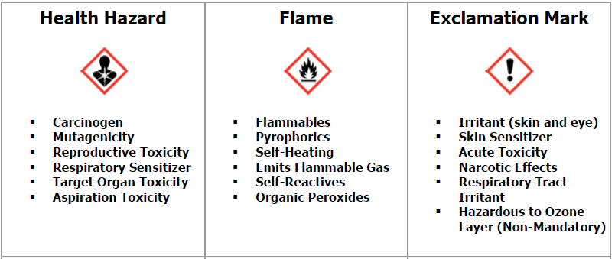

Slide 10
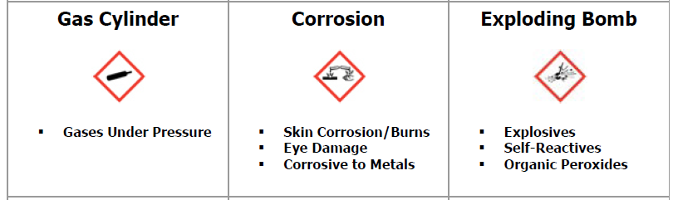

Slide 11
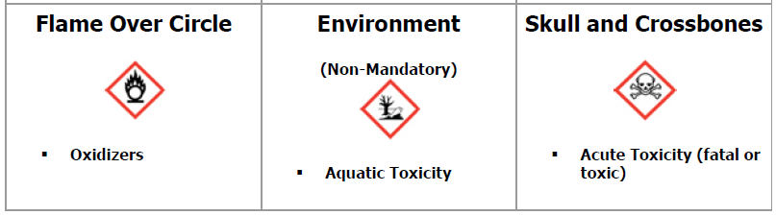

Slide 12
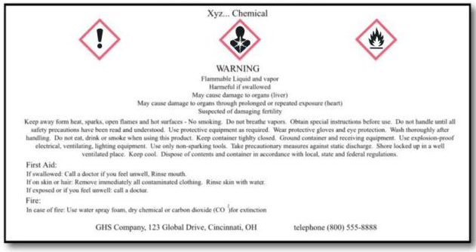
Label Example

Slide 13
Material Safety Data Sheet
Safety Data Sheet
standardized format and content

Slide 14
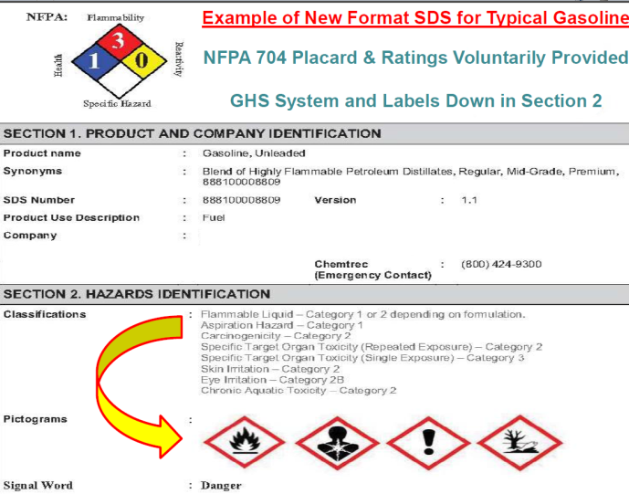
Product XYZ

Slide 15
Agenda - Department of State
Changes to code enforcement training requirements
Part 1203
  State Energy Code
  Delete county and local government annual reports

Slide 16
Part 1204
  Includes some of the 1203 changes
  Prescribe form for reporting
  Post annual reports on website
Part 1205
  Changes for variances
Part 1240 – State Energy Code

Slide 17
Training Grant Opportunities
NYS CSEA Partnership
  High Pressure Vessel Safety
UUP Joint Labor Management
  Grant programs are open

Slide 18
emergency@suny.edu
Chancellor’s Office/Communications
Capital Facilities
Student Services
EH&S
University Police

Slide 19
NY-Alert
Task Force formed
Will review strengths and weaknesses
Still soliciting input
Technical support meeting in February
Recommendations in March

Slide 20
Generator Project
4 @ 800 Kw
2 @ 350 Kw
Users’ manual

Slide 21
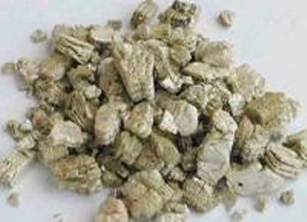
Vermiculite

Slide 22
Asbestos
≠
Vermiculite

Slide 23
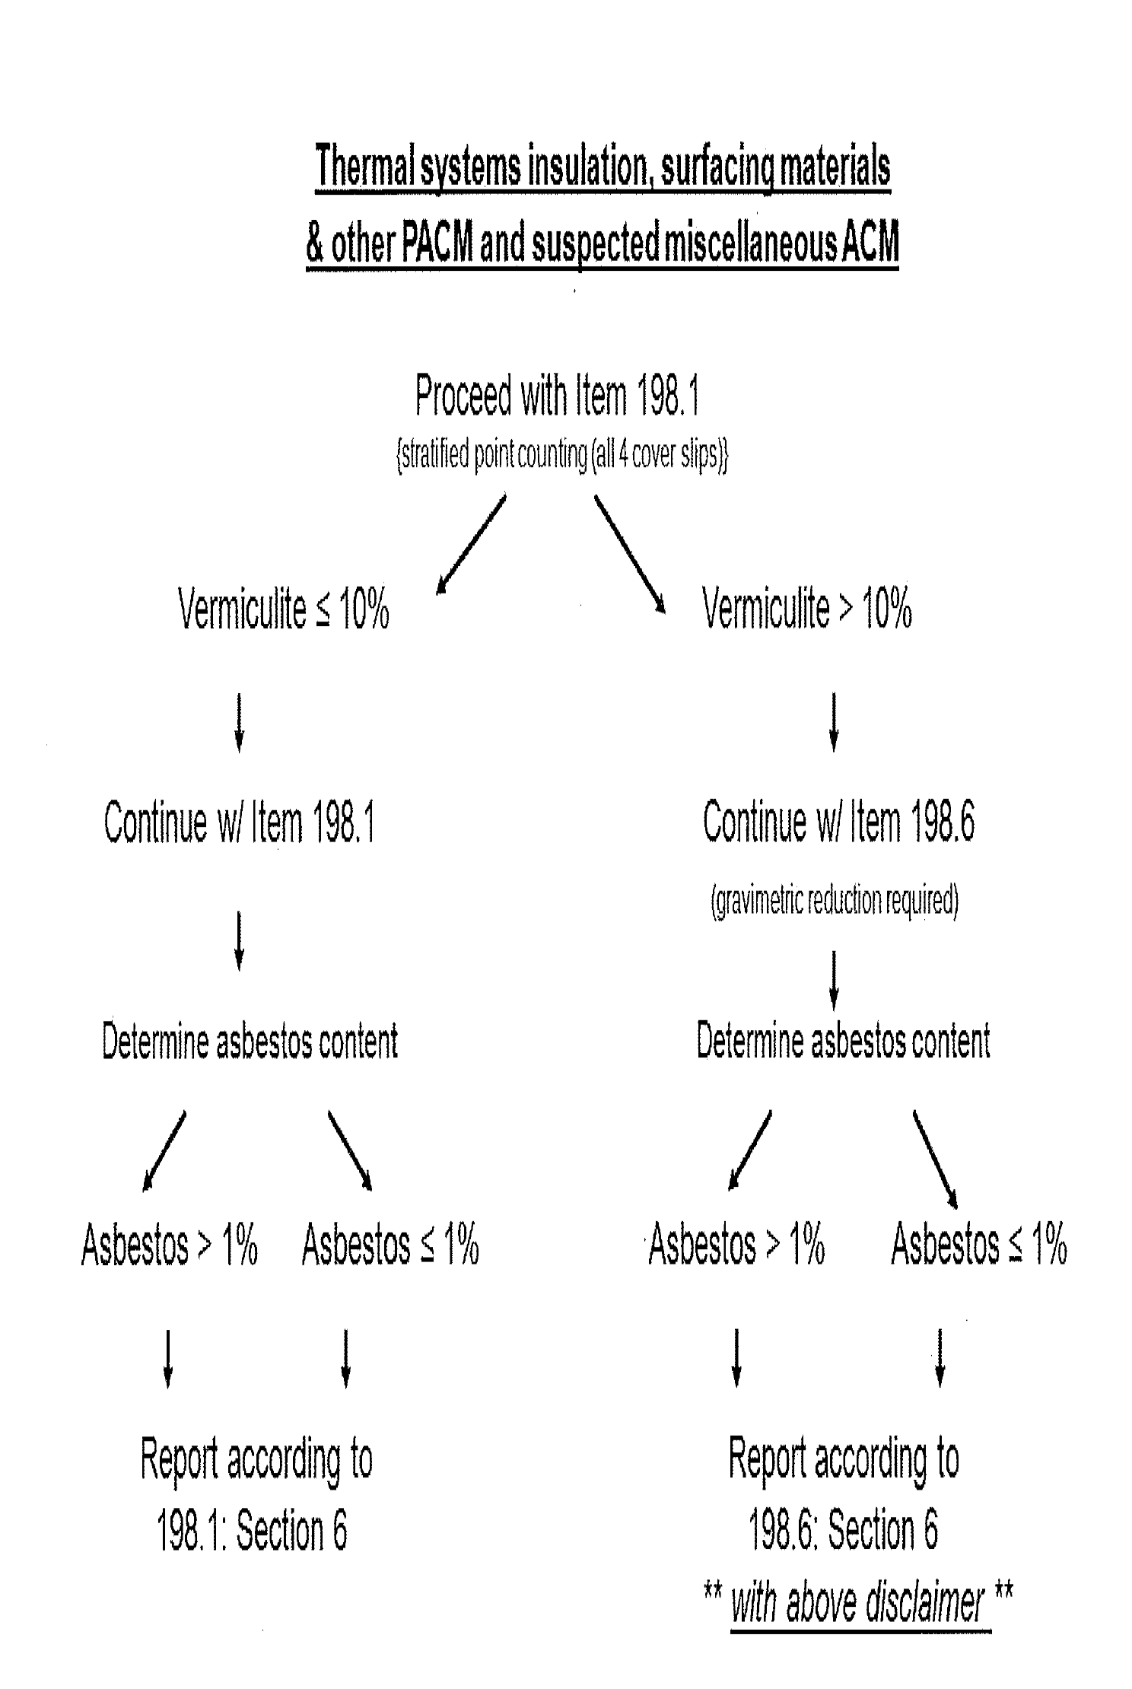
Take 2 –
July 2013
198.1 PLM
198.4 TEM
198.6 PLM after NOBS digestion
“This method does not remove vermiculite and may underestimate the level of asbestos present in a sample containing greater than 10% vermiculite.”

Slide 24
Possible Lab Result
Asbestos <1.0 %
Vermiculite >10%
Report: non-ACM*
*This method does not remove vermiculite and may underestimate the level of asbestos present in a sample containing greater than 10% vermiculite.
What???!!!

Slide 25
Building Owner Options
Postpone project
Treat as ACM
  Lower risk position
  Obviously more costly, up front
Could cautiously venture to treat under some other protocol.

Slide 26
  Treat it as regular construction dust.
    Perhaps add some air monitoring/control
  Treat it per OSHA asbestos standard.
  Treat it per an “original” method.
  For all, realize you may have to defend your decisions!

Slide 27
Wet methods only
Prompt clean up and removal of debris
Controlling emissions
No high speed tools without exhaust
No compressed air for removal

Slide 28
Considerations:
Restricted work area
Critical barriers
Impermeable drop cloths
Negative air or HEPA exhaust
Respirator Use
Tyvek Suits/Decon areas
Restrict to Asbestos Trained Workers

Slide 29
How this is playing out…..
ELAP is trying to identify and validate an acceptable method.
Takes time to validate methods (6 months?)
Float/sink method
CARB 435
Light milling options

Slide 30
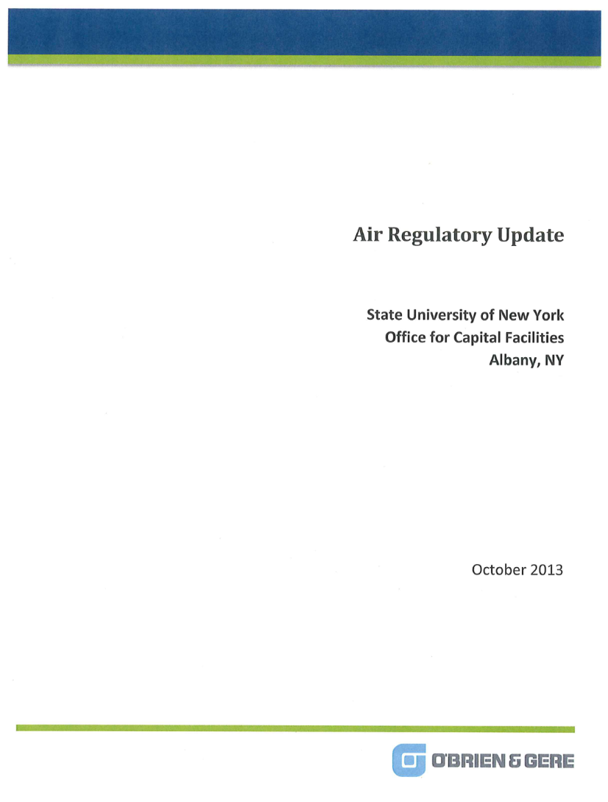
Air Regulations

Slide 31
General Format
Overview
Who is affected?
What should a campus do?
  Hyperlinks to regs
  Summary Table
  Appendix Supporting Docs

Slide 32
Institutional Boiler MACT
Gas fired – generally exempt
Oil Fired
  Notification to EPA (Jan 2014 unless already done)
  Tune up (Mar 2014, could be extended)
  Energy assessment
  Reporting Requirements
Sulfur Limitations - What to do with oil reserve?

Slide 33
Emergency Generators and Permitting
When do they need to be permitted?
What happens if I go over 500 hours per year?
What if I am using them for non-emergency use?

Slide 34
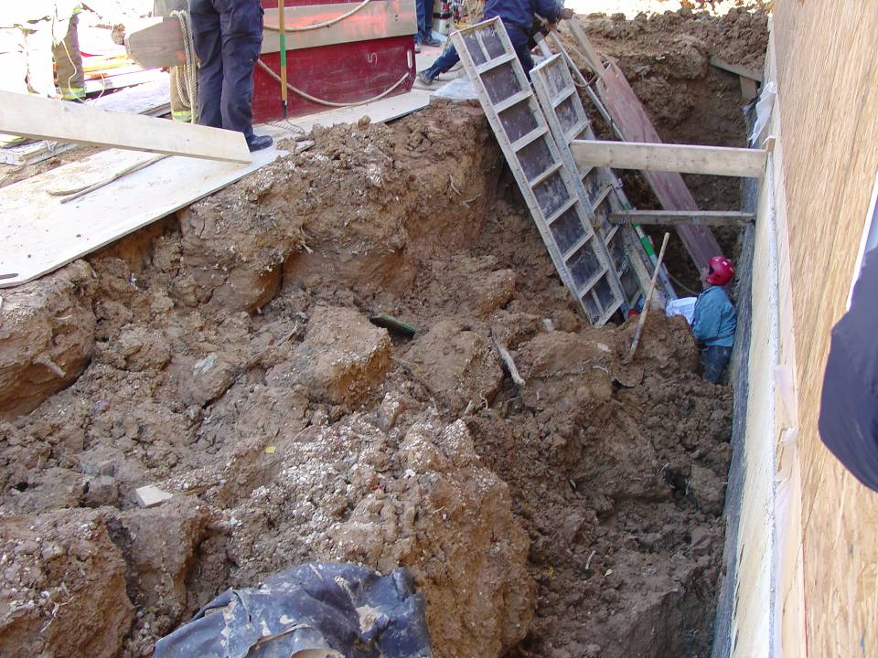
Trenching for Interested People
Some slides for this topic are from OSHA Harwood Grant projects.

Slide 35
competent
For this purposed of this part of the presentation!
INTERESTED
COMPETENT

Slide 36
Competent Person
  The designated competent person should have and be able to demonstrate the following:
    Training, experience, and knowledge of soil analysis; use of protective systems; and OSHA requirements.
    Ability to detect potential hazards.
    Authority to take prompt corrective measures to eliminate existing and predictable hazards and to stop work when required.

Slide 37
Inspections
  Inspections shall be made by a competent person and should be documented.
    Daily and before the start of each shift;
    As dictated by the work being done in the trench;
    After every rainstorm;
    After other events that could increase hazards, e.g. snowstorm, windstorm, thaw, earthquake, etc.;
    When fissures, tension cracks, sloughing, undercutting, water seepage, bulging at the bottom, or other similar conditions occur;
    When there is a change in the size, location, or placement of the spoil pile; and
    When there is any indication of change or movement in adjacent structures.

Slide 38

Moving at 45 mph….

Slide 39
Trenching Numbers
5 feet → you need protection, competent person
Egress @ 4 ft, every 25 ft
20 ft → you need a PE to design protection

Slide 40
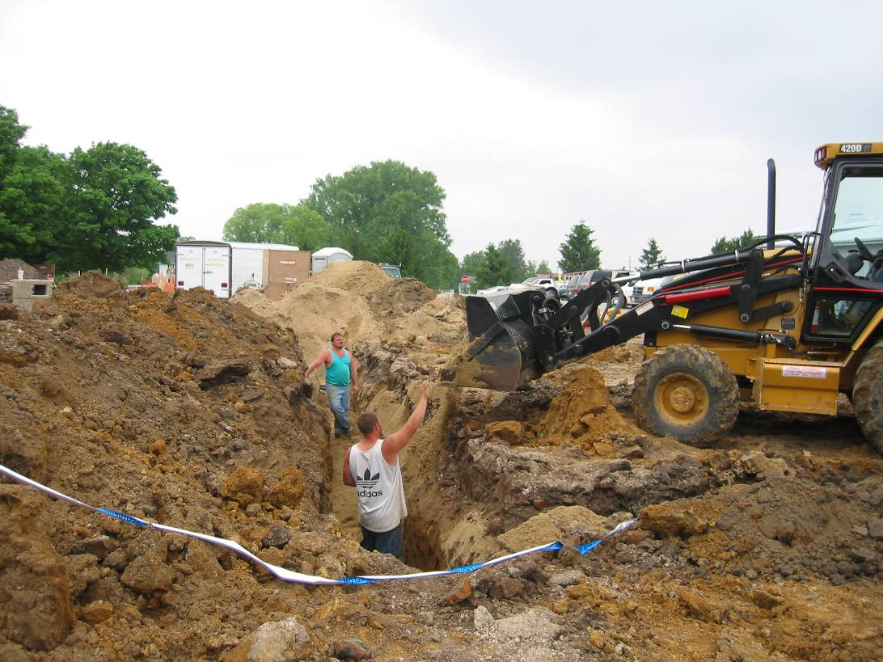
Walking Towards the Trench….

Slide 41
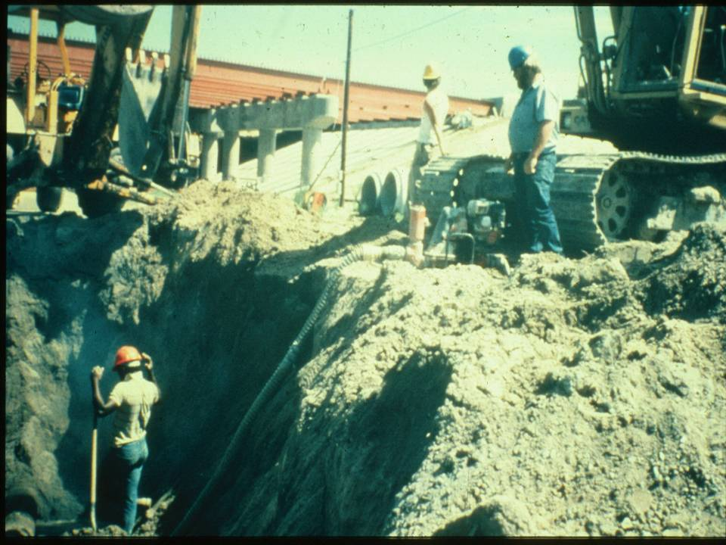
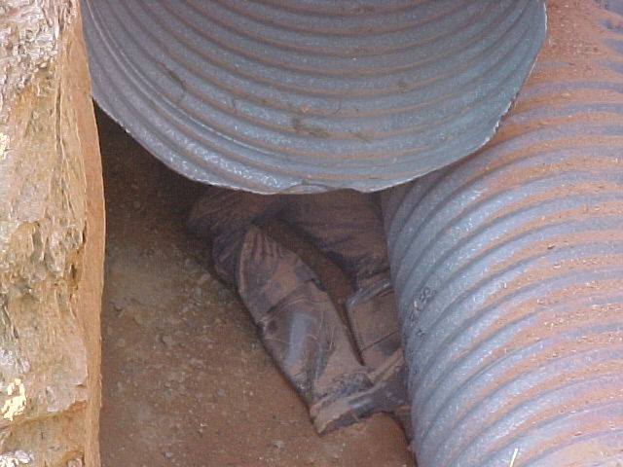
Where’s the traffic?
Is overhead work going on?

Slide 42

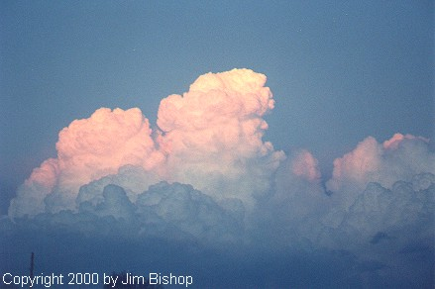
Water

Slide 43
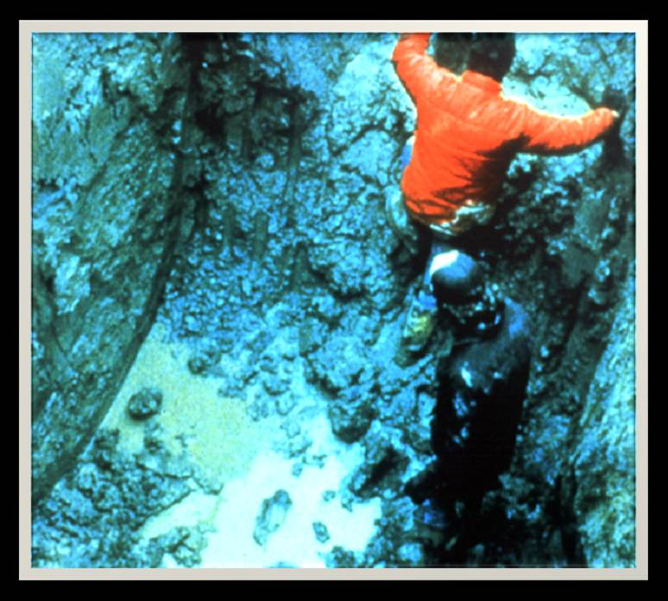
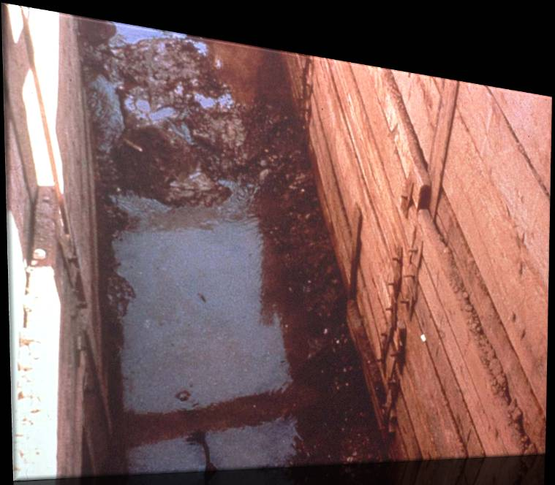
Is it wet?

Slide 44
What water brings:
It Brings Additional Weight
  Hydrostatic Pressure
It Erodes the Trench Wall
  Water movement typically moves soil
It Can Freeze and Thaw
  Resulting in cracks & false cohesion

Slide 45
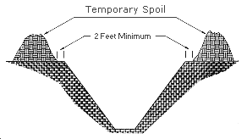
Where’s the spoil?
Top side stressors?

Slide 46
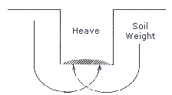
Heaving or Squeezing

Slide 47

Tension Cracks
Tension cracks usually form at a horizontal distance of 0.5 to 0.75 times the depth of the trench, measured from the top of the vertical face of the trench.

Slide 48
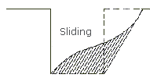
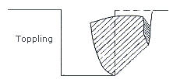

Slide 49
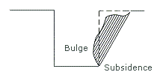
Subsidence or Buldging

Slide 50
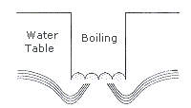
Boiling

Slide 51
How is the trench or the people protected?
Shoring
Trench boxes
Sloping and Benching

Slide 52
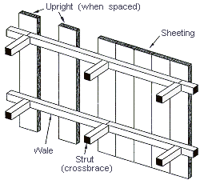
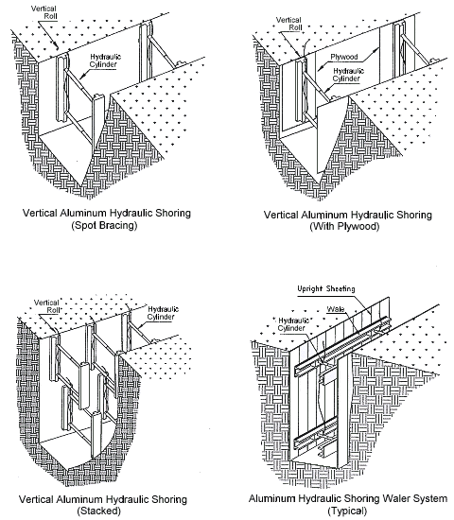
Shoring

Slide 53
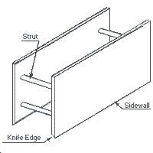
Trench Boxes – protect workers

Slide 54
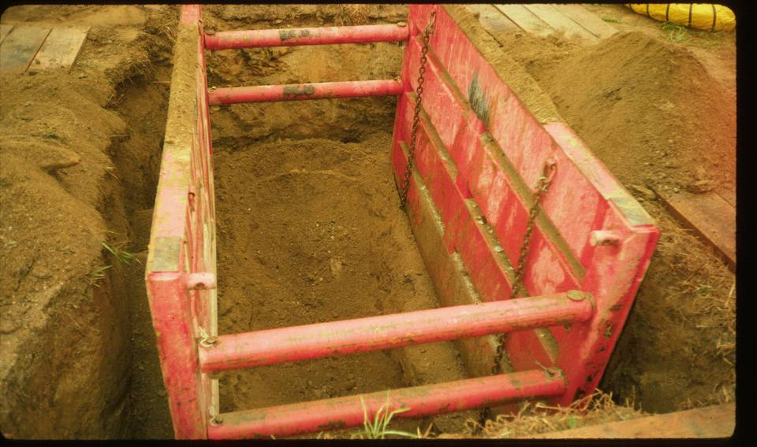

Slide 55
Backfill to prevent lateral movement of the box.
The box should extend at least 18 in above the surrounding area if there is sloping toward excavation.
Earth excavation to a depth of 2 ft below the shield is usually permitted.

Slide 56
Slope - Soils Types
Stable rock (vertical)
Type A → clays (¾:1)
Type B → angular gravel, silt (1:1)
Type C → sandy (1 ½:1)
Wet and previously disturbed soil is always more dangerous!

Slide 57
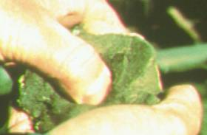
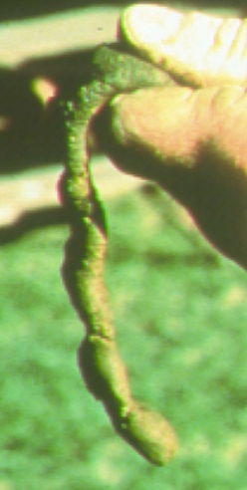

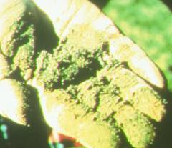
Manual Soil Testing Procedures
Thumb penetration
Ribbon test
Plasticity
Dry strength test

Slide 58
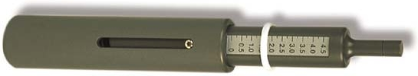
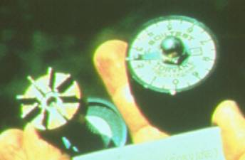
Manual Soil Testing Procedures
Penetrometer
Shearvane

Slide 59
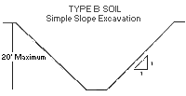
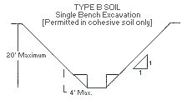
Sloping/Benching

Slide 60
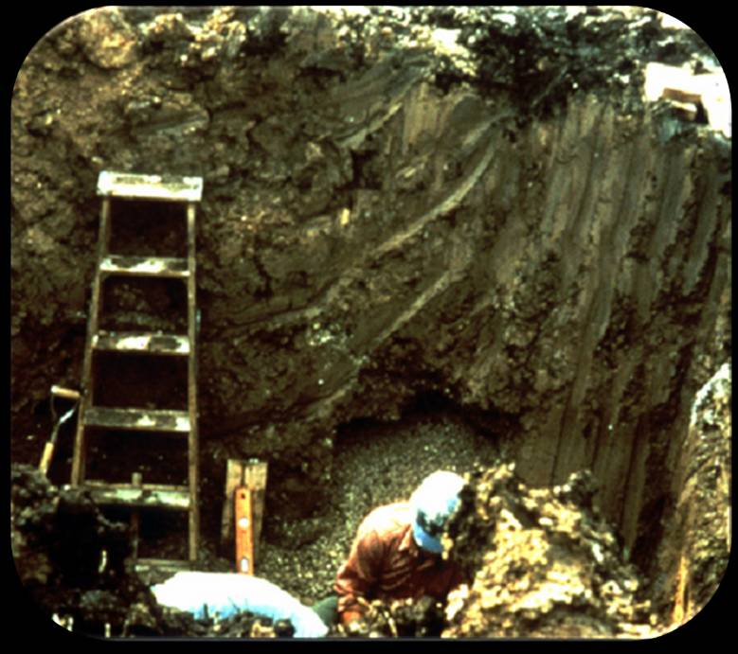
Ingress and Egress
4 feet depth
25 feet travel distance
3 ft over the top
safe

Slide 61
Hazardous Atmospheres and Confined Spaces
  Employees shall not be permitted to work in hazardous and/or toxic atmospheres. Such atmospheres include those with:
    Less than 19.5% or more than 23.5% oxygen;
    A combustible gas concentration greater than 20% of the lower flammable limit; and
    Concentrations of hazardous substances that exceed safe limits

Slide 62
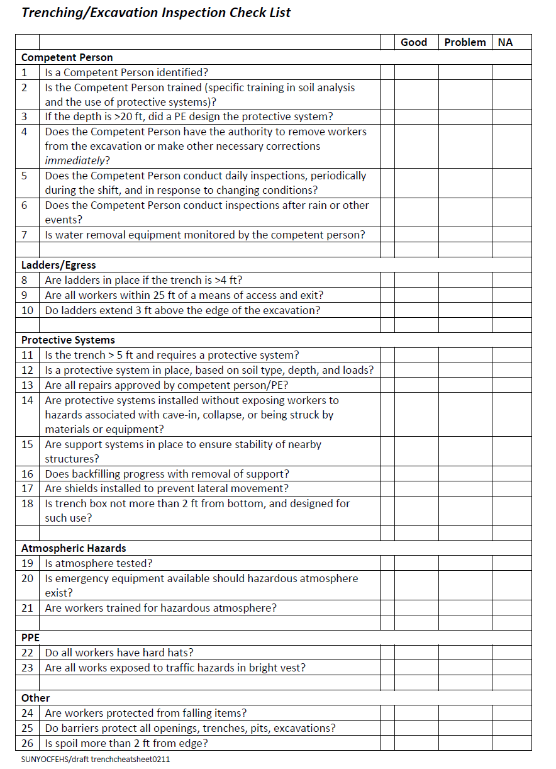

Slide 63
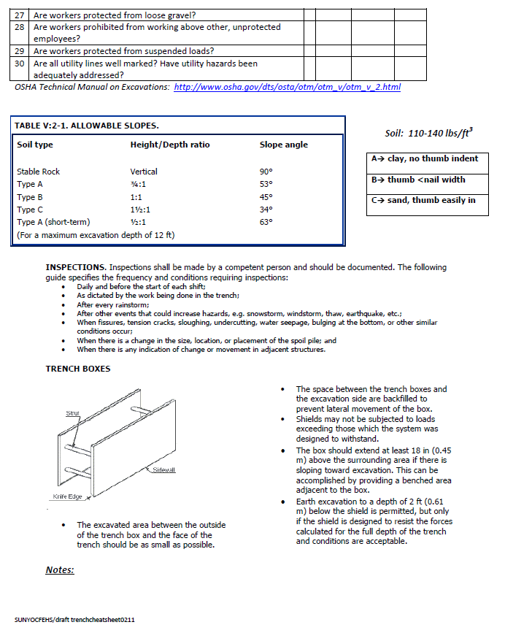

Slide 64
Thank you!
Barbara.Boyle@suny.edu

