Slide 1
SUNY Office for Capital Facilities
PPAA 2014 Winter Meeting Update

Slide 2
Agenda
Executive Order 88
  Basics
  O&M Plan
Project Opportunities with NYPA
Procedures
Start Up NY
Res Hall Hard Dollar

Slide 3
EO88 Basics

Slide 4

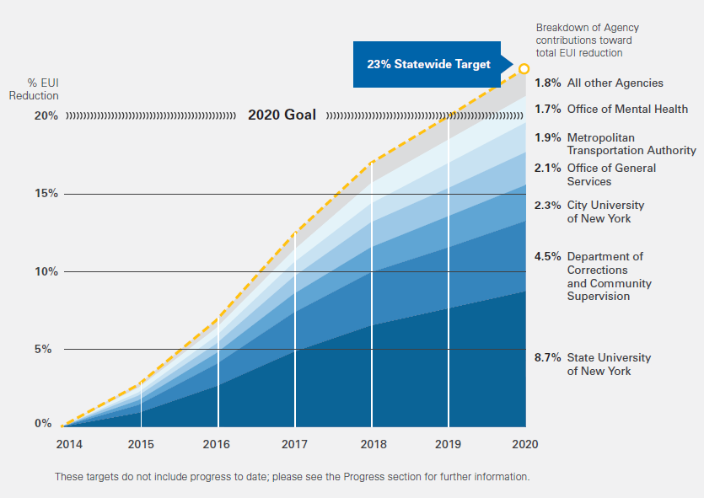
SUNY 8.7%
Notes:
This graph which depicts the overall savings targets that have been assigned to each State agency for the duration of the order clearly shows how important SUNY is to the success of EO 88
SUNY plays a pivotal role as 8.7% of the overall State wide 20% savings goal. Overall the graph has a 23% Statewide Target. This includes a contingency placed on each agency in order to assure that even if a few agencies fall short, as a whole the State will reach its mandated goal. Following a detailed analysis, SUNY’s actually goal is 22% of our 2010 baseline.

Slide 5
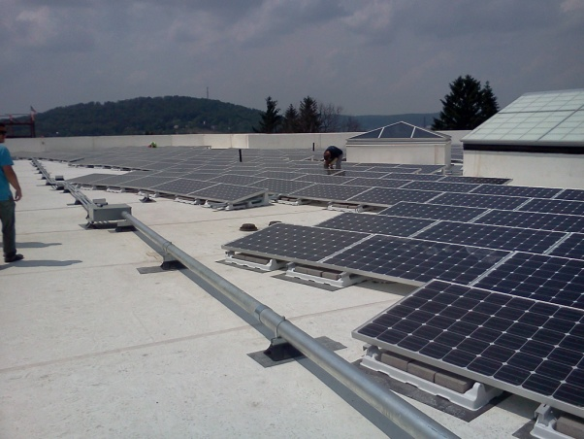
EO 88 is not EO111 by another name
Components of EO 88
  Audit Plan
  Submetering Plan
  Project Tracking
  Retro-commissioning Plan
  Operations &Maintenance Plan
On-site Renewables Count
Notes:
EO 88 is not just a reissued EO 111. EO 88 focuses on measurement & verification of current and future energy use through audit and submetering. It includes: active review of opportunities to improve, through project tracking; sustainability of the savings through retro-commissioning, constant commissioning and perhaps most important, attention to proper operations and maintenance.
Additionally, because EO 88 measures Energy Use Intensity, which includes the energy to produce and transport the electricity, steam chilled water, etc to a site, development of on-site renewable projects helps SUNYs overall numbers by removing the delivery factor which is otherwise included in the calculation of use that comes from off-site production.

Slide 6

EO 88 - Audits
Several campuses have started the ASHRA level 2 Audits which will provide recommended measures to save energy
The Build Smart Team is developing a process for getting a waiver for similar audits that have been recently completed
Retro- commissioning and constant commissioning are alternative approaches
Notes:
EO 88 starts with the Audits. Several campuses have already initiated this process. The audits will result in a multitude of potential energy savings projects. Key will be the affordability of those projects, and ultimately development of schedules for implementing the cost effective recommendations.
As an alternative to a formal ASRAE Level 2 audit, campuses that have recently done a similar analysis may request a waiver of the ASHRAE level 2 requirement. Currently the Build Smart team is developing a formal process for processing such waivers.
Additionally retro-commissioning and/or installation of a constant commissioning system, may also be used in lieu of the audit requirement. The Build Smart team will review any such proposals and provide direction as to steps necessary to meet the requirements established by the guidelines. The Office for Capital Facilities will provide additional information on the RCx and Ccx opportunities and be the conduit to the Build Smart team for all such requests.

Slide 7
SUNY Systemwide O&M Plan

Slide 8

2030?
Notes:
The O&M plan for Build Smart NY asks the question – What will operations and maintenance look like in the year 2030?

Slide 9
A SUNY Wide O&M Plan??
Documentation
Budget
Staff
Data
Capital
Final plan Due June 2014
Notes:
As currently written, the plan has 5 elements. Budget, Staff, Capital, Data and Documentation

Slide 10
Budgets
Incentivize Facilities to save energy by having facilities manage the utility budget and reinvest savings back into additional energy savings measures.
Notes:
Incentivize Facilities to save energy by having facilities manage the utility budget and reinvest savings back into additional energy savings measures and other facilities needs.

Slide 11

O&M Staff in 2030
Setting Standards
APPA Cleanliness Levels
  Level 1 Orderly Spotlessness
  Level 2 Ordinary Tidiness
  Level 3 Casual Inattention
  Level 4 Moderate Dinginess
  Level 5 Unkempt Neglect
Notes:
What result is both desired and reasonable?
Using custodial as an example, one first determines the acceptable level of cleanliness. APPA the internationally recognized leader in facilities management resources has established these cleanliness levels. Level 1, is practically pristine and generally not affordable, while Level 5 would be seen as unacceptable to most students and parents considering a particular campus. Somewhere between is reasonable. Each of these levels has a detailed description which helps determine what is acceptable. Once the goal level is selected, a formula is applied to determine the number of staff needed. There are additional factors including building hours, type of facility etc that must be considered. APPA is just one of the potential standards for this type of analysis.
SUNY has neither tracked nor benchmarked facilities staffing for years. As part of the O&M plan we would review industry standards and adopt the best standard for SUNY, and then work to get the facilities staff to the appropriate size.

Slide 12
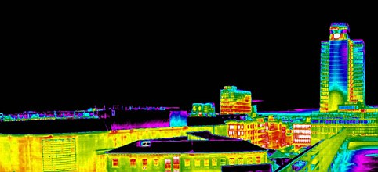
Insufficient HVAC Staff = Wasted Energy
Notes:
For Executive Order 88 this becomes more important and more complicated looking at mechanical, electrical, plumbing and other technical staff because the potential for wasted energy increases when these components of a building are not properly maintained. Performing regular preventative maintenance keeps equipment functioning more efficiently resulting in energy savings. Good maintenance reduces some of the need for capital investment by prolonging equipment life. Insufficient staff = wasted energy, a costly trade.

Slide 13
Staff Capabilities
Sufficient staff is not enough. Proper training is also critical.
Union classifications have not stayed current with the technology skills needed for today's buildings
Notes:
Sufficient staff is not the only consideration. Proper training is essential. Training can be costly, but properly trained staff will keep equipment in better condition and therefore save energy.
Union classifications have not been updated for years and therefore most do not recognize the importance of computer skills. The O&M plan proposes to work with Civil Service to modify the skills required for many maintenance positions. It also proposes collaborative efforts to enhance training opportunities.

Slide 14

Shared Services
In areas of electronic data management , could we get better service and save money by having shared but dedicated staff managing our information
systems?
Notes:
Related to staff capabilities it is important to look for ways to share services such as creation of specialists that work remotely for several campuses creating efficiency.

Slide 15
Designing Maintainable buildings
Buildings will be better maintained if the design considers the needs of the maintenance staff
Consultation with maintenance staff would be required on all capital projects
Notes:
Additionally, one of the best ways to insure buildings are properly maintained and therefore retain the designed in efficiencies, is to have them designed so that they can be maintained.
While most campuses may already have a process of including consultation and consideration of maintenance staff input throughout the design process, the Build Smart NY O&M plan would require including this consultation as a formal part of the design review process.

Slide 16
Capital
Sufficient predictable capital is key to smart investments
Inadequate capital results in poor decisions that can result in wasteful energy consumption
Find funding mechanisms for retro-commissioning and constant
commissioning
Notes:
Maintenance of facilities that do not have sufficient predictable capital funds, forces wasteful decisions which impact material, labor and utility budgets. Without predictable capital, project decisions based on the unknown future results in ineffective capital planning and inefficient O&M. Capital must be put aside capital for unknown needs. Funding mechanisms for systemwide retro-commissioning and constant commissioning systems would further ensure that buildings continue to operate at the highest possible efficiency, again this is a goal of the O&M plan.

Slide 17
Data Systems - Base
The Building Characteristics Inventory (BCI) and Physical Space Inventory (PSI) are the base many of the data sets used for management of facilities
These systems are outdated and in need of an overhaul
The State is also looking to develop an statewide asset management system.
Notes:
Facilities data falls into two main categories – management of the facilities and management of the capital investment.
The draft O&M plan primarily deals with data systems that are key to management of facilities. The base for these systems is the combination Building Characteristics Inventory (BCI) and Physical Space Inventory (PSI). The O&M plan starts by recognizing that the BCI/PSI base is outdated and in need of major change. The State is also recognizing the importance of information about all State assets and is looking at developing a program for use throughout the state. OCF and the Fund are working closely with the State group on any advance in this area.

Slide 18
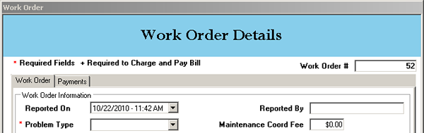
Data Systems – Facilities Management
Computerized Maintenance Management
Preventative Maintenance
Building Management Control
Constant Commissioning
Notes:
Computerized maintenance management systems provide your workorders. There are several systems available and campuses choose their own preferred system. The O&M plan proposes that these systems have a live updating connection to the PSI, and that we create a single application programming interface which would be a base for all CMM programs, allowing for systemwide reporting from any CMM software.
Preventative Maintenance is also proposed to have live updating to PSI and have systemwide reporting capabilities, but the O&M plan goes a bit further in looking for a way consistently gather data from contractors for all new building components that should be included in a PM system.
Building management control systems direct countless building components and are also proposed to have a seamless tie to the PSI. Further consideration should also include how extensive these systems should be in campus buildings in order to get systemwide reporting. Additionally extensive building management controls are the base needed for constant commissioning. Constant commissioning systems take the data from the Building management controls and perform analytics designed to identify anomalies that can identify a problem with equipment before major problems of failure. By catching problems early corrections can be made and energy saved.

Slide 19
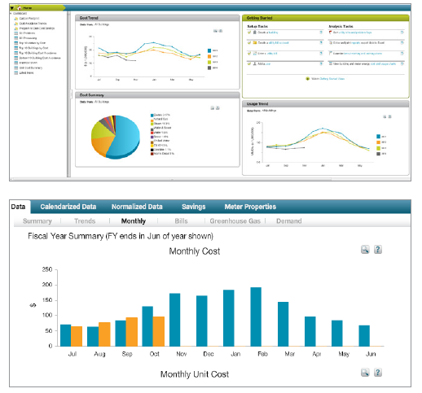
Energy Related Data
Energy Cap
Submetering
Statewide Energy Manager
Smart Grid Management
Notes:
Energy related data systems include our Energy Cap, which is the source for reporting SUNY energy use to the Build Smart team. A few campuses have begun implementing phase 2 of Energy Cap to capture submetering data. The Build Smart team is also shortly rolling out a Statewide Energy Manager which will allow us to benchmark against other stat agencies including the closest to us in function – CUNY. Our Energy Cap data will feed this new statewide system.
Finally the future sees smart grid technology on the campuses which will analyze usage data tracking peak and off peak use and help develop recommendations for adjustments that can shift specific usage from peak to off peak hours.

Slide 20

Data Conclusion
By 2030 SUNY will have a single “Application Programming Interface” (API) and protocols for collection of data sets into systemwide reports.
Notes:
The O&M plan proposed that by 2030, SUNY would have a single Application Programming Interface (API) with protocols and a defined data dictionary upon which various companies could coordinate their facilities related software to communicate dynamically with the base data BCI/PSI and the various component programs providing accurate, up-to-date information in all aspects of facilities maintenance. Additionally, all campuses would have these systems installed and dynamically interfaced resulting in Systemwide reporting capabilities at the building, complex, campus, sector and system levels.

Slide 21
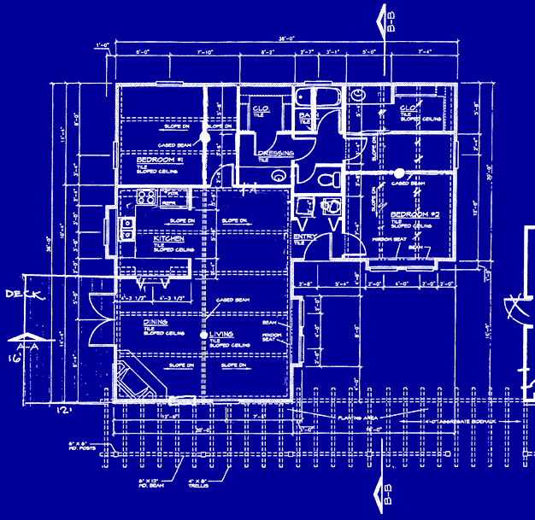

Documentation
Building and equipment documentation is critical
Current staffing levels do not permit the luxury
of ideal document management.
Accurate Complete information is lacking
Notes:
Good documentation of all components of a building is crucial to effective maintenance and operations. This includes building drawings, operations and maintenance manuals, control sequencing, preventative maintenance requirements, parts lists, shut-off locations, accurate electrical panel documentation and much more.
With SUNY building stock age averaging over 40 years and some SUNY buildings constructed more than 100 years ago, documentation is a concern. The oldest buildings may not have original construction drawings. Numerous modifications to buildings throughout the system further exacerbate the situation as each project is it’s own set of documents. No one set of building plans incorporates all of the existing conditions of a building. As staff retire much of the knowledge of the building systems goes with them.

Slide 22
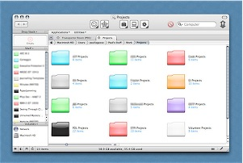

Documentation ideal
Cataloging, documentation and retrieval of existing building conditions will be seamless
Catalogue of PM routines will be available to all campuses
Equipment will be bar-coded for easy tracking
Notes:
Ideally, by 2030, building documentation, cataloguing and retrieval systems will be well functioning and will provide quick accurate retrieval of key building information, with all essential documents needed for the maintenance of the facilities contained within the electronic sphere. Preventative maintenance requirements for building equipment would be shared across the system in a central repository of equipment data, allowing campuses to simply grab the information from the central system to create a PM routine for newly installed equipment. Equipment will be bar-coded so that accurate information about each piece can be tracked and we will know that equipment is being maintained to the highest degree possible.

Slide 23
EO 88 O&M Challenges
How to get buy-in?
First we need PPAA to help finalize the plan and provide full endorsement
Next we need the business officers to recognize that an investment in facilities will result in significant savings in energy
My office cant do this without
your help
Notes:
Creation of a working group to explore these ideas and finalize the O&M plan is the first step.

Slide 24
NYPA Project Opportunities

Slide 25
New NYPA Opportunities
Two Co-Generation plants, with the main goal being energy resiliency and independence
Two micro grid projects for current co-gen operators
to also achieve
independence
Notes:
NYPA is offering two project funding opportunities. The first is co-generation or combined heat and power. The second project type is to create a micro grid at a facility that already has an operational co-generation plant.

Slide 26
Procedure Updates

Slide 27
Procedures
Minor Critical Maintenance (MCM) was recently transitioned from a Fund procedure to an official SUNY procedure
Equipment Purchasing Guidance Document recently released to be followed by a webinar
Notes:
The Minor critical maintenance MCM procedure was recently transitioned from a Fund procedure to an official SUNY procedure and will soon be available on the SUNY procedures website.
Equipment guidance - eliminates the old Group 1,2 3 categories. Instead it identifies FF&E, furniture, fixtures and equipment with two categories - fixed and movable equipment. The guidance outlines when it is proper to use capital funding.

Slide 28
Start-Up NY

Slide 29
Start-UP NY
Who can build on campus? Start-up statute includes an allowance for a private business to construct on campus on formally designated property and pursuant to an approved business plan
Drawing requirements
Unique IDs
Notes:
System Administration has a project review team made up of staff from legal, budget, Research Foundation, provost, community college and capital facilities.
Start up Statute provides that the private businesses with approved start up plans can build on specifically designated campus property. This is contrary to previous rules and guidance we have provided. OCF will be developing a revision to the CLC-3 Construction Authority to include this information.
Drawing requirements and Unique IDs protocols have been finalized

Slide 30
Residential Hall Hard Dollar
Notes:
Implementation of the State Financial System has been a burden on SUNY in many ways, this is another example. In working to get allocations into place for hard dollar capital projects changes as a result of SFS created significant delays. OCF will be documenting this new process to assure this type of delay never happens again.

Slide 31
Just ask!!
We are here to help you!

