Slide 1
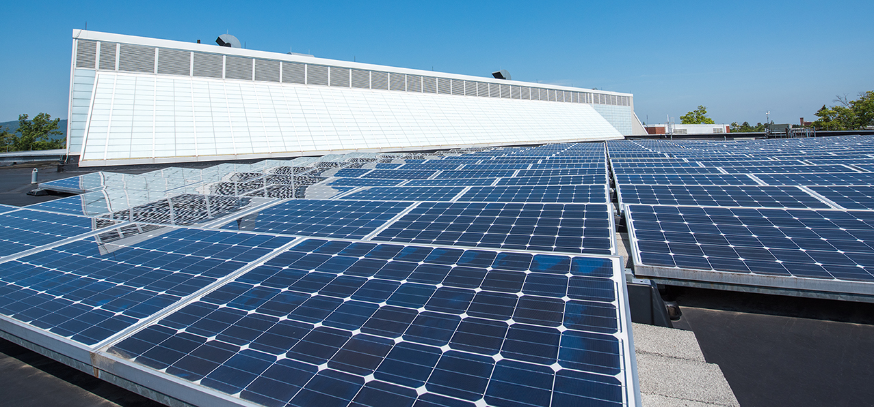
SUNY/PPAA Summer Conference
Office for Capital Facilities
July 2019

Slide 2
Agenda
SUNY’s Got Your Back
New OCF Staff
Energy Items
Potential NYS Building Code Changes
Residence Hall Bonding
AiM Updates
Notes:
SUNY’s Got Your Back
New OCF Staff
Energy items
Potential NYS Building Code Changes
Res Halls
AiM Updates
Miscelaneous

Slide 3
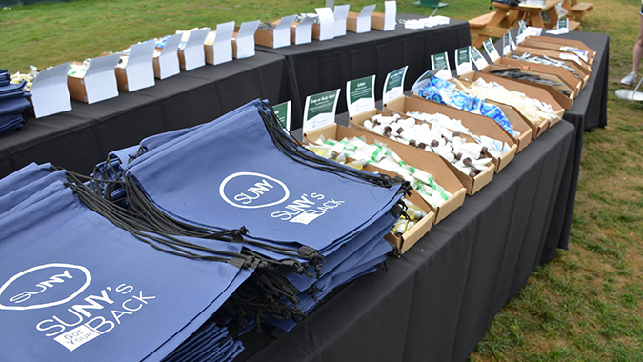
SUNY’s Got Your Back
Joe Storch Associate Counsel

Slide 4
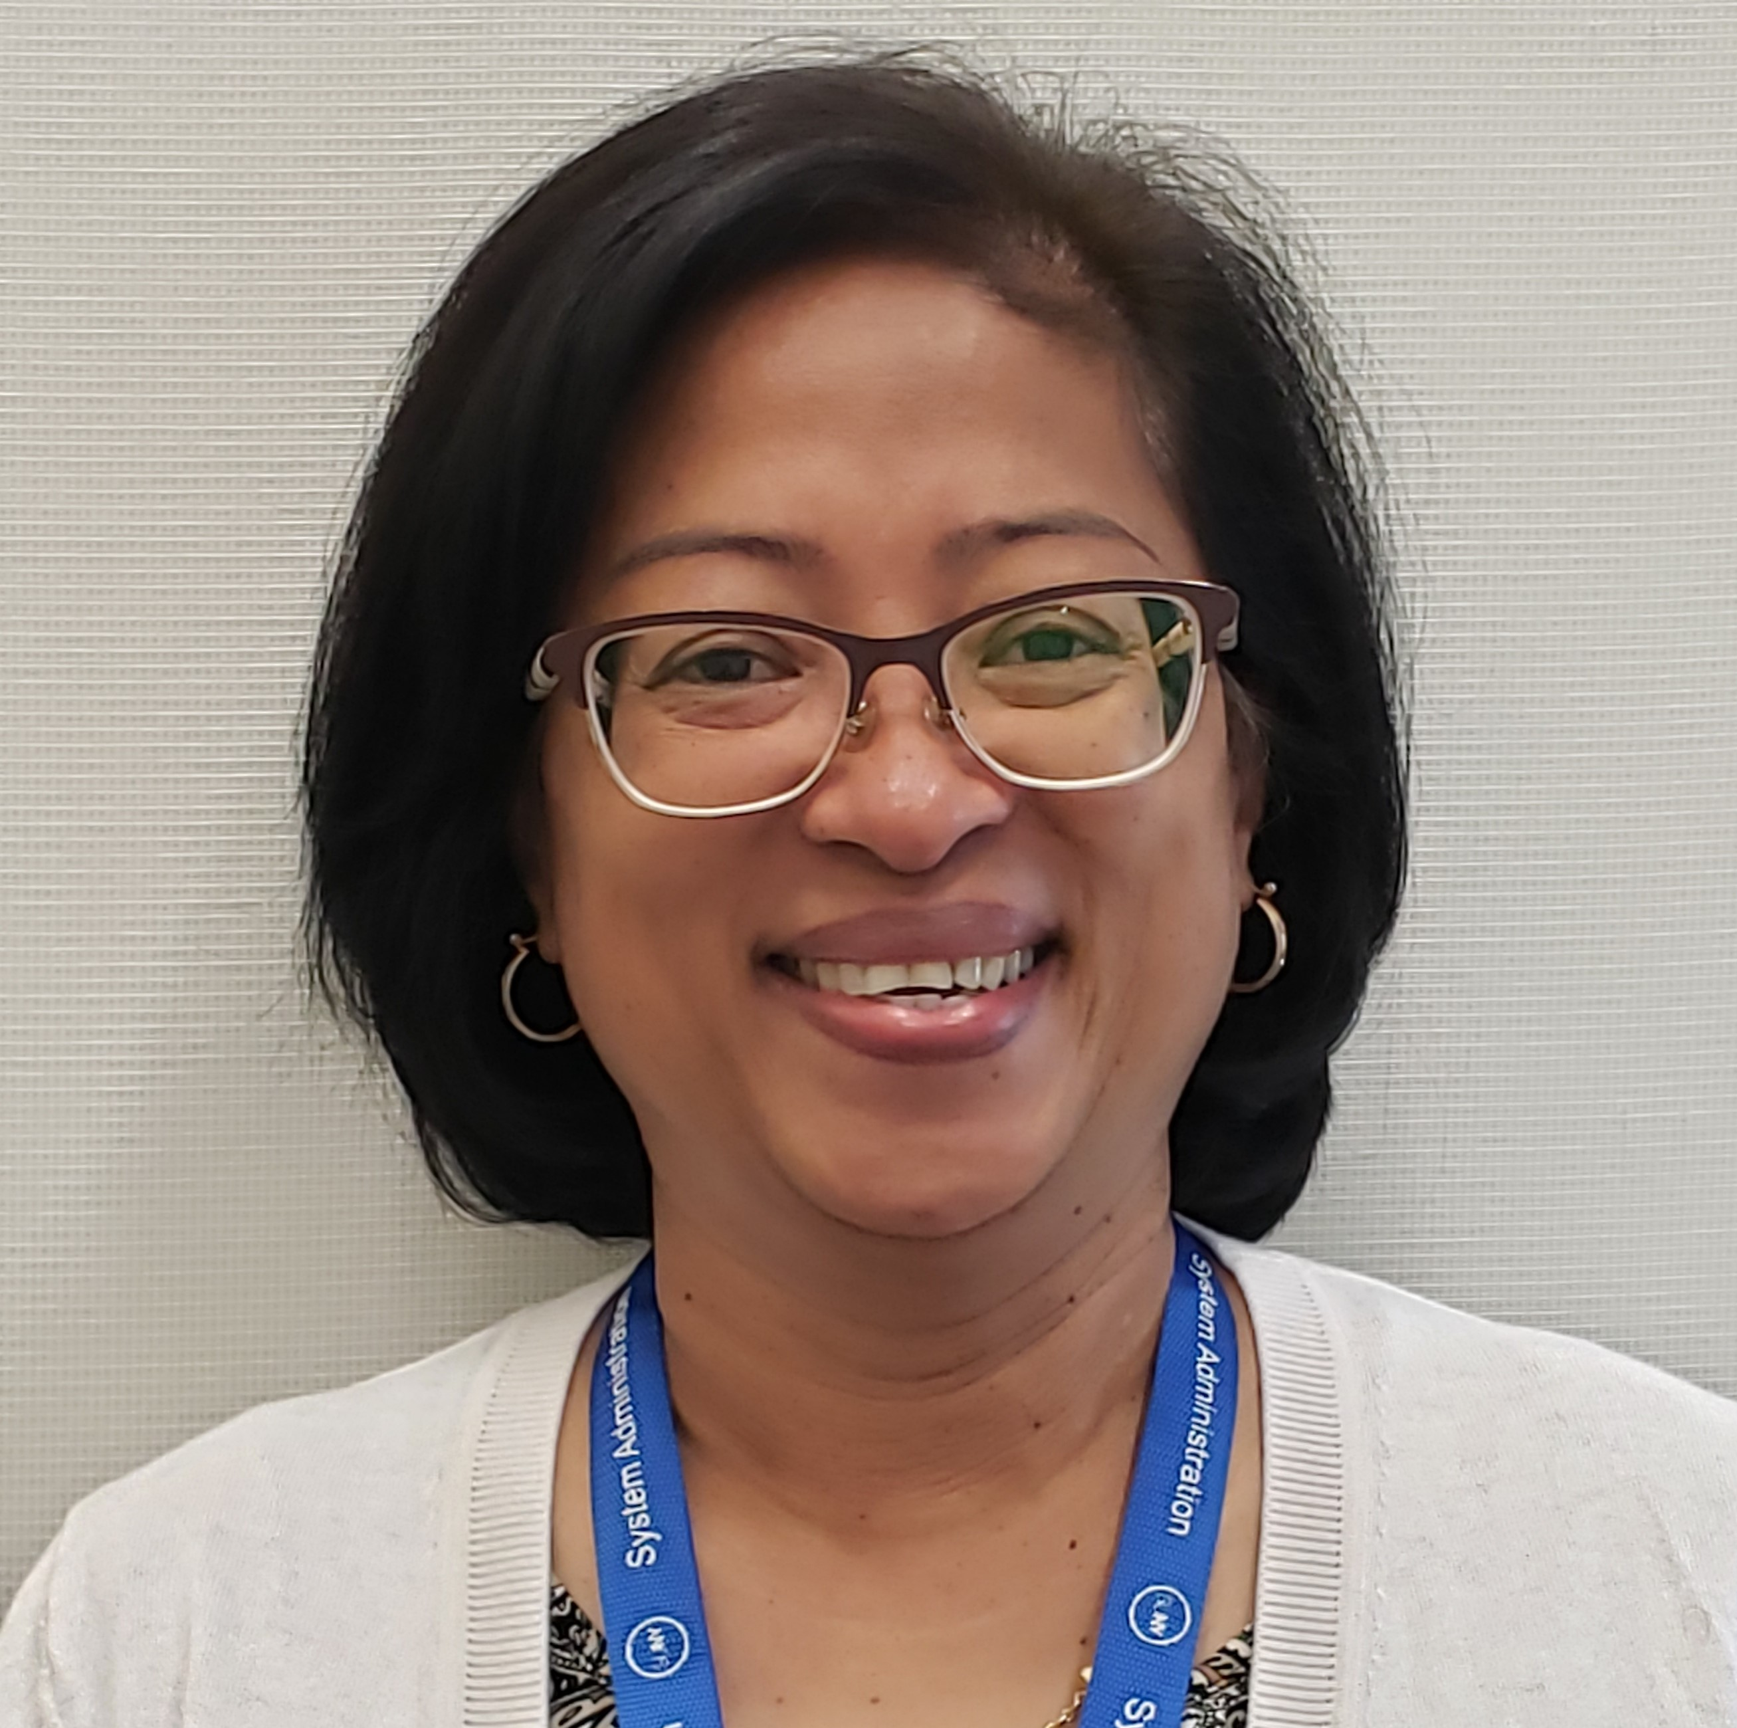
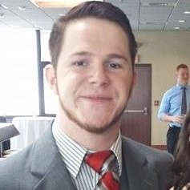
Introducing two new OCF Members
Alex Lykins – Clean Energy specialist
Petula Phillips - Junior Energy Accountant
Notes:
Petula Phillips – Started in March as the junior accountant for the Energy Buying Group. Petula is a fast study, learning the technical details of handling the NYISO transactions and the campus transactions. Petula was previously with Hudson Valley CC. Petula along with Mindy and Dan will continue to make sure that campuses save money as members of the Energy Buying Group.
Alex Lykins – Alex started yesterday will be assisting campuses, Construction Fund and DASNY staff with grant applications for energy savings incentives. Alex will be your expert on available incentives and will help with the paperwork, deadlines and documentation needed to receive incentives. Campuses pay into the various programs as part of the utility costs, but as a whole we do not get back in incentives nearly what we pay. Alex will help SUNY get its fair share.

Slide 5

OCF/Campus MOU
MOU will define Alex’s role, campus role and how much funding will come to System Administration to help pay Alex’s salary
Notes:
One of Alex’s first actions will be to develop an MOU to define clearly the services Alex will provide and the service fee we will collect for those services.
Alex will help campuses work the service fee into the actual applications so that the impact to the campuses will be minimal, while the benefits will be both the reduced energy costs and receiving incentive or rebate payments that can be directed toward more energy projects, continuing to improve the campus’s overall performance.

Slide 6
Notes:
This chart shows the success of the Energy Buying Group which has saved SUNY campuses over $38.8 Million over the 15 years of operations, averaging around $2.5M per year.

Slide 7

Green Revolving Loan Fund
Low interest loans ≈ 2.5% no additional fees
Projects that save on energy budget
Launching Soon??
Notes:
As soon as we have the Ok, information will be sent out to both State Ops and CCs. The process for the CCs is slightly different, but a portion of the funds are being set aside specifically for the CCs, so the more protracted process will not reduce the amount available to the community colleges.

Slide 8
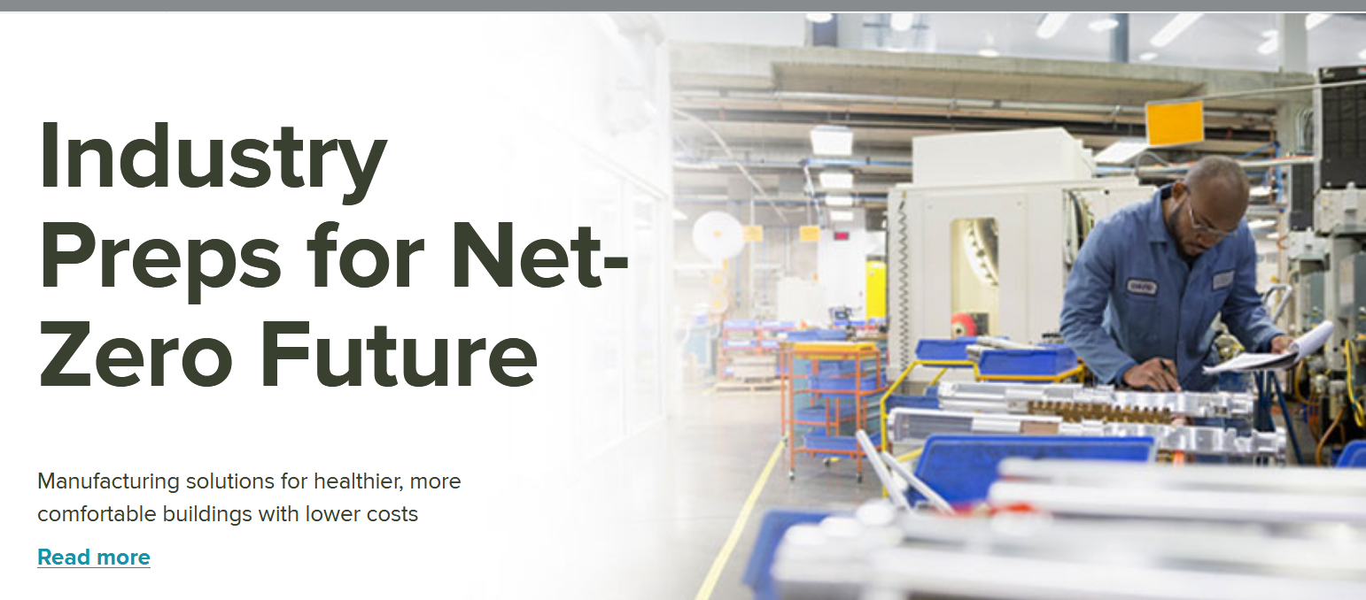
Retro-fit NY
Notes:
NYSERDA continues to lead this project which is geared toward developing new solutions for how to take old building stock and greatly increase the efficiency to achieve a net zero carbon facility. This slide is taken directly from the NYSERDA Retrofit NY website showing that a major part of this effort involves the manufacturing community and the concept of wrapping existing buildings in a new ultra insulating exterior skin to significantly reduce the heating and cooling needs of the building. The concept is also geared at providing a non-invasive approach, where building occupancy is uninterrupted.
SUNY Oneonta is a pilot campus for this program along with six affordable housing units. Currently two design build firms are progressing on two separate design solutions in response to a DASNY design-build RFP.
This will not be easy, but is part of the process of changing how we move our existing building stock from its current state to a carbon neutral building stock. This is clearly a difficult process. It requires looking beyond what we currently know and looking into the future to a world that does not rely on burning fossil fuels.

Slide 9


New York Higher Education Large Scale Renewable
(NY HE LSRE)
Not Just Renewable Energy Credits (RECs)
The Power of SUNY and Beyond
Notes:
Purchasing SUNY’s grid sourced electricity from renewable sources is a major goal for SUNY. This project is moving along rapidly. The contract with Edison Energy (AKA Altenex) was approved by OSC in May. In June we had an all-day meeting hosted by SUNY ESF where we brought all of the consortium campuses together to learn more about the project and the steps necessary to move SUNY to a 100% renewable electricity position. Most of the campuses have had individual calls with Edison to establish campus specific goals. Project meetings are being held weekly. Once we have been successful with the consortium campuses we will start meeting with the remaining campuses to review how we can move those campuses forward to achieve the Chancellor’s goals.

Slide 10
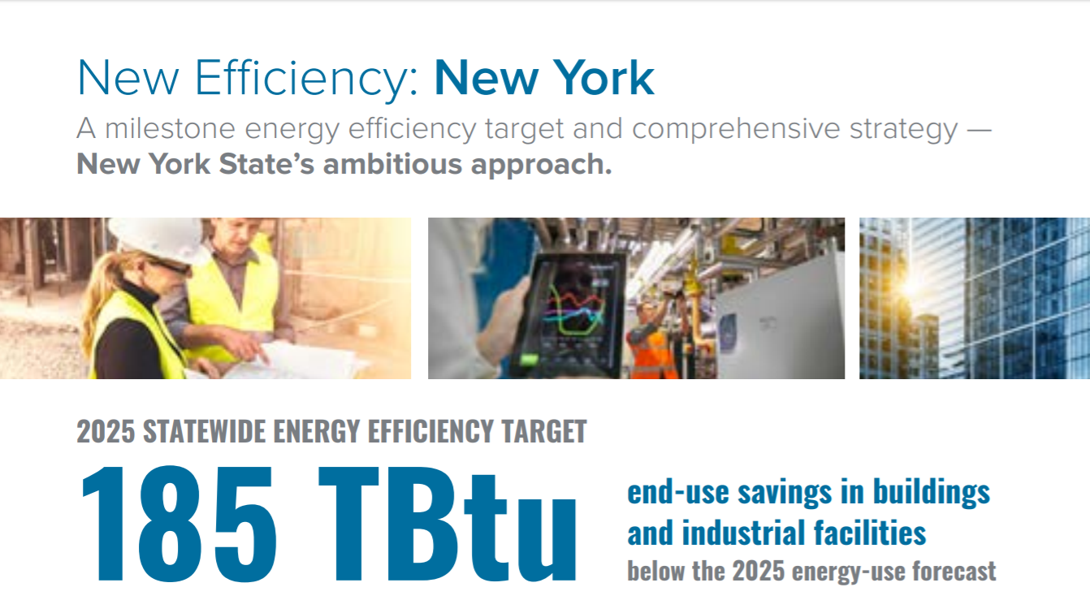
New efficiency NY XXX tbu
Energy manager chart from eric
Goals from eric
Plastic bags probably not
Food waste
Notes:
The Chancellor mentioned many of the Governor’s goals and initiatives. For one of these initiatives Eric has been working with a cross agency team led by DEC to develop new guidelines that combine the many Executive Orders related to energy and sustainability into a single publication that defines goals and resources for achieving those goals. As soon as the final document is completed it will be sent to the campuses.
New Efficiency NY sets a milestone target for savings statewide in buildings and industrial facilities of 185 Trillion Btu from the current 2050 energy use forecast. Don’t get hung up on the measure and exactly what number each campus needs to hit. Rather focus on the type of work that will continue to improve the campuses efficiency.
And start thinking about and planning for electrification

Slide 11


Electrification
Notes:
“The future is electric”. Isn’t natural gas supposed to be the clean fuel for now and into the future? Isn’t the electric grid dirty?
The answers lie in future. Currently, 40% of electricity feeding the grid comes from “dirty sources”, but the governor’s goal is to have a 100% clean electric grid by 2050. Therefore, in calculating the cleanest approaches to building infrastructure, electrification must be a major part of the plan.
And while natural gas is much cleaner than coal and fuel oil, natural gas is still a fossil fuel, removing carbon that is sequestered deep in the earth and releasing it into the atmosphere through burning. Reducing dependence on natural gas is a key part of the path to a cleaner future for future generations.
The electrification of building heating systems and domestic hot water, is not an easy task, especially with so many campuses having central heating plants. The goal of electrification needs to be a part of the planning for the future through transformation away from natural gas boilers to electric air or ground source heat pump systems, or other clean solutions. To help the campuses SUNY is working with NYSERDA on some workshops to help campuses learn more about geothermal, and other electrification approaches.
And SUNY also must plan for electrification of transportation.

Slide 12

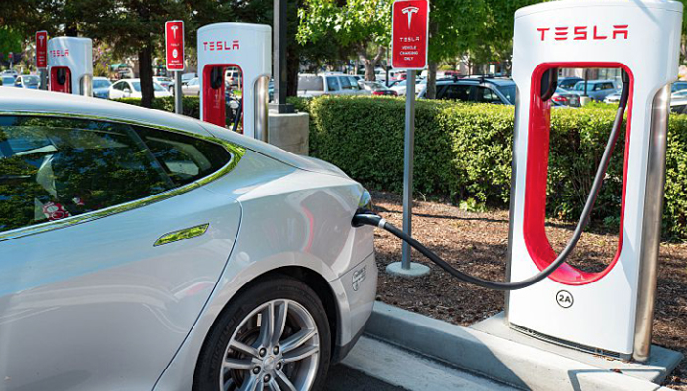
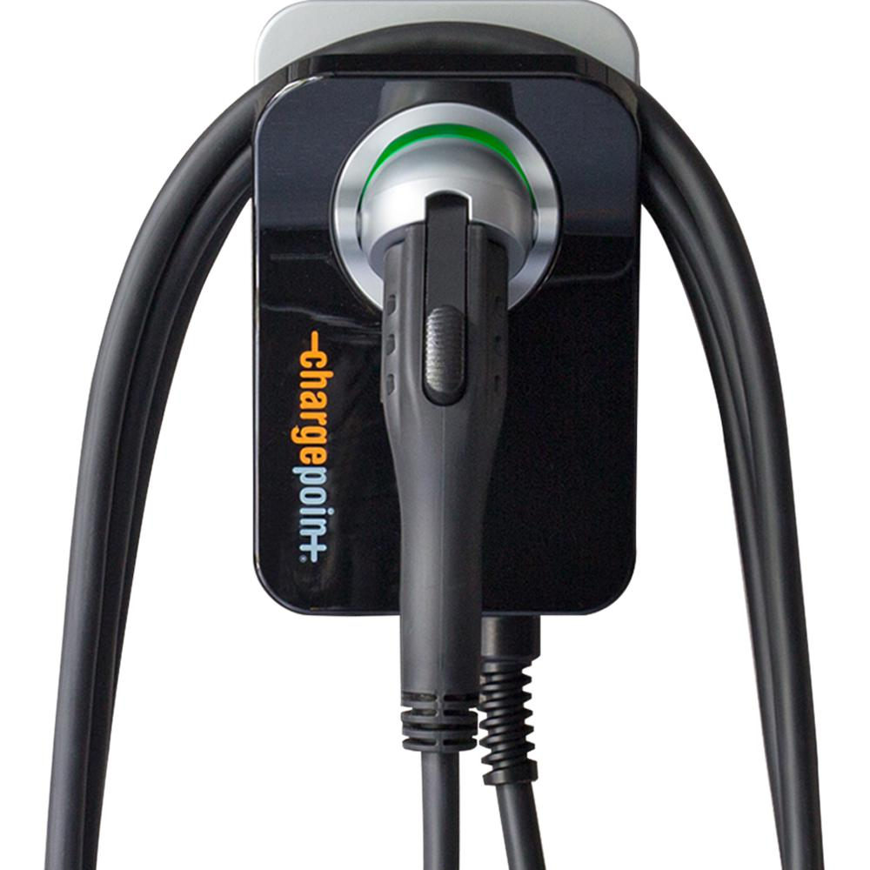
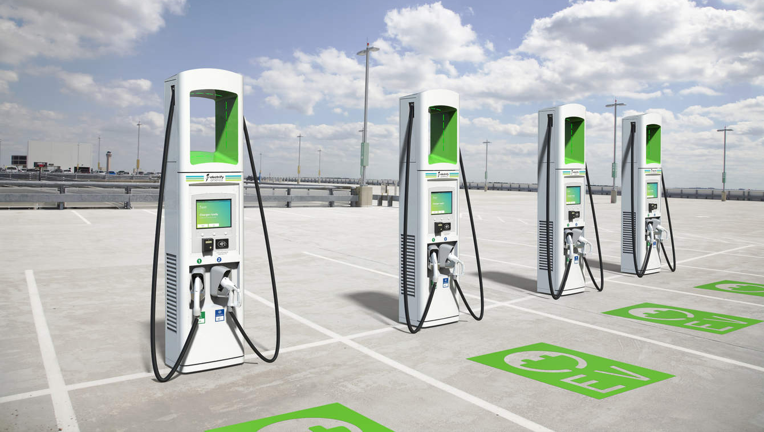
Level 1 Charger 120V
Level 2
Charger 240V
Level 3
Charger 480 V DC
Notes:
Electric vehicle fleet charging stations. This year SUNY OCF provided guidance for creating a policy for charging stations on your campus. Alex will be reaching out to campuses to assist in getting grants to fund the installation including infrastructure. Some grants may even provide operating expenses for the first year. Yet what will this look like in 10 year, in 20 years?
Currently charging stations come in three levels.
Level 1 – basic household plug, at 120 V At this level a vehicle can take 24 hours to charge. Obviously this is not practical as the long term solution.
Level 2 chargers – 208 or 240V chargers which provide a full charge in 4-5 hours. This is better and fine for a car that has regular access to a charger either during work or at home.
Level 3 chargers – Use a DC current at 480 V for a quick charge – 80% recharge in as little as 20 minutes, yet this is still at least twice as long as it takes to fill a car with gas, even including washing the windows.

Slide 13
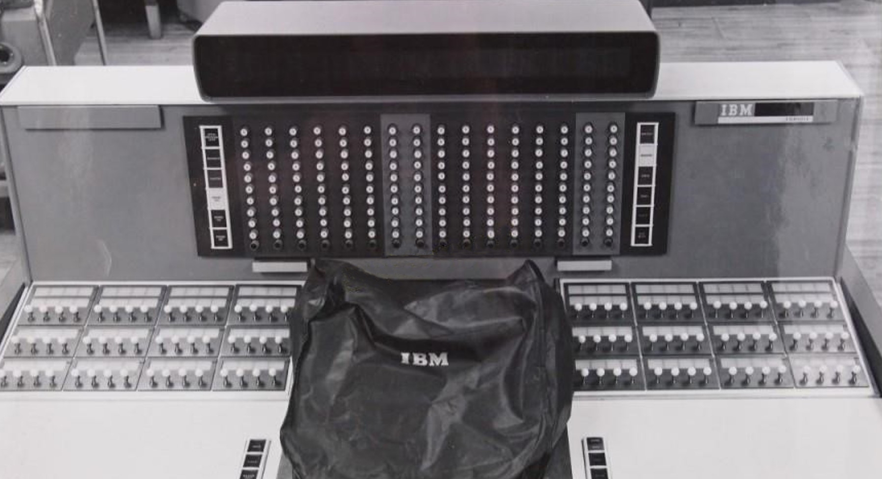
Rapid Technology Changes
1960 IBM Prototype computer
Notes:
When considering installation of electric vehicle charging stations, keep in mind how rapidly technology changes
This is one of several 1960 photos of prototype IBM computer in development. That was just 59 years ago. An Apple Watch is incredibly more powerful than these prototype computers.
The point is technology is rapidly changing our world. Things only dreamed by science fiction writers in the first half of the 1900s are routine today.
Electric vehicles are changing rapidly and I believe technology and demand will develop a better solution that stand alone charging stations. Perhaps service stations of the future will be like the rhino propane tank program. Drive up a small ramp, release your dead batteries, proceed to the next stop and pick up a fresh set, all from the comfort of your car.
Think about 15 years ago when Ethernet outlets were needed everywhere for computers to connect to the internet. Those have become less critical with wireless hotspots providing the access instead.
Be a part of the advancing changes, but stay nimble enough to adapt to the changes which will come.

Slide 14

Renewable Natural Gas
Notes:
Renewable Natural Gas is an important product to understand. RNG is “natural gas” produced from organic material that if left alone or if dumped in a landfill would have instead produced Methane through the natural decay process. Methane is a greenhouse gas (GHG) 84 times more damaging to the environment for the first 20 years of its release. CO2 is less damaging but continues it damaging impact until it is removed from the atmosphere.
The Environmental Defense Fund reports “about 25% of the manmade global warming we’re experiencing is caused by methane emissions”
So what does this have to do with Natural Gas? Instead of letting organic materials decay and release methane, bio-digesters are being used to convert the organic material to natural gas to then be used to produce heat or electricity. In this scenario, the impact of burning the renewable natural gas is significantly less than the impact of the methane that would result from allowing the organic material to decay naturally.
How does this impact SUNY campuses? Two ways:
New regulations related to food waste will require all campuses that produce more than 2 tons per week of food scraps will be required to recycle all food scraps beginning January 1, 2022. Bio-digesters will be looking for your food scraps. As this develops over the next two years SUNY will be providing campuses with more information.
The second way this can impact campuses is campus staff may be approached to purchase renewable Natural Gas. This is a good thing for a campus to do, but a warning, RNG is currently very expensive. While it can provide a good sustainability action, be cautious about any long term contracts. It is anticipated this fuel will become more plentiful and less costly in the future. If you are approached please don’t hesitate to reach out to us for help in analyzing the cost and benefits related to overall campus carbon accounting.

Slide 15

EBG Campuses Be Cautious
Credit provided builds with no place to spend
Notes:
Another area campuses may be approached by is for Community Solar.
Some recent changes in regulations are leading these companies to go after larger potential clients such as university campuses.
While community solar is an excellent program, be cautious related to how this type of program will work for any campus that belongs to the SUNY Energy Buying Group
A community solar contract involves a credit from the community solar company to the campus electricity bill. The problem is the EBG is your supplier and the credit can’t come to the EBG. Your utility provider does charge the campus for transmission and delivery, and yes the credit can be used against those charges, but if your T&D charge is less than the credit, you will accumulate a credit with nothing for which it may be used.
Don’t be pressured, and make sure to reach out to SUNY OCF if you have questions so that we can make sure that are not entering into a contract that will actually be at a negative impact to the campus
However seriously consider these contracts if you are not in the EBG or for your home.

Slide 16

Buffalo State Pilot
Energy Manager was part-time (6 days per month)
Average Annual Cost Savings over two years = $156,613.
Approximately 5% of the total energy cost
A full-time position is easily projected to save closer to 10%
Notes:
Many campuses have dedicated energy managers, but many others do not.
Two years ago Buffalo State received a grant through NYSERDA to have a local consultant provide energy management services. The service only included 6 days per month of the energy manager being on-site.
The 2-Year Average Energy Cost Savings for the pilot = $156,613.
Approximately 5% of the total energy cost
This was on a part-time basis (6 days per month)
A full-time position is easily projected to save closer to 10%
It is important that the energy manager be given a proper degree of control while being sure the person understands the importance of happy students, faculty and staff to a successful campus.
If you want more information please reach out to Eric.

Slide 17
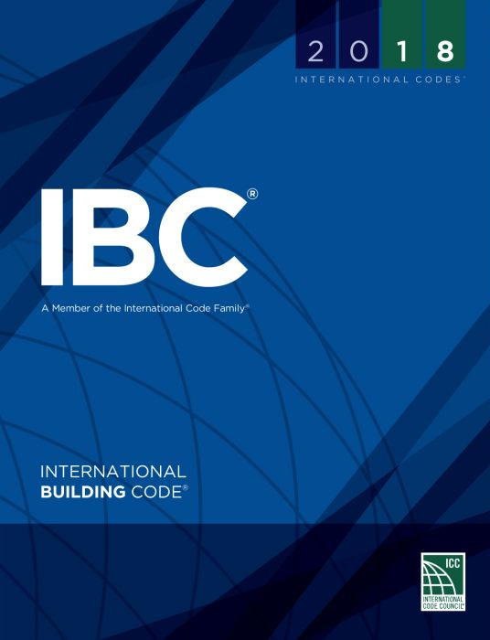
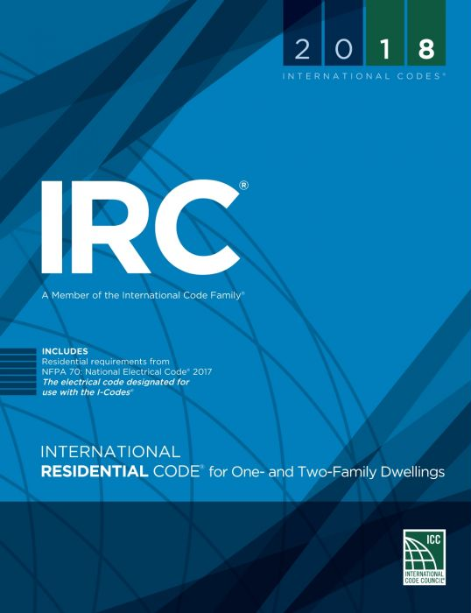


Notes:
New York state building code life safety code revisions are forthcoming
Each five years NYS does a major update to the codes. NYS codes are based on the International Code Council code series, but with NY specific language. The Codes will be amended to reflect the 2018 ICC Codes
The NY Energy Conservation Construction Code and other minor specialty codes will also be updated.

Slide 18

NYS Building Code Updates
Public hearings will be held on September 5
Open for public comment until September 10
Anticipate a late 2019 adoption, with transition training for Code Enforcement Officials beginning in early 2020.
Full text on Department of State website https://www.dos.ny.gov/dcea/noticadopt.html#rulemaking
Notes:
Posted to State Register for public comment on July 3, 2019. Public hearings will be held on September 5, with the public comment period ending September 10.
Anticipate a late 2019 adoption, with transition training for Code Enforcement Officials beginning in early 2020.
Full text can be found on their website https://www.dos.ny.gov/dcea/noticadopt.html#rulemaking

Slide 19

Some – but not all – changes of interest:
New section on all-gender bathrooms (Chapter 29)
Chapter 38 provides options for fire protection and chemical use/storage in some laboratories.
Crowd Managers 500 people in indoor events
Automatic fire-extinguishing systems for R-2 kitchens
Notes:
New section on all-gender bathrooms (Chapter 29 of the NYS Building Code and Plumbing Code)
Crowd Managers will be required for 500 people in indoor events (was 1000 people). [ICC FC 403.12.3]
Chapter 38 provides options for fire protection and chemical use/storage in some laboratories.
Automatic fire-extinguishing systems for R-2 kitchens [ICC FC 904.13 and 906.1]

Slide 20
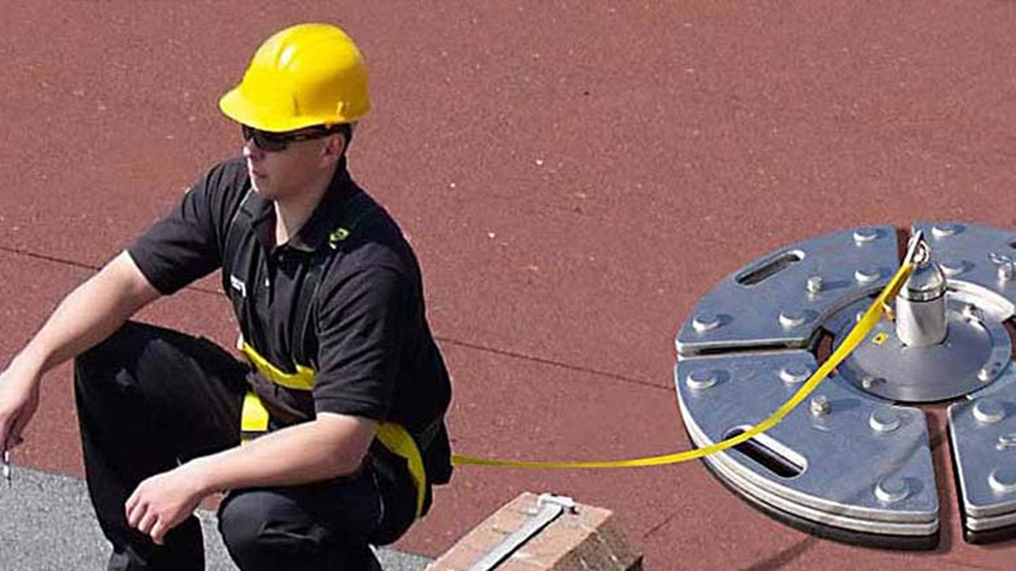
More – Still not all – changes of interest:
Fall arrest systems for service within 10 feet of the roof edge. Not the same as PESH
Inspections of Emergency Egress lighting]
Rapid shutdown of Solar PV Power Systems
Membrane structures
Outdoor Assembly Events need permit at 1000 people (DOH is 5000)
Notes:
Fall arrest systems for service within 10 feet of the roof edge. [ICC FC 1015] (not the same as PESH)
Inspections of Emergency Egress lighting [ICC FC 1031.10]
Rapid shutdown of Solar PV Power Systems [ICC FC 1204.5]
Membrane structures [ICC FC 3105]
Outdoor Assembly Events need permit at 1000 people (DOH is 5000) [ICC FC 3106]

Slide 21

Continuity of Operations (COOP)
Continuity – Business and Operational
Providing Core Services
Many References including NFPA 1600
NYS Looking at COOP
Required by SUNY Policy 5606
Notes:
Continuity. A term that includes business continuity/continuity of operations (COOP), operational continuity, succession planning, continuity of government (COG), which support the resilience of the entity.
Business Continuity/Continuity of Operations is an ongoing process to ensure that the necessary steps are taken to identify the impacts of potential losses and maintain viable continuity and recovery strategies and plans.
How will your campus continue to provide necessary core services after a significant adverse event?
One reference is NFPA 1600 Standard in Continuity, Emergency, and Crisis Management.
NYS is carefully looking at Continuity Planning for Disaster Response Commission Agencies. (SUNY is not a DRC.)
Continuity planning is required by SUNY policy 5606. Qualitative questions about campus continuity planning were included as part of the 2019 annual submission process.

Slide 22

Notification to System Administration
SystemNotification@suny.edu
Notes:
When originally setting up the email address emergency@suny.edu System Administration had gone through a flood, a fire, Hurricanes Irene and Lee, and Superstorm Sandy. It became clear SUNY needed a way to get information from campuses about important events happening at the campus level. The initial implementation was the email address emergency@suny.edu. Overall this works well, but many tend to shy away from using it for things, for fear the event is not a major emergency.
Therefore, SUNY has created a new address called SystemNotification@suny.edu. It serves the same purpose. It is a single email that provides notification to several people in the building. The same people are notified. Either address can be used, but think about the purpose as notifying the System office of something that could hit the press, thereby allowing individuals to be aware before the media call.
It also let’s offices know there may be a need for assistance. Please use this to keep System informed.

Slide 23

Alternative Bond Test (ABT)
Res Hall Debt Service coverage
Revenue (Room Rent, Parking Other revenue) $ 531.8 M A
- Expense (O&M, Energy, Res Hall Staff, etc) - 342.6 M - B
= Net Revenue (A - B) 189.2 M C
DASNY Bond Payment 130.3 M D
Debt Service Coverage (C ÷ D) 1.45 E
074 capital and Rev Loan are excluded from this calculation
Notes:
Revenue – operations expense = net revenue
Net Revenue/Debt service must be greater than 1.2
This is the Alternative Bonds Test (ABT) which is used to determine if the program is healthy enough to take on additional debt.
The risk is if this level is not met we will not be able to bond, leaving projects stranded with no cash to finish. Default on contracts – a real mess.

Slide 24
WHY is staying above 1.2 ABT so Important?
15 Year projects out of Money
30 Year projects out of Money
Notes:
If the program falls below 1.2 we will be stopped from issuing bonds
This means defaulting on contracts and facilities that are not available for student occupancy.
The upper section are 15 year projects and the lower section are 30 year. There are more project that aren’t even shown here.
We are not going to have this problem this year. This is just an illustration of what would happen if we did not meet our ABT, and why it is important to facilities managers.

Slide 25
Debt Service Coverage (ABT)
Campus | FY 14-15 | FY 15-16 | FY 16-17 | FY 17-18 |  | Campus | FY 14-15 | FY 15-16 | FY 16-17 | FY 17-18
Albany | 1.79 | 2.50 | 1.68 | 1.98 |  | Geneseo | 1.71 | 2.94 | 1.86 | 1.95
Alfred State | 5.38 | 6.82 | 2.72 | 1.88 |  | Maritime | 1.79 | 2.49 | 1.82 | 1.96
Binghamton | 0.84 | 1.03 | 1.14 | 1.20 |  | Morrisville | 4.30 | 2.34 | 3.20 | 2.72
Brockport | 1.61 | 1.02 | 1.47 | 0.77 |  | New Paltz | 1.42 | 1.43 | 0.97 | 2.75
Buffalo State | 1.62 | 1.78 | 1.00 | 1.17 |  | Old Westbury | -0.44 | 2.58 | 0.19 | 1.74
Buffalo Univ | 1.73 | 1.76 | 0.95 | 1.14 |  | Oneonta | 1.28 | 1.47 | 1.81 | 1.08
Canton | 4.93 | 2.65 | 0.55 | 1.46 |  | Oswego | 1.69 | 1.82 | 2.47 | 1.62
Cobleskill | 7.05 | 2.89 | 2.29 | 3.15 |  | Plattsburgh | 1.94 | 1.92 | 1.14 | 1.25
Cortland | 1.60 | 1.81 | 1.99 | 0.85 |  | Potsdam | 1.79 | 1.15 | 1.45 | 0.96
Delhi | 6.52 | 4.13 | 4.23 | 3.24 |  | Purchase | 1.83 | 2.32 | 1.71 | 1.82
Downstate | 10.34 | 35.41 | - | - |  | Stony Brook | 1.22 | 1.25 | 2.17 | 1.14
Farmingdale | 1.63 | 1.81 | 1.58 | 2.21 |  | SUNY Poly | 0.59 | 2.61 | 1.63 | 2.07
Fredonia | 3.31 | 2.00 | 1.01 | 3.19 |  | Total DSC | 1.40 | 1.54 | 1.44 | 1.34
7 Campuses with DSC below 1.20
9 Campuses with DSC between 1.21-1.39
Notes:
Some campuses are doing very well while others are moving in the wrong direction. . 16 of the 25 campuses in the program ended last year in a worrisome position.
At the end of FY 17-18 we had 7 campuses below the 1.2 and 9 between 1.21 and 1.39

Slide 26

How Facilities can impact the ABT?
Maintenance quality improves occupancy
Maintenance efficiency reduces costs
Preventative Maintenance to prolong assets
Reduce Energy Costs
074 Hard Dollar
Revolving Loan 15 year Funds
Notes:
Improve occupancy through quality facilities
Create operational efficiency in cleaning and general maintenance
Preventative Maintenance – keep capital assets functioning
Reduce Energy Expense
Use Revolving Loan rather than 15 year bonds
Use 074 hard dollar for capital improvements – not operating

Slide 27

074 Hard Dollar Capital
Use for capital improvements over $10,000
Similar to Minor Critical Maintenance – create subaccounts
Develop a process for funds request from maintenance staff
Notes:
Use for capital improvements >$10,000
This is similar to Minor Critical Maintenance. Use it for things that are beyond the operating budget and which will extend the useful life of the facilities
If you don’t already have eon, develop a process for requesting funds and creating sub accounts. If you need help please reach out to us for assistance

Slide 28

AiM Campuses O&M
Plattsburgh – Live Feb 1st
Jefferson CC and Alfred State – Live June 1st
ESF, Cobleskill and Sys Admin – Trained, Going live beginning of August
All others except Albany and Upstate. Going live September 2019 through January 2020
Albany and Upstate - Spring & Fall 2020
ReADY
Facilities Self-Service
AiM
Enterprise IWMS
Go
Field Service APPs
Notes:
Three campuses are currently live on O&M, Plattsburg, Jefferson CC and Alfred State
Three more go live in August ESF, Cobleskill and System Admin
All other participating campuses except for Albany and Upstate go live by January 2020.
Albany and Upstate will go live later in 2020
Any additional campuses that want to join the program are welcome
We have several sessions during the conference to discuss various aspects of the program
WE have just purchases ReADY Request the self service application which provides a

Slide 29
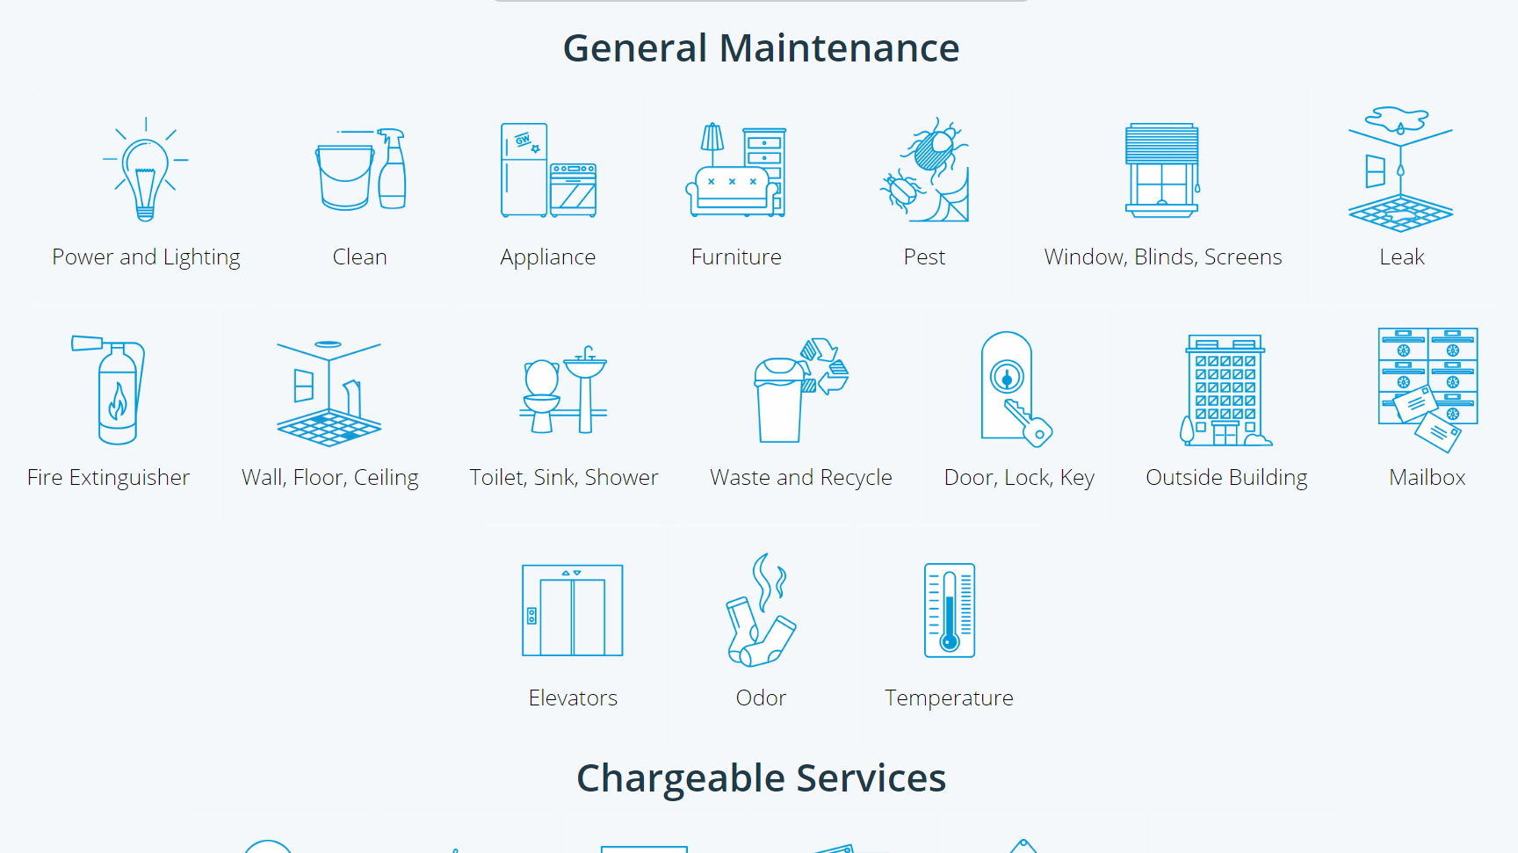
Notes:
ReADY Request provides a customer facing portal that walks the customer through the information collection process asking for different information depending on the type of work needed.

Slide 30
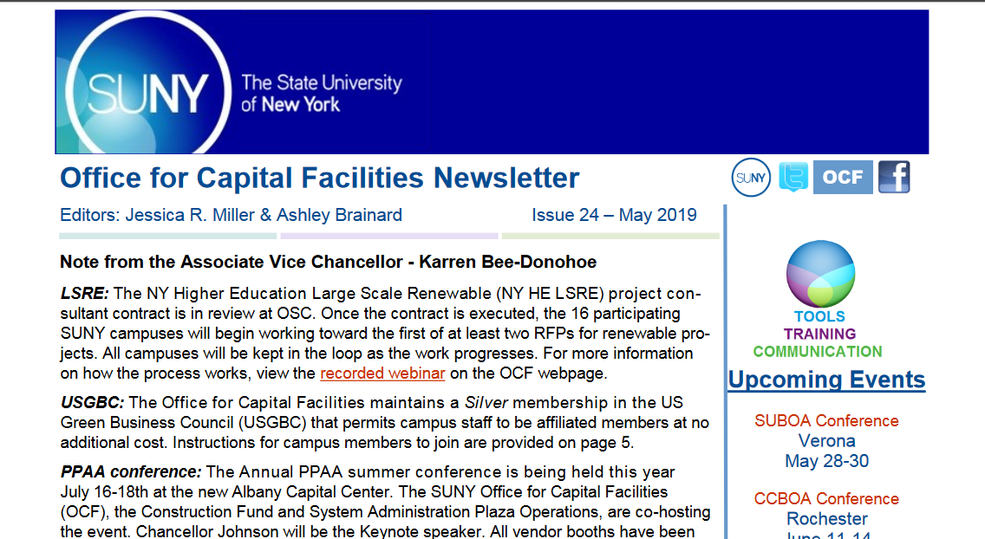
Miscellaneous
Newsletters
Webpage
AutoCAD
Notes:
Reminder the office for capital facilities issues a newsletter almost quarterly. In addition, we maintain an index of all articles so that you can easily find information from past articles. Please let us know if there are topics you would like us to cover in a future newsletter
In addition there is an AiM specific newsletter covering specifics related to AiM
The OCF webpage is constantly being updated. Please think of it as a main resource and again let us know if there is something you would like to see added
Lastly we have additional space for a few more campuses in the AutoCAD program. This gets you access to the most up-to-date and back version of AutoCAD, AEC tools, REVIT and more at a fraction of the cost of buying individual licenses.

Slide 31


