Slide 1


SUNY/PPAA Winter Conference 2018
Office for Capital Facilities
January 2018

Slide 2
Office for Capital Facilities Agenda
APPA Total Cost of Ownership (TCO)
Energy - Aggregated Solar Project and Deep Energy Retrofits
APPA Thought Leader Series
AiM O & M, Help Desk, SIG, Assets and Training
Why is this important
Vision for the future
What we’ve done so far
What we propose
How it helps campuses
Cost and potential savings

Slide 3

APPA Total Cost of Ownership (TCO)

Slide 4
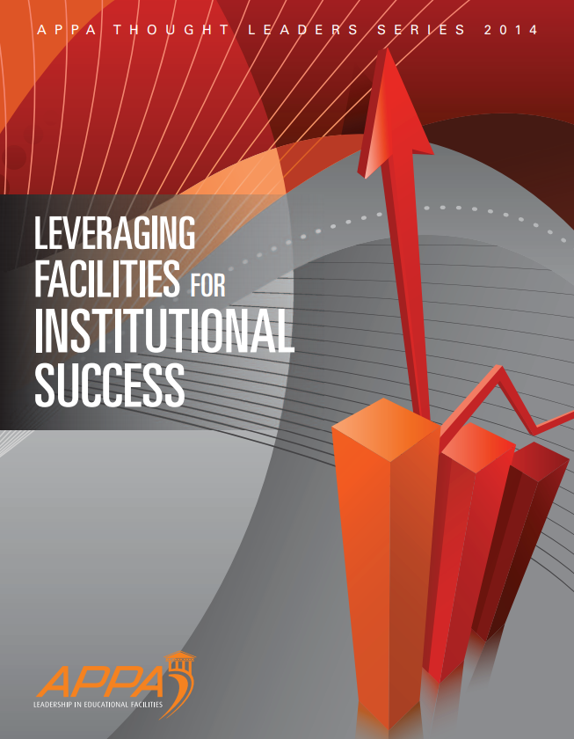
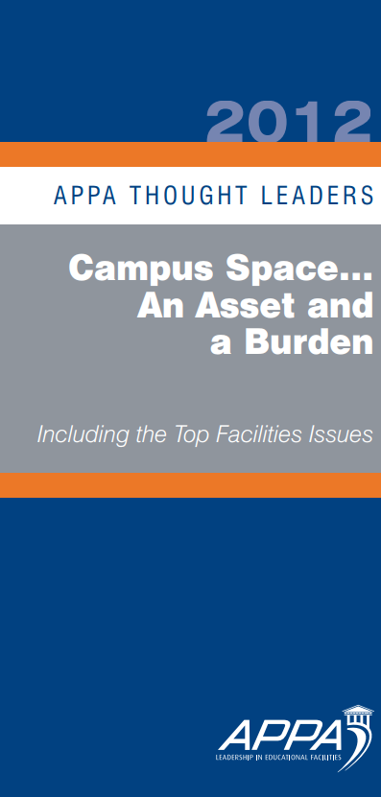

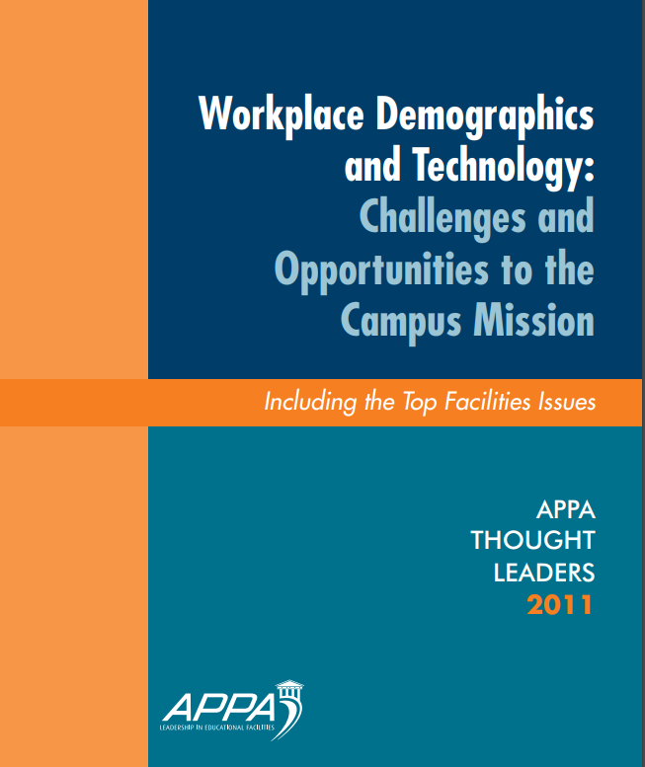

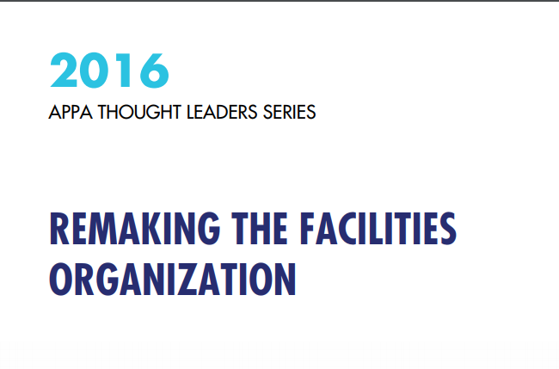

2018 The Landscape, Framework and Strategies for Managing and Mitigating Risk”.

Slide 5

Send a Text to: 505 208 0623
Loss of Institutional Knowledge from Retirements
Insufficient Emergency Preparations
Degradation of Underground Infrastructure
Insufficient Preventative Maintenance
Overwhelming and unmanageable project documentation
Facilities Staff Qualifications both existing and new
Insufficient Facilities Budget
Energy Costs
Procurement Regulations

Slide 6
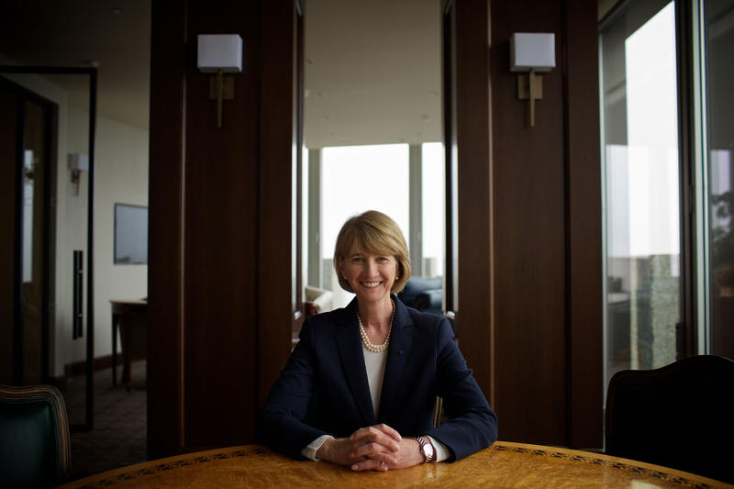
Vote 505 208 0623
Text the letter only
A – Retirements
B – Emergencies
C – infrastructure
D – PMs
E – Documentation
F – Staff Quals
G – Energy Costs
H - Facilities Budget
I – Procurement
Vote for up to three
One of Chancellor Johnson’s Four Goals is Sustainability

Slide 7
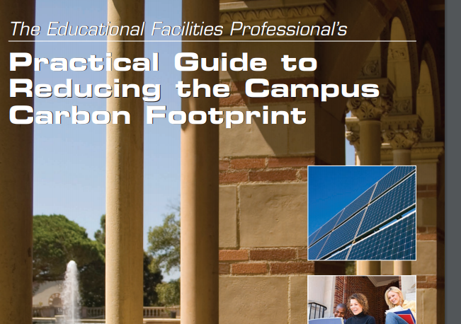
Vote 505 208 0623
Text the letter only
A – Retirements
B – Emergencies
C – infrastructure
D – PMs
E – Documentation
F – Staff Quals
G – Energy Costs
H - Facilities Budget
I – Procurement
Vote for up to three
Purchase Green Power
Deep Energy Retrofits

Slide 8
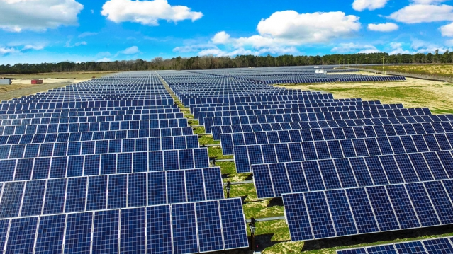
Vote 505 208 0623
Text the letter only
A – Retirements
B – Emergencies
C – infrastructure
D – PMs
E – Documentation
F – Staff Quals
G – Energy Costs
H - Facilities Budget
I – Procurement
Vote for up to three
Installing more renewable energy on campuses
Currently 51%, nuclear and large hydro making up 41% of the 51%
<2MW Solar projects on or adjacent to campus
Including battery storage

Slide 9


New York Campus Aggregated Renewable Energy Solution (NYCARES)
The Power of SUNY and Beyond
Not Just Renewable Energy Credits (RECs)

Slide 10
NYCARES Large Scale Renewable Energy Project

Slide 11

Retrofit NY

Slide 12
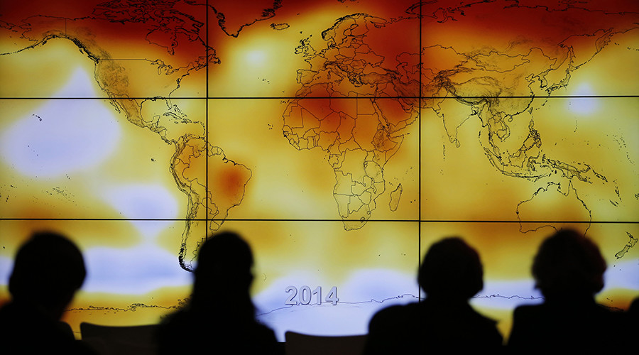
Vote 505 208 0623
Text the letter only
A – Retirements
B – Emergencies
C – infrastructure
D – PMs
E – Documentation
F – Staff Quals
G – Energy costs
H - Facilities Budget
I – Procurement
Vote for up to three
EO166
Reduce GHG 40% by 2030 and 80% by 2050
Create Agency Plans
Agencies must implement measures to improve efficiency and reduce GHG

Slide 13



AiM: Modules
Fleet and Fuel
Integrated Workplace
Property Risk Management
Currently - Property, Space and Asset Life Cycle Management
Next - Work Order Management
Property, Space and Asset Life Cycle
Construction Management
Surplus Management
Parking Management
Field Service Solutions
Energy Management
Asset and Inventory

Slide 14

Vote 505 208 0623
Test the letter only
A – Retirements
B – Emergencies
C – infrastructure
D – PMs
E – Documentation
F – Staff Quals
G – Energy $
H - Facilities Budget
I – Procurement
Vote for up to three

Slide 15

We are here to help!

