Slide 1


SUNY/PPAA
Summer Conference
Office for Capital Facilities
August 2016

Slide 2


Agenda
Energy
NY Energy Manager
NYPA Agreement
OGS State-wide Solar Contract
Existing OGS Contract
Campus Let Contract Update
AutoCAD
AssetWORKS
Notes:
► Several Energy topics including
► Update on NYEM
► Highlight an agreement we have developed with NYPA that may expedite some contracts
► Discuss potential for a Statewide solar contract through OGS
► Additionally overview an existing OGS contract that may help advance energy projects and other construction items.
► Update on Campus Let Contract
► Update on AutoCAD
► Discuss AssetWorks the new asset management program

Slide 3

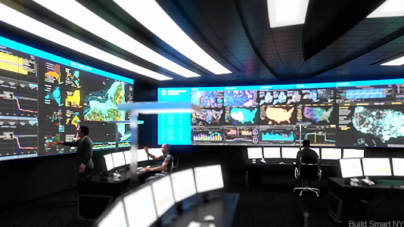
Energy – EO88 Annual Report
Usage from Energy CAP
Building SF from BCI with Indicators for Excluded buildings
Notes:
► Official data for the 2015-2016 State FY for the EO88 report. Reported based on the State fiscal year that ended March 31, and comes from EnergyCap.
► The other critical piece of data is the building square footage that is included in the formula to arrive at the Energy use intensity. The Campuses will have an opportunity to review the data for which buildings are included in that SF to calculate the Energy Use Intensity.
► The goal is to make sure that we match building usage and building AF as accurately as possible.

Slide 4




EO 88 Performance Portal
Continuous Monitoring Portal
Free
$TBD
Notes:
► Extensive communication over the past year about NYEM.
► NYEM has two parts:
Data of record for EO88
Data Analytics to help operators maintain greater efficiency of the buildings.

Slide 5
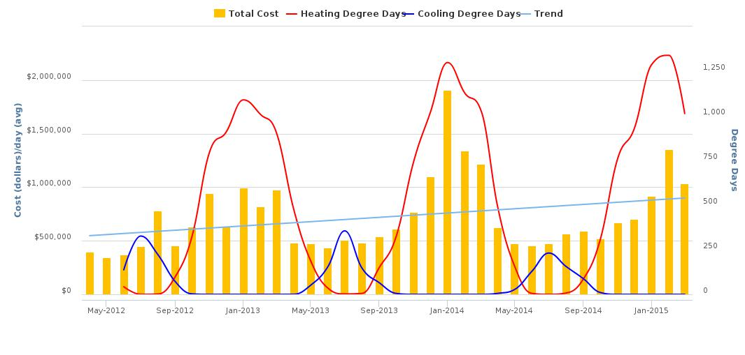
Energy Costs
Total Cost Per Month
$2,000,000
$1,500,000
$1,000,000
$500,000
$0
1,250
1,000
750
500
250
0
May 2012 Sept 2012 Jan 2013 May 2013 Sep 2013 Jan 2014 May 2014 Sep 2014 Jan 2015
Notes:
► SUNY State Operated campuses spend on average around $500,000 per day
► The trend from 2010 through 2015 was an increase of nearly $10,000 per day

Slide 6
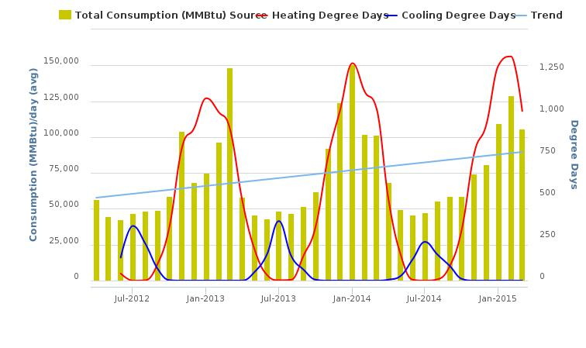
Energy Use
Total Consumption Per Month
Notes:
► This chart shown the consumption per month for the same period. Overall trend is upward. However this data is only through March 2015.

Slide 7
MMBTU Site Energy
Notes:
► Initial look at this year’s data appears to show a reduction from last year, and while slightly higher than the base year. SUNY has added a significant amount of SF. Overall EUI should drop when the 15-16 data is finalized.

Slide 8

Energy Analytics
NYEM
Proof of Concept
Training
Notes:
► Related to the second purpose for NYEM, currently 12 campuses are feeding submetering data into the NYEM platform.
► Not yet seeing the type of progress from the system expected and needed, in order to achieve the savings needed to meet the goals of NYEM.
► Pressuring NYPA to put more attention into the proof of concept activities on NYEM. The data is being fed into the system, but there are not sufficient analytics occurring.
► Nor is there sufficient training of the campus staff for them to take advantage of the system in order to add true value to the campus energy conservation efforts.
► Remaining optimistic that data analytics to achieve constant commissioning remains one of the most promising technologies to help us achieve and sustain energy efficiency. Continuing to push NYPA to move this process forward. Running out of time to make the significant reductions that are being requested.

Slide 9

Maintenance Operations Staff Qualifications
SUNY Provost Office
Certificate and Degree Programs
NYSERDA and PPAA
Training Opportunities
Notes:
► Many building operations managers comment insufficient access to staff with the skillsets needed to run the more complex facilities that are being built today. Staff feel overwhelmed with the new systems.
► Working with the SUNY Provost office to develop academic certificate and/or degree programs in building management geared toward educating the next generation of building operators.
► That process will be very slow.
► To help address the immediate need, working with NYSERDA and PPAA’s education committee chair, to identify grant opportunities for training that can help you now.
► If you have ideas about specific needs for your current employees please discuss with OCF.

Slide 10

OGS Solar Contract
Collaborative Team
Power Purchase Agreements
Notes:
► Working with Office of General Services to develop a contract for implementing solar installations.
► Small team from OCF, SUNY counsel and a campus rep.
► In communication with the Controller’s office to determine whether or not solar power purchase agreements are required to go to OSC for review. The current thinking is that these contracts qualify as a commodity purchase which does not require AG/OSC pre audit.
► If you are planning to implement solar on your campus we strongly recommend you contact OCF for assistance with the financial feasibility, and electricity markets. Whether or not the campus currently participates in the Energy buying group can affect the affordability of solar projects.
► Additionally, if an Energy buying group campus does choose to move forward with solar, it is important to communicate with OCF related to the electricity the Energy Buying Group is procuring for the campus.

Slide 11

Contract Tools for Advancing Energy Efficiencies
NYPA Contract
OGS Contract
Notes:
►Two contracting options, one new and one old that may have gone unnoticed that can help with energy and other projects.
►NYPA Contract
►OGS Contract

Slide 12

NYPA Energy Efficiencies Services Program Master Services Agreement
Notes:
►A team from the Office for Capital Facilities together with the Office of University Counsel, has executed a master agreement with the New York State Power Authority, for Construction and Construction-related Energy Efficiency Services.
►The Agreement is written so as to provide construction related design services and construction of actual energy projects, which removes the need for these NYPA projects to be reviewed by OSC. Previously campuses accessed NYPA through and OGS contract which required OSC approval for each contract assignment made through that agreement. This new agreement should streamline ability to engage with NYPA for energy efficiency projects.
►The Agreement can be used for assessment and turnkey projects such as;
►Audits and Energy Master Planning
►Lighting efficiency upgrades
►Controls
►HVAC improvements
►Distributed generation
►Microgrid evaluation and design
►A guidance document is being drafted and will be on the Office for Capital Facilities website for reference in the near future.

Slide 13

OGS Group 77201 Security Systems and Solutions Contract
Building Security
Building Security Alarm Systems
Building door hardware
Security Lighting
Security Fencing
Notes:
► OGS Security Systems and Solutions Contract.
► The name of this contract does not tell the whole picture when one considers the services that are covered under this contract.
► The contract includes project scopes related to building security such as the installation of:
► Building Security Alarm Systems
► Building door hardware
► Security lighting
► Security fencing

Slide 14

Going Beyond Security
Contract also includes:
Fire Protection/Detection Controls
Energy Management Systems
Building Automation Control Systems
HVAC Systems
Notes:
►But it goes beyond security to include
►Fire Protection/detection and controls
►Energy Management Systems
►Building automation control systems; and even
►HVAC systems (chillers, boilers, ductwork, etc.)
►They clearly state it is also not the intent of this contract to perform the erection, construction, or reconstruction of buildings, however the contract has built-into it, the ability of the contractor doing installation of the covered services, to hire subcontractors for related services that can include electric installation, Elevator Controls, general construction, cabling, HVAC modifications, etc.
►Each approved contractor has a specific summary of the potential subcontracting that may be done through this contract. Campuses should note however that the markup for this added work generally runs at 25%.
►Major building controls contractors such as Honeywell, Johnson Controls, and Siemens are there along with a myriad of other vendors, including chiller equipment through Trane

Slide 15

Things to Remember
Notes:
►Contract is intended to be a “not to exceed” contract. Campuses are encouraged to seek quotes from multiple contractors, and to negotiate for better pricing specific to your project from one or more of the nearly 100 businesses on this contract.
►The various vendor contracts (i.e. Johnson Controls, Trane US, inc, Siemens Industry, Inc., Honeywell Business Solutions, Control Technologies, Inc. etc.) are distinguished by lots and regions throughout the state. Be sure to check whether the contractor is authorized for your region
►Contract for some vendors the contract expires in 2017 while others have been extended to 2020.
►Authorized Users should always follow their Internal Procurement Guidelines and Best Practices and maintain a detailed Procurement Record.

Slide 16


Campus Let Contracts
Training
3 Campus Let sessions:
  Reached 205 staff from
  30 campuses
Notes:
► Campus training for over 200 staff from 30 campuses.
► The training focused on procurement requirements, the fiscal responsibilities associated with capital procurements and the administration of the Minority and Women-owned Business Enterprises program. (A similar round of trainings were conducted in 2013 reaching a total of 235 staff members from 30 campuses.)
► The Campus Let Contracts Program intends to continue to offer one or two regional sessions each year, rotating locations throughout state.
►Ideas for training related to Campus Lets, or suggestion for future training topics, please reach out OFC

Slide 17

Communications
Webinar Recordings
Insurance Requirements
Consultant Selection
Guidance Documents
CLC – 11 Approval for Real Property Transactions
Notes:
► Two webinar recordings available, one for Insurance requirements and another on consultant selection.
► New guidance document for Real property transactions.

Slide 18

Campus Let Contracts – Up Next
Tools
Updates to Construction Bid Documents
  Information for bidders
  Division 1 General Requirements
Communications
Records Retention Guidance Document
Notes:
►There are currently two separate efforts underway to improve the Campus Let bid documents.
►The first is to update the SUNY information for bidders to include the improvements incorporated by the Fund including enhanced requirements related to bidders experience, including the requirement that a bidder has completed three contracts of similar size, scope and complexity within the last five years.
►The second effort will include an evaluation of SUNY’s Division 1 General Requirements Document, and likely result in the development of two separate general requirements documents, one for simpler small dollar projects and one for larger dollar more complex projects.
►And finally the Campus Let program is working to finalize a guidance document on record retention.

Slide 19
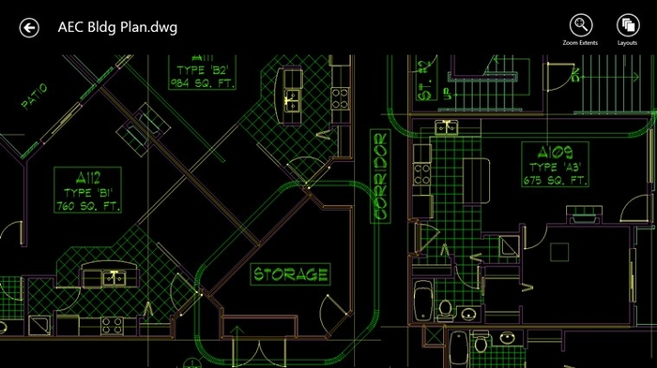
AutoCAD
Current Contract expires in October
License Manager System
Pricing
Notes:
►The initial contract we created last year is expiring. Working with Autodesk on pricing for those campuses that want to continue and any that might want to join this systemwide procurement of a license manager system that allows participating campuses to access the most up to date AutoCAD software at a lower cost than buying individual licenses at the campus.
►We are working with Autodesk on pricing to continue the contract. There will be a short turnaround on this process to keep the contract functioning.

Slide 20
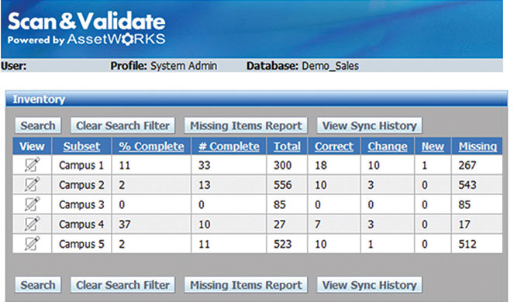
AssetWORKS
Goal – Condition assessment for 17-18 budget request
Campus Data Reviews
Critical Deadlines
Short Surveys
Procedure Changes
Notes:
► As with all new software program implementations, AssetWorks brings challenges, and we need campuses to be prepared.
► The goal is to have the building and space data in place later this year, along with major building systems and subsystem data. With that in place the focus will be on condition assessments toward the end of the year, so that reports of capital deficiencies can be ready in early spring for use to develop the 2017-18 capital budget request.
►There will be a lot of data to review, and critical deadlines to keep on track.
►In addition to the initial request for asset information there will be additional areas needing campus input, for which we will create short surveys. It will be important to participate in these, in order to have your voice heard.
►There will be procedure changes. Patience will be needed to learn the system and to understand the necessary changes

Slide 21

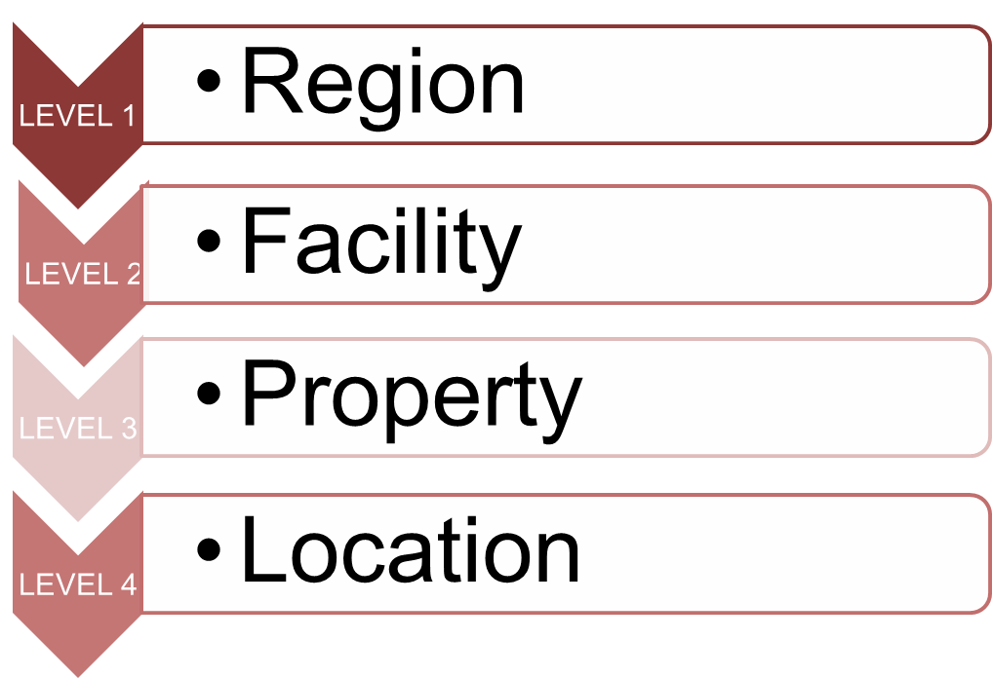
Property Hierarchy
AssetWORKS
Institution
Campus
Building
Room
Notes:
►An illustration of one of the changes, different labels to discuss things that are very familiar. The new system will have terms like Region, Facility, Property and Location.
►These represent Institution, Campus, Building and Room.

Slide 22
AssetWORKS
Property Hierarchy
Region
University at Albany
Facility
Downtown
Property
0001 (Draper Hall)
Location
102 (Faculty Office)
Region
University at Albany
Facility
Main Campus
Property
SFTB (Softball Field)
Location
INFD (Skinned infield)
Notes:
►For Example Albany has four different facilities, the main campus, an East campus, a Downtown campus and a facility at Whiteface mountain.
►In the hierarchy Facility will be used to identify each.
►At the downtown campus is a Building called Draper Hall, and in the building is Room #102 which is a faculty office.
►This system will not only track buildings, but also other properties such as athletic fields.
►In this example there is a softball field which is the “Property”. Using the term “Building” would be limiting. Transition the vocabulary.

Slide 23


AssetWORKS
Organizational Hierarchy
INSTITUTION (Cortland)
DEPARTMENT (Facilities)
ORGANIZATION (Custodial)
Notes:
►There are other hierarchies in the system including how your campus is organized. This is used for assigning entities to locations. These new ways of organizing our data will take time to learn but will give us many more ways to manage all of our capital assets.

Slide 24


Full Asset Management
Work Order Management
Key Management
AutoCAD integration
Notes:
► AssetWORKS is a full asset management system. Start thinking about capital assets as more than just the buildings.
► Additional Modules include such things as work order management, key management and Cad integration.

Slide 25

AssetWORKS
Training, training, training
Support Person in OCF
Notes:
► Training will be provided including a train the trainer process in order to spread the knowledge most effectively to all of the campuses.
► Pushing for support person to manage the system and be a direct resource to the campuses.
► Patience timely responses to data requests.

Slide 26

Questions?

