Slide 2
Agenda
Tools, Training, Communication
Res Hall Capital Budget
Community College Capital Budget
Energy Buying Group
Environmental Health & Safety
  Director of Sustainability

Slide 3
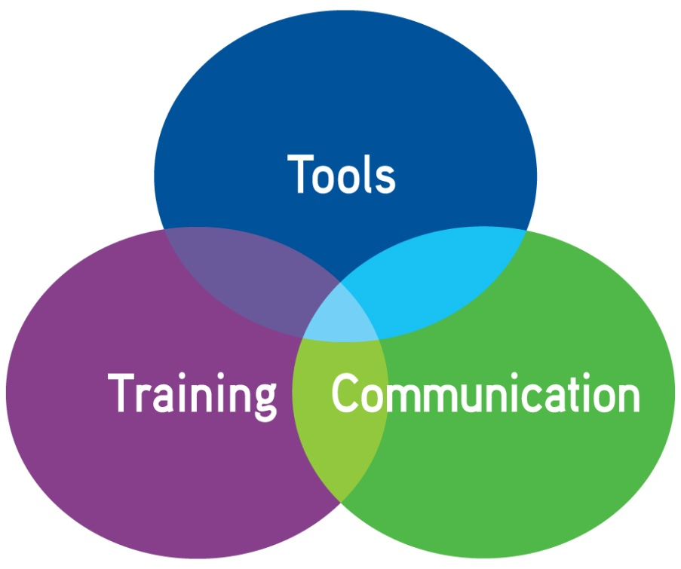
Think Tools, Training,
Communication
OCF Newsletter
OCF Webpage
Survey Results
Guidance Documents

Slide 4
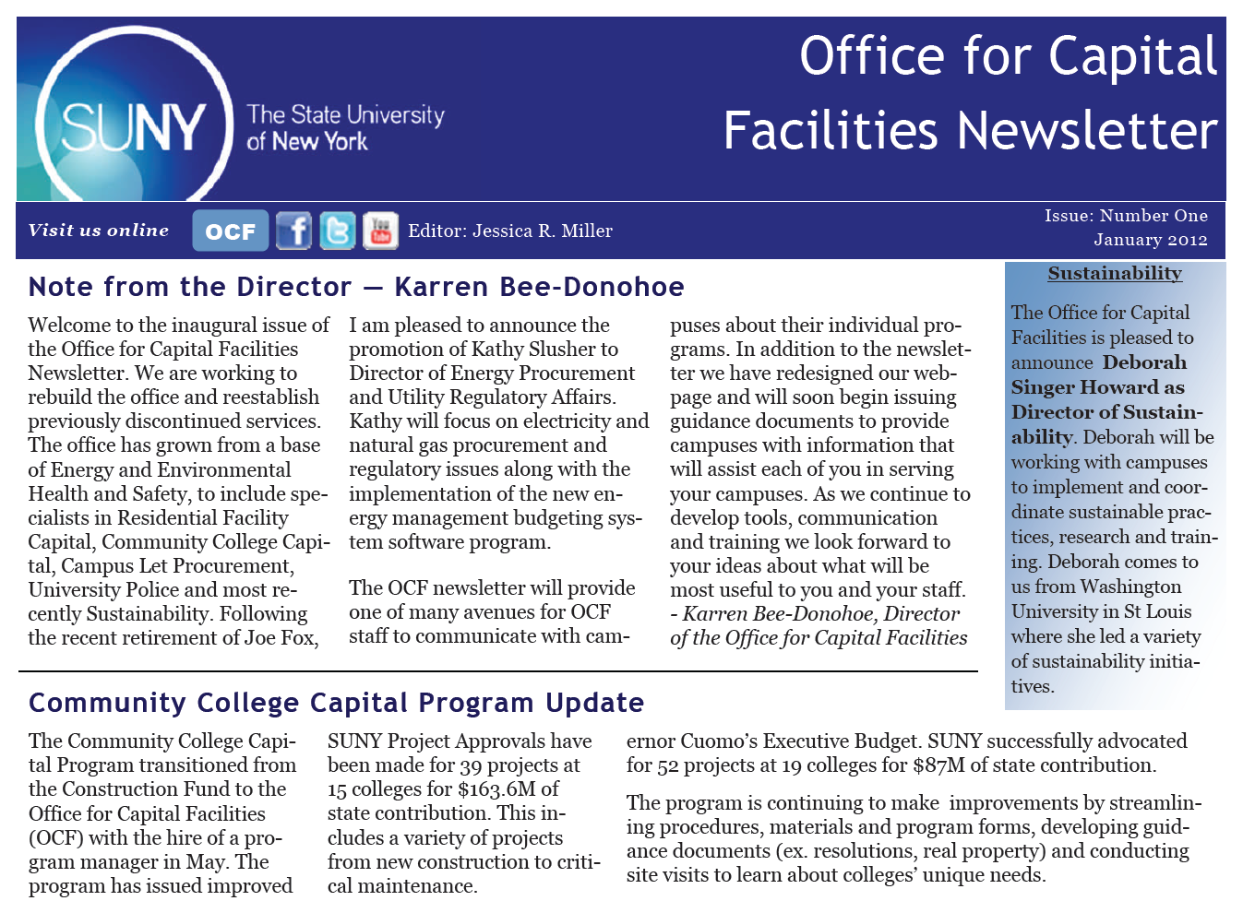

Slide 5
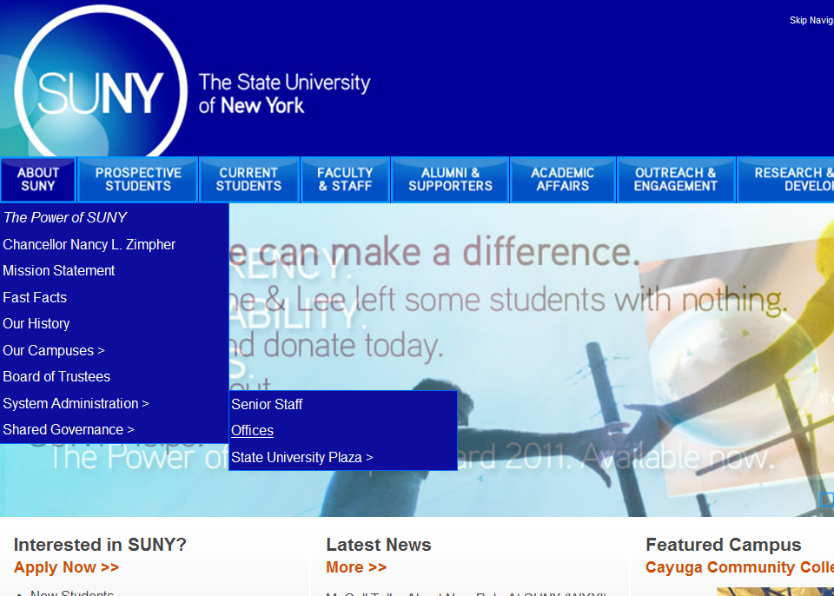

Slide 6
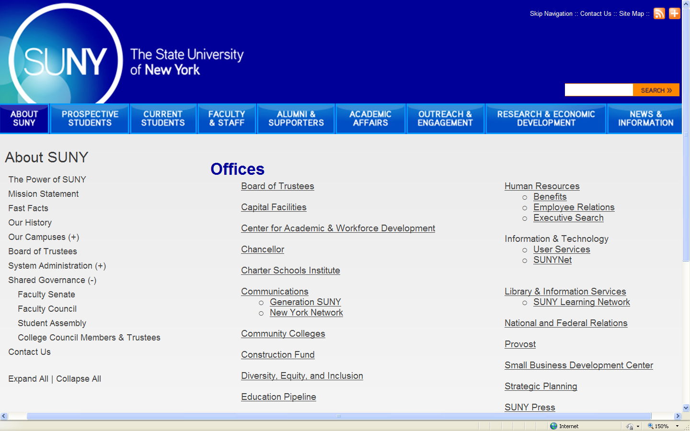

Slide 7
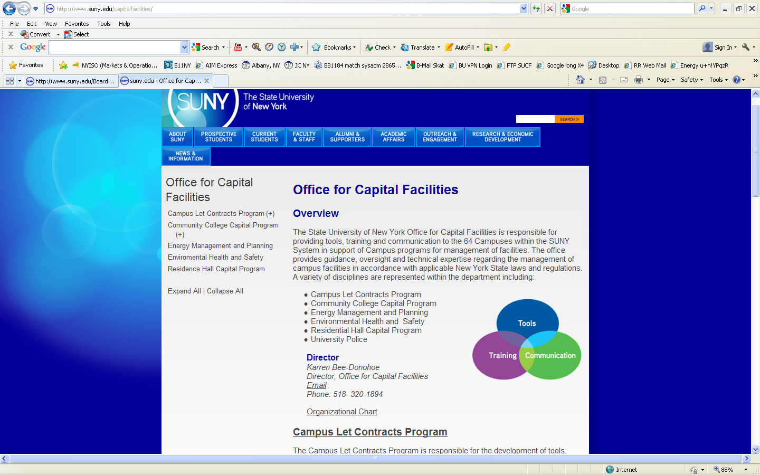

Slide 8
Survey Results
Questions asked regarding the tools, training and communication preferences
24 state operated campuses responded
Answers were categorized as
  Yes!!! I need this!
  Would be nice
  Might use it
  No thanks

Slide 9
Rate the following standard contract templates according to importance/priority to your campus.
Standard Contract Templates | Yes!!! I need this! | Would be nice | Might use it | No thanks | N/A
Term - AE Services (single consultant) | 68% | 32% | 0% | 0% | 0%
Backdrop Term - AE Services (multiple consultants, requires mini selection) | 41% | 50% | 9% | 0% | 0%
Time & Material | 43% | 29% | 24% | 0% | 5%
Specialty Services | 55% | 30% | 10% | 5% | 0%

Slide 10
Survey Results – Contract Templates
Rate the following standard contract templates according to importance/priority to your campus.
Responded “Yes I need this” or “Would be nice”
  Term AE Services - 100%
    single consultant
  Backdrop Term AE Services - 91%
    multiple consultants, requires mini selection
  Specialty Services - 85%
  Time and Material - 72%
Notes:
Specific Comments
Oneonta: AE Term contracts desired
Cortland: Regional terms like SUCF desired
Oswego: AE terms and training desired
Canton: Campus visits desired

Slide 11
Rate the following Specialty Service contract templates according to importance/priority to your campus.
Specialty Services | Yes!!! I need this! | Would be nice | Might use it | No thanks | N/A
Asbestos Abatement Design | 55% | 23% | 9% | 9% | 5%
Code Reviews | 27% | 23% | 32% | 14% | 5%
SHPO Archaeological | 14% | 23% | 41% | 14% | 9%
SEQR | 32% | 23% | 41% | 0% | 5%

Slide 12
Survey Results – Specialty Services
Rate the following Specialty Service contract templates according to importance/priority
Responded “Yes I need this” or “Would be nice”
  Asbestos Abatement Design – 78%
  Code Reviews – 50%
  SHPO Archaeological – 37%
  SEQR – 55%
Notes:
Fredonia: Updated boilerplates desired

Slide 13
Rate the following Time & Material contract templates according to importance/priority to your campus
Time & Material Contracts | Yes!!! I need this! | Would be nice | Might use it | No thanks | N/A
Asbestos Abatement | 41% | 45% | 9% | 5% | 0%
Welding | 18% | 14% | 27% | 36% | 5%
Window Treatments | 18% | 27% | 41% | 14% | 0%
Carpet installation | 32% | 23% | 41% | 5% | 0%
Excavation | 23% | 36% | 27% | 14% | 0%
Signage | 9% | 32% | 41% | 18% | 0%

Slide 14
Survey Results – Time & Material
Rate the following Time & Material contract templates according to importance/priority
Responded “Yes I need this” or “Would be nice”
  Asbestos Abatement – 86%
  Welding – 32%
  Window Treatments – 45%
  Carpet Installation – 55%
  Excavation – 59%
  Signage – 41%
Notes:
Purchase: T&M for general construction desired
Buffalo: Terms for trades desired
Albany: Elevator maintenance and fire alarm systems contracts desired
OGS Contract – Guidance Document being released

Slide 15
Think Shared Services
Development of contracts for consultants, time and material work, and construction services templates is an example of shared services
OCF is a part of the shared services discussion, centrally creating tools for campuses
Campuses can participate in shared services by offering tools they have created to other campuses

Slide 16
Shared Services & Systemness
Whether developed centrally or by individual campuses, sharing them among all campuses reduces redundant effort across the state
Regional groups can jointly execute contracts for multiple campuses to use
Systemness - recognizing that while the campuses are competitors they are also essential parts of a system and success of each is vital to the whole

Slide 17
Rate the following training topics according to importance/priority to your campus.
Training | Yes!!! I need this! | Would be nice | Might use it | No thanks | N/A
Campus Let Process (Overview) | 45% | 45% | 9% | 0% | 0%
Fee Negotiations & Documentation | 45% | 27% | 27% | 0% | 0%
Wicks Law | 36% | 41% | 14% | 9% | 0%
MWBE | 41% | 32% | 18% | 5% | 5%
Sole Source Justification | 50% | 41% | 5% | 5% | 0%
Contract Closeouts | 45% | 41% | 9% | 5% | 0%

Slide 18
Survey Results - Training
Responded “Yes I need this” or “Would be nice”
Campus Let Process (General Overview) – 90%
Fee Schedules (Negotiations & Documentation) – 92%
Wicks Law – 77%
MWBE – 73%
Sole Source Justification – 91%
Contract Closeouts – 86%
New facilities officer training
Notes:
ESF: Insurance and bonding training desired

Slide 19
How would you prefer to receive communication from the Office for Capital Facilities related to contracts? (Check all that apply)
Communications | 41 Total Responses | %
SUNY Webpage for Facilities/Contracts | 10 | 24%
Facebook Page for Facilities/Contracts | 0 | 0%
Email Updates via PPAA listserv | 15 | 37%
Email Updates via a NEW campus let listserv | 9 | 22%
Quarterly News Letters | 5 | 12%
Confluence Online Discussion Forum | 2 | 5%

Slide 20
Listserv Options
Current SUNYPPAA List includes State Ops, Community Colleges, DASNY, SUCF, Private Colleges
Potential uses include:
  Capital Projects - design, construction procurement
  Energy & Sustainability
  Maintenance and Operations

Slide 21
Where next with listservs?
General Purpose – SUNYPPAA
Capital Projects – SUNYCLC
Facilities Directors?
Maintenance & Operations?
Energy & Sustainability?

Slide 22
Guidance Documents
Campuses recently received letter from Bob Haelen announcing new guidance documents to be issued by OCF
Initial documents will be in area of capital procurement
Session tomorrow will review construction authority and thresholds for various requirements

Slide 23
Guidance Documents & Other Tools
Guidance Documents
  Construction Authority
  Threshold Chart
  Construction Bonds
  OGS Construction Services Contract
Future topics will include all areas of OCF
Looking for your input - how we can help you?

Slide 24
Res Hall Capital Projects
Private Use Survey coming soon
Budget Request
  2012-13 two year request
    $ 355 million bonded appropriation
    $ 45 million in hard dollar
  Executive Budget includes the hard dollar request but no bonded appropriation
  Most bonded projects, not currently funded with a full project budget, will not be able to progress

Slide 25
Res Hall Funding Options
Smaller projects could be funded by Res Hall reserve cash using hard dollar appropriation
Medium sized projects could be funded by 15-year revolving loan program, although overall pot is limited to around $20-25 million
Bonded projects that have not yet started design might be able to be funded for design only.

Slide 26
OCF Actions
Reviewing all projects with DASNY for schedule and budget changes
Reviewing cash flow as it impacts future bond sales
Work with Campuses on other options to move projects forward

Slide 27
What Campuses can do to help
Provide OCF with impact of no funding
Review current project schedules and budgets and free up any unneeded appropriation – remember “Systemness”, your actions can help other campuses
Consider hard dollar options using reserve funds or 15-year revolving loan
Alert OCF soon if you would like to use cash reserve or revolving loan

Slide 28
CC Capital Program
CC Capital Request for almost $87 million in capital
Executive Budget included all requested capital appropriation
Continuing to move the projects through the complicated system of split funding

Slide 29
Environmental Health & Safety
Code Training
  ICC, NYS-DCEA and NYSERDA are providing certification exams in lieu of 24 hour annual training http://www.dos.ny.gov/DCEA/icccertif.html
Construction Safety
  Barbara providing and update tomorrow focusing on construction safety
Compliance Calendar http://www.suny.edu/capitalfacilities/EHS.cfm
Notes:
NYS Department of Code Enforcement and Administration

Slide 30
Energy Updates
Energy Management Budgeting System contract approval moving through OSC
Once approved Kathy’s group will work with campuses on the implementation.
This is another example of a shared service. All campuses will be on the same platform for tracking of utility bills. Campuses that want to go beyond the mandatory use may do so at the campuses expense.

Slide 31
Sustainability Director
Director, Deborah Howard began mid January
Will catalogue what is already being done at the campuses
Deborah will help share best practices, and coordinate activities throughout the system working closely with ESF President Neil Murphy and sustainability coordinators throughout the system

Slide 32
Chancellor’s State of the University Address
http://www.suny.edu/chancellor/speeches_presentations/SOU2012.cfm

Slide 33
We are here to Help!!

