Slide 1


SUNY/PPAA
Summer Conference
Office for Capital Facilities
July 2015

Slide 2
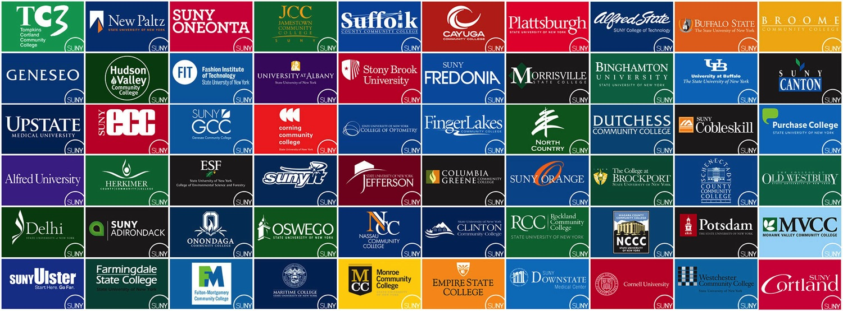

Agenda
SUNY OCF Orientation
APPA FPI
BCI/PSI Life Cycle Models
Energy
Carbon Monoxide

Slide 3

Thank You
Brunch with the Office for Capital Facilities
Summer PPAA Conference
July 14,2015
Notes:
► Target audience, those who are relatively new to their positions, new to SUNY or looking to advance in the future.
► The orientation was designed to help provide a better understanding of the functions and offerings of capital facilities and how each of the OCF staff can help campus staff be successful.

Slide 4

ERAPPA
NYAPPA
SUNY
APPA
Notes:
► APPA is an international organization that covers all of North and Central America.
► APPA is the parent organization, ERAPPA is the Eastern Region, NYAPPA which includes both SUNY campuses and private colleges is the sister organization to SUNY/PPAA and co-sponsor of our conference.

Slide 5
APPA seeks to create positive impact in educational facilities on three important levels:
APPA transforms individual facilities professionals into higher performing managers and leaders, which…
Helps transform member institutions into more inviting and supportive learning environments, which…
Elevates the recognition and value of educational facilities and their direct impact on the recruitment and retention of students, faculty and staff.
Notes:
► APPA provides valuable services to facilities managers with the following three goals:
1 - Transform the people – Helping to develop effective facilities leaders through numerous training opportunities, publications and other resources:
2 - APPA works with facilities managers to help them transform higher education institutions to improve the learning environment; and
3 - Finally works to elevate the importance of facilities in faculty, staff and student recruitment, something that you already know but which is not well recognized by other campus administrators.
► Membership is strongly recommended to take advantage of the APPA offerings.

Slide 6

APPA Facilities Performance Indicators
Oneonta & Brockport participated 2014
Includes self assessment
Peer comparison and benchmarking
Understanding of the data/information
Notes:
► Facilities Performance Indicators survey.
► Oneonta and Brockport each participated in the 2014 report, and for Brockport this was their second year of participation.
► What is the survey and why participate?
► The survey examines key facilities measures that are important to you as leaders.
► It includes critical self assessment. To complete the survey you must examine several factors related to your facilities, your operations and your capital plan.
► The survey results provide peer comparison and benchmarking allowing you to better understand how your campus compares to your selected cohort. If the survey is continued over multiple years it will demonstrate how your campus is freeing over the duration of your reporting.
► The process of undergoing the survey will give managers a better understanding of the key data surrounding facilities operations, maintenance and capital, which will help in making the case to those who control your budget.
► The survey is a collection of Facilities related data that spans all aspects of facilities management from custodial through general maintenance, grounds and into capital. It collects data about the institutions and also about both Personnel supplies materials and contracts.
► The survey helps campuses develop the current replacement value for each facility.
► Finally the survey provides access to data from other campuses for benchmarking purposes.

Slide 7

Sounds Like a lot of hard work
Notes:
► Both Oneonta and Brockport readily admitted that this first year effort was a major task, and one that required some careful decisions on how to best answer the questions.
► However, Brockport can attest that the second year is much easier and did not require as extensive an effort.

Slide 8
What’s First?
Full survey or essential set of questions?
Include auxiliaries or exclude auxiliaries?
Understand the definitions
Find the data sources
Institutions may array the data differently than the survey asks for it
Call an APPA FPI Advisor
Notes:
► The first decision is whether to complete the full survey or an express version. The more you put into it, the more campuses get out of it.
► Decide whether or not to include auxiliaries
► Spend time understanding the definitions
► Data on your campus may not seem to fit into the survey because of differences in the manner of data management at individual institutions.
► Therefore, APPA provides advisors to help your campus through the process.

Slide 9
What Do You Get Out of It?
The FPI provides a set of analytical metrics which informs on the performance of the campus facilities portfolio
How well is your facilities portfolio in alignment with your institution’s strategic direction?
Notes:
► The FPI provides numerous metrics that help campuses to better understand where you are doing well and where you fall short.
► The metrics can also be useful in looking at how your campus’s facilities align to the campus mission.

Slide 10
FPI Data Can Be Segmented
APPA region
Carnegie classification
Public & private institutions
Enrollment size
Members and non-members of APPA
Building age and more
Notes:
► The data can be sliced and diced many ways to create comparisons that may be regional, can be based on Carnegie classification, comparing public to private, based on size, building age and more.
► The system allows participating institutions to determine how it is best to present your campus data.

Slide 11

Reviewing FPI Report Outcomes
Every school compares itself differently
Find out what Data is important to your VP
Determine your peer institutions
Makes the business case
Notes:
► The FPI reporting is extensive. Think carefully about how to manage the reporting.
► Each school will look at the data different depending on individual circumstances.
► Understand what data is important to your VP, and how the right data may be able to move your VP to act in a manner beneficial to facilities.
► Determine campus peer institutions including other SUNY campuses. For meaningful comparisons they will also need to participate.
► The comparisons that can be developed will help your campus to make the business case for improved investment in your facilities operations.

Slide 12

APPA Resources to Assist You
Visit the APPA website at www.appa.org
The online FPI survey instrument can be accessed on the APPA website.
Additional information on the FPI Qualified Advisors Program can also be found on the APPA website
http://www.appa.org/research/FPI/index.cfm
Questions? Contact Christina Hills,
APPA Research Specialist
Tel: 703/684-1446
Email: christina@appa.org
Notes:
► APPA provides significant resources to members throughout the survey process.
► OCF will share more information when the survey opens this fall.
► The FPI logo sums it up nicely – tracking your campus’s facilities vital signs.

Slide 13
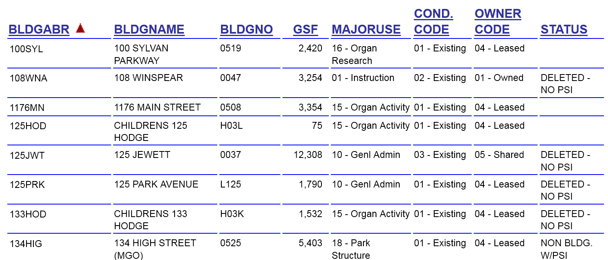
BCI/PSI and Life Cycle Modeling
Open For Data Entry At All Times
Simple Customizable Reporting
True Life Cycle Management
Notes:
► A multi departmental team at System Administration has been working hard this past year evaluating our needs and potential programs to replace the current Building Characteristics Inventory (BCI), Physical Space inventory (PSI) and Building condition assessment Survey (BCAS) with a truly functional database that will allow among other things:
► always open and available for update;
► Simple customized reporting; and
► true life cycle management tools

Slide 14
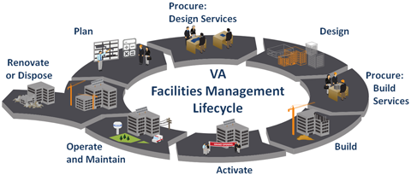
Life Cycle Management
Notes:
► The life cycle program will be a replacement to the BCAS.
► Instead of a snapshot every five years, the new program will incorporate data from newly completed projects to update the condition of building components, and more importantly to provide estimates of the remaining useful life of the building components.
► This data will allow for more informed decisions on how to spend precious capital resources.
► The data will also provide better information for System Administration and the Construction Fund to advocate for increased capital funding.
► Additional reporting requirements to the Division of the Budget and legislature require more comprehensive data on the facilities renewal needs than is available through the process BCAS process of the past decade.

Slide 15

We Need SUBOA Support
Business officers need to be on board
This will replace outdated dysfunctional legacy databases and processes
Should be able to make APPA FPI process easier
Notes:
► SUBOA support is critical.
► Business officers need to understand the importance of this program which will replace the existing legacy, outdated and dysfunctional programs.

Slide 16


Energy
Why it is so critical?
Daylight Hour
NY Prize
College & University Challenge
EO88 O&M Grant Program
EO88 Consultant Assistance
Energy & Sustainability Survey
Remote Net Metering
Notes:
Energy and related issues.
► Why energy is such a focus,
► NY Prize;
► The Daylight Hour challenge;
► The new REV College and University Challenge;
► The O&M Grant program;
► Consultant assistance from the Build Smart team;
► The Energy and Sustainability Survey; and
► Remote Net metering and some potential pitfalls.
Obviously both the Chancellor’s Strategic Plan goals and the EO88 Goals have heightened the importance of energy for the Office for Capital Facilities and the campuses, but there is another factor, one that you already know, but is still worth mentioning.

Slide 17
State Operated Campuses Energy Statistics
Annual $200 Million
ID | Daily Statistics | 2013-2014 Average $/Day
1 | All Campuses | $545,768
2 | Max – Stony Brook | $137,866
3 | Average | $16,538
4 | Median | $8,856
5 | Min - Empire | $944
Notes:
► Energy is a big cost at our campuses.
► The energy portion of SUNY’s annual utility budget, is nearly $200 million a year. This doesn’t include water, sewer or vehicle fuels.
► The average daily cost for energy in 2014 for all of SUNY State Operated Campuses was $545,000. That is over 1/2 million dollars per day.
► Half of the campuses spend under $8800 day;
► Empire spends just under $1000 per day;
► Stony Brook the energy cost is $137K per day;
► Average for the campuses is $16,538 per day, the equivalent of a half time cleaner salary going to energy every day.

Slide 18
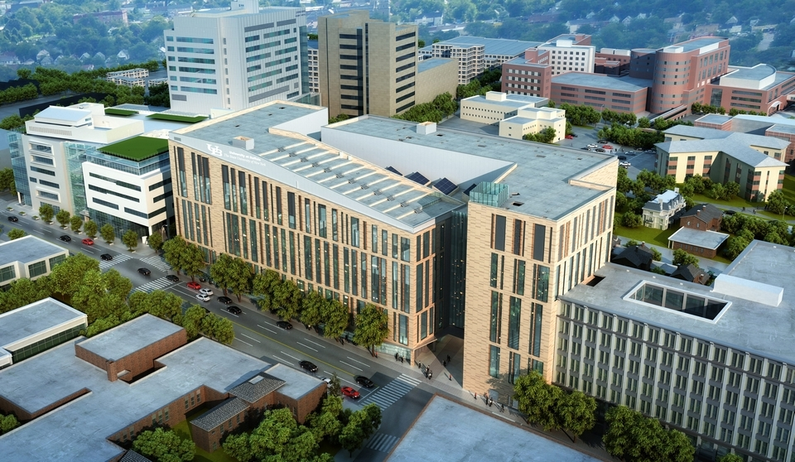
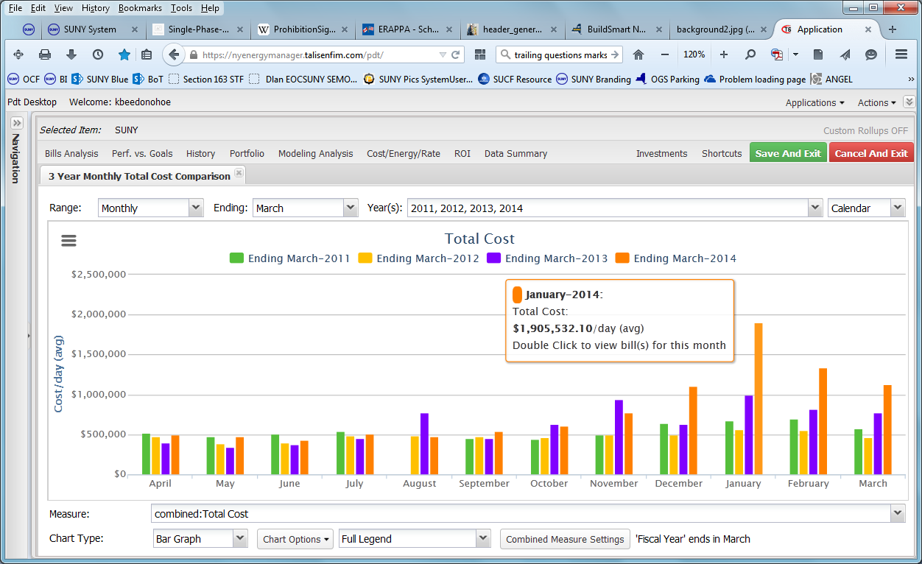
January 2014 - Peak Daily Cost - $1.9 Million
Notes:
►New York Energy manager reports such as this one which shows 4 years of cost data for all campuses.
►The spike on the right represents the Polar Vortex in January of 2014 when the daily average cost for that entire month was $1.9 million per day.

Slide 19
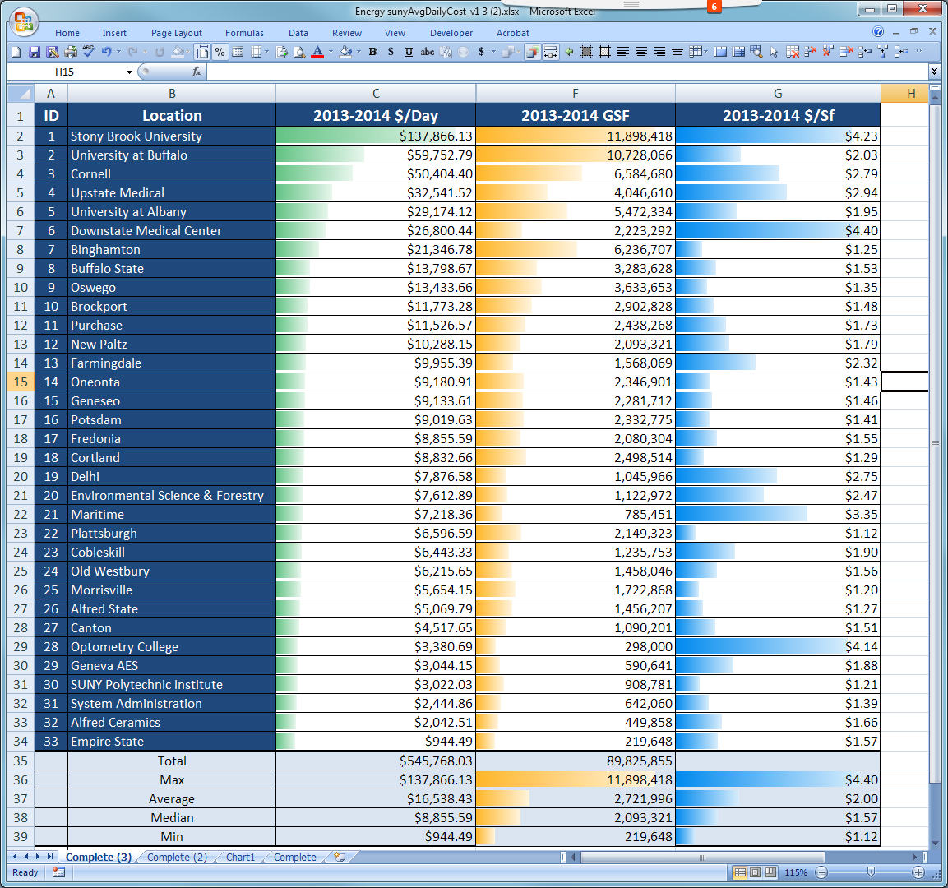
Notes:
► Total SF impacts our overall cost. This graph illustrates that SF is not the only factor, efficiency and local cost factors come into play.
► On the left is the total cost per day by campus with the green shading showing the level of cost, sorted from high to low.
► In the middle the orange shows the corresponding SF of the campuses. The shading gets a bit ragged in comparison to the smooth curve on the left.
► On the right is the cost per SF which in many cases has lost any correlation to the total cost per day.
► Near the bottom Optometry has a large blue bar. This represents one of the three highest costs of energy per SF at $4.14, compared to Plattsburg at $1.12 per SF.
► Plattsburg enjoys the lowest cost of electricity while Optometry is faced with the highest.
► Other variations on the right are related to efficiency factors that provide great opportunity for savings.
► With such a high expenditure we need to do everything we can to reduce costs.

Slide 20
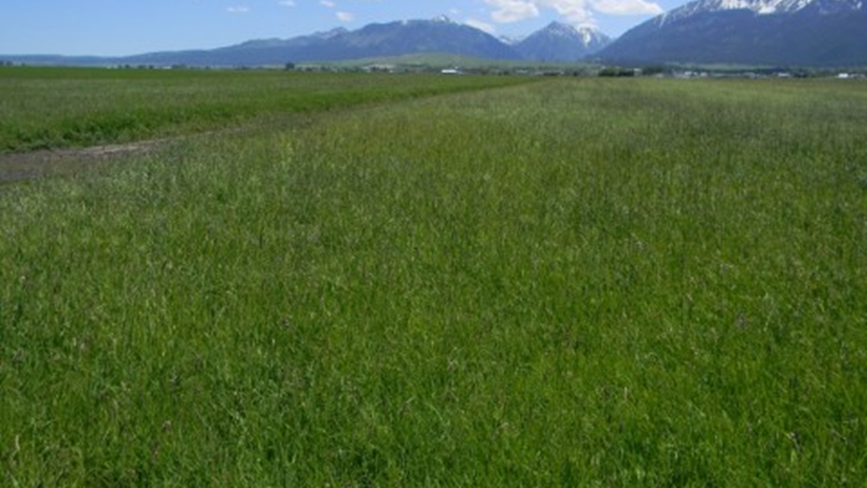
Princeton Review Green Guide
“Among nearly 10,000 teens who participated in our 2015 College Hopes & Worries Survey, 61% told us that having information about a school's commitment to the environment would influence their decision to apply to or attend the college”, said Robert Franek, The Princeton Review's Senior VP-Publisher.
Notes:
► According to the Princeton Review Green Guide, 61% of participating students indicated that a campuses environmental commitment would influence their decision.
► Environmental awareness, reduction of greenhouse gas and other smart energy policies can help campuses successfully attract students as well faculty and staff.

Slide 21
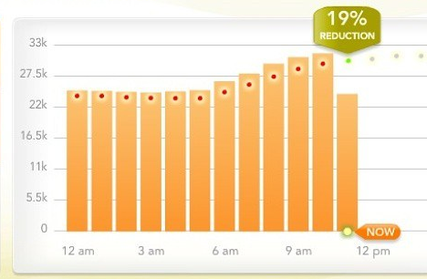
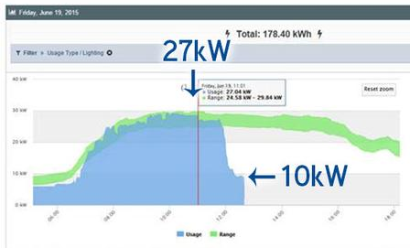
Daylight Hour
http://blog.suny.edu/2015/06/suny-turned-down-the-lights-for-daylighthour-2015/
Notes:
► Fifteen campuses participated in June in the Daylight Hour Challenge.
► Graphs illustrate the reduction in energy achieved by a simple request to turn off light at noon when daylight provides sufficient light to function in most offices.
► The graph on the left shows a 60% reduction in the lighting circuits of the Federal Building at SUNY Plaza. The green bar at the top being the standard lighting levels for the building.
► The graph on the right shows a nearly 20% reduction at Stony Brook.
► This event simply highlights the impact human behavior can have on our overall energy use. Campaigns designed to influence behavior are worth the effort.

Slide 22
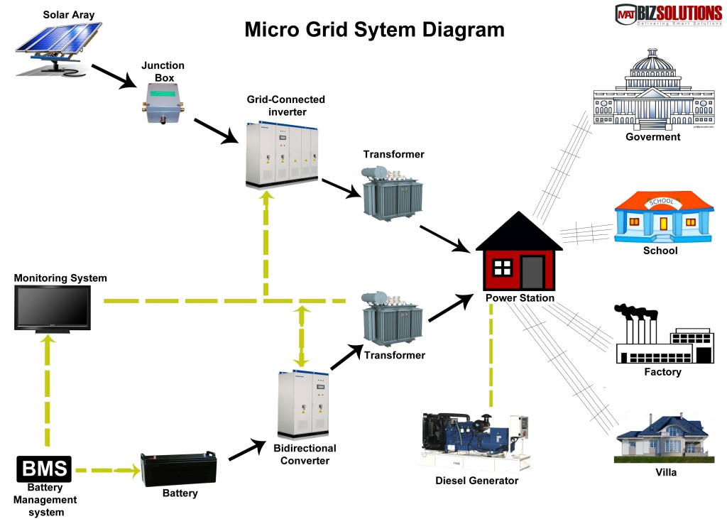
NY Prize
Notes:
► Microgrids are electricity grids that can be islanded from the main statewide electricity grid, and function on their own even when main grid power is down.
► Microgrids provide resiliency to an area during periods of blackout due to grid failures from storms or other factors.
► They incorporate some type of generation. They may incorporate electricity storage, and most importantly they have proper controls and safety equipment to function independent of the main grid when necessary.
► The NY Prize competition is looking to develop microgrids that do not just encompass a campus, but that also incorporate other community resources such as K-12 schools, fire and police stations, and hospitals.

Slide 23
NY Prize
SUNY Geneseo
SUNY Plattsburgh
SUNY Downstate Medical
SUNY New Paltz
SUNY Oswego
SUNY Upstate Medical
SUNY Canton
University at Buffalo
Cornell
Erie Community College
Schenectady Community College
Jefferson Community College
Westchester Community College
Onondaga Community College
Ulster Community College
Notes:
► Fifteen (15) SUNY campuses and Community Colleges participated and received awards in the first Phase of the NY Prize competition. Congratulations to these campuses.
► Originally the first phase was planned to award only 25 grants, but with over 160 applications they increased the awards to a total of 83.
► The first phase provides a grant for development of a concept report, which can then be used for entry into the second phase of the competition which will provide full design development and is currently planned to award 10 grants. Those designs will be entered into the third and final phase which is for construction money to build the micro grid.
► Additional projects may be entered into phase 2 even if a phase one grant was not received.
► SUNY Blog will follow the progression of the NY Prize competition.

Slide 24

REV Campus and University Challange
Renewing the Energy Vision (REV) College & University Challenge
Energy & Sustainability
Academics and R&D
Community Engagement
Notes:
► Many campuses participated on June 30 in the workshop for the REV College and University Challenge.
► New challenge is part of the Governor’s REV program - Renewing the Energy Vision. The program does not establish another set of requirements, but rather campuses set their own goals around three pillars.
► Energy and Sustainability - a campus can simply set the goal that they will meet the requirements of EO88. The EO88 data then becomes the measure of the campuses success. The goal can be the Presidents Climate commitment, STARS, some number existing buildings meeting LEED operational standards, or any other goal campuses want to establish.
► Campuses are measured against that goal and can be recognized as part of the program for successfully achieving the stated goals.
► The second pillar will require Facilities to work with Provost and Research VP to set academic and or R&D goals.
► The third pillar will require coordination with your External affairs VP and/or Student Affairs division.
► The information will be communicated to Presidents formally in the near future.

Slide 25

Operations and Maintenance
Understaffed and Underfunded
Tasks not accomplished can result in wasted energy
Notes:
► Most facilities departments are understaffed and underfunded, both of which can lead to wasted energy.

Slide 26
O&M Grant Program
Intended to stimulate and accelerate operations and maintenance (O&M)
Examples include:
  Repairs, upgrades, optimization of existing HVAC systems;
  Lighting retrofits/replacements;
  Awareness programs; and
  Preventative maintenance
Notes:
► O&M grant designed to help stimulate and accelerate O&M measures that have an impact of lowering energy use.
► The grant details and application process will be announced in the very near future.
► This is grant money, not a loan.
► Projects will be very individual to the campuses.
► Be creative in your proposals.
► A few examples of the type of projects you can consider.
► Basic repairs, upgrades or optimization of your HVAC systems.
► Lighting retrofits, especially to LED
► Awareness programs that take the Daylight hour experiment to scale
► Updates to preventative maintenance program.
► Grants will be limited to a maximum of $250,000, but smaller grants will be favorably viewed as the idea is to stretch the resource as widely as possible.
► Discuss with Admin VP the idea that the savings achieved can be redirected into additional Facilities needs, especially those that further the energy savings. Points will be added in the grant process for initiatives that create this reinvestment.

Slide 27


Build Smart NY
Free Consultant Services To Help Move EO88 Efforts
Notes:
► An additional offering for which detail will be available in the next couple of months is consultant services through NYPA for the express purpose of helping with your EO88 progress.
► These services will be free of cost and should be focused on ways to improve your campus progress.
► For example you may have many great ideas for energy projects, but need a white paper to present to the VP to get support. This consultant team can help develop that documentation to help you with efforts to get financial support.
► Consider this as extra staff for a very specific task that current staff either can’t get to, or do not have the right expertise for the specific task.

Slide 28
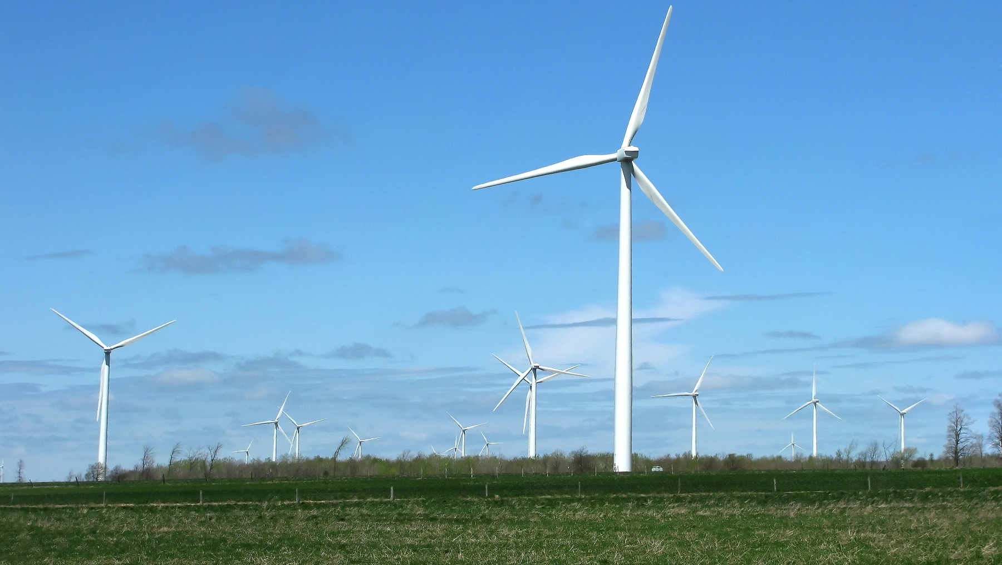
Remote Net Metering
Beware Of Credits Exceeding Expenditures
Notes:
► Remote net metering and some of the important considerations that need to be reviewed before deciding to enter into a remote net metered contract.
► An important pitfall and a couple of rules help illustrate the importance of seeking advice from OCF
► Remote net metering, it is a way to get renewable energy onto campus without actually putting the renewable project on campus property.
► Entities install Solar or other renewables on property that is not necessarily on or adjacent to your campus. The energy is produced in a location that does not permit the flow of the energy directly into the campus grid or what is called behind the meter. These projects are typically solar, wind or small hydro plants called Micro Hydro.
► Because the energy production is remote, the campus does not actually receive the energy, rather it is sold into the statewide grid, and the campus receives a credit for the amount of energy that is produced based on the terms of the agreement.
► If the campus is a member of the energy buying group or purchases electricity supply from other then the local utility a remote net metering project could create a problem.
► Energy buying group members receive electricity supply from the buying group, and campus only pays your local utility for the transmission and delivery of the electricity to campus. Many campuses also participate in one of many gas purchasing contracts OCF has facilitated, and again are only paying the transmission and delivery costs to the utility.
► With remote net metering, particularly with the smaller campuses, there is a potential that the monthly credit received for the renewable energy produced by the remote net metered project will be greater than the campus owes the utility for transmission and delivery. In this event the credit will continue to build, but there won’t be sufficient offsetting expenditures. In this case the only choice may be to leave the energy buying group and go back to purchasing the balance of electricity needs from the utility. This will increase supply costs and has to be carefully considered in the evaluation of the deal. OCF can help work through the numbers so that the campus is making an informed decision.

Slide 29

Rule 1
Maximum 2MW per Property
Notes:
► There are some important rules to consider related to the size, location and acceptable metering configuration.
► The first rule is that remote net metering projects are restricted to a maximum size of 2 MW

Slide 30
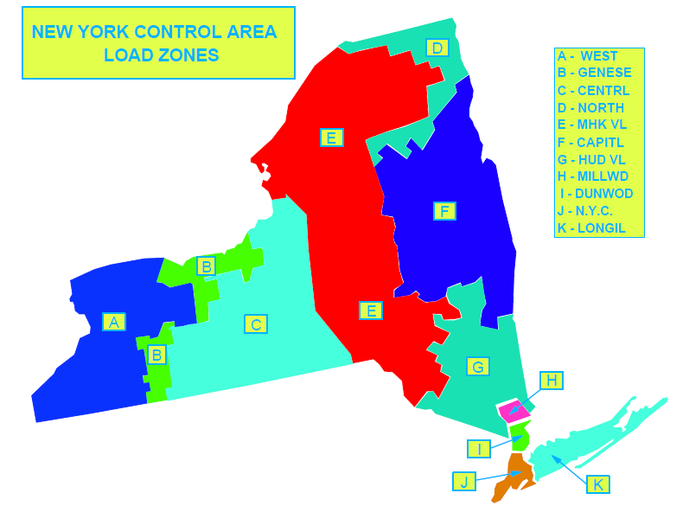
Rule 2
You must be in the same NYISO Zone
Notes:
► The second rule is that remote net metering projects must be in the same NYISO zone as the campus that is receiving the credit,

Slide 31
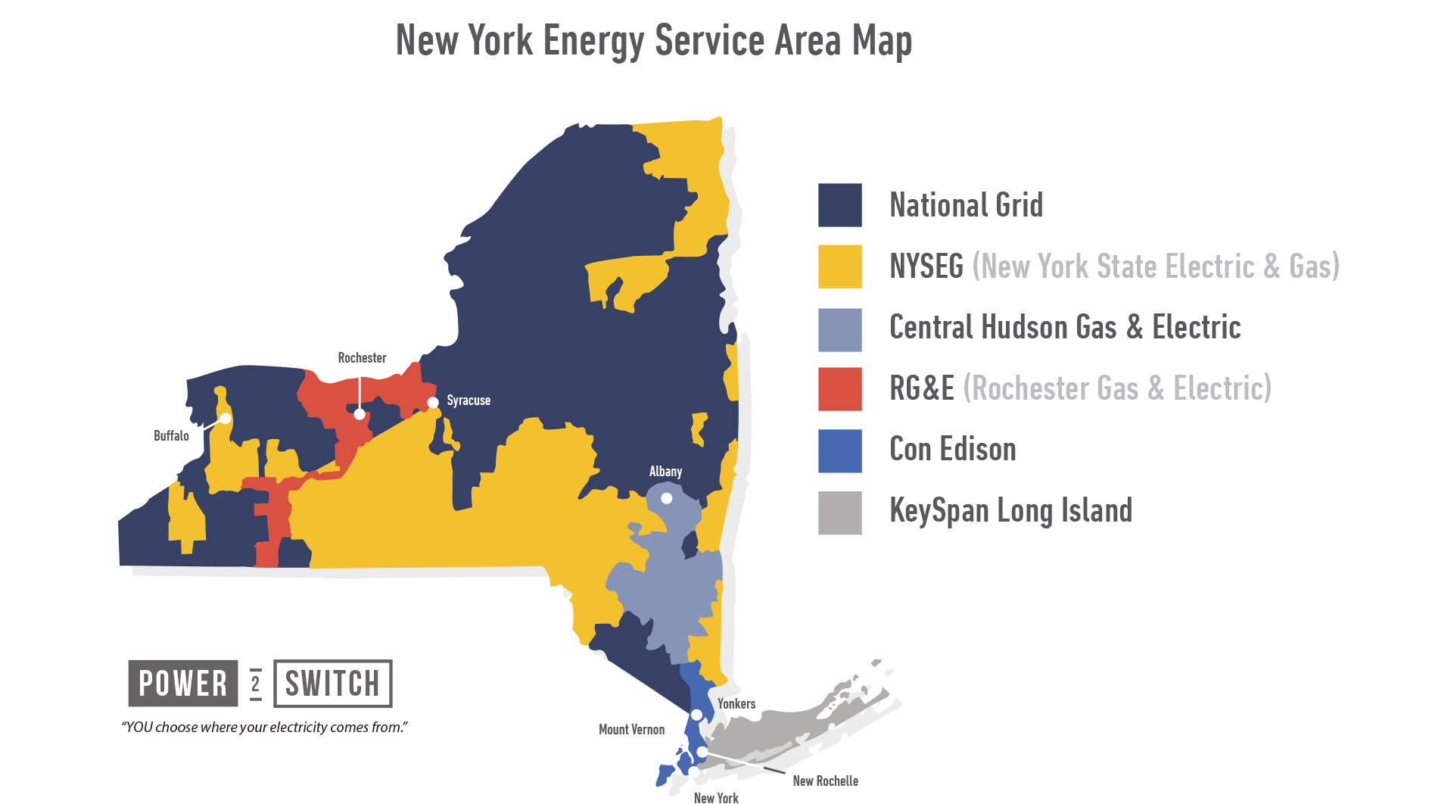
Rule 3
You must be in the same utility territory
Notes:
► And where the project is feeding into the grid has to be the same utility provider as the campus. Can’t have a remote net metered project in National Grid while the campus is in NYSEG territory.

Slide 32

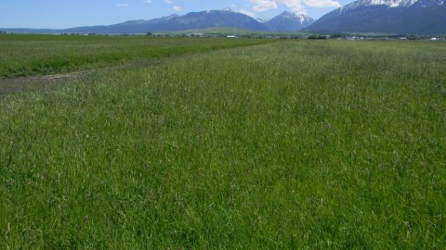

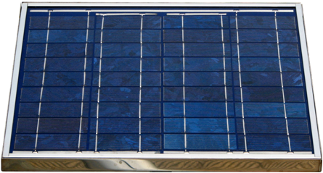
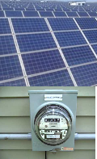

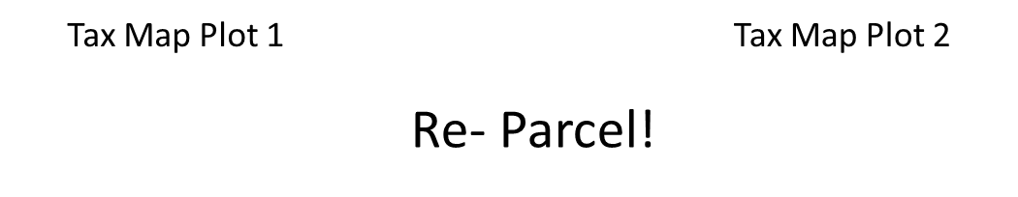
1 MW
1 MW
Rule 4
Only one RNM per property
Notes:
► The fourth rule is that each property may have only one remote net metered project.
► To illustrate this suppose the campus is interested in a 1 MW remote net metered project. The campus is comfortable with the financial arrangements, and the project is installed. There will be a meter that measures the project’s production which will determine the campus credit.
►Assume the project is going well and the campus wants to add another MW. The procurement process restarts. Can the campus install another MW on the same property? There is a 2 MW limit per parcel, however there is another controlling factor. Each parcel can have only one remote net meter.
► Therefore the campus can’t add the additional MW to the same parcel.
► What if the campus aggregates the two meters into a single meter?
► Unfortunately, that is also not permitted.
► Instead the only option is to formally subdivide the parcels working with the local tax authority and real property division.
► Once they are legally separate parcels they may each have a remote net meter. This is very important to consider if the campus is considering starting small with an option to later expand.
Typical purchasing requirements also apply and OCF can help answer questions related to the procurement process.

Slide 33
Energy Manager/Sustainability Survey
.
A census of energy managers and
Sustainability Coordinators is needed
Please complete the survey
Results will be provided to all
Notes:
► EO 88, the REV Campus Challenge, and the State’s 2030 goals, the importance of energy management and sustainability continues to be significant.
►To help manage the goals ahead, OCF needs a census of dedicated campus energy manager and sustainability staff .
►Please complete the survey to assist OCF with determining campus resources.

Slide 34

Metering & Retro Commissioning Survey
.
Form has previous data
Review and Update with current status
Notes:
► OCF will be requesting information on submetering status for all campus buildings. Much of the information is already completed on the form but Campuses need to review it carefully and provide updates as appropriate

Slide 35
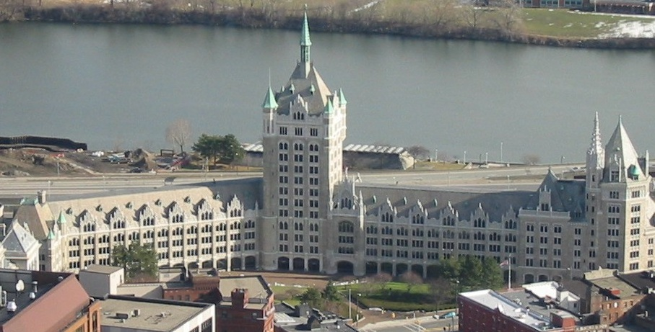

Purchasing Flexibility
Current flexibility expires at the end of June 2016.
Jessica and I are working with other System Admin departments on continuation of the current flexibility. More to follow
Notes:
► Purchasing flexibility SUNY has followed for the past 4 years is due to sunset at the end of June 2016. System Administration and the Construction Fund are working with our government relations staff with the goal of continuing this important flexibility.

Slide 36
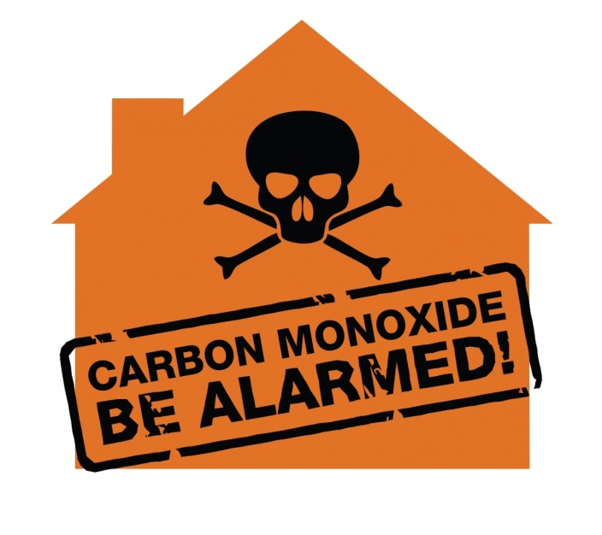
New Regulation:
Carbon Monoxide Alarms- Commercial Buildings
New §1228.4
Nelson’s Law
As of July 1, 2015

Slide 37
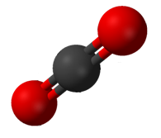

Chemistry/Biology Lesson
Carbon Monoxide
CO
incomplete combustion
very dangerous
Carbon Dioxide or CO₂
clean combustion or respiration
_{much less toxic}
normal component of breathing air

Slide 38
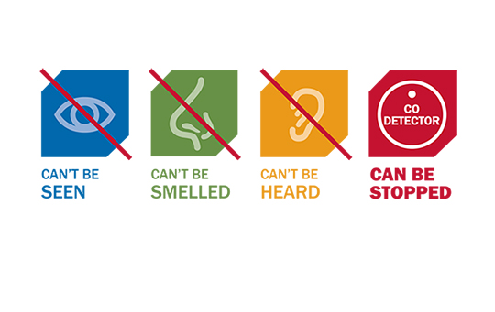
Mixes well with air
No smell or taste
No visual cues
Mild → headaches, tiredness, flu-like symptoms
More significant → death
  Treatment in significant cases is more than just moving to fresh air.

Slide 39
New regs will impact many buildings – new and existing.
Existing commercial building → constructed/permitted before Dec 31, 2015
  New commercial building means not an existing commercial building. (look at definition)
  Classrooms in this reg is K-12.

Slide 40

Time Line
Effective Date: June 27, 2015
Transition Period: June 27, 2016
    It will not be construed as a violation if the owner provides to the AHJ a statement certifying that they are making a good faith effort to move into compliance.

Slide 41
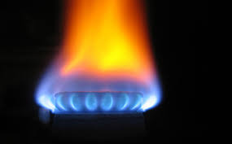
Carbon Monoxide Source
any appliance, equipment, device or system that may emit carbon monoxide
  including, but not limited to, fuel fired furnaces; fuel fired boilers; space heaters with pilot lights or open flames; kerosene heaters; wood stoves; fireplaces; and stoves, ovens, dryers, water heaters and refrigerators that use gas or liquid fuel
garages
other motor vehicle
related occupancies.

Slide 42
Carbon Monoxide-Producing HVAC System
uses ducts to provide heat, ventilation and/or air conditioning
  - With ducts, and/or
  - Is supplied with recirculated or makeup air from an area that contains a carbon monoxide source.
  Forced hot air heat
  Supply from an area with a CO source

Slide 43
Detection Zone
The term “detection zone” means a story of a commercial building.
  However:
  A story with more than one CO-producing HVAC systems may be more than one detection area.
  Each classroom is a separate detection zone.
  Garages are separate zones.

Slide 44
General rule
In commercial buildings, carbon monoxide detection shall be provided in every detection zone that
  Contains any carbon monoxide source
  Is served by a CO-HVAC system
  Is attached to a garage and/or any other motor-vehicle-related occupancy.
  Exceptions.

Slide 45
Trigger Conditions
Triggering Condition 1:
carbon monoxide source in a detection zone
furnaces hot water heaters
bunsen burners stoves and ovens
fire places kilns
dryers

Slide 46
Triggering Condition 2
duct opening or other outlet from a CO-HVAC system in the detection zone
  However, not be deemed to be a triggering condition if
    (a) carbon monoxide detection is provided in the first room or area served by each main duct and
    (b) the signal is automatically transmitted to an approved location.

Slide 47
Triggering Condition 3
garage or other motor-vehicle-related occupancy adjacent to a detection zone
Exceptions

Slide 48
Detection
Detection zones <10,000 ft² →central location
Detection zones ≥10,000 ft² →
  central location and additional locations within such detection zone as may not exceed 100 ft travel distance

Slide 49
Detection Equipment Choice
Carbon monoxide alarms
Carbon monoxide detection system

Slide 50
Carbon monoxide alarms
(self contained units)
UL 2034 Listed
Power source
  primary power from the building wiring, permanent
  backup battery
    Carbon monoxide alarms powered solely by a 10-year battery shall be permitted in
      (a) existing commercial buildings and
      (b) commercial buildings without commercial electric power
  A combination carbon monoxide and smoke alarm is not allowed.
  New buildings – interconnect and sign for unoccupied locations.

Slide 51
Carbon monoxide detection systems
Send signal to the control unit that then provides notification to occupants and to off-premises monitoring location.
Carbon monoxide detection systems shall comply with NFPA 720.
  May have combo detectors.
Carbon monoxide detectors shall be listed in accordance with UL 2075.

Slide 52
New buildings need off premises notification where a fire alarm control unit is required by 903 or 907.
Can not activate the fire signal to the panel or trigger fire notification appliance.
Must have at least one on-site notification per building.

Slide 53
#1
Does the building fall under the definition of commercial building?
#2
Is there a CO source, CO-HVAC, or garage/motor vehicle source?
#3
Need Detection
Alarm vs system
Determine zones in building
Determine locations for detection

Slide 54
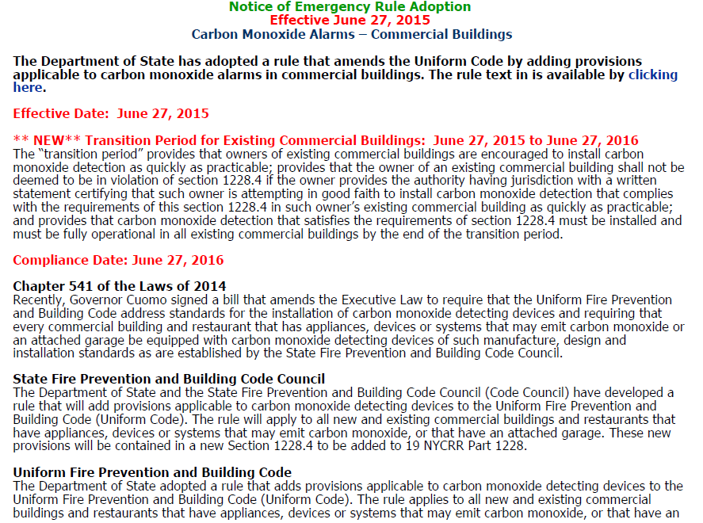

Slide 55
Questions?
Notes:
►

