Slide 1


SUNY/PPAA Summer Conference 2017
Office for Capital Facilities
June 2017

Slide 2
Agenda
AiM Phase 2 – O & M Proposal
EO166 – Affirming the Paris Agreement
Geothermal – NYSERDA PON
Procurement Legislation – What happened in 2017
RetrofitNY – Deep Energy Retrofit Project
Aggregated Solar Project >20MW
EO4 – Green Procurement
Why is this important
Vision for the future
What we’ve done so far
What we propose
How it helps campuses
Cost and potential savings

Slide 3

Are your facilities the best they can be?

Slide 4

IBM Watson
IBM’s Watson
Analytics
Big Data

Slide 5
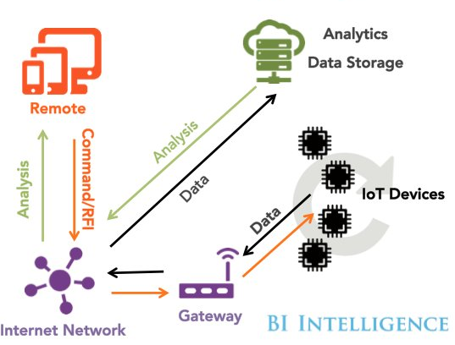
IoT
The Internet of Things
Billions of devices, sensors, data, and massive information databanks

Slide 6

Better Data is needed
Optimize day to day operations
Decide where to invest
Benchmarking
Sharing best practices

Slide 7


OCF Mission is not to judge, scorn or damage facilities managers, but to help each campus to reach their potential

Slide 8


Current Status
O&M Current Status
20 commercial programs
6 homegrown solutions
1 with no system
1 uses Word
21 near or at enterprise level

Slide 9

No Data
Good, fair or really bad?
Financial benefits of good facilities management?
Reducing Utility costs?
Ideal preventative maintenance levels?
Notes:
Most have a system
May even pull reports backlog, WO completed
What do those tell you? Does it really let you know doing a good job?
Compare to previous years but how do you compare to others?
Once comprehensive system meaningful reports across campuses benchmarking
Compare Department staffing levels, backlog and WO production

Slide 10
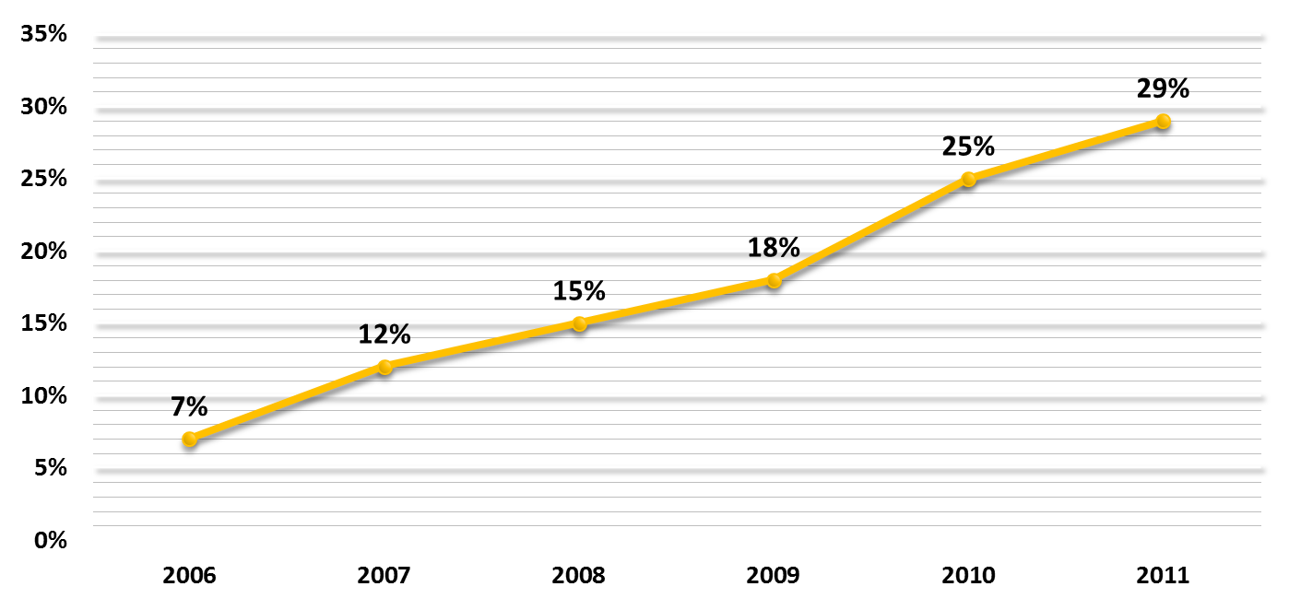
Data-driven decision making
Preventive Maintenance: Percentage of Available Employee Hours
Goal: 45%
Notes:
Staff needed to analyze data for those things that don’t need comparison to others
Industry goals are 45%
This graph shows an AiM campus improving but with more room for improvement
OCF will help provide analysis from the data as part of our role
Additionally goal with PM to imbed into contracts
Impossible to standardize 26 systems
Should have a library of equipment and standardized PM to select when new equip installed.
One campus enters it, all campuses can use it
Better tracking of warrantees beyond one year contractor guarantee

Slide 11

Flexibility of AiM
A=250
B=287
C=350
Before
Capacity = Numeric
Number of Workstations = Text
Now
Capacity →Code Capacity = Text
Number of Workstations = Numeric
Notes:
Part of the why is the flexibility of AiM
Capacity, workstations
Capacity was numeric, workstations text.
Campuses wanted to report on WS which is the populated the data from PSI
Switched the data and renamed the fields
Capacity is now called Code Capacity and is text field allowing for multiple capacities to be listed
Workstations is numeric, allowing for calculations
Committee campus fund OCF will examine these issues in future and make decisions for change

Slide 12

AiM:
Currently - Property, Space and Asset Life Cycle Management
Fleet and Fuel
Integrated Workplace
Property Risk Management
Add AiMCAD and Unlimited Space licenses
Work Order Management
Property, Space and Asset Life Cycle
Construction Management
Surplus Management
Parking Management
Field Service Solutions
Energy Management
Asset and Inventory
Notes:
Proposal
Current limited 2 licenses each campus
Expand to unlimited and add AiMCAD
Add O&M
Other modules potential for future

Slide 13
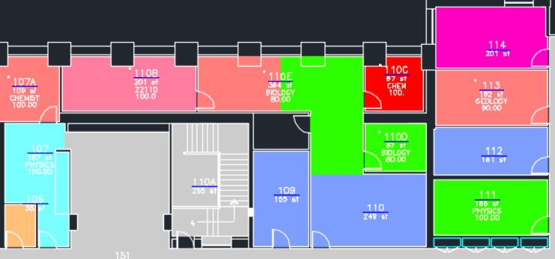

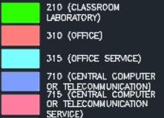
FICM Space Type
Determine and plan for departmental space needs
Space Planning
Notes:
What AiMCAD do?
Space data in AiM combines with CAD drawings
Depart, org, space type or combinations or other data
Multiple planning scenarios and more

Slide 14
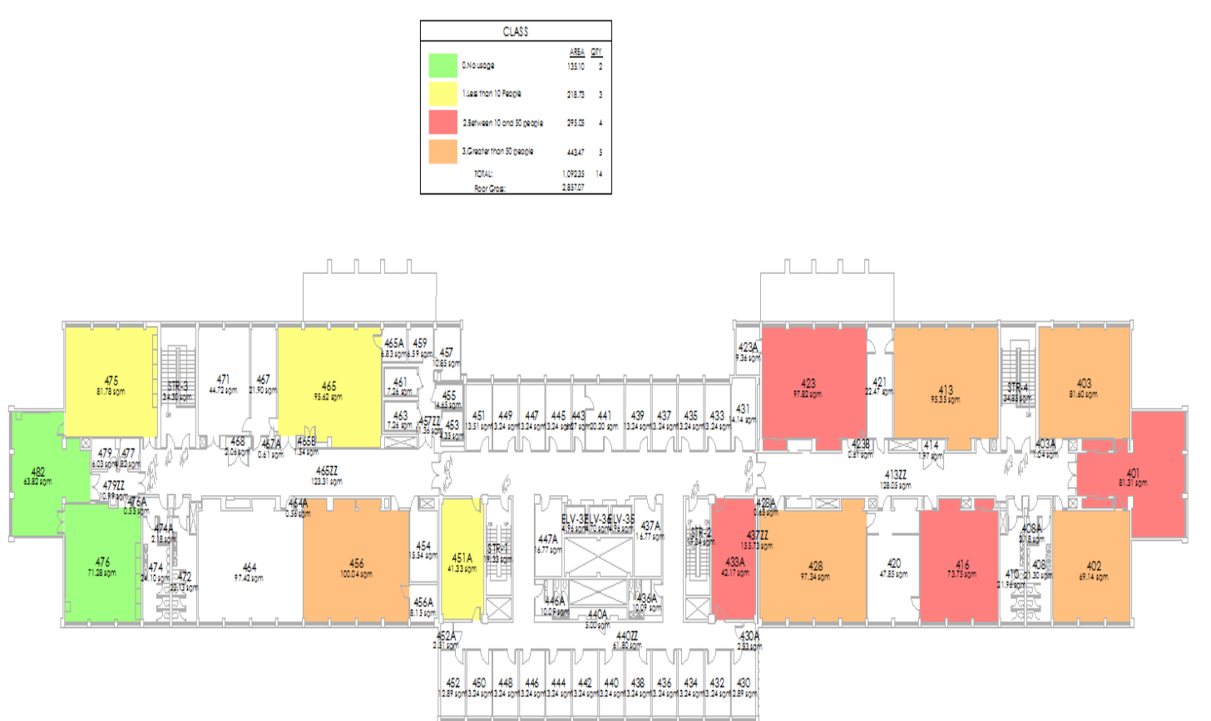
Determine cleaning needs based on daily use as measured by people counters at doorways
No usage
Less than 10
10 to 50
> 50
Reporting: Space
Notes:
Can be combined with data outside of AiM
People counters at door
Each evening feeds to AiMCAD and produces drawing of classroom occupancy that day
Don’t clean rooms no one used
Redirect staff to other priorities
The people counter data can also be used to control HVAC, shutting down cooling if class is cancelled and therefore no one using the room
Also can combine with classroom scheduling data for planning classroom use

Slide 15
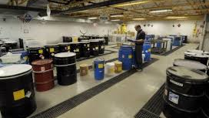
EH&S
Hazardous Material Management
Container Issue/Return Tracking
Hazardous Material Disbursement/Recovery/Disposal
Asset Management Integration
Notes:
Add-on features with O&M including Key Control and EH&S.
EH&S provides Hazardous mat management
Container issue/return
Hazardous Materials disbursement/recovery/disposal
Integration with assets, specifically with buildings or major equipment
OSC audit on hazardous waste management just getting started.
This program could go long way toward mitigating any documentation problems uncovered

Slide 16
Operations and Maintenance
Property and Space Utilization
Asset Renewal Needs
Integrate O&M with property and space
O&M
Enterprise license
Benchmarking
Improved Asset Management
Notes:
Largest part is O&M
O&M needs property, building, room or asset for where work is needed
AIM bldg. space data of record, and therefore is ideal as base for O&M
Will include unlimited enterprise licenses
SUNY wide reports can be developed to help facilities managers analyse existing and justify additional resources

Slide 17

Cost for Phase 2
Phase 1 | Phase 2 Property and Space | Phase 2 AiMCAD | Subtotal | Phase 2 O&M | SA Overhead | Total
$79,653 | $38,086 | $40,390 | $158,129 | $147,904 | $27,815 | $333,848
Annual Maintenance includes cost for three existing modules, maintenance of the new modules, plus System Administration server costs, $10,000 in general OTPS, and a System Administration indirect cost charge at 2.64%
Notes:
Phase 1 annual maintenance $79,653 shared by Fund
Fund purchased the Phase 1 licenses at $750, 000 – no cost to campuses
Expansion of Phase 1 to unlimited adds $38,000 to the annual licenses
Adding AiMCAD adds another $40,000 to annual licenses
Subtotal for the part shared by all 64 campuses plus the Fund and RF is $158K
O&M adds another $148K to annual licenses, only participating campuses
More that join O&M, the less $ per campus
All costs per campus are based on GSF

Slide 18


Attend Webinar Tuesday 18th at 10am, Link will be resent
Express interest in program with email to Karren Bee-Donohoe
Determine all current costs being incurred for these functions
Receive from System the actual cost based on total participants
Formally commit and participate in the implementation
Notes:
Tuesday July 18 Webinar
Express interest via email to KBD
Determine your current costs for all things that this will replace
System will prepare participation agreements with actual costs based on the participating campuses
Campuses sign participation agreements formally committing
Last minute changes mean everyone costs need to be recalculated.
Later as campuses join, everyone's costs will go down
Need enough participation for DoB to agree that we use Fund capital for the purchase

Slide 19

EO166
NYS Reduce GHG 40% by 2030 and 80% by 2050
Create Agency Plans
NYSERDA and DEC to provide technical assistance
Agencies must implement measures to improve efficiency and reduce GHG
Notes:
Most familiar with Beginning of June Trump announced withdrawing US from Paris agreement
Governor Cuomo & other governors issued executive orders
NY EO166 “Redoubling New York State’s fight against economic and environmental threats posed by climate change and affirming goals of Paris climate agreement

Slide 20
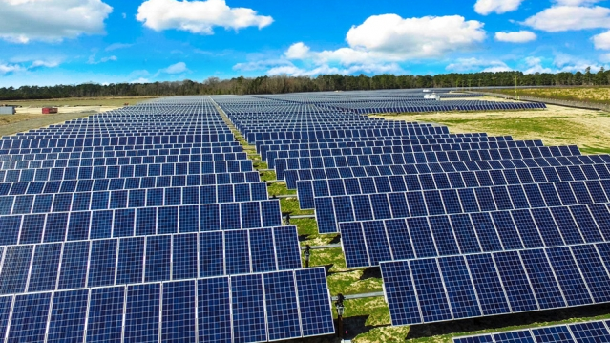
Aggregated Solar and/or Wind Project
More flexible than Remote Net Metering
>20 MW Solar or >40 MW Wind
Campuses participate at the MW level that works for the campus
Options for how RECs are handled
Notes:
Major Solar and/or wind project
Challenge for Solar is amount of land, and wind has NIMBY problem with neighbors
Remote net metering potential solution
Limitations <2M same ISO and utility zones
Industry ever changing to meet the challenges, now have aggregators
Pool requirements of several entities, in this case SUNY and private colleges
Find suitable land outside of SUNY
Install and sell into the wholesale market. To do so they need minimum 20MW solar 40 MW wind
Participating entities get % of proceeds based on the Power Purchase Agreement (PPA)
Provides options for RECS

Slide 21
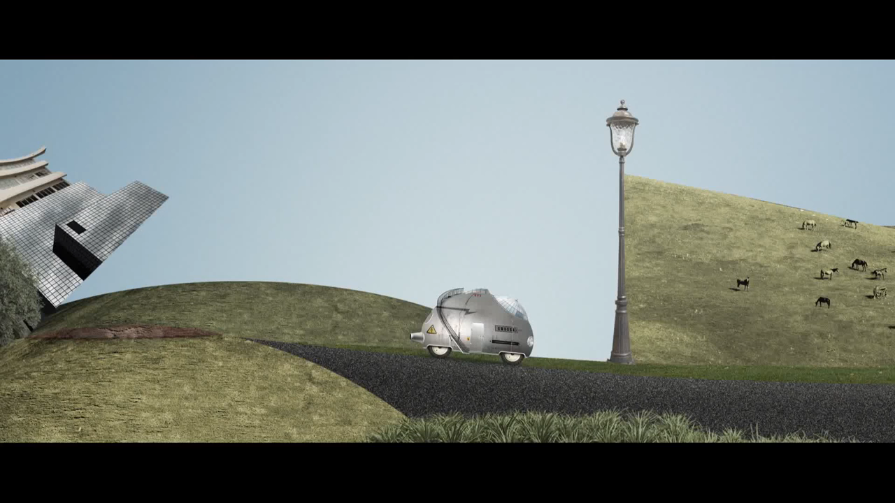
RetrofitNY
Notes:
Video

Slide 22
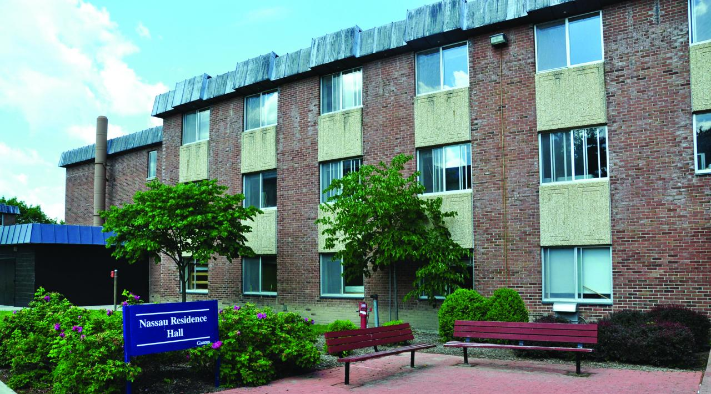
Retrofit NY
Netherlands team came to NY for 6 months
Setting up Criteria
Planning a design competition
Notes:
Since Jan a lot has happened
Team from Netherlands here for 6 months
Working with SUNY and DASNY looking at Res hall portfolio
Developing criteria for prototype buildings
Box like, not Plaza, flat roofs, façade needs work, not recently renovated, heating oil or district heating
Suffers winter open window syndrome
RFP for a design competition

Slide 23
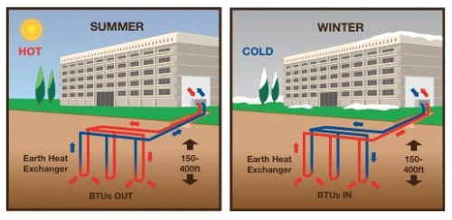
NYSERDA PON3620
$15M incentive pool
$1200 per ton of cooling
$500,000 per building
Notes:
Geothermal PON 3620
Money $15M from clean energy Fund
>10ton cooling $1200 per ton up to $500K per bldg

Slide 24

EO4 Updates
Approved Green Purchasing Specifications:
Considered "final" and required to be used in purchases
Disinfectants and Sanitizers
Floor Finishes and Floor Removers
Furniture
General Purpose Cleaners
Hand Cleaners, Hand Soaps, Consumer Antiseptic Hand Washes and Hand Rubs, and Personal Care Cleansing Products
Lighting Fixtures, Ballasts and Lamps
Notes:
EO4 update
Directs green procurement
Exceptions:
Specified products, services or technology do not meet form function or utility
Cost is not competitive
Emergency need or safety consideration
Otherwise required to follow the specs
Items listed just had updated specification approved by interagency committee

Slide 25

Procurement Legislation
Proposed return to pre-audit
Being pushed by Controller’s office
Response to SUNY Poly problems
More important than ever – follow procedures properly

Slide 26
Vice Chancellor for Capital Facilities
Robert Haelen
OCF Today
Associate Vice Chancellor, OCF
Karren Bee-Donohoe
Administrative Assistant
Ashley Brainard
Director, Energy Procurement &Utility Regulatory Affairs
Kathleen Slusher
Energy Manager
Eric Mazzone
Director,
Capital Programs
David Ferrari
Director, Environmental
Health & Safety
Barbara Boyle
Senior Energy Buying Accountant
Dan Russ
Contract Specialist
Jessica Miller
Property Managment Specialist
Patrick Deloughery
Community College Program Manager
Rebecca Goldstein
Residence Hall Program Manager
Donald Smith
Emergency Planning Specialist
Allan Styno
Energy Buying Junior Accountant
Melinda Race
Notes:
Current Capital Facilities Org Chart

Slide 27

We are here to help!
Notes:
AS I told you in January 2010 my first presentation in this role, I’m from Albany and I’m here to help. That was true then and true now for everyone in OCF.
Thank you

