Slide 1


Office for Capital Facilities PPAA - Feb 2015
2015

Slide 2


Agenda
Res Hall Program
Veterans Hiring
PWEF
EO88
Preview Tomorrow

Slide 3
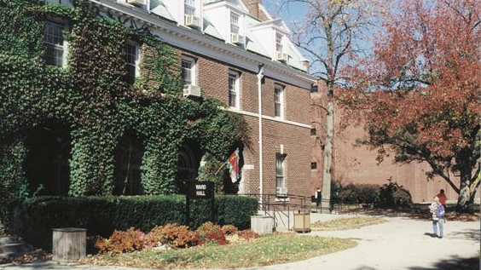
Res Hall Capital
Project Budgets are a must
Discussion Items
Capital Plans
Debt Service Liability is key to affordability
Refunding (refinancing)
Wicks/PLAs
Notes:
Project budgets and corresponding debt service are examined at the res hall capital plan reviews.
A primary driver of each capital plan is the campus Debt Service Liability.
Each of the projects is examined to ensure that all associated debt service is accounted for in the plan, and that the timing of borrowing is accurately reflected.

Slide 4

Greater Responsibility
$1.2 billion in outstanding debt
High Credit Rating
Notes:
Res Hall facility program was removed from the bond cap in 2012, placing a large amount of responsibility on Capital Facilities.
The program no longer has the backing of SUNY or of NYS.
It is an entirely stand-alone credit with approximately $1.2 billion in outstanding debt.
David Ferrari and Don Smith in OCF collect information in order to maintain a high credit rating for the program and get the best rates possible for capital borrowing.

Slide 5

Capital Plan Reviews Include
Historic Trends
Controller & Budget Input
Campus Meetings
Notes:
Capital Facilities thoroughly reviews each plan to ensure accuracy and completeness – Primary goal of review is to ensure that each campus can maintain solvency through the life of their capital plan.
Included in review are:
comparison of historical trends to what is being forecasted
(2) consultation with SUNY Controller and Budget Office to forecast financial performance of the individual campus’ DIFR program
(3) meeting with individual campuses to make edits as needed

Slide 6

Campus Meeting - Discussion Items
Discussion Items
Project Budgets
Project Dates
Project Dates
Borrowing
Future Operating
Utilization Rates
Notes:
Items that are scrutinized or discussed during review and at campus visits:
Project budgets and corresponding debt service
Project dates
Types of borrowing
Future Operating expenses
Utilization Rates/Occupancy/Room Rates & their effects on Revenue

Slide 7

Project Budgets must be accurate
Project dates influence debt
Borrowing type 15 or 30 year
Bonds or hard dollar
Notes:
The Project Dates are also reviewed during the capital plan review.
Important piece of data
Used to account for the timing of the borrowing
Also used to forecast future cash-flows to assist in the timing and sizing of future bond sales
The types of borrowing are also discussed. The residential facility program includes multiple potential funding sources.
Bond funds with 15 or 30 year life, each of which may either capitalize the interest or not during the first couple of years
Hard dollar funds, which can be either the SUNY revolving loan program or campus cash
Review is done to ensure the type of borrowing requested is reasonable and applicable based on type of project being done and campus resources

Slide 8

Future operating must be considered
Room rents also affect revenue
Utilization affects revenue
Notes:
Future Operating Expenses must be forecast as part of the residential facility program.
-Each campus’ expenses are reviewed for reasonability and that they reflect current trends
-Important to developing campus cash flow projection
-Known escalation rates and comparison with other campuses help ensure reasonability
Utilization rates/Occupancy/Room Rates and their effects on Revenue are also examined.
-a main factor in this is the projected increase in room rents
-in addition to tuition and fees being a concern for lowering cost of higher education, room and board are also under scrutiny
-for residential facility program, room rates are revenue that sustains entire program
-as costs increase, rates increase
-projected utilization rates also influence future revenue growth
-utilization rates compared with historical data to ensure figures are in line
-utilization rates are a key component of this plan

Slide 9

Facilities Staff Must be Involved
Insert yourself in the process
Notes:
Make Facilities Office a major player in development of Res Hall ten-year plan.
Alert Capital Facilities at SUNY System ASAP to major changes in Res Halls.
Submit major changes any time throughout the year, even though the plan is updated annually.

Slide 10
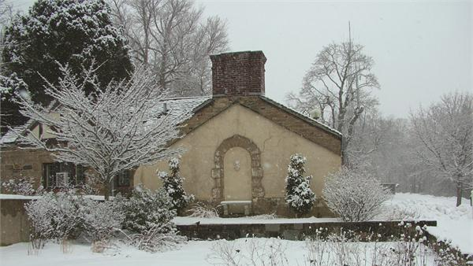
Res Hall Refunding (Refinancing)
$30 Million in Savings
Another Transition Slide
Notes:
Over next several weeks, we will be refunding (refinancing) several older bond series.
-will reduce the rate
-will save campuses money on debt service
-anticipated to save approximately $30 million over life of the bonds
-by removing $300 M in funds from the bond cap, will leave more room for Ed facilities program

Slide 11
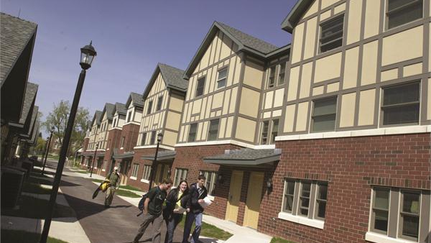
Res Hall Campus Let Program began in 2007
Wicks waivers 2010-2012
No longer - Under current program waivers only for hard dollar
Project Labor Agreements in lieu of Wicks
Notes:
Since 2007, campuses have had the ability to do campus let res hall projects using bonded funds
-bonded funds were appropriated to the Construction Fund – through their wicks waiver authority they could provide a waiver for res hall bonded projects
-hard dollar project funds appropriated to the Fund, so hard dollar renovation (Revolving Loan or campus cash) eligible for a Wicks waiver
New program in 2012
-funds no longer appropriated to the Fund
-alternative to using Wicks on campus let projects that uses res hall bond funds
-Labor Law section 222 – option to use a project labor agreement in order to bypass Wicks
-plan to have Jessica become expert in this and be a major resource to campuses

Slide 12

Veterans Hiring
Building Services Asst.
Clerk Titles
Parking Services Attendant
Campus Worker 1
Notes:
Since summer hiring is generally temp positions, may be required to check the Veterans list for potential employees.
-currently, only titles covered by this are:
Building Services Assistant, Clerk Titles, Parking Services Attendant and Campus Worker 1
-will keep you informed if others are added
-if using these titles, you will need to review veteran’s list as step in hiring plan and give preference to qualified veterans

Slide 13

PWEF
DOL Letters
Notes:
When creating term contracts – enter them in Purchasing system as a zero dollar contract
-you pay on the original contract value and any subsequent contract value changes
-when using contract for a particular project, increase contract value to cover that project and DOL fees will only be on the increased portion

Slide 14

EO88 – Build Smart NY
New Energy Manager, Welcome Eric Mazzone!!
Actions to date
EMPs
Sub-metering
Virtual Audits
O&M Plan
Notes:
Baseline – 2010
Have until 2020 to reach SUNY 22% goal
Our actions to assist so far include:
-getting Energy Master Plans (EMPs) started
-pushing for sub-metering
-connecting submeters to NYEM
-reporting on data to NYEM
-collecting data for virtual audits
-developing O&M plan that is not yet implemented

Slide 15
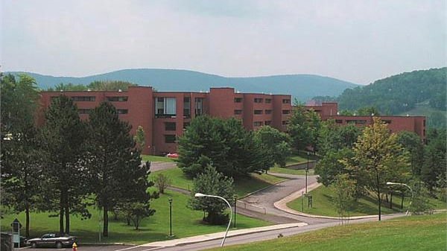
EO88 Grant Program
Jumpstart Energy Savings
Notes:
Idea to develop a grant program
-would be based upon Binghamton’s successful energy improvement program (developed based upon a seed fund, savings accomplished by the projects got invested back into more projects)
Working with NYPA to create a similar program
-would help jumpstart energy savings efforts
-concept in early development

Slide 16

Campus Budget officers control budget
Savings - Reinvest into Facilities
Notes:
System Admin can direct things that need to happen, but most campus budget decisions are controlled locally.
we need some assurance that savings will be reinvested in facilities O&M and energy projects
contemplated that grants would come with agreement from campus budget office that a significant portion (% determined through discussion with business officers)
would be reinvested into additional facilities to further advance goals of EO88

Slide 17

Keep Application Simple
OCF and Build Smart will select Winners
Simplified M&V required
Notes:
Would like grants to focus on projects that improve the Operations & Maintenance of facilities in ways that continue and increase energy savings.
-want to keep application process simple
-OCF with EO88 team would review and select recipients
-would develop a requirement for a type of M&V, but don’t want to create a lot of additional work
Interested in hearing feedback as well as having a few volunteers to help develop grant program.

Slide 18
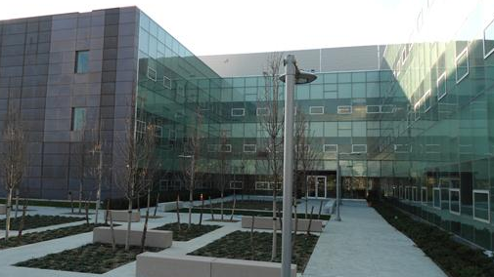
EO88 – 2015 & 2016 Deadlines
06/30/15-Retro-Commissioning
12/31/15-Energy Audits
12/31/15-CMMS
12/31/16-Submetering
12/31/17-Energy Monitoring & Control
Notes:
EO88 Deadlines for 2015 and 2016
June 30, 2015 – Retro-Commissioning Deadline – Complete RCx studies and measure implementation for one-quarter of portfolio
December 31, 2015 – Energy Audits – ASHRAE II Audits of lowest performing quartile of buildings
December 31, 2015 – Implement CMMS for Operations and Maintenance Activities – All Agencies deploy a new or updated CMMS with energy related maintenance protocols in place
December 31, 2016 – Submetering Requirement Complete – Covered buildings larger than 100,000 gross sqft. shall be submetered for all fuels

Slide 19

Tomorrow’s Preview
Ebola, NFPA, CO, Codes, NFPA & More
B1184, MCM, Upcoming Projects
Remote Net Metering
Energy Buying Group Meeting

Slide 20



