Slide 1
SUNY Office for Capital Facilities
PPAA 2014 Summer Conference Update

Slide 2
Agenda
Executive Order 88
  O&M Plan
  NY Energy Manager
Sale of Hess to Direct Energy
Start Up NY
Communications

Slide 3

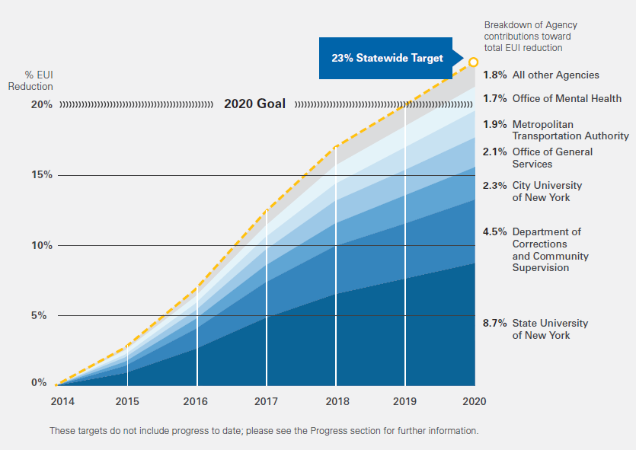
SUNY 8.7%
Notes:
This graph depicts the overall savings targets that have been assigned to each State agency for the duration of the order.
A 23% Statewide target has been established providing an overall contingency.
The top 6 agencies are shown individually and
the grey sector at the top of the chart represents all other agencies.
This chart clearly shows how important SUNY is to the success of the EO with 8.7% of the overall State wide goal.

Slide 4

Concerns from campuses
I’ve already picked all of the low hanging fruit
Newer buildings and major renovations have a higher energy use intensity than the older buildings?
Notes:
Campuses have already been executing energy savings projects as part of the previous executive order 111 and wonder if there are any affordable projects left.
New building or major renovation can add to campus EUI because upgraded facilities have added HVAC and electric service that didn’t exist in the older buildings prior to renovation.
Even though newer buildings and major renovations, are being constructed to meet a minimum of LEED silver as required by the SUNY Board, these buildings have a higher energy use intensity than the older buildings on the campuses.

Slide 5
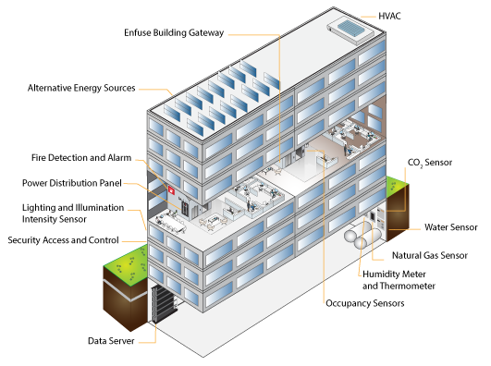

Build Smart Approach
New Technologies are key
LED lighting has great potential, especially Smart fixtures - not just on-off
But – achieving energy savings will require more than just another round of retrofit projects
Notes:
Build Smart and NYSERDA are constantly looking at new technologies.
SUNY Plaza is installing an emerging technology as a test site. Build Smart is getting started with another technology test installation at both White Plains and in part of SUNY Plaza.
LED technology has advanced significantly. Lighting retrofits have great potential for savings. Outdoor lighting retrofits in particular have great potential for savings not only by reducing overall fixture wattage but by incorporating smart fixtures which allow for more than just on-off controls.
The Build Smart team recognizes that Energy conservations measures will need to include more than just retrofit projects.

Slide 6
Other Ways to Save
Build Smart Team is going to help SUNY campuses find other ways to save energy and sustain the goal.
NY
Energy
Manager
O&M
Plan
Notes:
The two additional approaches to energy conservation are O&M and NY Energy Manager

Slide 7
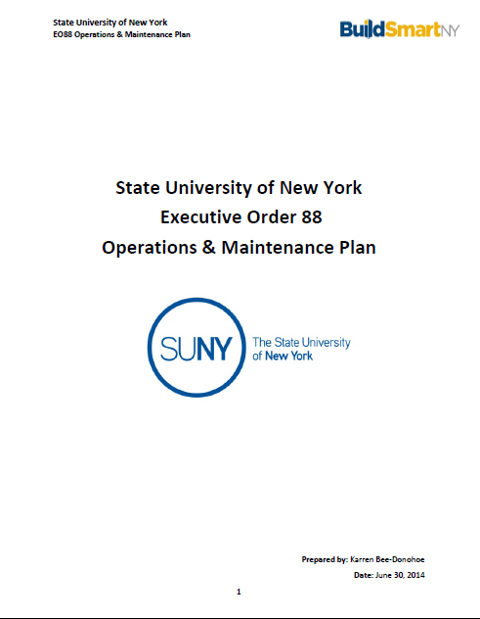
Operations &Maintenance
Build Smart recognizes O&M as a key factor in energy efficiency
Notes:
Build Smart recognizes that O&M has the potential to save or waste energy.
EO88 requires each agency to develop an operations and maintenance plan that looks 10 years beyond the EO88 timeframe.

Slide 8
O&M Plan Working Team:
Joe Batchelder – Cobleskill
Al Gilewicz – University of Buffalo
Christopher Jackson – Plattsburgh
Gary Kittel – Upstate
Mike Kukawa – Binghamton
Greg Lischke – Brockport
Neil Palmatier – Delhi
Tom Rathbone – Oneonta
Joe Russell – Stony Brook
George Stooks – Geneseo
Additional facilities staff from these
  campuses contributed along
  with System Administration budget
  staff, the CIO Association and
  SUBOA members
Notes:
From March through June, a working group of ten facilities managers, supplemented by their staff, a few business officers, a representative from the Chief Information Officers, and System Administration employees from budget, communications and government relations participated in weekly calls to discuss different portions of the draft O&M plan.

Slide 9
The O&M Plan Challenges
No energy manager at System Administration;
Facilities staff skills needed to maintain modern facilities;
Strained facilities budgets;
Challenges managing and cataloging building documentation;
Severely outdated data systems; and
Unpredictable capital funding
Notes:
The revised document identifies several challenges and proposed actions.
CHALLENGES
No energy manager at System Administration;
Facilities staff skills needed to maintain modern facilities;
Strained facilities budgets;
Challenges managing and cataloging building documentation;
Severely outdated data systems; and
Unpredictable capital funding

Slide 10
Proposed Actions
Hire an Energy Manager
Review benchmarking from other Universities
Benchmark SUNY
  CMMS, BMS, staff levels, OTPS levels, budget, etc.
Develop standards for facilities staff & budgets
Upgrade BCI/PSI system
Integrate sub meters into NY
Energy Manager
Notes:
The O&M plan proposes several actions.
Hiring an Energy Manager - a key step to achieve all following proposed actions;
Review existing benchmarking data from other higher education systems;
Benchmark current conditions at SUNY through a survey of campuses for the following items:
CMMS, BMS, staff levels, OTPS levels, budget, etc.
Using Benchmarking data develop ideal standards for SUNY facilities staffing and budgets;
Webinars to share campus programs such as Cortland Construction Manager and Brockport Project Manager integration to Building Condition;
Upgrade BCI PSI Database to make it useful for integrating with other facilities space based systems; and
Assist Campus facilities staff to integrate sub meters into NY Energy Manager.

Slide 11
Proposed Actions (cont.)
Revisit qualifications and testing for PUE series
Assist campus in financing opportunities – NYPA financing and NYSERDA grants
Train Business Officers to better understand relationship of facilities and utility budgets
Implement a program for BCAS and benchmark all campuses
Notes:
Engage with SUNY System HR and Civil Service regarding qualifications and testing for PUE series;
Help campuses with establishing financing opportunities including NYPA financing and NYSERDA grants for energy projects;
Training for budget officers to better understand the relationship between facilities budgets and utilities budgets; and
Implement a program for building condition assessment surveys and to benchmark all campuses

Slide 12
Proposed Actions (cont.)
Confirm campuses include maintenance in design of capital projects
Assess the current commissioning process and improve overall services
Standardize data collection for building documentation
Develop standardized facilities training
Develop Warranty Database
Notes:
Standardize the involvement of maintenance in capital projects;
Work with the Fund to analyze the effectiveness of current commissioning process and potential to improve overall services;
Standardize collection for new/renovated facilities documentation;
Develop standardized training for various areas of facilities management; and
Assist campuses with development of a Warranty Database that would be populated by contractors as a requirement of the contracts to track warrantees that extend beyond the one-year contractor warranty.

Slide 13
TIMELINE
Hire an energy manager
Integrate sub meters into NYEM
Assist with project financing
Train budget officers
Engage with SUNY HR and Civil Service
Develop standards for SUNY
Collect data from SUNY
Review data from other colleges
Upgrade BCI PSI database
Webinars to share campus programs
Fall 2014
Fall 2014
Winter 2014-15
Summer 2015
Spring 2015
Summer 2015
Fall 2015
Spring 2015
Spring 2015
Spring 2015

Slide 14
NY Energy Manager

Slide 15
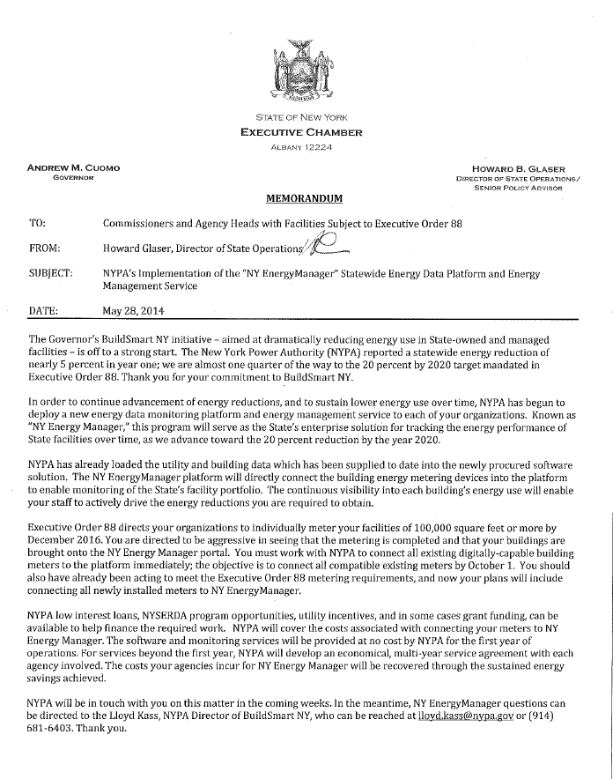
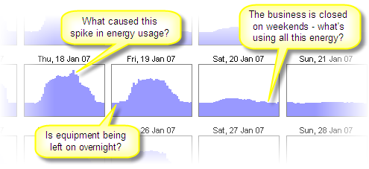
NYEM
New York Energy Manager is a tool to assist campuses meet the goals
Notes:
Memo from Howard Glaser introduced NY Energy Manager.
The memo emphasized all currently metered buildings are to be connected to NY Energy Manager by October 1.
What is NY Energy Manager;
What it can do for campuses;
What campuses are required to do; and
How this impacts Energy Cap Phase 2 and other programs such as Iconics and NuEnergen

Slide 16

What is NY Energy Manager
Talisen Technologies selected as the vendor for NY Energy Manager (NYEM)
Based in St. Louis, MO, Talisen implemented similar system for State of Missouri & USDA
Arun Veda Arunkumar.Vedhathiri@nypa.gov hired as Manager for NYEM
NYEM brought online in early
2014 & populated with EO 88
data
Notes:
In 2013 NYPA issued an RFP for an Energy Management system and selected Talisen Technologies as the vendor for NY Energy Manager (NYEM). Talisen is a St. Louis, Missouri based company that has implemented similar systems for the State of Missouri & US Dept of Agriculture;
With a program selected, Build Smart hired Arun Veda to be the manager of the program and opened a satellite office in Albany at the College of Nano Science and Engineering.
NYEM was brought online in early 2014 and has been populated with EO 88 reported data from 2010-11, 11/12 and 12/13

Slide 17
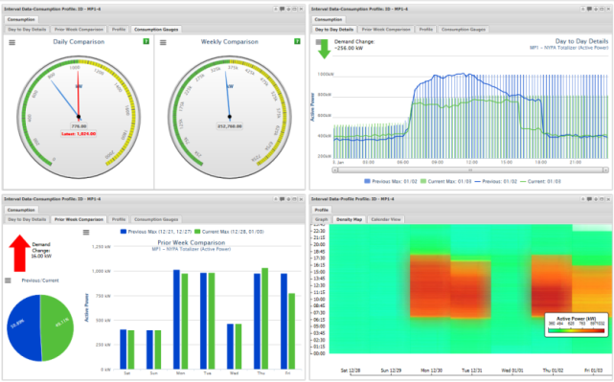
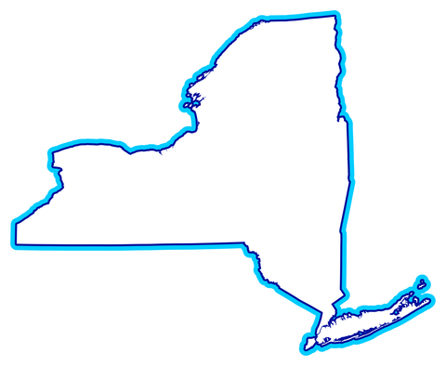
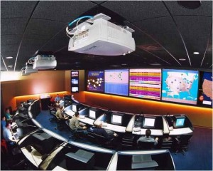
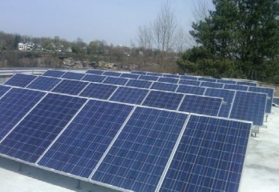
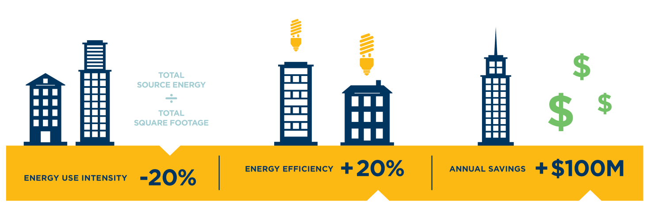

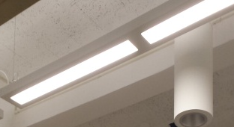
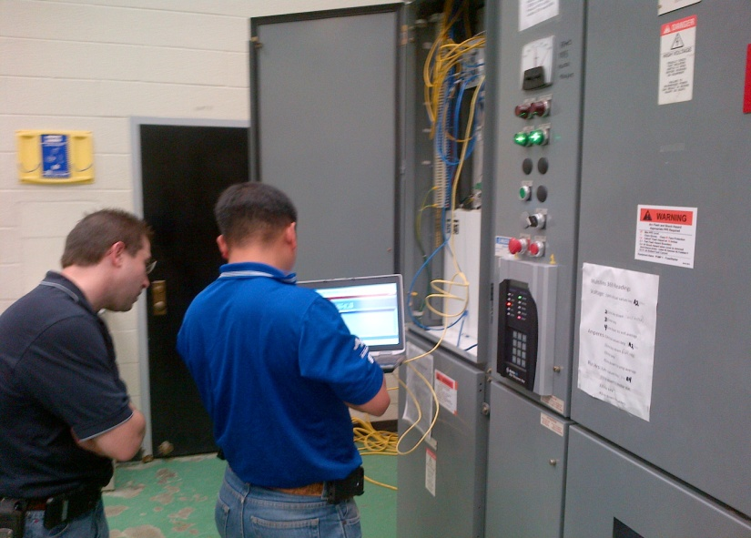



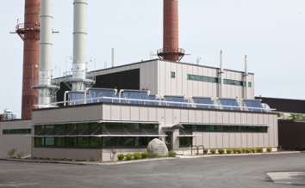
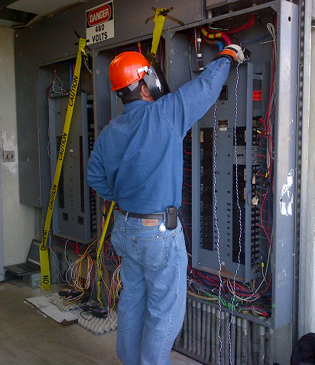
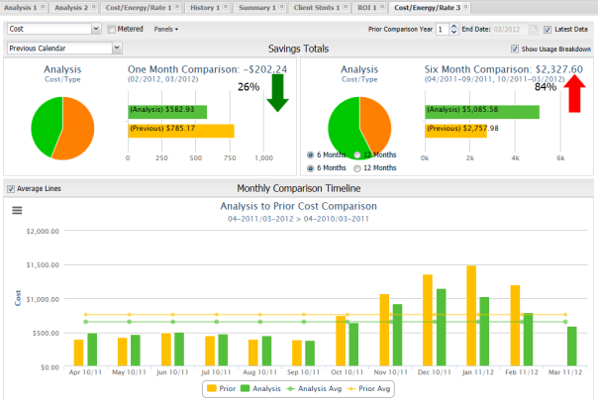
The Vision
Notes:
NY Energy Manager is a comprehensive statewide energy management system housed at NYPA and managed by the Build Smart team with a data management center located in Albany in the College of Nano Science facilities. The center will monitor data throughout the state with the ultimate goal of leading SUNY to the 20% EUI reduction and saving the campuses money.

Slide 18


Two major data management needs:
Organizing and tracking utility data for BuildSmart NY
Supporting Agencies with ongoing support and analytics
Solution:
EO 88 Performance Portal
Continuous Monitoring Portal
Free
$TBD
Notes:
The program has two key purposes
Tracking data related to the EO goals
Supporting agencies with analysis of utility data
The solution is NYEM will provide analytics to campuses of where buildings or systems do not appear to be operating most efficiently in order to allow for corrective action
The performance portal will be free
The monitoring portal cost has not yet been determined.

Slide 19
NYEM Performance Portal Features
Source energy metrics for building, campus, and agency – including consumption and EUI
Track Progress against EO 88 targets & other requirements (Audits, RCx, submetering)
Utility Analysis – comparison of consumption and costs, trends, forecasting - campus to campus, agency to agency
Enterprise tool to view and manage energy consumption and spend
Notes:
The performance portal is the Data of Record for EO88. Utility usage data from EnergyCap is forwarded by Kathy and her staff to the Build Smart team for inclusion in the NYEM performance portal.
The performance portal will provide reports on source energy metrics for building, campus, and agency – including consumption and EUI.
The portal will also track Progress against EO 88 targets & other requirements (Audits, RCx, submetering)
The portal will also provide Utility analysis – comparison of consumption and costs, trends, forecasting – This will allow campuses to compare to other campuses as well as to other agencies.
The portal is an enterprise tool to view and manage energy consumption and spend. Energy Cap already provides this feature to campuses.
The performance portal function of NYEM is at no cost to the campuses. The data transfer is done by System Administration and requires no additional work from campuses.
Our office is working on integrating Energy Cap with the SUNY accounting system so that the data put into EC will flow into the accounting system eliminating double data entry.

Slide 20
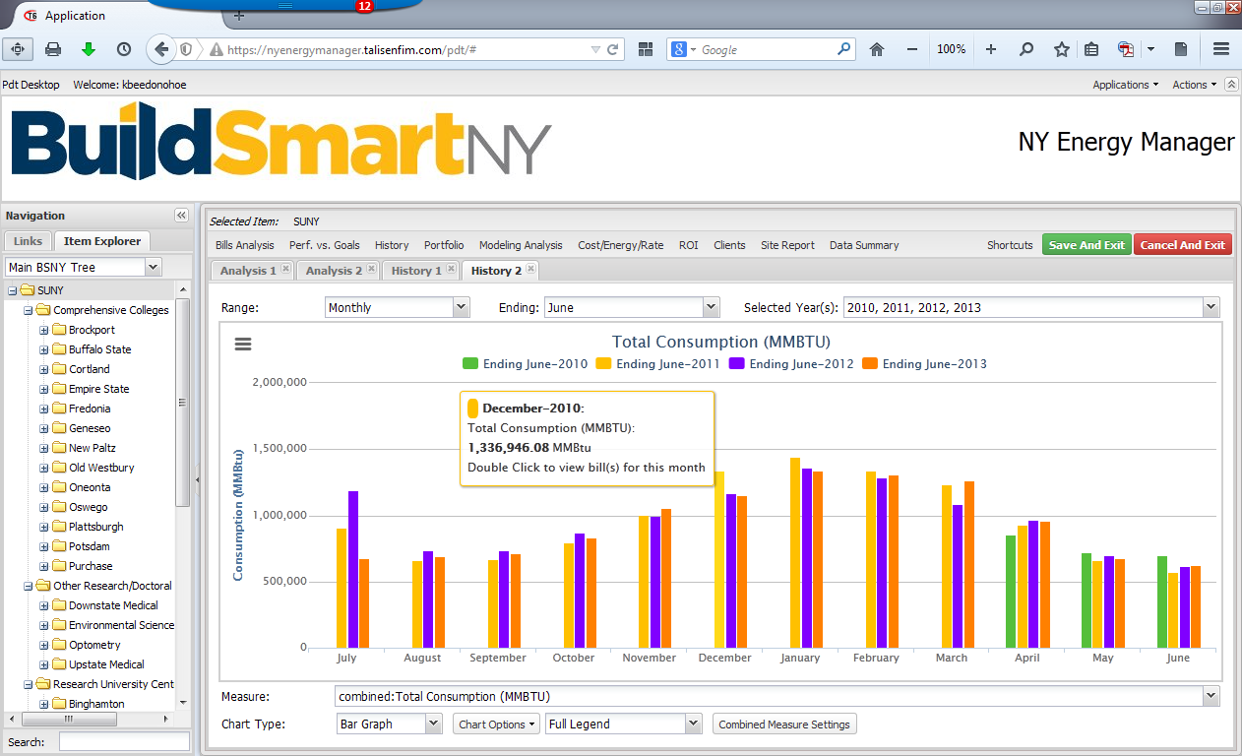
Performance Module - Historical Consumption All SUNY
Campuses by Sector
Hover for Pop-up
Notes:
In the portal, the panel on the left is for navigation by campus. The intent is to share the data amongst all campuses;
The plan is also to be able to see data from other state agencies;
As one hovers over a bar a pop-up provides detail about that bar.

Slide 21
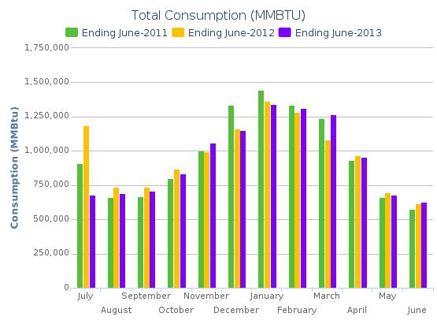
Total SUNY Energy MMBTU FY11, 12, 13
Notes:
This view shows the monthly consumption for all of SUNY in MMBTUs. The system takes the usage data for coal, gas, electric, etc. and converts it into MMBTU, and displays it monthly;
SUNY Energy Purchasing staff provides data to the system in bulk fro Energy Cap.
Graphs and data can be expported.

Slide 22
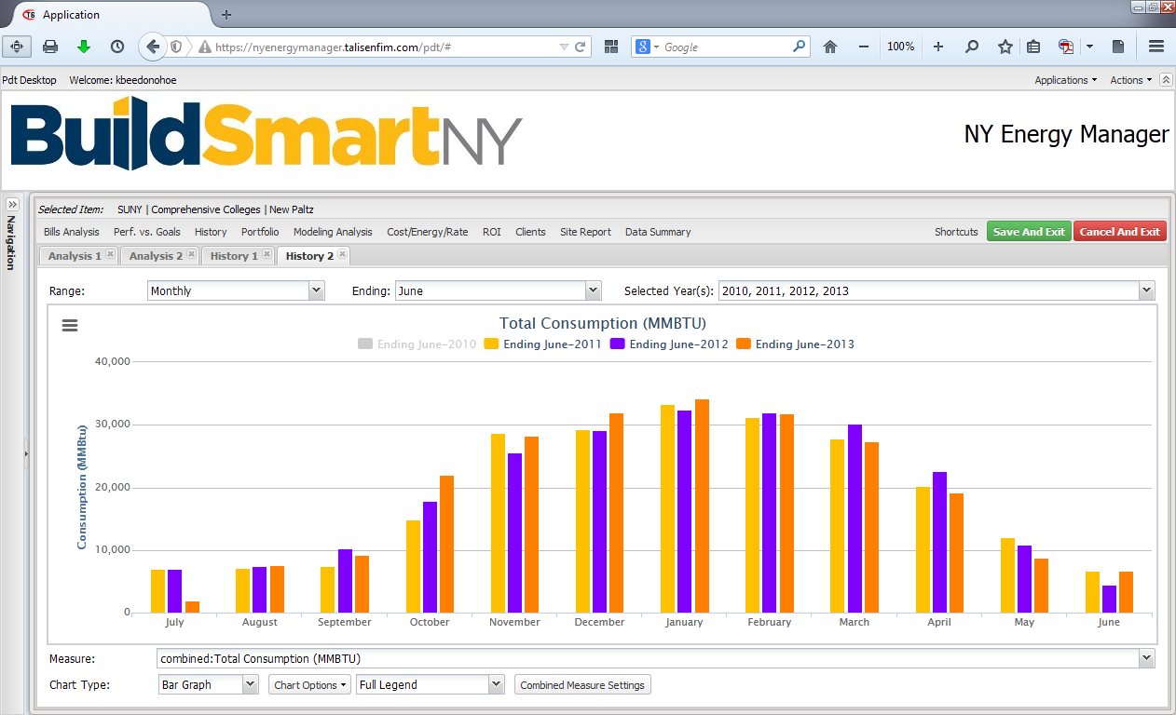
Performance Module - Historical Consumption New Paltz
Notes:
This view is the same report for a single campus, New Paltz. One could also click on Comprehensive to get a report of just the Comprehensives.

Slide 23
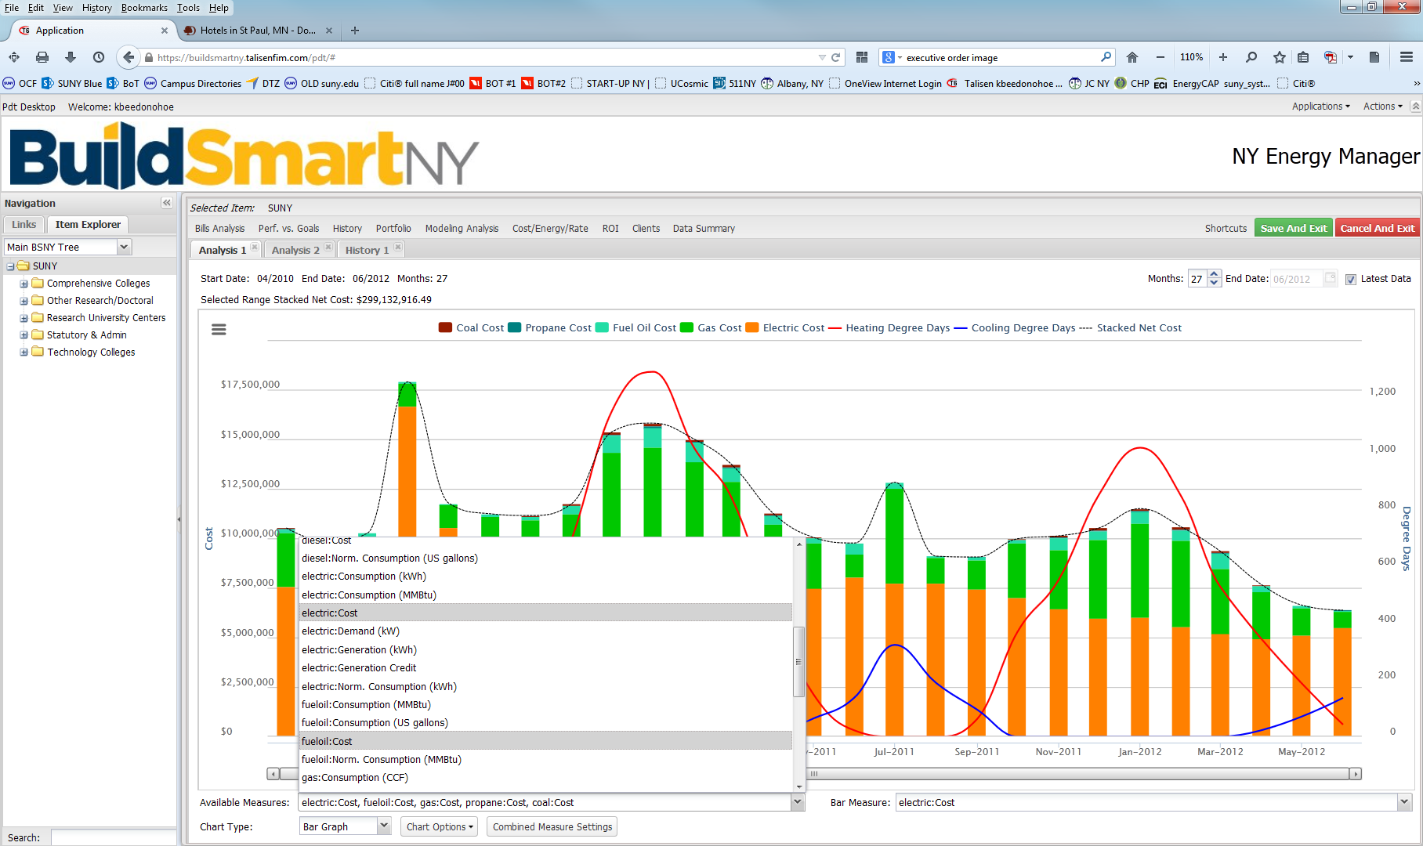
Performance Module - Numerous options
Select Items for Report
Notes:
The system is very simple to navigate for creation of new reports.
The bottom a panel includes a pop-up, that will allow one to select items to report. This report is cost for each of the different utilities.
Many additional reports can be created by simply selecting items to graph.
The report can also show heating and cooling degree days as are shown here with the red and blue lines.
The system also includes normalized consumption data which accounts for the heating and cooling degree days so that more valid comparisons can be made of consumption.
EO88 measures agencies after normalization so that agencies are not penalized by differences in weather from year to year.

Slide 24
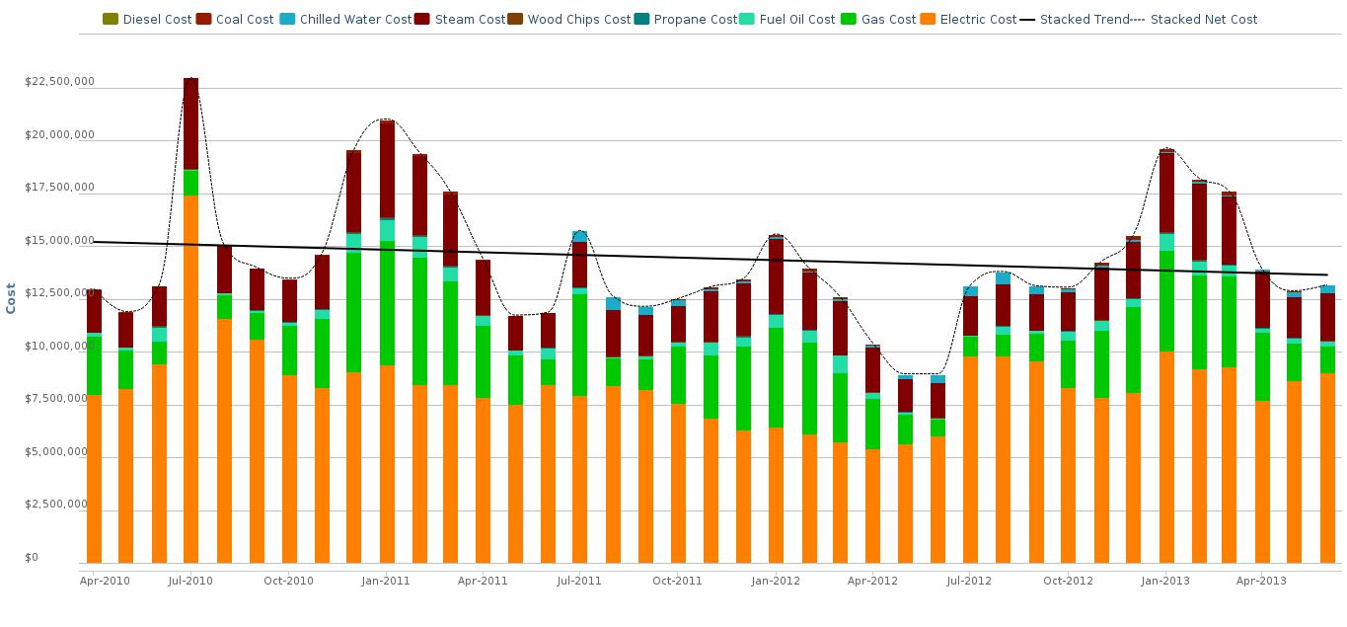
Performance Module - Reporting all SUNY Costs
Notes:
This report shows an analysis of energy costs for all of SUNY. It is includes electric, natural gas, oil, coal and other utilities.
The commodities are all stacked by month and include the 39 months of data currently in the system.
There is also a trend line which in this case shows that over this period our costs are slightly decreasing. This does not however include January 2014 high prices.
Office for Capital Facilities will eventually feed monthly data from Energy Cap to NYEM.

Slide 25
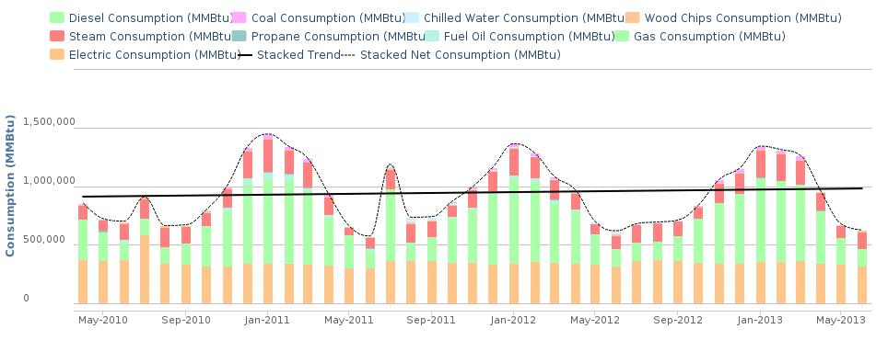
Performance Module - Analysis all SUNY Usage
Notes:
This is the same report looking at consumption instead of cost, shows a slight increased trend in consumption

Slide 26

Performance Portal Next Steps
OCF will be requesting list of those needing access
Logins will be provided to campuses
Web-based tutorials will be given periodically by Talisen to walk users through the system
Notes:
SUNY Office for Capital Facilities will be sending a request to campuses asking for a list of those that should have access to the system. There is no limit to the number of logins that can be requested. Be prudent in the requests as the staff will need to be trained.
Logins will be provided along with access to the system.
Talisen and Arun will schedule webinars to provide training.

Slide 27
Continuous Monitoring Portal
Building-level analysis of energy consumption patterns at 15-minute intervals
Device-level for energy intensive equipment
NYEM specialists to provide continuous monitoring and feedback
Can support Building Management Systems
Demand Response service offering in development
Notes:
The second Portal of NYEM is critical to ultimate achievement of not only achieve the 20% EO88 goal but to exceed it and meet the Chancellors goal of 30% with a centralized Energy Management control center which will be collecting and analyzing submetering data from buildings, portions of buildings, and major building equipment to identify the anomalies in energy consumption that indicate problems in the system.
To be most effective, device level monitoring is recommended for energy intensive equipment such as centrifugal chillers.
NYEM specialists will provide continuous monitoring and feedback to the campuses
The system will accept data from your current BMS
Demand response services will be offered in the future

Slide 28
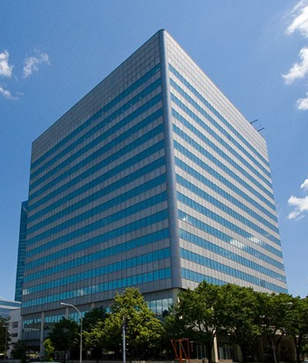
Continuous Monitoring Portal Case Study
NYPA’s White Plains Office is already being monitored and they have found areas for savings
Notes:
The Build Smart Team believes in setting an example so they have already connected their office building in White Plains to the continuous monitoring portal of NY Energy Manager

Slide 29
NYPA’s White Plains Office Case Study
420,000 square foot office building
Integrated 30+ metered points on utility panels, air handlers and other major energy systems
Used NY Energy Manager to analyze interval data
Optimization projects include:
  Modification of programming sequences in BMS
  Peak load management
  Plug load scheduling adjustments
Improved performance expected by August
Notes:
The Building is 420,000 sf
Build Smart has integrated over 30 points for various panels, air handlers and other energy intense equipment.
They are using the data to analyze the building performance and using that information they modify BMS sequences, better manage peak loads and make adjustments to plug loads. They expect to be able to document the savings by August.

Slide 30
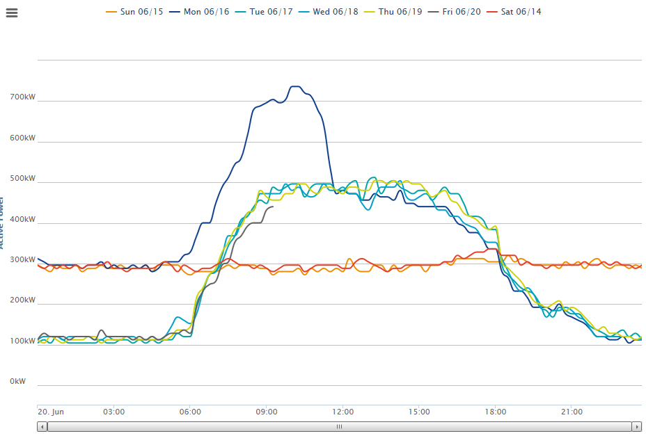
Continuous Monitoring Portal Case Study
Non HVAC Building Total: Very High Monday Morning Ramp Up, High weekend use
Notes:
This shows the load profile of the office for each day of a given week. On Monday, the spike is much higher than normal.
This indicates some abnormal activity that could likely be rectified by changing the sequencing of equipment startup – this could result in substantial demand reduction, and dollar savings.
In this case, it was the scheduled start up time of the fuel cell which was part of early Monday morning ramp up items.
A minor update to its startup time reduces the peak by 180kW. Without this view, it would not be easy to discover it.

Slide 31
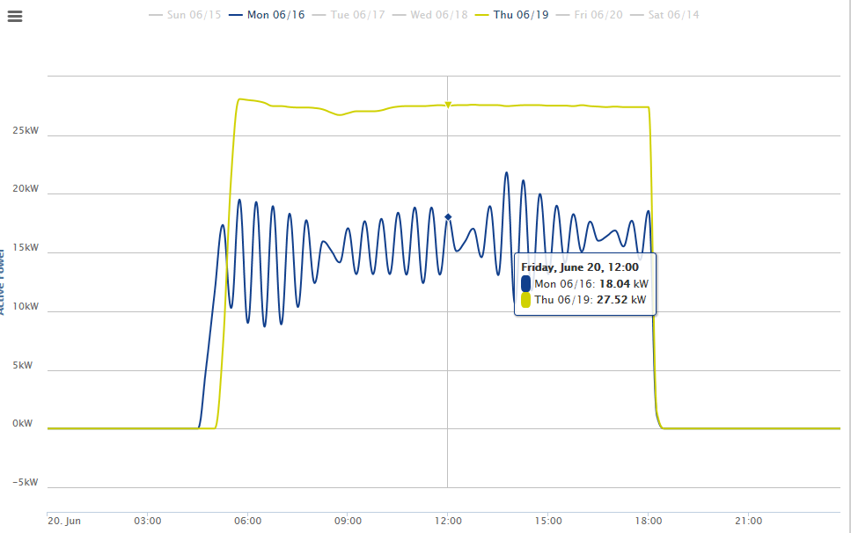
Continuous Monitoring Portal Case Study
VFD Operation failed on Thursday
Notes:
This chart shows the operation of a VFD drive on a daily basis. The blue line (Monday) shows the VFD working properly while the yellow line (Thursday) shows a consistent and sustained peak, indicating the VFD was shut off on this day. From this info, staff can investigate and determine why the equipment was shut off to and avoid that happening again.

Slide 32
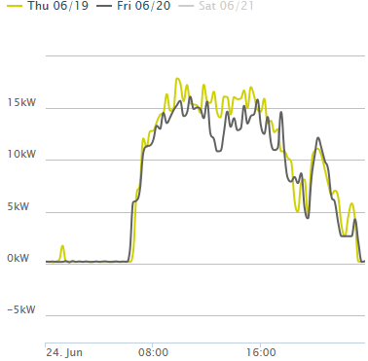
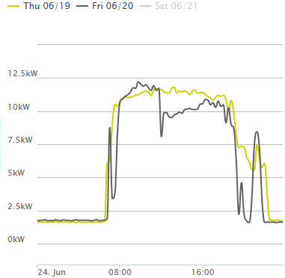
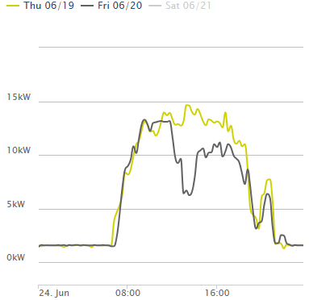
Continuous Monitoring Portal Case Study
Floor 5
Daylight Hour Competition
Floor 6
Floor 10
Notes:
This shows the results of the NYPA Efficiency Friday challenge, where NYPA asked each floor on the building to shut off their lights for 1 hour (12pm-1pm) if they were receiving sufficient natural light.
There is an obvious dip in usage at 12pm on Friday compared to the same time on Thursday. The performance of various floors is evident on the charts. These not only help quantify the savings driven by this initiative, but also show which floor performed best. (For the record, the BSNY Team all sit on the winning 10th floor!)

Slide 33
Overview of Potential Fees
Functionality | Cost
EO 88 Performance Portal | No charge
Continuous Monitoring Portal (includes ongoing support) | No charge for setup 1st year - no charge Beyond 1 year: TBD < $20 per point/month
Future development, additional modules: Building Automation Systems Monitoring Virtual Audits & RCx studies | Most additional functionality will be part of Continuous Monitoring Portal cost
Notes:
The EO88 Performance Portal is and will continue to be free for unlimited number of logins.
The continuous monitoring portal will have no charge for set up. BMS system vendors may charge campuses something to coordinate the connection to NYEM but that cost should be minimal
First year or so no charge for the analysis services.
Beyond year one a charge of less than $20 per point/month with final cost TBD. Don’t compare this to the number of points on Building Management systems. Only key points from campus BMS will feed into NYEM
Other functions are built into the continuous monitoring cost

Slide 34

What About Energy CAP?
Energy Cap is primarily a budgeting system
Phase 2 allows by building or department tracking of costs
Notes:
Energy Cap is primarily a budgeting system
Phase 2 of energy cap provide campuses the ability to track not only overall campus costs but also the ability to track and perhaps charge departments on campus for energy use making them more accountable
Energy cap is vital to collecting the data that feeds NYEM performance portal

Slide 35
What about Iconics or NuEnergen?
These are great programs, and there are many more that do what NYEM does.
Campuses continue to have choices
We recommend putting some buildings on NYEM even if you have another system to compare not only results but also cost
Notes:
These are great programs, and there are many more that also perform similar functions to do what NYEM does.
Campuses continue to have choices
It is recommended to put some buildings on NYEM even if you have another system to compare not only results but also cost

Slide 36
Memo from State Operations Office
Reinforces the need to expedite sub-metering to meet EO 88 requirements
Requires all sub-meters to be brought online with NYEM
Notes:
The forgoing information should illustrate the value and potential of NYEM to help campuses achieve the collective goal.
The memo from the State Operations Office reinforces the need to expedite sub metering in order to gain an advantage from NYEM.
The goal is to get all of the existing sub-meters connected to NYEM by October.
The Build Smart team and Talisen will work closely with campuses to make this happen with the least possible effort on the part of the campus.

Slide 37
Build Smart Awards
First Annual Awards for Excellence is Energy Management
Noteworthy and innovative projects and initiatives are eligible
Deadline July 31
Award ceremony September 16
Notes:
Build Smart announced the first Annual Build Smart awards.
Noteworthy capital-intensive retrofits, equipment installations or rehabilitations are eligible,
In addition to other types of initiatives, such as innovative approaches to energy management, operations & maintenance, or behavioral change activities among building occupants.
Deadline is July 31
Award Ceremony is tentatively scheduled for September 16

Slide 38

Solar Projects
SUNY Counsel is drafting an RFP template for campus use
Build Smart will be scheduling a Solar Webinar to discuss how the Build Smart team can assist in expediting
Hold the date Aug 5th 10 am to noon
Notes:
SUNY Counsel is drafting an RFP template for campus use based on a successful project at Cortland that took a lot of effort to get through OSC.
Build Smart will be scheduling a Solar Webinar to discuss how the Build Smart team can assist in expediting
Hold the date Aug 5th 10 am to noon

Slide 39
NYSERDA
Free consultant services to the campuses for understanding NYSERDA opportunities and applying for grant money
Lindsay Holle, Energy Efficiency Services
lkh@nyserda.ny.gov 518-862-1090 x3051
Don Wells, Taitem Engineering, dwells@taitem.com
607-277-1888 x133
Notes:
NYSERDA staff Lindsay Holle and Don Wells are available to help guide you through the myriad of NYSERDA offerings and help simplify the process for you to get free money.
Lindsay is the Assistant Program Director responsible for SUNY while Don is a consultant paid for by NYSERDA that provides free services to you.

Slide 40


Hess sold its commodity business
Direct Energy will invoice under the new name of Direct Energy, LLC.
Amendments to OCF contracts for Natural gas contracts will be processed by processed by OCF
Once amendments are processed, copies will be sent to facilities and procurement at campuses
Notes:
Hess Corp. sold its commodity business section. Direct Energy has begun to invoice under the new name of Direct Energy, LLC. All natural gas contracts processed by the OCF Energy Office will have the contract amendments processed through the OCF office.
Once the documents have been processed OCF will forward copies to all of the procurement offices and facility directors, and will contact campuses if further information is needed to process the changes.

Slide 41
Start-UP NY

Slide 42


Questions Regarding Start UP
  Who can construct?
  Who issues Permits?
  Must Prevailing Wages be paid?
  Does MWBE 15A apply?
  Does Wicks apply?
  What does Start UP do to Private Use?
Notes:
Several questions
Who can construct?
Who issues Permits?
Must Prevailing Wages be paid?
Does MWBE 15A apply?
Does Wicks apply?
What does Start UP do to Private Use?

Slide 43
Who Can Construct?
Private businesses cannot construct on SUNY campuses without specific legislative authority to do so.
Two legislative exceptions have existed for several years – energy projects and off-budget housing
Start UP provides a third
exception.
Notes:
Start up Statute provides that the private businesses with approved start up plans can build on specifically designated campus property.
This is contrary to previous rules. Prior to Start UP, specific legislation was required for private entities to lease space from campuses and construct facilities on that space. The two previous exceptions to project specific legislation were off-budget housing and energy projects. Start-UP is a third exception as the legislation that created Start-UP specifically permits private entities to construct on our property.
OCF will be developing a revision to the CLC-3 Construction Authority to include this information.

Slide 44
Who issues Permits?
SUNY remains the Authority Having Jurisdiction (AHJ) for renovations in designated Start UP State Owned buildings
SUNY will be the AHJ for new buildings constructed on State owned land
The municipality will be AHJ for construction on or in SUNY affiliate owned
land/facilities
Notes:
SUNY remains the Authority Having Jurisdiction (AHJ) for renovations in designated Start UP State Owned buildings
SUNY will be the AHJ for new buildings constructed on State owned land
The municipality will be AHJ for construction on or in SUNY affiliate owned land/facilities

Slide 45
Must Prevailing Wages be paid?
YES

Slide 46
Does MWBE 15A apply?
YES

Slide 47
Does Wicks apply?
NO
Notes:
SUNY Counsel reviewed the law and found that only prevailing wage and MWBE are specifically called for by Start UP statute. Other purchasing rules including Wicks are not required. Project labor agreements may be used but are not required.

Slide 48
What does Start UP do to Private Use?
This is one of our largest challenges currently
Most buildings have outstanding bonds
Private use has two limitations
  Limitation per building of 5% unrelated use or up to 10% if directly related to your functions
  Up to $15 million per bond sale
Notes:
This is one of the largest challenges
Most buildings have outstanding bonds
Private use has limitations on the % of use and total per bond sale. The following is a very simplified explanation, though reality is much more complicated
Limitation per building of 5% unrelated use or up to 10% if directly related to your functions
Up to $15 million per bond sale

Slide 49
Communications
Newsletter was sent out earlier in the week
We have several listservs for communication
Our Webpage is robust
http://system.suny.edu/capital-facilities/
OCF is looking for feedback – are we providing the services that you need, what are we missing?
Notes:
OCF Newsletter
several listservs for communication
Webpage http://system.suny.edu/capital-facilities/

Slide 50
SUNY Office for Capital Facilities
Just ask!!
We are here to help!

