Slide 2
Topics
Governor’s Energy initiative – EO88
Energy News – Kathy Slusher
Res Hall Capital New Legislation – David Ferrari
Community College Capital
Campus Let Audit
Project Sunlight
Preview tomorrow - Campus Lets and EHS

Slide 3

Governor’s Energy Initiative
BuildSmart NY
Executive Order 88 – calls for increasing energy efficiency in state buildings by 20% in seven years
Goals include:
  Save millions of dollars
  Create thousands of jobs
  Reduce greenhouse gas
  emissions by more than
  eight million metric tons
EO 111 is repealed by EO88

Slide 4
BuildSmart NY and SUNY
Governor’s team and SUNY selected initial five campuses for Energy Master Plans
  Buffalo State, New Paltz, Canton, Albany and Stony Brook
Comprehensive Energy Master Plans will study current conditions and establish savings options
Intended to address largest most inefficient buildings first with comprehensive whole-building improvements
Notes:
Guidelines will be developed

Slide 5
Build Smart NY Key Requirements
Benchmarking and annual reporting beginning January 2014 for all Buildings over 20,000 sf. If not sub-metered, report by Campus
Building sub-meters are required for all buildings over 100,000 by December 31, 2016
Governor’s team will develop comprehensive operations & maintenance plan for State facilities
Highlighting the accomplishments via
Build Smart NY http://www.buildsmart.ny.gov/
Notes:
Other features include Credits for on-site generation. Exemptions are available building maintaining Energy Start or similar certification

Slide 6


Energy News
Multiple Intervenors
Update
EnergyCap Update

Slide 7
Multiple Intervenors Update
“Temporary” State Assessment has been extended for 5 years
National Grid tariff increase will be approved
Legacy charges by NG will go away in Jan 2013
Governor wants PSC to have greater penalties for T&D companies who do not perform restoration services fast enough.
New Program called “Charge NY” to encourage electric car use. Provides funding for charging stations for the public.

Slide 8
EnergyCap News
Currently over 1400 accounts set up
Moving to the mainframe on January 30, 2013
URL will change to http://web.energycap.com/
Annual training event to be held in May at State College, PA. Users are encouraged to attend to get the most out of the software. Kathy has information at 518-320-1658

Slide 9
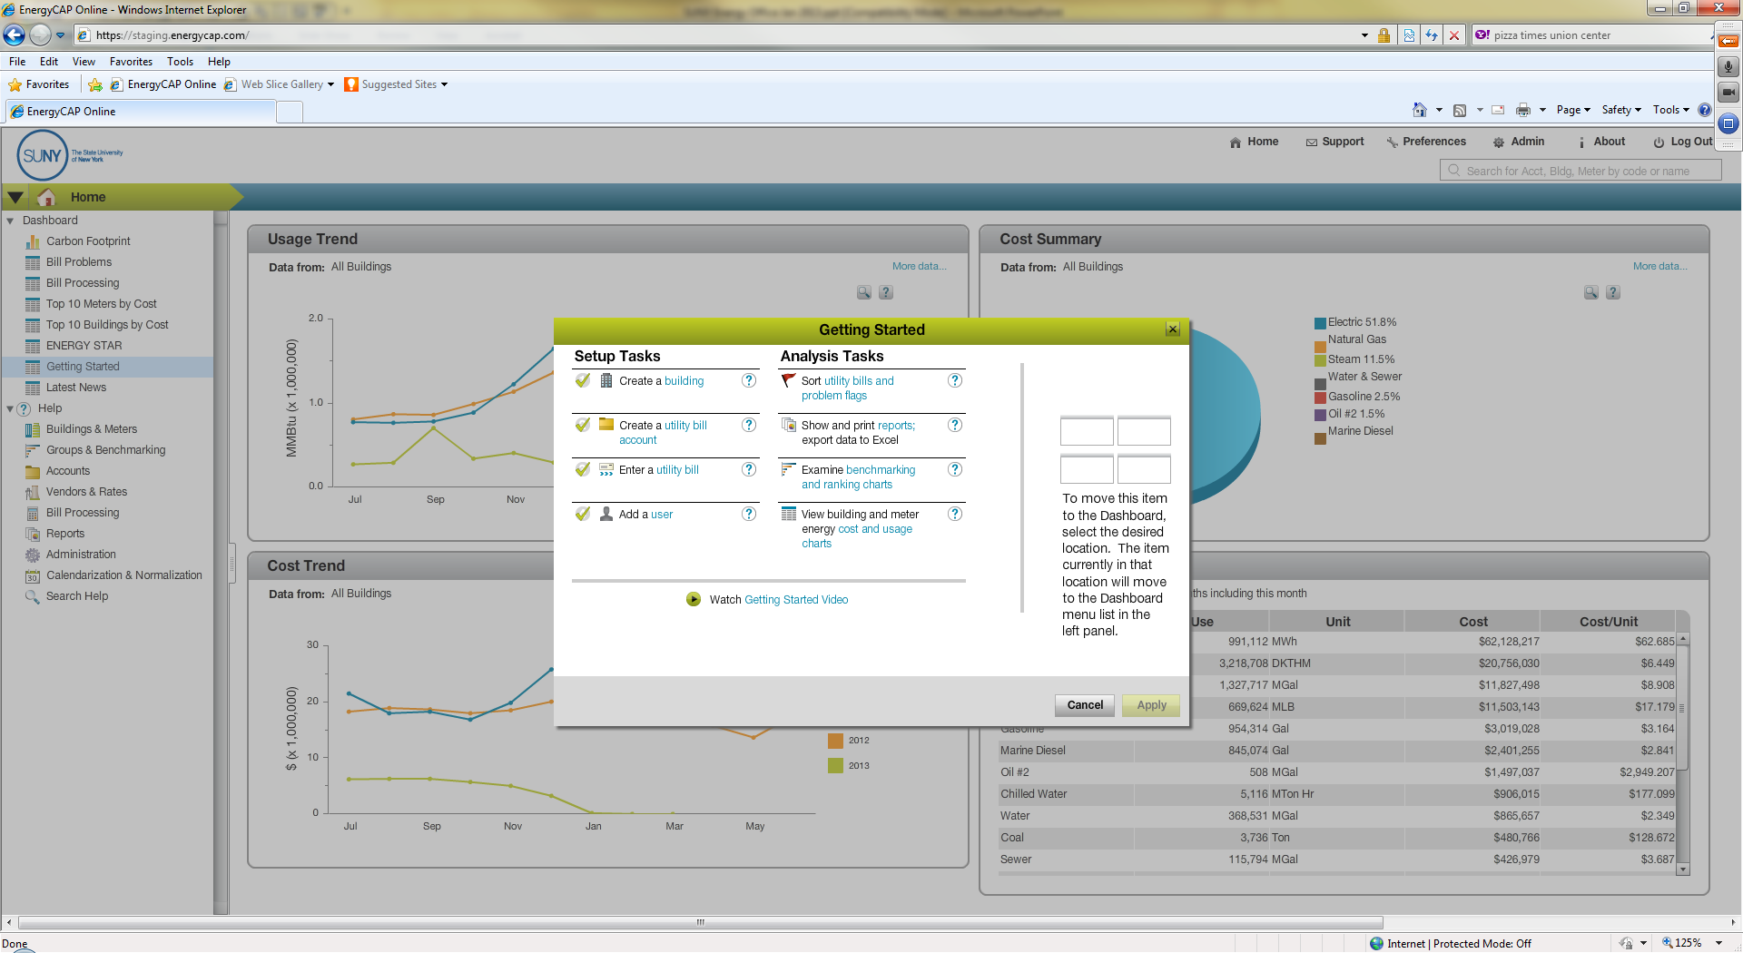
Help and Getting Started

Slide 10
Look Here

Slide 11
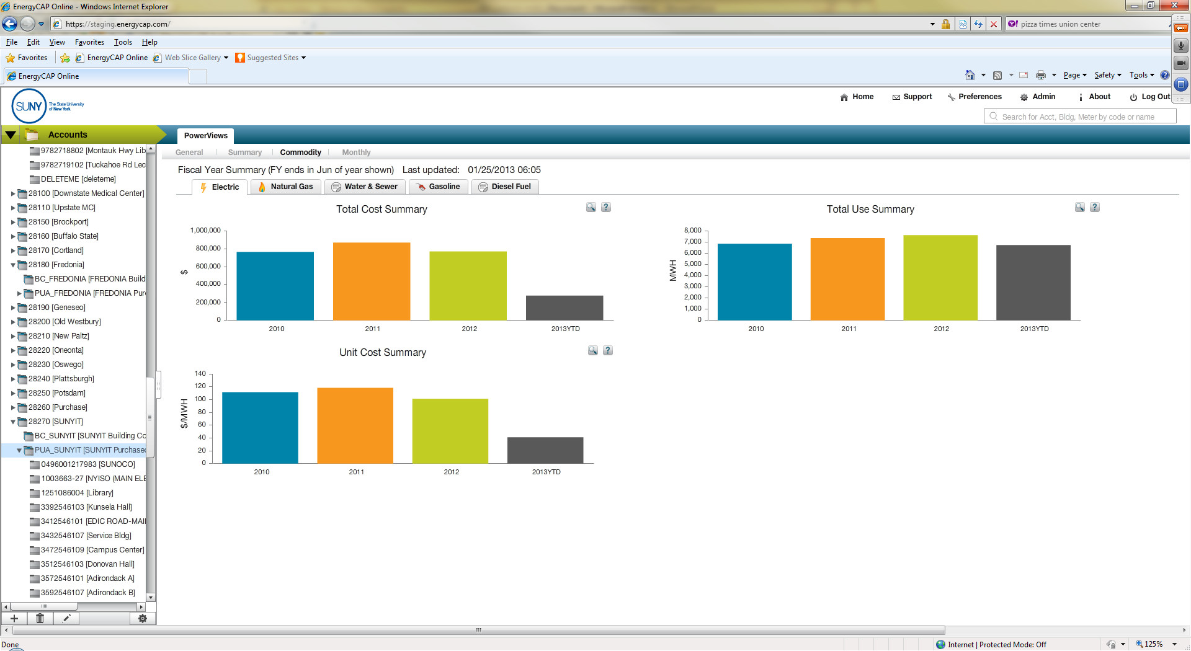
EnergyCap Power View

Slide 12
Power View Options

Slide 13
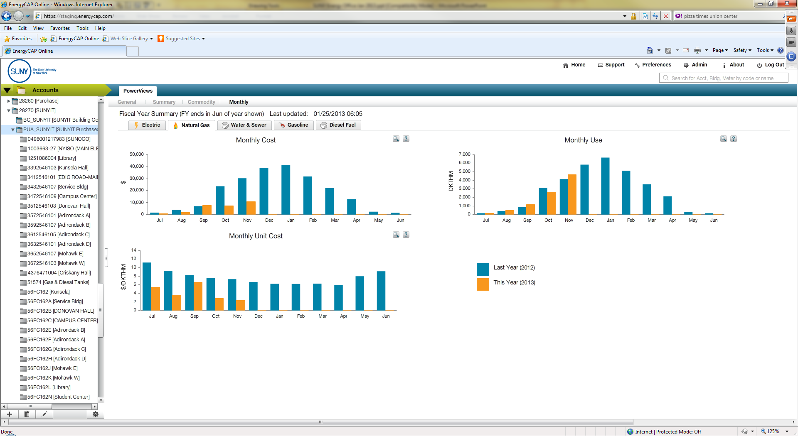
EnergyCap Power View Monthly Information

Slide 14
EnergyCap Power View Monthly Information

Slide 15
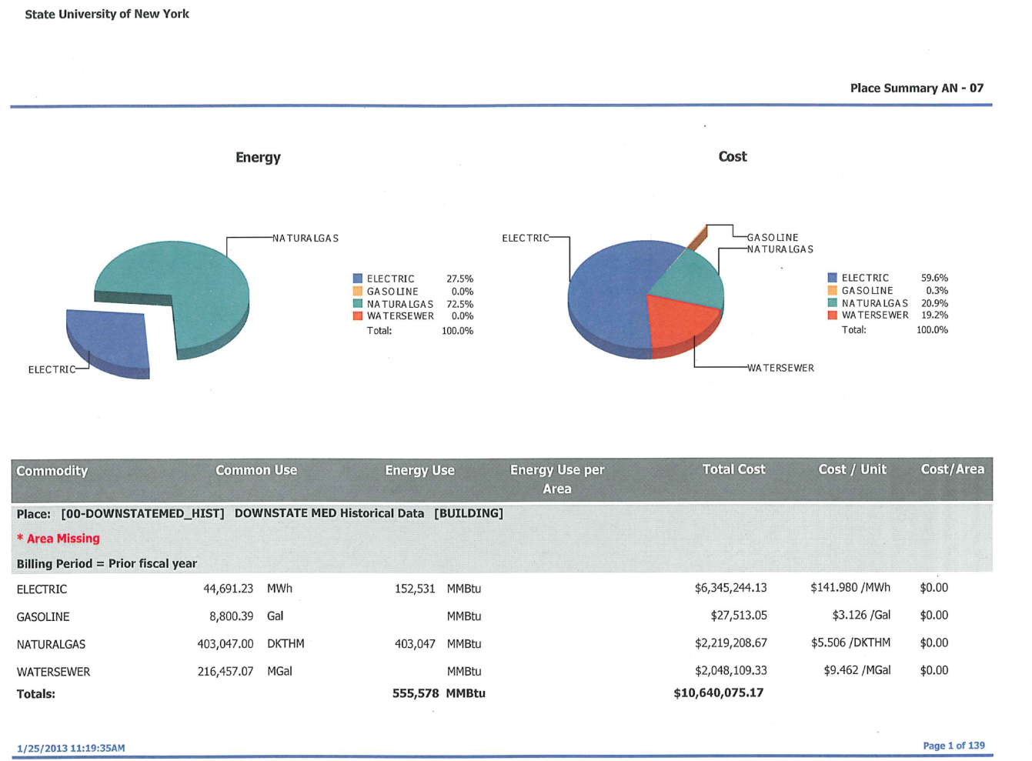
The New EMBS

Slide 16
Residence Hall Capital Program

Slide 17
Residence Hall Capital Program
2012-13 State Budget Impact
2013-14 Executive Budget
Overview of New Bill
Operational Impact of New Bill

Slide 18
Residence Hall Capital Program
2012-13 State Budget Impact
  System wide project demand ($205M) was denied by NYS DoB
  Many bonded projects were delayed or cancelled with no answer in sight regarding future bonding capacity
  Campuses were faced with the reality that they may have no way to fund critical maintenance and life safety projects
  Advocacy efforts began in order to provide options in the event 2013-14 budget omitted residence halls too

Slide 19
Residence Hall Capital Program
2013-14 Executive Budget
  Description Requested Awarded/5 Yr plan
  Hard Dollar $42M/$197M $50M/$250M
  Bonded $318M/$944M $0M/$0M
  Re-Approp $514M $514M
  New Bill $944M $944M

Slide 20
Residence Hall Capital Program
Overview of the New Bill
  SUNY Admin worked with DASNY, outside bond counsel, NYS DoB, and others to develop a bill that would have best chance of success
  This iterative process yielded a bill that will allow us to bond $944M over the next 5 years
  This bond limit is not related to the personal income tax debt cap
  The bill must pass the legislature to become part of the enacted State budget and become law

Slide 21
Residence Hall Capital Program
Operational Impact of the New Bill
  Long term planning will be possible … we will not have to seek appropriation each year
  Program will operate based on affordability and need … not restrained by State appropriations
  Campuses will still be required to show affordability of plan through submission of 10-year cash flow
  A formal project approval process is being developed
  Flow of funds will change impacting the campus accounting & budget staff

Slide 22
Residence Hall Capital Program
Operational Impact of the New Bill (cont.)
  DASNY construction projects will continue with no changes
  Details are being worked out to handle Campus Let projects
  Operations & maintenance will not change
  Hard dollar capital will not change
  Please join me in the “Birds of a feather” segment for further discussion

Slide 23
Community College Capital Program

Slide 24
Community College Capital
Typical Process – CC obtains 50% sponsor support, SUNY requests 50% State support as part of annual budget request
This year only the critical maintenance projects have been included in the Executive budget
New facilities are not included
CCs have two options – apply for SUNY 2020 grant funding or apply for capital funding through Regional Economic Development Councils

Slide 25
Campus Let Audit
Following almost two years of post audit, SUNY Internal Audit is scheduled to audit some campus let projects
Audit is planned for this Spring or Summer
The audit will help identify problem areas
OCF will follow up with a lessons learned for all campuses
Goal is to find problems, make correction now before OSC audits the program

Slide 26
Project Sunlight
Q: What is Project Sunlight?
A: Project Sunlight, a component of the Public Integrity Reform Act of 2011, is an online database that provides the public with an opportunity to see what entities and individuals are interacting with government decision-makers.
For the text of the law, see Chapter 399 Part A, § 4 of the Laws of 2011.
Notes:
How many have heard of Project Sunlight?
Public Officers Law changes several years ago reducing what had been – golf, lunch, etc

Slide 27
Project Sunlight
Q: What is covered by Project Sunlight?
A: In order for an interaction to be covered by Project Sunlight it must:
  Be an appearance,
  Between covered individuals, and
  Concern one of the five subject areas covered by Project Sunlight (procurement, rate making, regulatory matters, judicial or quasi-judicial proceedings, adoption or repeal of a rule or regulation)

Slide 28
Project Sunlight
Q: Who at the state entity is covered by Project Sunlight?
A: Appearances should be reported if they are conducted before an individual at the state entity who has the power to exercise agency discretion in one of the five covered categories, or advises someone who has such discretion.

Slide 29
Project Sunlight
Q: Do appearances related to procurements below my agency’s discretionary purchasing threshold need to be reported?
A: Appearances related to procurements under $25,000 do not need to be reported.
More information can be found at the following: http://www.suny.edu/compliance/topics/projectsunlight/index.cfm

Slide 30
Project Sunlight
The OGS database is available for campus input
The public site is not yet live but expected to go live in early to mid February once agencies have submitted appearances into the database
Agencies that submitted exemptions should hear back next week as to their approval
SUNY System Administration has submitted proposed exemptions on behalf of the entire system

Slide 31

Campus Let Contracts
Consultant Contracts
Term and Backdrop contracts

Slide 32
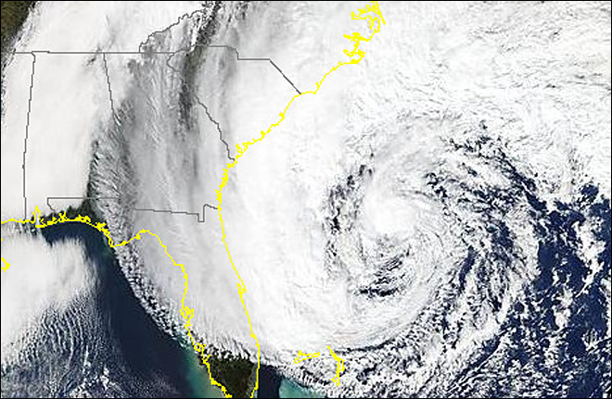
Environment Health and Safety
Hazard Communication (aka Right to Know)
Sandy
Oil Storage

Slide 33
The End

