Slide 1


Brunch with the Office for Capital Facilities
Summer PPAA Conference
July 14, 2015

Slide 2



Office for Capital Facilities
The SUNY Office for Capital Facilities is responsible for providing tools, training, and communication to the 64 SUNY campuses in support of various campus programs that manage facilities. The office provides guidance, oversight and technical expertise in accordance with applicable New York State laws and regulations. A variety of disciplines are represented within the department including:
Campus Let Contracts Program
Community College Capital Program
Residence Hall Capital Program
Environmental Health and Safety
Energy Procurement and Utility Regulatory Affairs
Energy Management, EO88 and Sustainability

Slide 3


Office for Capital Facilities
Vice Chancellor for Capital Facilities
Robert Haelen
Executive Director, OCF
Karren Bee-Donohoe
Energy
Manager
Eric Mazzone
Director of Energy Procurement & Utility Regulatory Affairs
Kathleen Slusher
Community College
Program Manager
Rebecca Goldstein
Contract
Specialist
Jessica Miller
Residence Hall
Program Manager
David Ferrari
Director, Environmental
Health & Safety
Barbara Boyle
Energy Procurement
Sr. Accountant
Dan Russ
Energy Procurement
Accountant
Melinda Race
Capital
Financial Analyst
Donald Smith

Slide 4

SUCF
SUCF Trustees
Robert M. Haelen
General Manager
Jo Anne Di Stefano
Corporate Integrity and Ethics Officer
Vacant
Counsel
Beth Perrella
Executive Assistant
Vacant
Deputy General Manager
W. Thomas Mannix
Deputy General Manager
Jon Gurney
Director Capital
Program
Management
Christopher Marcella
Director Design
William Held
Director
Construction
Nora McCabe
Director
Capital
Program
Finance
Mary Jo Lais
Director Administration and
Human Resources
Joseph Rourke
CIO
Arthur Foo
Director Capital Procurement
Tammi Coburn-Sossei
Controller
Lois McLaughlin
Director Opportunities Program

Slide 5


Environmental Health & Safety
General Areas of Support
  Occupational Safety and Health
  Environmental Compliance
  Life Safety and Building Codes
  Emergency Planning and Response

Slide 6
Environmental Health & Safety
Some state-entity specific notes:
PESH vs OSHA
NYS Right-to-Know Law and PELs
Asbestos (no in-plant exception)
Workplace Violence Prevention
Sun Safety
DERA
AEDs in Public Buildings
Labor Management H&S Groups resources and services

Slide 7

Environmental Health & Safety
Annual Report Roll Ups
  Part 1204 Report for building code administration
  State Agency Environmental Audit
  Diesel Emissions Retrofit Act Report
  Residence Hall Fire Safety Report

Slide 8

Environmental Health & Safety
NFPA Access (via SUNYConnect)
Codes Online (via Construction Fund)
Emergency Generators
NY-Alert
Access to Labor/Management H&S Committees

Slide 9

EH & S Resources
AED Programs
Ebola Health Alert
Emergency Information
Environmental Compliance
Fire, Life Safety and Building Codes
Hazard Communication
Lab Safety
Mold
Occupational Safety
EH&S Compliance Calendar
Major Environmental Health & Safety Training Requirements

Slide 10


Campus Let Contracts
 | # of Bldgs | Sq. Foot⁽¹⁾ | Avg Age⁽²⁾ | Funded By | Projects Managed By
Educational Facilities | 1,859 | 58.6 | 46 | State | Fund/Campus
Hospitals | 18 | 2.9 | 27 | Hospital Revenues | Fund/Campus
Residence Halls | 487 | 21.1 | 36 | Room Rents | DASNY/ Campus
Community Colleges | 523 | 19.3 | 42 | 50% State 50% Local | Local
Totals | 2,887 | 101.9 | 43
SUNY’s
Capital
Program
Notes: ⁽¹⁾ Square footage and funding expressed in millions.
⁽²⁾ Average age (in years) represents straight average with no consideration given to the size of buildings or subsequent renovations.
All figures from Fall 2013

Slide 11

Campus Let Contracts
Capital Projects
  Campus Let Contracts
  Campus Funded Contracts

Slide 12





Campus Let Contracts
Construction Authority

Slide 13

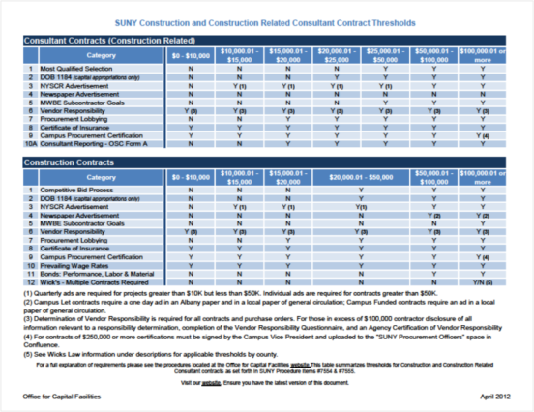
Campus Let Contracts
Procurement Requirements

Slide 14

Campus Let Resources
TOOLS
TRAINING
COMMUNICATION
Policies and Procedures
Contracts
Threshold Chart
Regional and On-site Campus Let Contracts Training
Webinars
Guidance Documents
    Construction Bonds
    Temporary Services
    Construction Authority
    DOB Approvals
    Debriefing
    Single/Sole Source
    Field Orders
    Equipment

Slide 15

Residence Hall Capital Program
Program Structure
  Participating Campuses
  Ownership of Buildings
  Support from System Administration

Slide 16

Residence Hall Capital Program
Annual Processes
  Capital Plan
  Bond Sale
  Budget Submittal
  Surveys

Slide 17

Residence Hall Capital Program
Capital Projects
  Construction Management
  Funding Options

Slide 18
Res. Hall Resources
TOOLS
TRAINING
COMMUNICATION
SUNY Residence Hall Program- Minimal Living Standards
(SUNY Policy No. 3451)
DASNY Residence Hall Guidelines
Campus Let Procedures
DASNY Property Insurance Presentation – April 2014
DASNY Fee Overview Presentation - December 2014
Residence Hall New Program Information Sheet
Article VII 2013-14 Residence Hall Program

Slide 19

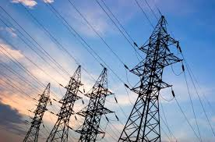

Energy Procurement & Utility Regulatory Affairs
SUNY Energy Buying Group for Electricity
Demand Response Programs
Natural Gas Procurement
Multiple Intervenors and Utility Tariffs
Energy Cap for Utility Use and Cost Tracking

Slide 20

Energy Buying Group
  Wholesale Market
  Upstate Campuses
  FERC Rules
  Savings $27.3 million

Slide 21
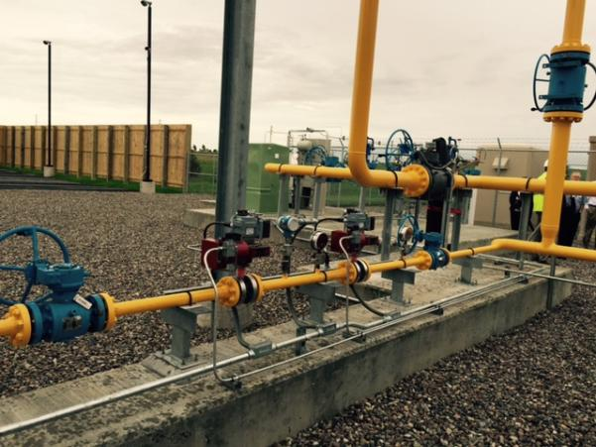
Natural Gas Aggregation
  NYMEX + Basis
  Utility Company
  City Gate

Slide 22
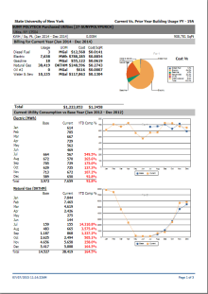
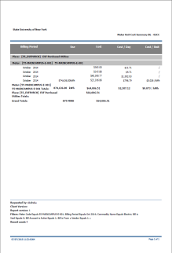

EnergyCap
Tracks:
  Commodity Type
  Usage
  Cost
  Location
  Weather’s effect
  EO88 Reporting

Slide 23

Multiple Intervenors
  60 large industrial and commercial electricity and natural gas users in NY
  Represents us in rate cases at PSC and FERC
  Fair cost per market segment
  Fair ROE for utilities

Slide 24

Energy Procurement Resources
TOOLS
TRAINING
COMMUNICATION
Natural Gas & Electric
Utility Provider Information
Public Service Commission
New York Independent System Operator (NYISO)
US Energy Information Administration (EIA)
Current Natural Gas Supply Contractors' Information
EnergyCap Utility Tracking
NYSERDA
NYPA
NYISO
U.S. Energy Information Administration
Energy Buying Group

Slide 25



Energy Management, EO88 and Sustainability
Executive Order 88
NY Energy Manager
Financial Assistance

Slide 26
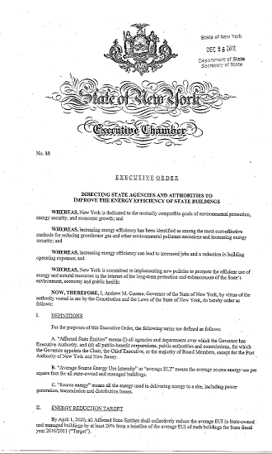

Executive Order 88
College and University Clean Energy Initiative; REV Campus Challenge http://revcampuschallenge.ny.gov/
2030 Clean Energy Goals
  Energy Master Plan

Slide 27

NY Energy Manager
  11 campuses connected to date
  2 more scheduled
  Virtual Audits
  Operational improvements

Slide 28
Grants
    Flex Tech
    Existing Facilities program
    NY Prize
    Utilities
    Custom and Rebate style incentives

Slide 29
Financial Assistance
    Design Build and Construction
    Construction Management
    Customer Implementation
    Operation and Maintenance Funding
    Master Services Agreement

Slide 30

Energy Management Resources
TOOLS
TRAINING
COMMUNICATION
Database of State Incentives for Renewables & Efficiency
Green Professional Building Skills Training
Build Smart NY EO 88 Guidelines
Build Smart NY Annual Status Report
Build Smart NY O&M Plan (June 2014)
Build Smart NY Baseline Energy Report
Build Smart Facility Star 2015
NYSERDA Funding Opportunities

Slide 31

Questions?
http://system.suny.edu/capital-facilities/

