Slide 2
OCF Organization Chart
Vice Chancellor for Capital Facilities Robert Haelen
Director
Karren Bee-Donohoe
Energy
Kathy Slusher
Environmental Health and Safety Barbara Boyle
Campus Let Procurement
Jessica Miller
Community College Capital
Rebecca Goldstein
Res Hall Capital
David Ferrari
Sustainability
Deborah Howard

Slide 3

TOPICS
Residence Hall Capital Program
Sustainability - Build Smart NY – Executive Order 88
Environmental Audit

Slide 4
Res Hall Legislation
Res Hall Capital no longer subject to annual appropriation or the State Bond Cap
New program allows for $944 million in bonding over next 5 years
Not all control is removed - SUNY must request an increase to the 5-year cap

Slide 5
New Res Hall Program
Continuing Requirements:
  Capital Planning
  Annual Certifications of Revenue and Expenditures
  Operations and Maintenance Reserve
  Repair and Rehabilitation Reserves
Additional Requirements:
  An Additional Bonds Test (ABT) is now required – net revenues must >= 120% of Debt Service
  An Annual Report to the Governor, Legislature and Division of the Budget is now required

Slide 6

Res Hall Revenue Flow of Funds
All revenue will flow through new Tax and Finance Account. It is this factor that make the program distinct and allowed it to be removed from the State debt cap
Campuses must have required reserve balances in place as of June 30 each year
Reserves may be used beginning July 1

Slide 7
Res Hall Program Documents
Existing Program
  1995 Lease & Agreement, amended and restated in 2003
  Campus Let agreement 2008
  Revenue Bond Resolution for old program
  Appropriations, Reappropriations and Financial Plan
New Program
  Enacted legislation forming the new program
  Lease and Agreement Supplemental Amendment *
  Financing and Development Agreement *
  Revenue Bond Resolution for new program
  Assignment of Revenues to DASNY*
  Tri-Party Agreement – Tax & Finance, DASNY, SUNY
  *require AG/OSC approval

Slide 8
Rating Agency Comparison
Moody's | S&P | Fitch
Aaa | AAA | AAA | Prime
Aa1 | AA+ | AA+ | High grade
*Aa2 | AA | AA
Aa3 | *AA- | *AA-
A1 | A+ | A+ | Upper medium grade
A2 | A | A
A3 | A- | A-
Baa1 | BBB+ | BBB+ | Lower medium grade
Baa2 | BBB | BBB
Baa3 | BBB- | BBB-
*SUNY Res Hall Program Current Ratings

Slide 9
Similar Program Ratings
 | Moody's | S&P | Fitch | ABT*
Nebraska | Aa1 | AA | NR | 1.15x
SUNY | Aa2 | AA- | AA- | 1.20x
Ohio State | Aa2 | AA- | NR | 1.10x
Florida | Aa2 | AA- | AA- | 1.25x
Washington State | Aa2 | A+ | NR | 1.25x
South Dakota | Aa3 | NR | NR | 1.20x
Iowa | Aa3 | A | NR | 1.35x
University of Alabama | A1 | A | NR | 1.20x
* Additional Bonds Test (ABT)

Slide 10



Implementing Executive Order 88 at SUNY:
Background, Context and 2013 Work Plans
May 2, 2013

Slide 11
Build Smart NY Basics
Goal: Accelerate implementation of energy efficiency improvements in state government buildings: reducing costs, curtailing greenhouse gases, and enhancing energy security
Objectives:
Foster cost-effective investment… in state government building equipment, operations and infrastructure
Institutionalize accountability… with a transparent performance management system that drives energy savings results and transforms building operations culture
Demonstrate success… and model energy efficiency solutions for public and private buildings
Generate economic growth… and green jobs across New York State

Slide 12
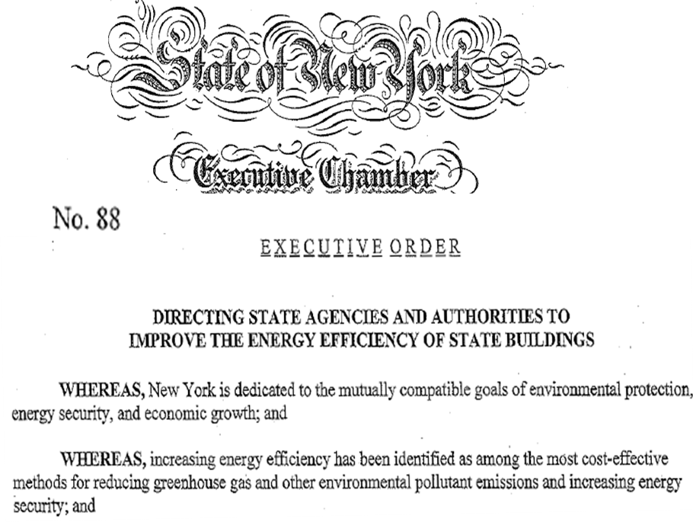
Executive Order 88 Basics
The Target:
20% energy consumption reduction in State-owned and managed by April 2020
The Metric
Source Energy Use Intensity
Baseline Year
State Fiscal Year 2010 – 2011
Source
Energy Use
Facility
Square Feet
Source
EUI
=

Slide 13


Executive Order 88 Basics (cont’d)
Central Management & Implementation Team (CMIT) within NYPA
Guidelines defining process and rules
Benchmarking of buildings > 20,000 SF
Energy audits of underachieving buildings
Submeter master-metered campuses
O&M optimization e.g., training, RCx, CCx
Capital plan integration
Annual Reporting

Slide 14
The “Big Six” Agencies
NY State owns and operates approximately 211 million square feet of real estate -- across +/- 16,000 buildings.
> 90% of this -- and energy consumption – is contained across 6 NY State government entities
Agency/Authority | Acronym | Gross Sq. Feet | % of Total
State University of NY* | SUNY | 86,444,011 | 41.0%
Department of Corrections & Community Supervision | DOCCS | 38,098,538 | 18.0%
City University of NY* | CUNY | 19,701,393 | 9.3%
Office of Mental Health | OMH | 19,025,432 | 9.0%
Office of General Services | OGS | 18,051,038 | 8.6%
Metropolitan Transit Authority | MTA | 10,344,220 | 4.9%
All Other State Agency Facilities |  | 19,186,730 | 9.2%
TOTAL |  | 211,086,74 | 100.0%
*+/- SUNY Buildings are over 20,000 SF

Slide 15
The “Big Six” Agencies

Slide 16
Source EUI for Select Agencies

Slide 17
University Source EUI

Slide 18
Near Term Work Plan

Slide 19
SUNY Environmental Audit
History
Audits were conducted 2002 through 2007
One thousand violations were disclosed
Penalties were waived - EPA estimate: $10M
Campuses identified and corrected many poor practices and deficient conditions
Campuses were expected to maintain corrective actions

Slide 20
Environmental Auditing List
Air Programs
Bulk Chemical Storage
Emergency Planning and Community Right-to-Know Act and New York TRI Reporting
Hazardous Substance Release Notifications
Hazardous Waste (RCRA)
Oil Pollution Prevention (Oil SPCC)
Oil Storage and Release Reporting (PBS)
Pesticide Management
Regulated Medical Waste
Safe Drinking Water Act
Stormwater Permitting (SWPPP)
Toxic Substances (TSCA-Lead-Based Paint, PCBs, and Asbestos)
Underground Injection Control (UIC)
Universal Waste
Used Oil Management
Wastewater Discharges (SPDES, MS4)

Slide 21

SUNY Environmental
Audit Program
Industry standard is for external environmental auditing every 3 to 5 years.
There has been no validation of Campus follow-through of prior audit findings!

Slide 22
Proposal for Moving Forward
Traditional third-party audit on 5 year cycle
  No agreement with EPA
  No planned disclosure
  No shelter from fines and penalties
Goals
  Increased compliance levels
  Improved risk management
  Better environmental stewardship

Slide 23
Office For Capital Facilities
Contact Information
Karren Bee-Donohoe, karren.bee-donohoe@suny.edu 518-320-1894
Angela Zullo , angela.zullo@suny.edu 518-320-1878
Rebecca Goldstein, rebecca.goldstein@suny.edu 518-320-1501
Kathy Slusher, kathleen.slusher@suny.edu 518-320-1658
Deborah Howard, deborah.howard@suny.edu 518-320-1489
Jessica Miller, jessica.miller@suny.edu 518-320-1129
Barbara Boyle, barbara.boyle@suny.edu 518-320-1879
David Ferrari, david.ferrari@suny.edu 518-320-1466

