Slide 1


Taking Our
Next Big Step
Toward Success
Chancellor Nancy L. Zimpher • University Faculty Senate • October 23, 2015

Slide 2

Remember this?
Notes:
Some of you may have seen this slide before.
It’s one that Alex has used when he talks about making the transition from campus to System.
He uses it to describe how his sense of possibility about what SUNY can achieve, if we all work together, has grown.
Well as you can imagine, I like that!

Slide 3
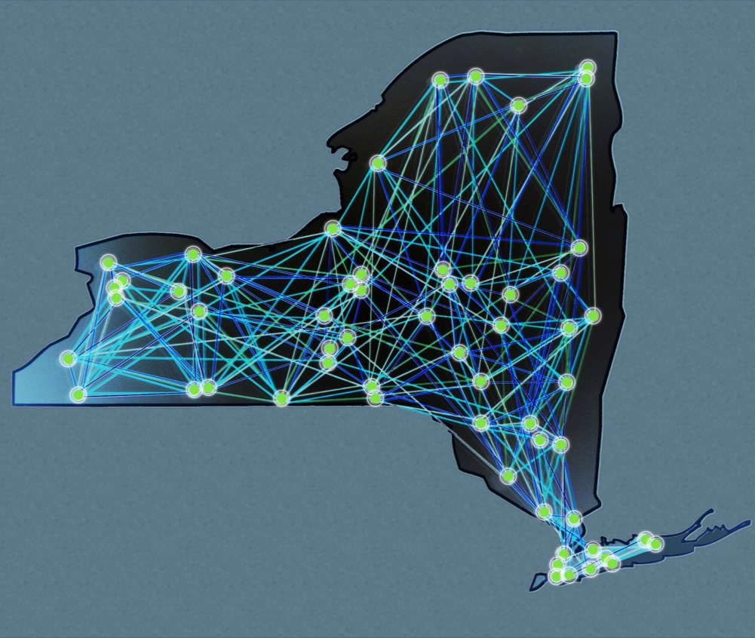

#1: CAUSE
BUILDING ON THE POWER OF SUNY
Notes:
Especially since it is a message I have been sharing with just about anyone who will listen since I first traveled to each one of your campuses; since we first built the Power of SUNY Strategic Plan.
We don’t shy away from tough challenges, and our focus is always on improvement.
We have a depth and a breadth at SUNY that allows us to do things that other simply cannot do.
Leveraging our systemness to describe our priorities is an approach that has yielded results.

Slide 4

Big, Hairy, Audacious Goal
SUNY will be a key engine of
revitalization for New York
State’s economy and
enhance the quality
of life for the state’s citizens.
Notes:
When I first arrived at SUNY, we started off by publicly defining our aspiration that SUNY would be an economic driver for the state.
And when I said this was a big, hairy, audacious goal, I didn’t necessarily mean that is was a big leap from our perspective – but from the perspective of the Legislature and Governor.
We wanted to make the point that the State just cannot succeed without us.

Slide 5










SUNY and
the World
SUNY and an Energy-Smart New York
Six Big Ideas
SUNY and the Entrepreneurial
Century
SUNY and a
Healthier
New York
SUNY and the
Seamless
Education Pipeline
SUNY and the
Vibrant Community
Notes:
We detailed the extent of our reach.
The Power of SUNY Strategic Plan featured six big ideas and a commitment to diversity in each.

Slide 6
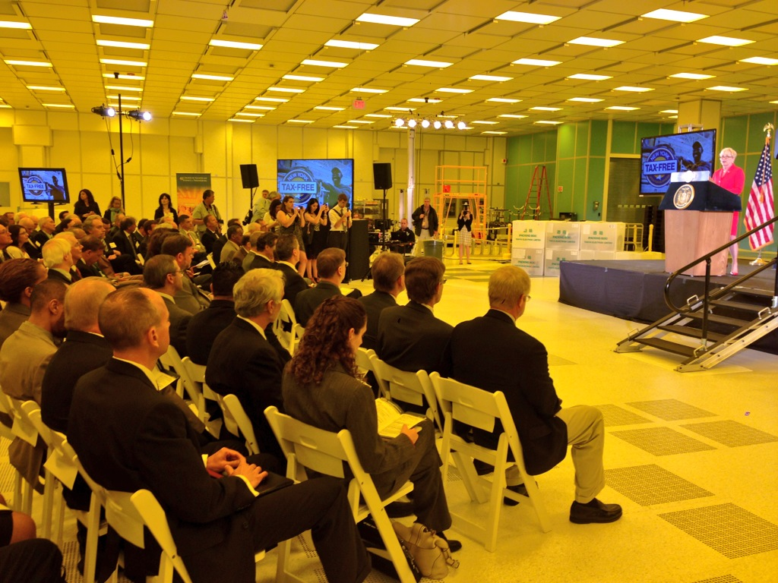

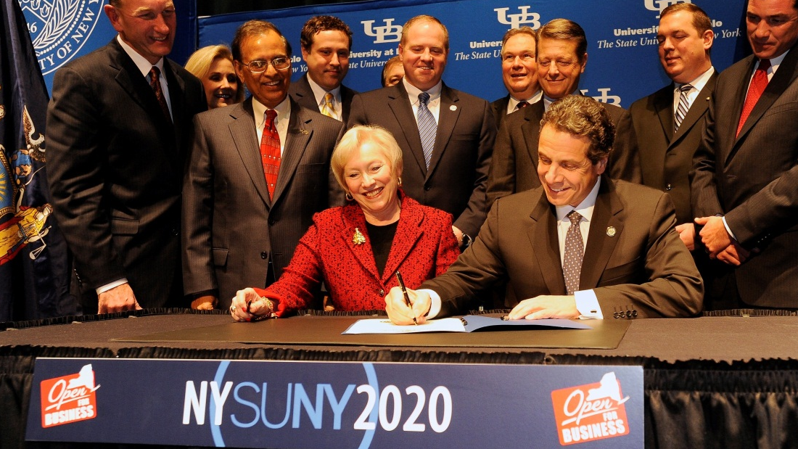

#1: EFFECT
Systemness at Work Yielded:
Rational Tuition
Maintenance of Effort (MOE)
Capital/2020
Notes:
It was an argument that resonated.
By 2012-13, we began to see real outcomes we could be proud of!
And importantly, the Governor and Legislature responded.
Here we see the signing of New York’s SUNY 2020 investment.
There was rational tuition. Start-up NY. Key system-wide initiatives like Open SUNY and seamless transfer. [Next Slide]

Slide 7
#2: CAUSE
Notes:
When I first arrived at SUNY, we started off by publicly defining our aspiration that SUNY would be an economic driver for the state.
And when I said this was a big, hairy, audacious goal, I didn’t necessarily mean that is was a big leap from our perspective – but from the perspective of the Legislature and Governor.
We wanted to make the point that the State just cannot succeed without us.

Slide 8
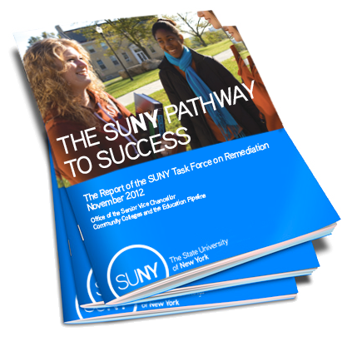
#2: EFFECT
Performance Funding for Community Colleges and Remediation Task Force
Notes:
When I first arrived at SUNY, we started off by publicly defining our aspiration that SUNY would be an economic driver for the state.
And when I said this was a big, hairy, audacious goal, I didn’t necessarily mean that is was a big leap from our perspective – but from the perspective of the Legislature and Governor.
We wanted to make the point that the State just cannot succeed without us.

Slide 9
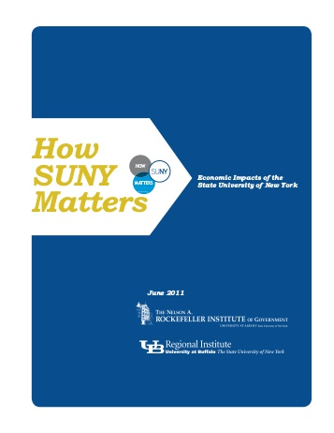
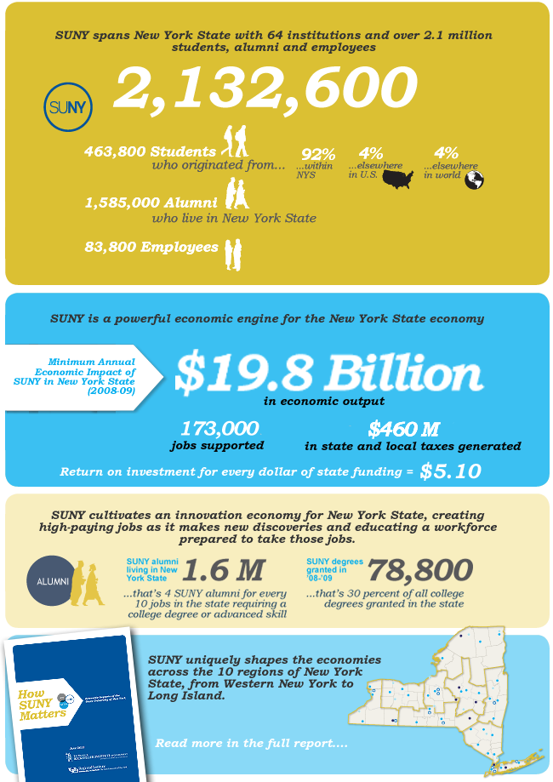
#3: CAUSE

Slide 10


#3: EFFECT

Slide 11


#4: CAUSE
A C S
REFRESH
Access Completion Success
Notes:
In 2014, when we started to think about the next five years of the System-wide strategic plan, we started by looking at our statutory mission.
We did a refresh of the Power of SUNY.
And we initially defined Access, Completion and Success as priorities.

Slide 12

SUNY Excels Metrics
Extensive Consultation Over Two-Year Period
System-wide Steering Committee Narrows 200+ Metrics to 17
ACCESS
COMPLETION
SUCCESS
INQUIRY
ENGAGEMENT
Full Enrollment Picture
NYS Citizens
Served by SUNY
Diversity
Capacity - programs
and courses
Completions
Student Achievement / Success (SAM)
Graduation Rates
Time to Degree
SUNY Advantage
(Applied Learning, Multi-Cultural Experiences, Student Supports)
Financial Literacy
Total Sponsored Activity
Courses in SIRIS that include
hands-on research, entrepreneurship, etc.
Scholarship, Discovery and Innovation
START-UP New York and beyond (businesses started / jobs created)
Alumni / Philanthropic Support
Civic Engagement
Economic Impact
Notes:
In consultation with all of you, and in recognition of the different missions of our institutions, we expanded ACS to become ACSIE: Access, Completion, Success, Inquiry and Engagement.
From the start, SUNY Excels was about a commitment to excellence, a commitment to continuous improvement.
Thanks to extensive consultation, we narrowed an initial list of over 200 possible metrics down to the 17 you see here.
We committed to setting goals and making progress in key areas that included everything from enrollment and degree offerings to graduation rates, time to degree, and financial literacy.
We committed to improvements in research and faculty scholarship, in workforce development, and opportunities for students to engage in hands-on applied learning experiences.

Slide 13
Big, Hairy, Audacious Goal
150,000 DEGREES
(up from 93,000)
Notes:
And we once again set a big, hairy audacious goal.
And I recognize that this one is a bit different from the last.
In part because this one is about more than just ensuring that the Governor and Legislature know what we do.
This is about making some changes in how we support students so we can meet a critical state and national need.
And I hear you that this may take longer than we had initially hoped – we’ll talk about that together today.

Slide 14
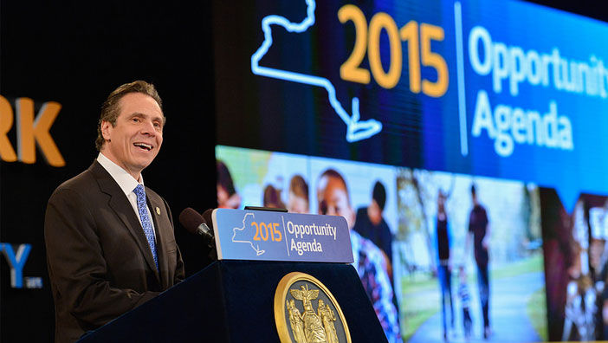
#4: EFFECT
Completion Agenda & Performance Improvement Framework Yielded:
$18M Investment and Performance Fund
$100M Expanded Investment and Performance Fund
$4.4M in New EOP Funding
Base Operating Aid $100/FTE
Notes:
Here again, having a plan – our performance improvement framework – and setting an ambitious goal yielded some positive results.
The State responded with an $18 million Investment and Performance Fund which we turned into $100 million.
We received $4.4 million in new EOP funding.
Base Operating Aid Increase of $100/FTE
Community College GAP funding of $1.5M
Community College Community School Grants and One-Stop Job Centers ($2.5M combined)
Educational Opportunity Centers and ATTAIN labs $3.0M total
Was it everything we wanted? Of course not.

Slide 15
#5: CAUSE
DIVERSITY AND INCLUSION
A C S I E
Access Completion Success Inquiry Engagement
COMPLETION AGENDA
IMPACT ON CHALLENGES
Notes:
So Alex has been working on a new version of ACSIE.
First, we feature all five focus areas.
And then there are three focus areas beginning to emerge:
Diversity and inclusion
Completion or Student Success
And Innovation or impact and engagement.

Slide 16



Turning Excellence into Impact
Diversity, Equity and Inclusion
Student Completion
and Success
Impact State and Global Challenges
Notes:
Diversity, Equity and Inclusion
Student Completion and Success
Impact State and Global Challenges
These three priorities are symbiotic, and done together, help to ensure the sustainability of SUNY.
For example, we have to continue to become more inclusive of diverse, underrepresented, and disadvantaged populations.
We also have to become more effective at getting our students the most out of a SUNY education. Part of that is the value derived from completion, but we can only do that by embracing diversity and delivering a high quality education in contextualized ways and through varied mediums and platforms. This includes ensuring students have are exposed to high impact practices, which George Kuh will touch on tomorrow.
That helps to grow the talent pipeline for graduate and professional education, while also providing students with the tools that will make them effective researchers and innovators, and engaged citizens moving forward.
It’s also about showing the breadth of our impact on New York State and the Globe. From workforce development and business and industry partnerships to sponsored research. From broad faculty scholarship and creativity to community service and all forms of applied learning.

Slide 17

#5: EFFECT
Stay tuned…
Notes:
So this is one new possible frame to consider.
It does lean on us working together – to improve both individually and as a system.
Alex – do you want to take us a little deeper into this and then we’ll start to get some feedback?

Slide 18



Slide 19

The Goal
+
+
BUILDING
on our Investment Fund
STRENGTHENING
our Base Support
EXTENDING
NYSUNY 2020

Slide 20

Section titles are always placed on the right and right justified, at the same height as content titles.
We’re taking our message back on the road.
The Tour
SUNY logo endorsement always stays visible in front of all content, unless the SUNY logo is prominently featured somewhere else on the slide.

Slide 21
Section titles are always placed on the right and right justified, at the same height as content titles.
The Strategy
#StandWithSUNY
SUNY logo endorsement always stays visible in front of all content, unless the SUNY logo is prominently featured somewhere else on the slide.
Notes:
The Campus Role
Participation in an expansive social media campaign, #StandWithSUNY.
Constant outreach to local legislators, news outlets, and community leaders promoting our major points.
Communication with System Administration about concerns heard on the ground.

Slide 22
Taking Our
Next Big Step
Toward Success
Chancellor Nancy L. Zimpher • University Faculty Senate • October 23, 2015

