Slide 1
Faculty Senate Plenary
Brian Hutzley- Vice Chancellor & CFO
January 25, 2013

Slide 2
Governor’s State of the State
SUNY prominently featured:
  Economic Development
    Innovation Hot Spots
    Innovation NY Network
    Innovation Venture Capital Fund
  Workforce
    Community Colleges as workforce trainers
    Next Generation Job Linkage Program
  Education
    Increased admission requirements for SUNY teacher preparation programs
    Requiring real work experience for teachers
    “Bar Exam” for teachers
  NY-SUNY 2020
    NY-SUNY 2020 Round 3: $55.0M in grant funding per year
  Climate Change / Emergency Management
    Effective Emergency Response / Establishing a World-Class Emergency Response Network

Slide 3
Influences to the Executive Budget
Operating:
  Economic impact of Super Storm Sandy
  Current and out-year budget gaps
    2013/14: $1.4B
    2014/15-2016/17: $14.9B
Capital:
  Continuing debt issuance restraints under existing bond cap legislation
    2013/14: $1.6B for all agencies

Slide 4
2013-14 Executive Budget Update: Highlights
State-Operated Campuses: Operating
  Maintenance of Effort (MOE): Continued with flat year to year funding
  Rational Tuition: Sufficient appropriation to allow spending of planned tuition rate changes
  Non-State tax supported funds appropriated at requested levels
  No contractual increases
  No funding for SUNY strategic priorities
Community Colleges: Operating
  Base Aid: Maintained at 2012-13 levels of $2,272/FTE
  No increase in support of 5 year plan
  Portion of base aid related to “vocational” degrees has new requirements
  New Program: $3.0M provided for new “Performance Based Funding”
State-Operated Residence Halls: Capital
  Language proposed to remove outstanding and new residence hall debt from State cap with new cash flow structure

Slide 5
2013-14 Executive Budget Update: Concerns
Hospitals: Operating and Capital
  Hospital State tax support reduced by 30% (removal of $27.8M legislative add from 2012-13)
  No new capital appropriations (4 years)
State-Operated Campuses: Capital
  Limited funding made available over next five years
  Little to no new critical maintenance funding
Community Colleges: Capital
  Only projects that were critical maintenance in nature were approved

Slide 6
Status of Resource Allocation Model
SUNY Board has approved:
  Concept of the model
  Roll-out concepts and use of transitional funds to implement the model
Eleven campuses facing downward adjustments have submitted preliminary requests for transitional funds
Requests will be reviewed by a group comprised of System Administration and campus professionals
Group will make recommendations for final decision to Chancellor and her Executive Staff
Coordinated projects for enrollment and on-line
RAM begins phase in at 30% of impact on July 1, 2013
  Additional 30% of impact July 1, 2014
  Final 40% of impact July 1, 2015
Reviewing additional roll-out scenerios

Slide 7
Transitional Funds
Definition: “Funding to aid campuses facing a downward adjustment in State Tax support due to the model progress to a situation wherein such adjustment is manageable through intelligent investment” Requires a plan. Goal is a stronger campus.
Funding comes from campuses that would experience an upward adjustment in State Tax Support and will be phased in according to the same 30/30/40 approach

Slide 8
Transitional Funds requests thus far
All eleven campuses have or will have applied
Overall Themes
Theme | Comment
Enrollment Growth | Primarily from transfers, augmented admission programs, and improved retention rates
Offering New or Refocusing Current Program Offerings | Orient degree offerings to areas that would impact the economic health of the State
Creating or Expanding Online Presence | Focus on non-traditional students to maximize campus resources
Reevaluating Campus Costs | Maximize operational efficiency in both staff and non-staff areas

Slide 9



Shared Services

Slide 10




The Vision
Over the next 3 years, SUNY will shift 5% of our spending to direct instruction and student services, resulting in $100M being reinvested.
Campus Based Priorities
Student Centered Strategies
Savings Remain at Source
Investment in savings will be required
Year 1: $20M redirected – 20% of $100M goal

Slide 11
Beyond Savings
Service Excellence
Innovation
Quality Improvements
Efficiencies
Best Practices
Savings and Reinvestments

Slide 12
Service Excellence
Elevator Contract; reducing 27 individual contracts to four regional contracts. Cost savings of ~$1.5 Million.
On-line tutoring consortium (STAR-NY) - Delhi, University at Buffalo, TC3, Alfred State, Oswego, Ulster Community College and SUNY Cortland.
All SUNY Libraries loan materials to all other SUNY libraries free of charge.
Veterans' Affairs Officer, Joint resource – Canton & Potsdam.

Slide 13
Innovation
SUNY Smart Track Campaign—University at Albany, SUNY Fredonia, Niagara County Community College, Purchase College, Schenectady County Community College, and SUNY Ulster.
SUNY Student hard waiver health insurance plan—University at Albany, University at Buffalo, Buffalo State.
SUNY Business Intelligence (BI) and SMRT programs—University at Buffalo innovation & Binghamton University leadership.
Securing local agreement allowing employees to work after hours on capital projects, resulting in an average savings of 25% per job– Cobleskill & Delhi.

Slide 14
Quality Improvements
Develop online compliance training for various EH&S regulations and other subject matter—Geneseo.
Collaborate on training for students and professional development for staff—University at Buffalo & Buffalo State.

Slide 15
Efficiencies
SUNY-wide print shop utilization efforts
Centralizing administration of employee recruitment and criminal background checks – Delhi & Cobleskill
Shared dining/food service contract – Clinton & Plattsburgh
National Association of Educational Procurement

Slide 16

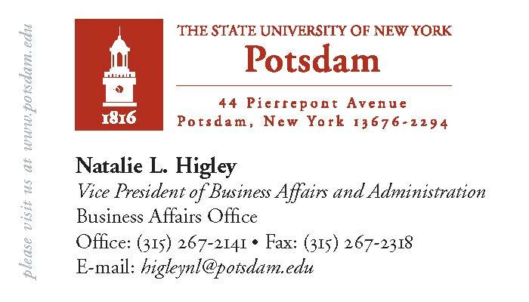
Natalie Higley
Joint CFO, Canton & Potsdam
Two sides of one card

Slide 17
Best Practices
Partnership with NYS Office of General Services to leverage their efforts utilizing best practices for shared services (Procurement, IT and Transaction Processing Center)
Regional hub created for MWBE initiative via outreach, training and sharing of vendor lists– Binghamton University
Consulting services – EOP, financial aid, townhouse development, student activities, auxiliary services, community service – Cobleskill, Delhi

Slide 18


Campus Reinvestment Plans
Major Themes:
New faculty hires
Financial aid programs, tuition credits, and scholarships
Career development programs and staffing
Tutoring and academic advisement
New academic and instructional equipment

Slide 19
Multi-Dimensional
System-wide
Regional
Sector
Functional
Specialized Mission/Program
Every faculty, staff, student, college council, and board member has a responsibility

Slide 20
Beyond Savings
Service Excellence
Innovation
Quality Improvements
Efficiencies
Best Practices
Savings and Reinvestments
Benchmarking, best practices, and creating a culture of continuous improvement

Slide 21
Beyond Savings
The New Model = Working Together
Campus to Campus
Regionally
System-wide
Locally
Across the State
Nationally

Slide 22
Shared Services
Harnessing Systemness: Regional Discussions on Efficiencies and Effectiveness
  Events are an opportunity for regional campuses to learn from neighboring institutions and foster greater regional collaboration. Participants will have a forum to share stories, celebrate successes and discuss creating greater operational efficiencies and improving service excellence.
  First event to be hosted by SUNY Cortland on Wednesday, January 30th, 2013

