Slide 1




Our Commitment to Student Completion & Success
Elizabeth L. Bringsjord
Interim Provost and Vice Chancellor
University Faculty Senate
October 25, 2013

Slide 2





My New Lens…

Slide 3
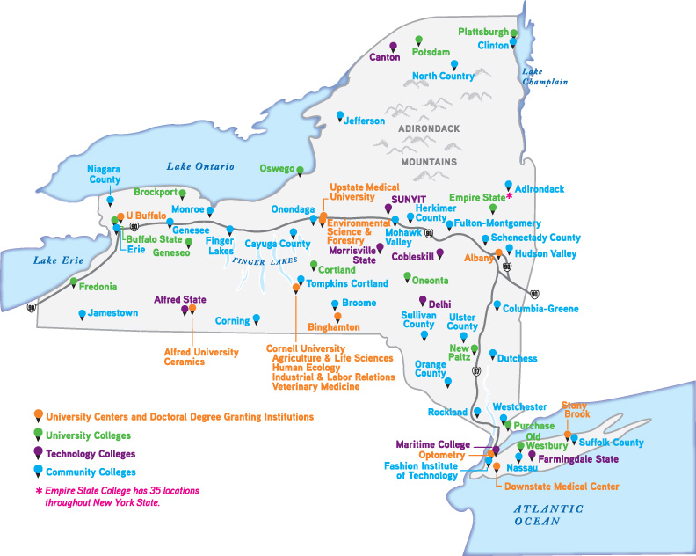
My New Lens…

Slide 4
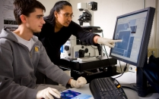



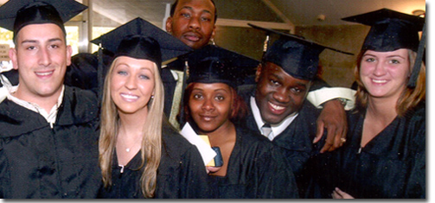
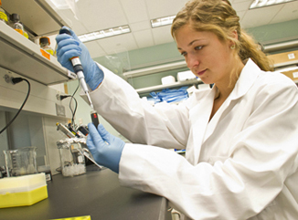
Our Focus
Building a Culture of Student
Completion and Success

Slide 5
Actual & Projected SUNY Enrollment

Slide 6
Under-Represented Minorities

Slide 7
Hispanic Population

Slide 8
We Need Strategic Enrollment
Align our academic programs to meet state needs and to maximize job opportunities for graduates across the state

Slide 9
An Example for Growth

Slide 10
Student Completion & Success
Data Brief: SUNY Graduation Rates and Student Success
  SUNY Campus Selectivity and Graduation Rates
  SUNY Baccalaureate Pell Recipients and Graduation Rates
  A Contextual Analysis of Retention & Graduation of Baccalaureate Students
  Four, Five, and Six Year Graduation Rates for First-Time, Full-Time Baccalaureate Students
  A Contextual Analysis of Retention & Graduation of Associate Students
  Two, Three, and Four Year Graduation Rates for First-Time, Full-Time Associate Students
  National Benchmark Groups Determined by Carnegie Class
  Baccalaureate & Associate Graduation Rates by Race/Ethnicity
  Under-Represented Minority (URM) Students Compared to Non-URM

Slide 11
Baccalaureate Graduation Rates

Slide 12
Associate Graduation Rates

Slide 13
If We Moved the Grad Rate for Bachelors

Slide 14
If We Moved the Grad Rate for Associates

Slide 15



Building a Culture of Student Completion and Success
FOUNDATION
  Exemplary campus policies, practices and outcomes
  Academic Excellence Transformation Team
  Student Completion and Success Task Force
  SUNY Task Force on Remediation

Slide 16
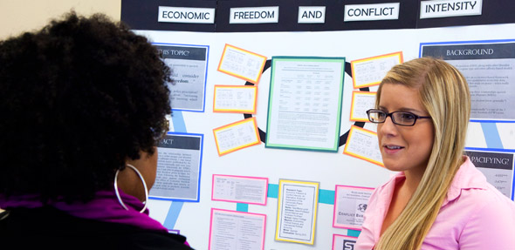

Building a Culture of Student Completion and Success
Goals focus on completion and success without compromising access, quality and diversity
  Academic integrity
  Transformational learning
  Student engagement
  Cultural and global awareness
  Personal & civic responsibility
  Values, ethics and diverse perspectives
  Preparation for lifelong learning and employment

Slide 17
Building a Culture of Student Completion and Success
CLEAR EXPECTATIONS (the blueprint)
High School curriculum and performance College readiness, including skills and attitudes Participation in orientation and regular advisement Exit points from developmental coursework Program and course requirements and sequencing Engagement in learning and co-curricular activities Commitment to Attendance Clarity on ramifications of course withdrawals, course repetition Clear timelines for major/program declaration Code of conduct

Slide 18
Seamless Transfer
Four-Year Institution to Four-Year Institution
6.6%
Other New York Institutions
SUNY Four-Year Campuses
Other US Institutions
8.6%
6.5%
1.7%
7.9%
7.4%
22.8%
10.5%
6.1%
International Institutions
SUNY Community Colleges
.9%
13.2%
Unknown
* Totals may not add up
to 100% due to rounding.
7.7%
Community College to Community College

Slide 19
Seamless Transfer
Guaranteed admission of SUNY A.A. and A.S. grads at a SUNY 4‐year campus since the ‘70s but wide variation in course-work accepted for transfer
1998 General Education Requirement resulted in greater student transfer without junior status
  SUNY bachelor's degree requires completion of 30 credits in 10 of 10 subject areas and 2 competencies:
    Areas: basic communication (required); mathematics (required); American history; other world civilizations; foreign language; social sciences; humanities; arts; natural sciences; western civilization
    Competencies: critical thinking (required); information management (required)
Some programmatic success: Teacher Education Transfer Template

Slide 20
Seamless Transfer
Enter the SUNY Student Mobility Project
  SUNY studied course requirements of A.A. and A.S. programs and the parallel courses for first two years of B.A. and B.S. programs at SUNY
  The common lower-division courses taken in the most highly enrolled majors were identified, which later became known as transfer paths
  Over 400 two- and four-year faculty in various disciplines developed common course descriptions for 140 types of transfer path courses
  Campuses identified 15,000 courses that fit these descriptions
Courses meeting these descriptions are now guaranteed to transfer in the major designated
  List maintained online; New courses/programs can be added over time
  Most transfer paths consistent with requirements outside of SUNY

Slide 21
Seamless Transfer
Mobility Project paved the way for new board policy
In December 2012, SUNY Board adopted a seamless transfer policy for gen-ed and programmatic transfer:
  First two years of instruction would include:
    7 of 10 areas and 30 credits of general education completed in the first 60 credits of all A.A., A.S. and bachelor’s degrees AND
    Foundational courses in the major and cognates sufficient for junior status
  Credit cap set for associate programs = 64 credits
  Credit cap set for bachelor’s programs = 126 credits
  Requirements for campuses and system to provide clear guidance to transfer students

Slide 22

Our Focus
What’s next?
Work with faculty and campus leadership on the implementation of seamless transfer policy
Solicit additional feedback on the challenge posed to Presidents on increased completion; share ideas

