Slide 1
University Faculty Senate Plenary Meeting
SUNY’s Diversity, Equity and Inclusion Policy
October 23, 2015
Carlos N. Medina, Ed.D.
Chief Diversity Officer and Senior Associate Vice Chancellor
Office of Diversity, Equity and Inclusion
State University of New York

Slide 2

Diversity is our Foundation
The SUNY system was founded to serve those who had been turned away from other institutions because of race, ethnicity and/or religion.
SUNY’s statutory mission states that the University will provide ‘broadest possible access, fully representative of all segments of the population…’”
Data Brief: Diversity Equity and Inclusion, SUNY Office of the Provost, June 2015
Clark, J, Leslie W., O’Brien K. (2010). SUNY at Sixty. SUNY Press.
Notes:
All of this is set against the backdrop of SUNY’s historic connection to diversity.
SUNY was founded in large measure to educate those who had been discriminated against by private institutions in the state because of race, ethnicity and/or religion.
Further, our statutory mission charges SUNY to:
“provide the highest quality education, with the broadest possible access, fully representative of all segments of the population.”
[next slide]

Slide 3



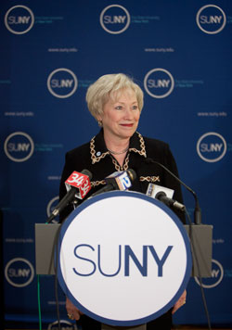
Chancellor’s Diversity Goal
“Ensure that SUNY continues to reflect the unique diversity of New York among student, faculty and administrative bodies. Therefore,
I am naming a special
Diversity Task Force
to propose ways to improve diversity in our SUNY family. Our goal is to catch up with the diversity of this great state and to surpass it.”
State of the University Address
January 14, 2014

Slide 4
The Chancellor’s Charge
“if you have thought about it or read about it, we have already tried it. Be bold in your recommendations.”
Notes:
The following initial recommendations of the SUNY Diversity Task Force are designed to advance diversity goals in a meaningful way.

Slide 5
Diversity Task Force
The SUNY Diversity Task Force recommends policies to strengthen diversity and ensure an inclusive, welcoming environment for all.
Task Force Focus Areas:
Student recruitment, retention and completion
Recruitment, retention and support of diverse faculty, staff and administrators
Creating welcoming campus and System environments
Identification of the most effective structures for diversity officers/offices

Slide 6

SUNY Aspires to be the Most Inclusive
State University System in the Country
We will strive to ensure that the student population we serve and the administrative staff and faculty we employ are representative of New York;
We will recognize the value of international experiences and interactions;
We will eliminate achievement gaps for minority and low income students;
We will develop strategic diversity and inclusion plans for system administration and at each campus that demonstrate that we embrace diversity, equity and inclusion.
We will be known for our commitment to inclusive excellence, wherein an institution can only achieve excellence when it is inclusive.
Notes:
As a result, we rightfully, set the bar high.
The proposed policy before you begins with SUNY’s aspiration to be the most inclusive State University System in the Country.
We will strive to ensure that the student population we serve and the administrative staff and faculty we employ are representative of New York;
We will recognize the value of international experiences and interactions;
We will eliminate achievement gaps for minority and low income students;
We will develop strategic diversity and inclusion plans for system administration and at each campus that demonstrate that we embrace diversity, equity and inclusion.
We are committed to inclusive excellence, wherein an institution can only achieve excellence when it is inclusive.

Slide 7
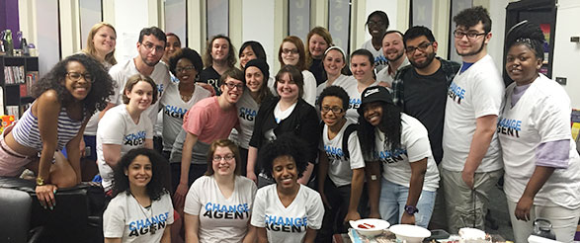
We will build on
existing successes.
Narrowed URM achievement gap to 8.6% in six-year grad rates
International enrollment now 5.3%
System tracks student opinions on climate, prejudice around gender identity and sexual orientation
Overall URM enrollment up from 14.7% to 23.8% in last 10 years
Several existing campus CDOs, many Diversity Centers and Student Groups
System Office of Diversity, Equity and Inclusion & System CDO
Notes:
We will build on existing successes:
SUNY has narrowed the achievement gap between Under-Represented Minority (URM) students and White students to 8.1% for six-year graduation rates, as compared to its national publics and private peers who on average face a gap of 17%.
As a percent of SUNY’s total enrollment, URM enrollment has grown from 14.7% to 23.8% in a ten-year period.
International enrollment is now at 5.3% - this is also a key part of our diversity.
SUNY administers and monitors student opinion survey responses about campus environment and incidences of prejudice based on gender identify and sexual orientation. [next slide]

Slide 8

Acting with Urgency
June 2015 Data Brief: Diversity, Equity, and Inclusion, highlighted gains and areas needing real improvement
State to become increasingly diverse; largest growth in most under-served populations
State data highlight growing number of minority adults who need a college credential to gain employment/advance
Lack of data on some diverse populations—LGBTQ, students with disabilities, veterans
Aging workforce with significant retirements expected
Notes:
We will also work aggressively to meet challenges and make needed improvements.
For example:
While we have made progress in closing the achievement gap for URM gradation rates at the six-year mark; gaps for Pell Recipients & URM retention are higher.
All need to be closed.
URM enrollment varies by campus from a high of 67% to a low of 8%
The majority of our leadership, faculty and staff are White. Only 17% of State-Op Presidents; 13% of CC Presidents; 16% System employees; and 12% of faculty are URM
We need better data to understand the needs of some diverse populations.
We also recognize that we have the depth and breadth to address state needs:
The State is to become increasingly diverse with the largest projected growth in the most under-served populations
State data highlight growing number of minority adults who need a college credential to gain employment
We currently have a lack of data on some diverse populations—LGBTQ students, students with disabilities, veterans. [next slide]

Slide 9
SUNY’s Student Diversity - 2014

Slide 10
Changing Demographics Demand
Greater Focus on Under-Represented Populations
Population Increase, Ages 0-24,
(in millions)
Percentage Increase, Ages 0-24, (percentage)
Note: Projected Population Growth, Ages 0-24, 2010-2050
Source: National Population Projections, U.S. Census Bureau. Released 2008; NCHEMS, Adding It Up, 2007

Slide 11
Race/Ethnicity Distribution of all SUNY Campus Employees - Fall 2013
Notes:
The figure shows the race/ethnicity percentage distribution of all SUNY Campus employees, full and part-time, as reported on the 2013 IPEDS Human Resources Survey. The under-represented minority percentage includes employees identifying as Black/African American, Hispanic/Latino, American Indian/Alaskan Native, Native Hawaiian/Pacific Islander or Two or More Races.

Slide 12

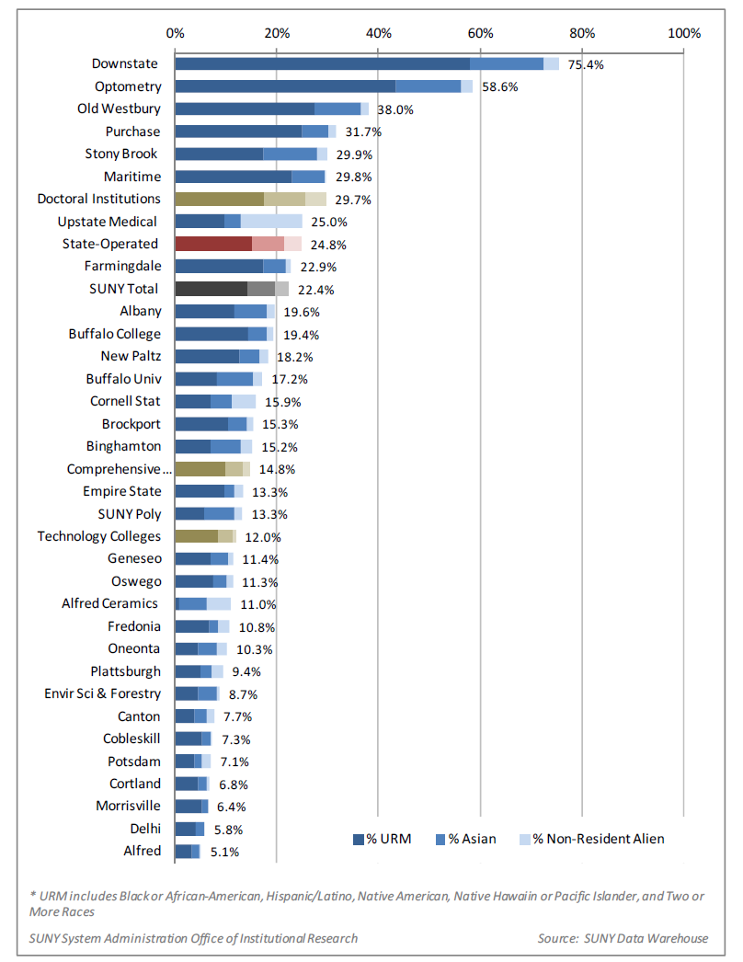
Percent Minority and International Employees by
State-Operated Institution - Fall 2013

Slide 13
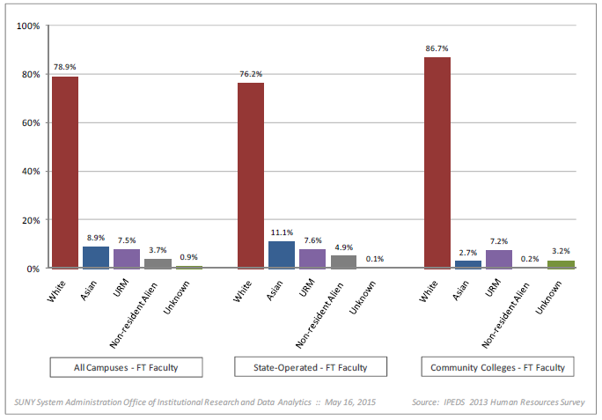
Race/Ethnicity Distribution of Full-Time SUNY Campus Faculty, Fall 2013
Notes:
.

Slide 14
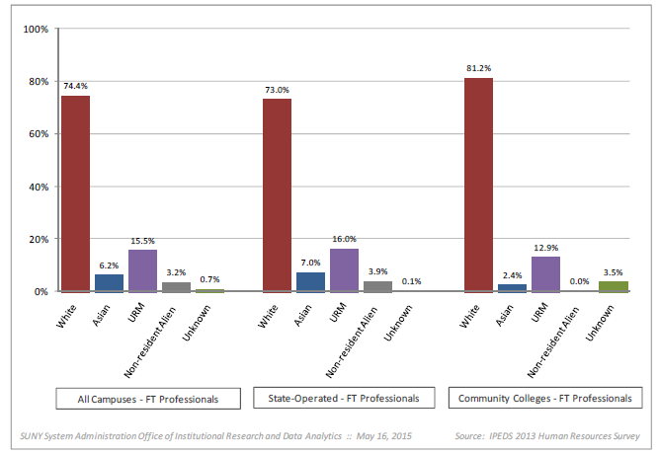
Race/Ethnicity Distribution of Full-Time SUNY Campus Professionals, Fall 2013
Notes:
.

Slide 15
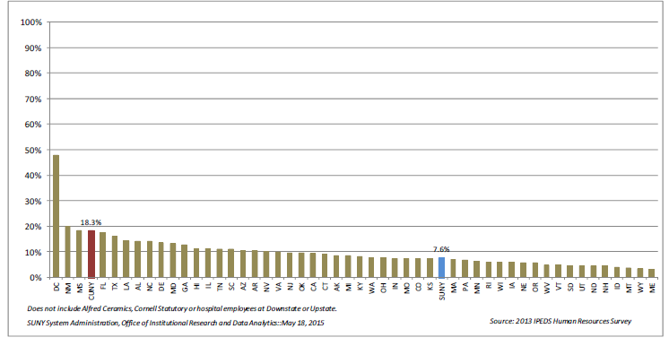
URM Full-Time Faculty at SUNY State-Operated Institutions vs. National Public 4-Year Institutions, Fall 2013
Notes:
.

Slide 16
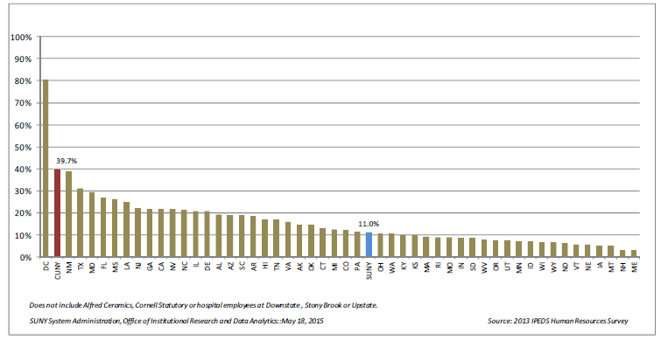
URM Full-Time Professionals at SUNY State-Operated Institutions vs. National Public 4-Year Institutions, Fall 2013
Notes:
.

Slide 17
Full-Time Campus Employees in Management Occupations by Gender, Fall 2013
Sector | Male | Female
All SUNY Sectors | 45.8% | 54.2%
State Operated | 46.5% | 53.5%
SUNY System Administration Office of Institutional Research and Data Analytics
Source: IPEDS 2013 Human Resource Survey
Notes:
.

Slide 18
Full-Time Campus Employees in Management Occupations by Race/Ethnicity, Fall 2013
Sector | White | Asian | URM* | Black/ African American | Hispanic/ Latino | American Indian/Alaskan Native | Hawaiian/Other Pacific Islander | Two or More Races | Non-Resident Alien | Unknown
SUNY Campuses | 83.1% | 2.6% | 11.6% | 8.4% | 2.5% | 0.4% | 0.0% | 0.3% | 2.0% | 0.6%
State Operated | 82.4% | 3.2% | 11.5% | 8.6.% | 2.4% | 0.4% | 0.0% | 0.2% | 2.7% | 0.1%
SUNY System Administration Office of Institutional Research and Data Analytics
Source: IPEDS 2013 Human Resource Survey
*Includes Black/African American, Hispanic/Latino, American Indian/Alaskan Native, Native Hawaiian/Pacific Islander, Two or More Races
Notes:
.

Slide 19
Executive Leadership by Gender and Race/Ethnicity, as of May 2015
 | Total | Male | Female | White | Asian | Hispanic | Black
State-Operated Institutions:
Presidents | 29 | 20 | 9 | 24 | 1 | 0 | 4
Provosts/VPs for Academic Affairs | 26 | 17 | 9 | 24 | 0 | 0 | 2
VPs for Business and Finance | 28 | 19 | 9 | 27 | 0 | 0 | 1
Community Colleges:
Presidents | 30 | 19 | 11 | 26 | 0 | 0 | 4
SUNY System Administration Office of Institutional Research and Data Analytics
Source: State-Operated data: SUNY Human Resources Management System (HRMS)
Source: Community College data: SUNY System Administration Office of Education Pipeline and Community Colleges

Slide 20
Diversity, Equity and Inclusion Policy
Notes:
The proposed policy is based on the recommendations of the system-wide Diversity Task Force
The policy has gone through a comprehensive vetting process.
The policy is designed to take a multi-faceted approach to not only addressing existing challenges but to underscoring our commitment to inclusive excellence:
Student recruitment, retention and success
Faculty recruitment, retention and success
The best structure for diversity on campuses and at system
And campus climate
It is a policy that includes measures for assessment and evaluation.
And we have committed to holding ourselves accountable:
Campus presidents will be required to report annually on their progress as part of their performance improvement plans.
System Administration will also develop an annual report.
System Administration will annually update the diversity data brief, incorporating System and campus progress, and submit the report to the legislature. [next slide]

Slide 21

For Every Campus and System Admin:
Chief Diversity Officers
SUNY-Wide CDO Network
Strategic Diversity/Inclusion Plans
Notes:
A key component of the policy is the appointment of a member of the leadership team – on campuses and at system – to support our progress.
The policy requires a chief diversity officer on every SUNY campus as soon as possible but no later than fall 2017.
The CDO must report to the President or Provost.
Campus CDOs will work with all offices on campus to establish programs to support success for diverse students and create a welcoming and supportive environment for all.
Each CDO will be part of a System-wide network of CDOs
Each campus and system will also develop strategic diversity and inclusion plans.
Campus plans include: a student recruitment, retention and completion strategies; administrative, faculty and staff recruitment and retention strategies; and an evaluation/assessment component. [next slide]

Slide 22

Cultural Competency Training
System-wide Research Effort
Cross-Campus Faculty/Staff Mentoring Network
Notes:
Carlos: Also part of the policy recommendations are:
Customized cultural competency training will be developed by System for implementation across the University.
We will convene dedicated faculty researchers in the areas of diversity, equity and inclusion to support the SUNY CDO network and evaluate the effectiveness of this policy with the aim of ongoing continuous improvement.
System will pilot a new cross-campus mentoring network for diverse faculty and staff to potentially be expanded later to all faculty and staff.
This is challenging but exciting work that we are ready to take on.
Alex? [next slide]

Slide 23
A New Internal Focus
for SUNY’s System CDO
Notes:
Because this policy applies to campuses and system alike, that means a new focus of our System diversity officer. Carlos?
CARLOS:
Thank you Provost.
Working with the Diversity Task Force over the past year has been an incredible experience.
Every time we talked about setting a high bar for campuses, they asked what we are going to do at System.
We will now be developing a strategic diversity plan for SUNY System.
This is a new area of focus for my office and we look forward to the challenge; to working closer with human resources and enrollment marketing to ensure that we are working to make system more diverse and inclusive.
We also look forward to leading the System-wide network of CDOs. What a tremendous resource to have; to be able to bring these folks together to solve problems and implement new ideas.
Next slide – also Carlos

Slide 24

Search Firm Guidelines
Notes:
Thank you Carlos.
A big part of our efforts to recruit campus and system leaders falls in the hands of search firms.
As part of this policy we are elevating our review of search firms with respect to diversity.
Campuses and System Administration will inquire about a search firm’s success in assuring diverse candidate pools.
In those instances where the campus is considered a Federal Contractor, the campus will require:
that the search firm provide it with information about the diversity of the search firm’s staff and
its success rate in placing diverse candidates prior to entering into a contract with such firm. [next slide]

Slide 25
Dual-Career Couple Relocation
Notes:
System will launch a new initiative to identify ways to meet the challenges associated with dual-career couple relocation.
We know that one nationally regarded best practice is cluster hiring; this is just one of the measures we will explore.
[next slide]

Slide 26
Limited Data Available on Sexual Orientation, Gender Identity and More
New Survey Too will Address Data Deficiencies
and Inform Student Support Services
First-Generation Status
Working On Campus and/or Off Campus
Sexual Orientation
Gender Identity
Disabilities
Active Military / Veteran Status
Notes:
.

Slide 27
Summary of Next Steps
Task Force Reconstituted to Diversity Advisory Board
Additional guidance and resources to campuses via Memorandum to Presidents
System to develop tools for cultural competency training
System and Advisory Board will begin initiative to address dual-career couple relocation
System and Advisory Board will examine feasibility of a cross-campus mentoring network
Campuses begin planning for CDO
Campuses begin strategic diversity and inclusion plans
Convene a group of faculty researchers in the areas of diversity, equity and inclusion to support CDO network and D&I Policy effectiveness
Notes:
.

Slide 28
Q & A

Slide 29
Feedback Questions
How can the faculty act to support a more welcoming and inclusive campus environment for new faculty particularly those from underrepresented groups including LGBTQ+? What interdepartmental collaborations could be created to support these intersections?
What can you as a faculty member do to assist your campus and ensure that your students (e.g. undergraduate and/or graduate) are culturally competent and understand the importance of diversity and inclusive excellence regardless of the subject matter being taught?
What diversity rewards and incentives can be put in place at the campus level to help you as a faculty engage URM students and mentor them beyond the classroom?

Slide 30
Feedback Questions
What types of professional development workshops/training/seminars would you like SUNY System and/or your campus to provide for faculty?
How can faculty help guide the Diversity and Inclusion agenda by campuses to assist SUNY in becoming the most inclusive system of higher education in the nation?
How can faculty support the development of campus strategic diversity and inclusion plans that address faculty and staff recruitment, retention and campus climate issues?
How can UFS support cultural competency training for all faculty and staff?

