Slide 1




Progress in the New Year
Elizabeth L. Bringsjord
Interim Provost and Vice Chancellor
University Faculty Senate
January 24, 2014

Slide 2




vz
Our Focus in 2014
Progress on key initiatives supporting completion and success
  Seamless transfer
  Degree planning and audit
  Open SUNY
  Educator preparation
Building on our commitment to data transparency and accountability
  Data Briefs for the SUNY Trustees’ Academic Affairs Committee
  Joining national initiatives (SAM, VFA)
Provost’s Office news
2

Slide 3
Seamless Transfer
With your leadership and hard work, much progress has been made
  Draft Memorandum to Presidents (MTP) shared for comment in March
  Final MTP: Policy and Guidance: Seamless Transfer Requirements issued
  in June
  New tools to assist faculty review of programs for alignment with the policy sent to campuses:
    The SUNY Undergraduate Sample Program Schedule (June)
    The Transfer Paths Requirements Summary Table (June)
    The Seamless Transfer Requirements Program Inventory (July)
  Seamless transfer policy FAQ posted online in September
  A new form for submitting all waiver requests was posted online in October
  Staff presentations at countless meetings – UFS, FCCC, Business Officers, Registrars, Admissions and Enrollment Management and more
3

Slide 4
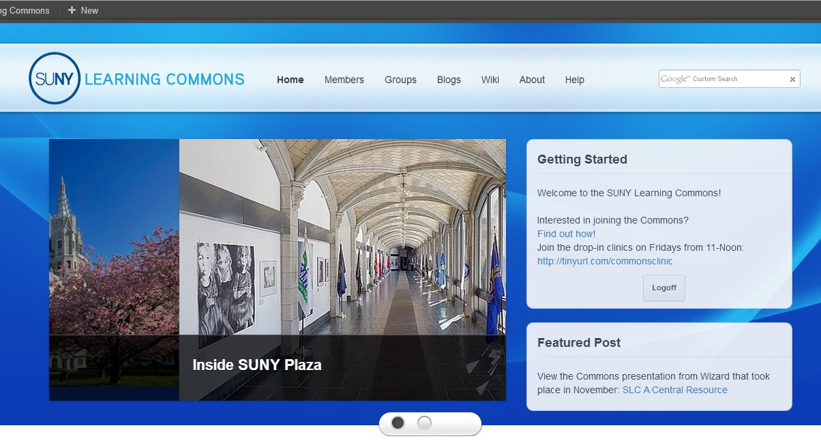
Seamless Transfer
When we faced challenges, we worked together to resolve them
  Transfer Path Review in the SUNY Learning Commons
    400 faculty initially developed the paths
    1,153 faculty registered to ensure paths are as strong as possible
4

Slide 5
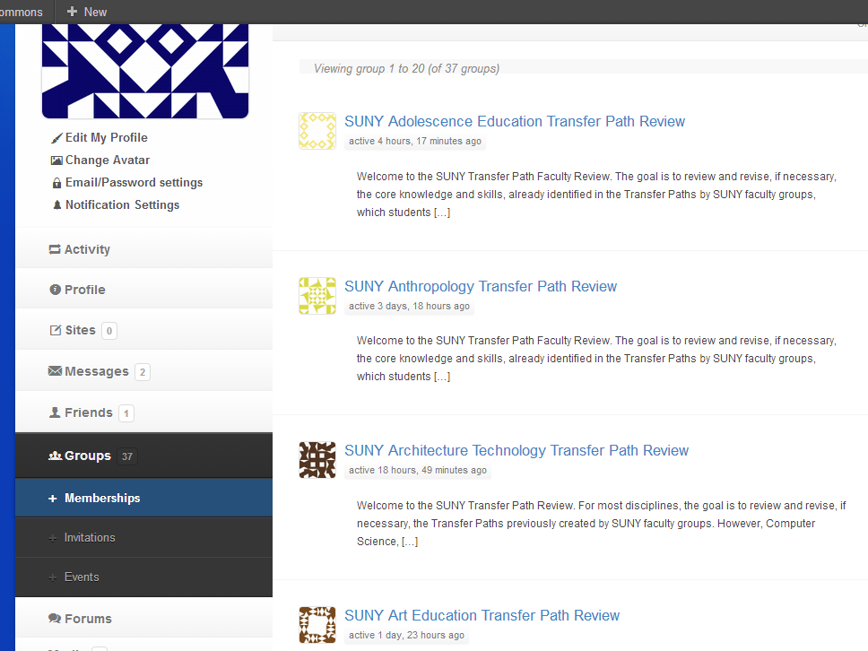
5

Slide 6
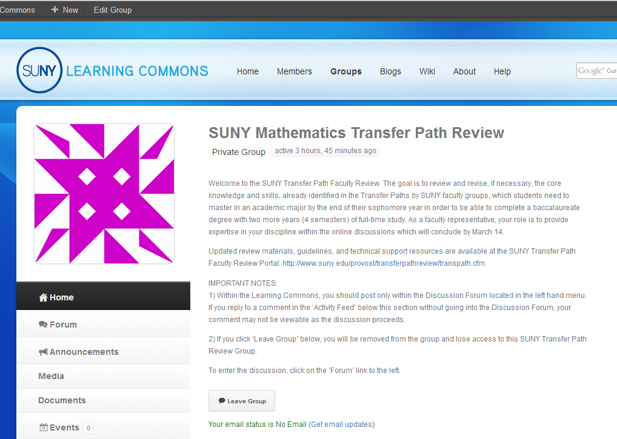
6

Slide 7
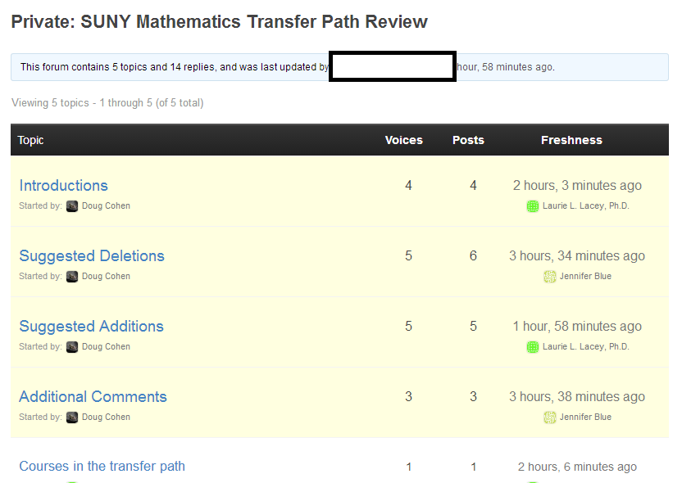
7

Slide 8
Degree Planning & Audit
100% campus participation in our customized version of the degree planning and audit tool Degree Works
  This Spring 50% of campuses will have students using Degree Works
    Remaining campuses will be online ASAP; this summer or early fall
The Transfer Finder, a unique add-on, allows students to:
  Review all courses taken at any SUNY campus (students can add non-SUNY courses);
  Select SUNY colleges and majors to which they might be interested in transferring; and
  Run an audit that compares their coursework to the requirements for general education and the majors at those campuses.
Degree Works will also provide campuses and advisors important analytical information on student progress and course demand
8

Slide 9
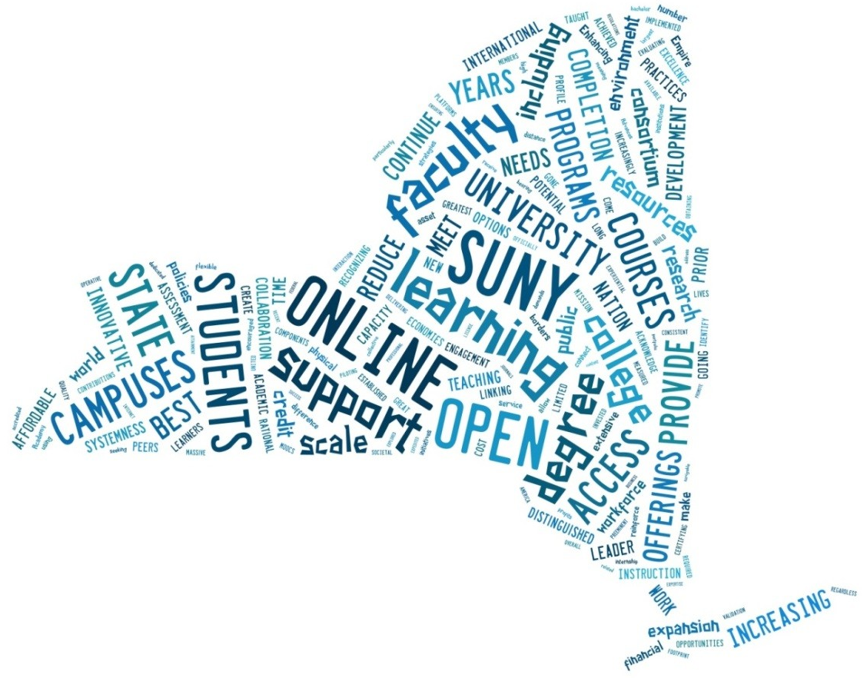
Open SUNY
  Open SUNY Vision
  Open SUNY aims to provide students with the nation’s leading online learning experience. Open SUNY aims to draw on the Power of SUNY and support campuses and faculty to:
  Dramatically expand access to higher education
  Raise completion rates
  Prepare students for success in their lives and careers, and contribute to the economic success of New York State and beyond
9

Slide 10

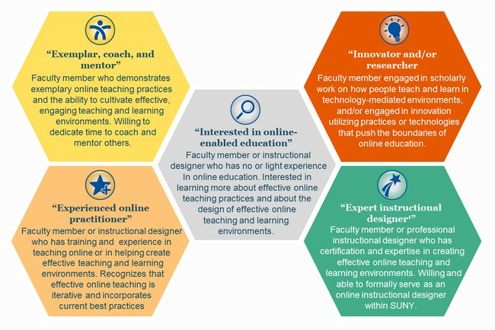
Open SUNY
10

Slide 11
Teacher Preparation
The SUNY Teacher & Leader Education Network (S-TEN) continues to make important progress
  Funding campus pilots of clinically-rich practices
  Establishing regional professional development consortiums to foster P-20 partnerships
  Supporting campuses in edTPA preparations
Plans are underway for regional Centers for Innovation in Education to expand professional development and research opportunities
11

Slide 12
Teacher Preparation
The Provost’s Advisory Council on Educator Preparation will be convened in early February. Its work will be informed by:
  SUNY’s New Vision in Teacher Education
  NCATE Blue Ribbon Panel report
  New York State Board of Regents’ Reform Agenda
  CAEP Accreditation Standards for Educator Preparation Programs
  S-TEN Recommendations
  New York’s Master Teacher Program
  Recommendations of the New NY Education Reform Commission
  SUNY Board of Trustee policies—September 2013 Resolution
  UFS Resolution of October 25, 2013
  Current literature on educator preparation
Broad membership: presidents, provosts, education and arts & science deans, faculty, faculty governance, labor, school and district leaders, NYSED, field administrators
Charge: Position all SUNY educator preparation programs as exemplars in New York State and the nation
12

Slide 13
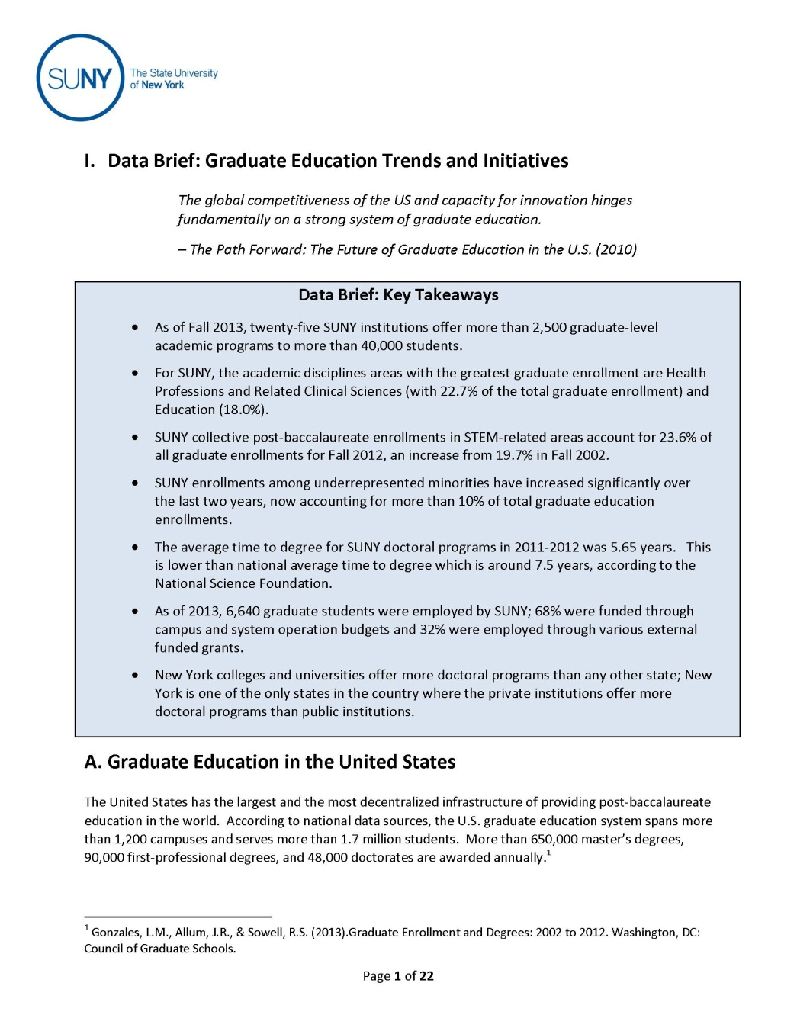
Data Brief Series
September 2012:
Graduation Rates
November 2012:
STEM Enrollments,
Degrees, and Programs
January 2013:
Graduate Education
Programs and Trends
13

Slide 14
Key Takeaways
Health Professions and Education comprise 40% of SUNY’s graduate enrollments; STEM-related programs another 25%
Steady growth in under-represented minority enrollment at the graduate level; now nearly 11% of total graduate enrollment
Multi-institutional collaboration is modest, but growing:
  Initiatives such as the Networks of Excellence foster opportunities for faculty collaboration
  The University Faculty Senate Graduate Research Symposium brings together scholars from all campuses
About 10% of SUNY graduate programs [55 programs, many representing multiple majors] are included in the top 50 of the U.S. News & World Report rankings
14

Slide 15
Distribution of Graduate Programs
Ranked in the Top 50 by U.S. News
15

Slide 16

The Path Forward
Enhance marketing and recruitment
Increase opportunity for graduate deans and vice presidents of research to dialogue
Benchmark best practices in how Systems can support graduate education
Develop a graduate education collaboration fund
16

Slide 17
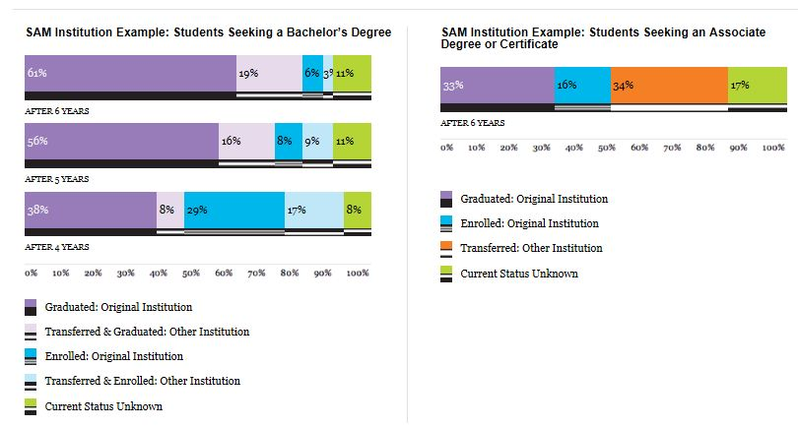
National Engagement
Student Achievement Measure (SAM)
17

Slide 18
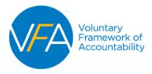
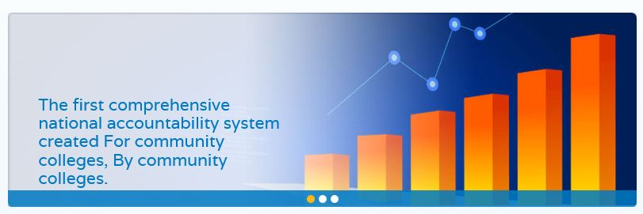
National Engagement
18

Slide 19


Power of SUNY Refresh
Setting goals for the next five years
Initial, Trustee-led
conversations have
begun
Strategic Plan
2010 - Beyond
19

Slide 20

Provost’s Office Update
Best wishes to Nancy Willie-Schiff
Welcome Phillip Ortiz
Best wishes to Rick Miller
Congratulations to Teresa Foster
Welcome back to Rockefeller Institute
20

