Slide 1
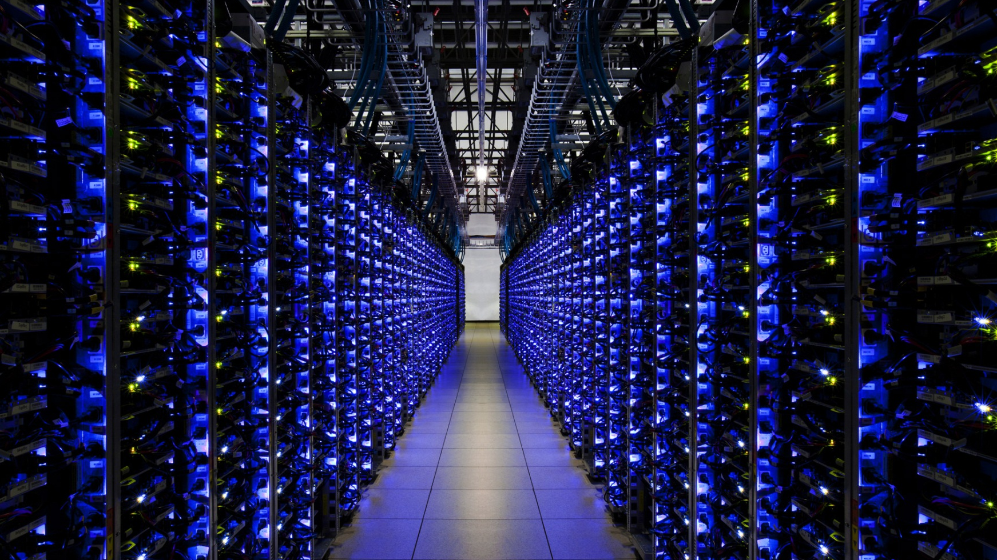

“This initiative will help bring our best ideas to market right here in New York State.” – Governor Andrew Cuomo
Notes:
“SUNY Networks of Excellence will bring together our top scientists and researchers to further our understanding of pressing societal issues, and in turn draw new venture capital to invest in commercialization activities that address our challenges in energy, the environment, economics and education. …This initiative will help bring our best ideas to market right here in New York State.” - AMC

Slide 2


Academic linkages
4E
Health
Public-Private Partnerships
Collaboration Platforms
Data Analytics
Materials & Advanced Manufacturing
Brain
Arts and Humanities

Slide 3
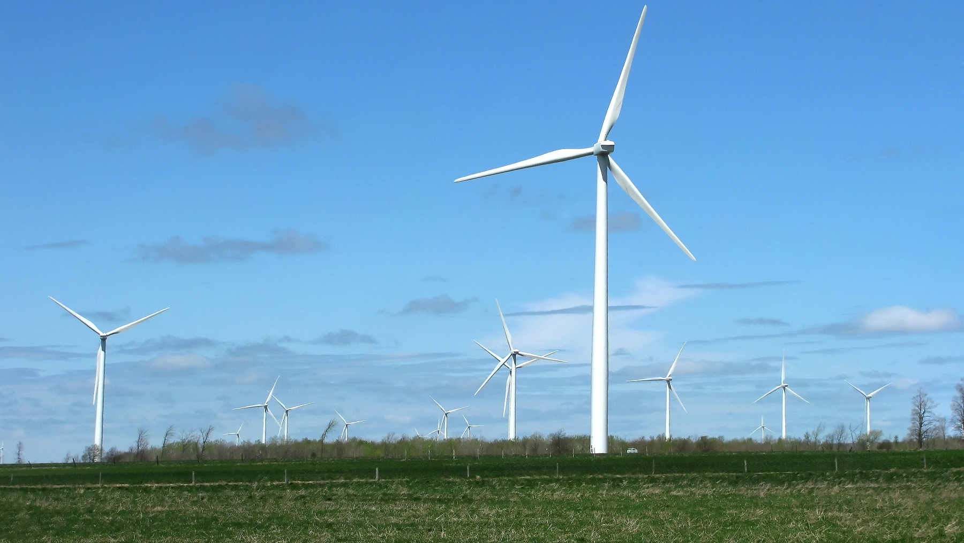

CREATE
4E
ENERGY
ECONOMICS
EDUCATION
ENVIRONMENT
Trans-disciplinary teams
leading the nation in
transformative research
Have a lasting impact on
society
VISION
Research related to energy and the environment
  economic considerations
  educational programming
UPDATE
Seed grant awardees will be announced in the next couple of weeks
Bring together SUNY faculty and facilities in partnership with:
  key academic institutions
  the private sector
  national labs
Notes:
Research across SUNY programs related to energy and the environment with associated economic considerations and educational programming.
Identify and bring together faculty and facilities across SUNY in partnership with:
key academic institutions
the private sector
national labs
Trans-disciplinary teams leading the nation in transformative research
Have a lasting impact on society

Slide 4
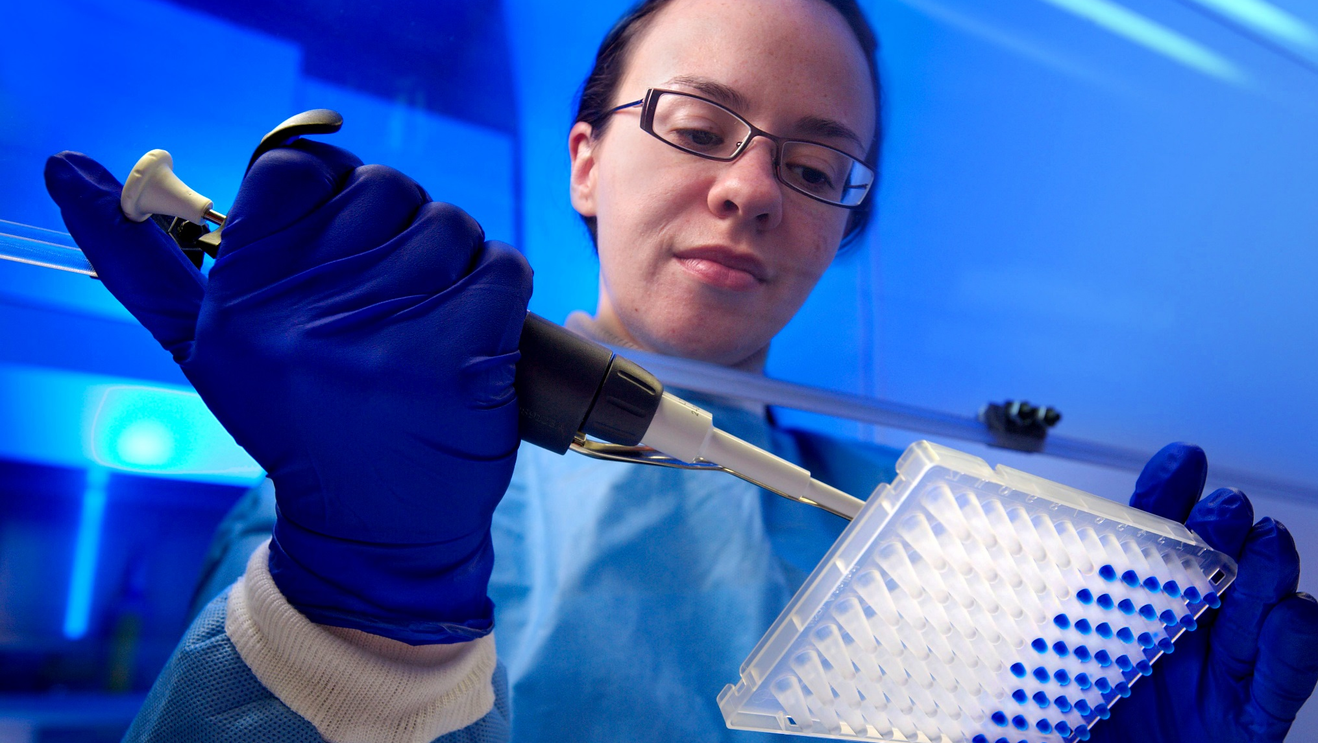
GOAL
Health
Advance drug design and personalized medicine through SUNY Network collaboration
Create new knowledge and accelerate discovery in health science
VISION
Facilitate diverse biomedical partnerships
with the SUNY community, academia and
industry
Build collaborations for innovative, increased
clinical and public health research
Expand preventive health care practice and
policy
UPDATE
Over 50 faculty and researchers
Submitted LOIs in review
Invitation to submit proposals to
be sent on January 28th, 2014
Notes:
drug discovery and molecular medicine
reducing health disparities
tissue and medical device engineering
translational medicine projects
Fostering basic, translational, and clinical research programs and partnerships
Create new knowledge and accelerate discovery in health science.
Maximize the diverse strengths in biomedical research across the SUNY campuses
Facilitate partnerships with academia, industry, and the community.
Leverage SUNY’s range to build and extend collaborations and partnerships for innovative public health, health disparities, community-based participatory research expanding preventive health care practice and policy.
Accelerate drug design and advance personalized medicine
Increase clinical research capacity, and develop "big data" tools for public health research.

Slide 5
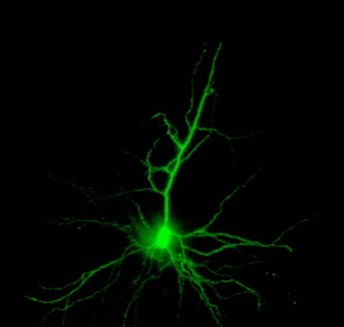
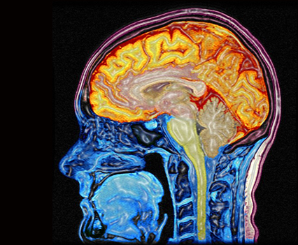
Membership of over 100 faculty and researchers
Brain
GOAL
Revolutionize approaches to brain activity mapping and understanding human disease/health
VISION
Connect the intellectual and vast infrastructure assets across SUNY
Align this program with the recent Brain Activity Mapping (BAM) announced by President Obama
UPDATE
Request for LOIs released with due date of February 28, 2014
Notes:
http://scienceline.org/2009/11/forgotten-memories-linger-in-the-brain/
we are bringing together the brains (literally) from across our campuses to put together our scale into responding to larger societal questions, that requires the scale of SUNY (infrastructure) that is beyond what one single campus (traditional way of conducting research) can do.
The Brain Network has a membership of over 100 faculty and researchers - neurosciences, behavioral sciences, psychology, nanotechnology, bioinformatics, engineering
Institutions involved:
Stony Brook
Downstate Medical
Upstate Medical
University at Buffalo

Slide 6


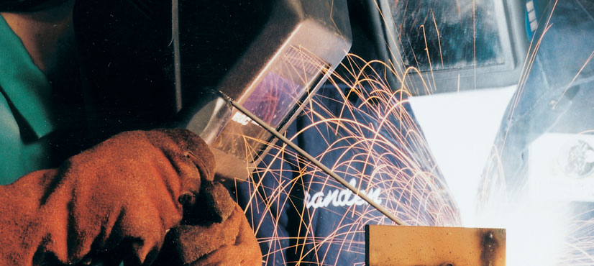

The activity of SUNY M&AM will impact medical, health, military, transportation industries, etc
Materials & Advanced Manufacturing
VISION
Build SUNY’s scope and scale in advancing and facilitating innovative manufacturing
Bring together faculty and infrastructure
  lower barriers against sharing
  foster collaboration
Create and build:
  BioMaterials, Green, Energy, Functional & Responsive Materials
  Flexible Electronics
  Green, Digital and Additive Manufacturing
UPDATE
Technical scope identified
Planning next virtual meeting
http://atecenters.org/#t-slide-one
Notes:
http://atecenters.org/#t-slide-one
Materials are important to practically everything we do…

Slide 7


Bridging the gap between research in
the Arts and Sciences.
Arts Humanities

