Slide 1


SUNY Policy and Philosophy Around Industry Partnerships
Faculty Senate
State University of New York College at Oneonta
January 25, 2013
Dr. Timothy Killeen
President, Research Foundation for SUNY
Vice Chancellor, State University of New York

Slide 2
SUNY as a National Leader in Scientific Integrity
SUNY has an opportunity to take a national leadership position with this statement on scientific integrity.
The benchmark research displayed in the summary of the top 50 research universities in the U.S. reveals that, while other universities have procedures to respond to allegations of scientific misconduct, very few have proactive statements that set out the expectations for integrity in the conduct of research.
A leader within the Union of Concerned Scientists has indicated that few institutions have a statement on scientific integrity.

Slide 3
DRAFT
Principles of Scientific Integrity
Transparency. Basic research should be open to review and vetting. Known potential conflicts of interests should be disclosed along with funding sources and affiliations.
Independence. Researchers must be free of outside influence when conducting or reviewing research. Many science and technology issues are closely related to a number of public policy issues and priorities, making “high quality objective scientific advice” vital and in the public interest.

Slide 4
DRAFT
Principles of Scientific Integrity
Free and Open Communication. SUNY researchers and scientists should be free to express their opinions so long as it is clear those opinions are theirs and not SUNY’s or the RF’s. This is true no matter how controversial the subject and even if there are public policy implications.
Accountability. Researchers and Scientists must have the ability to review, comment, and amend a final version of a document or publication that relies on their research or represents their scientific opinion. Scientific accuracy is paramount.

Slide 5
DRAFT
Principles of Scientific Integrity
Information Sharing. Sharing information and research data is a key component of the scientific process.
Peer Review. To ensure the quality of scientific information only qualified and non-conflicted scientists should be used.
External Pressure and Bias Eliminated. External pressure must be absent from the research process. Scientists and Researchers must be protected from external pressures from private and public sponsors, government officials, and university administrators.

Slide 6
DRAFT
Principles of Scientific Integrity
Conflict of Interest Policies. Policies and procedures governing disclosure and management of conflicts of interest must be adhered to. Sources of funding should be disclosed and research must be conducted free of outside interference.
Thoughtful and Thorough Review of Misconduct Allegations. Allegations of “fabrication, falsification, or plagiarism in proposing, performing, or reviewing research or in reporting research results must be reviewed pursuant to campus policies. Individual whisteblowers must be protected from retaliation.

Slide 7
DRAFT
Principles of Scientific Integrity
Scientific Basis for Public Policy and Discourse. When policy makers utilize faculty research or publications as the basis of supporting or rejecting a policy initiative, researchers and the university should make every effort to present or disclose information related to the underlying research, the findings, the scientific approach and process used to develop the underlying scientific information.^{[1]}
^{[1]} United States Department of Agriculture, Secretary’s Memorandum 1074-001, USDA Scientific Integrity Policy p2.

Slide 8
Scientific Integrity- Next Steps
The draft statement will be shared with SUNY Vice Presidents for Research, the Faculty Senate, and other selected stakeholders.
Review and update policies with SUNY stakeholders

Slide 9
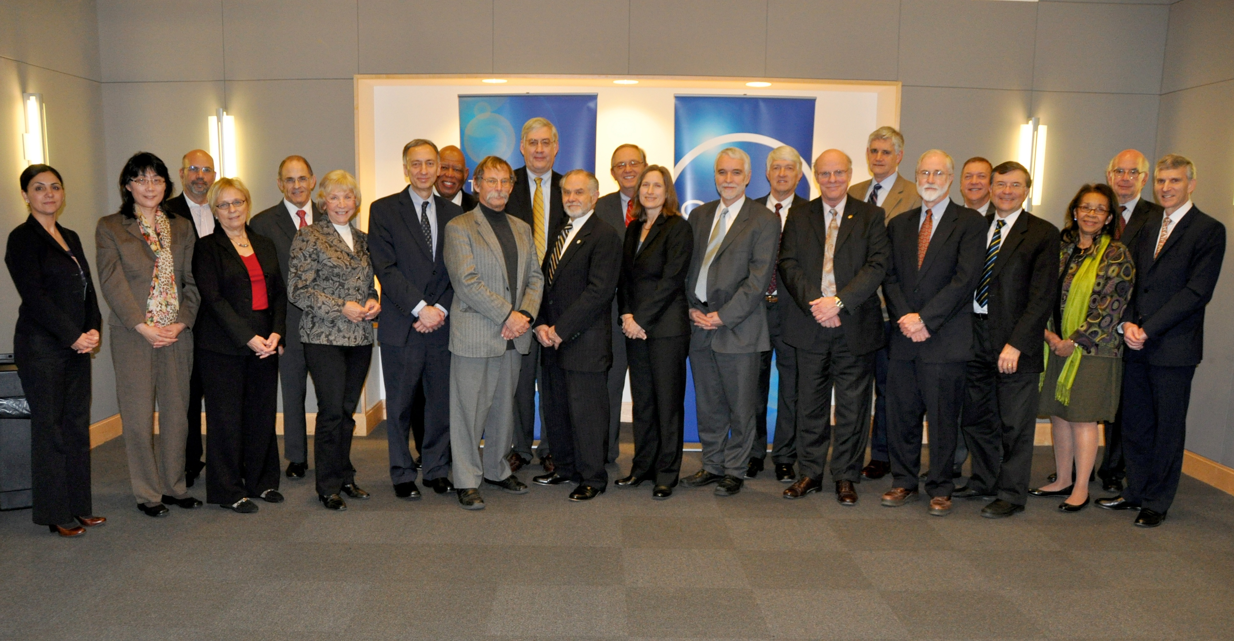
SUNY Research Council
Notes:
These are the members of the Research Council at our inaugural meeting on December 19th in NYC. I am very excited on what this group brings to the table. The members of the Council include:
- Members of the National Academies. One is a member of all 3 national academies, one of only ten living scientists to have been elected to all 3
- The first female director of Woods Hole Oceanographic Institution
- The founding director of the National Institute on Food and Agriculture
- The former Chair of the National Science Board and winner of the National Medal of Technology
- The winner of the Public Welfare Medal of the National Academy of Sciences, the highest award given by the Academy
- The vice president of the American Physical Society
Two members who are here with us today, Bahgat Sammakia and Sam Stanley, and can attest to the success of the first meeting.

Slide 10
SUNY Research Council
Strategic directions
Aspirational framing
Integration of Research and Education 2.0
Advisory to governance and leadership
Notes:
Role and Functions
The Research Council is an advisory council to the SUNY Board of Trustees, the Research Foundation Board of Directors, the SUNY Provost and Campus Presidents.
The SUNY Research Council lends deep and broad thinking and understanding to the question of SUNY’s leadership as a 21st Century public comprehensive research-intensive university system.
The Council considers and advises SUNY on strategies that encourage and nurture research as one of the primary missions of the University. The work of the Council will inform strategic and operational planning at SUNY and the Research Foundation.
In our inaugural meeting we had a colleague of mine, Jim Collins, Virginia M. Ullman Professor of Natural History and Environment at Arizona State University, on “The Evolution of Biology and the Research University of the 21st Century.” As well as sessions on human capital development , infrastructure and facilities, and science and engineering frontiers.

Slide 11
SUNY Research Council
Key Themes:
Start with a societal problem to be solved
Identify problems industry is trying to solve
Diversity is a strength
Focus on our areas of excellence
Notes:
As we synthesized what the Council told us during the meeting, themes emerged.
As you’ll see in the clip I’ll play next, they emphasized that SUNY can have an impact by leveraging its scope scale and diversity and its excellent researchers and infrastructure to solve big problems. We really need to focus.

Slide 12

SUNY NETWORKS of Excellence
North Country
SUNY 4E
University at Buffalo
University at Albany
SUNY
Health Now
Binghamton University
SUNY Neuroscience
Stony Brook University
SUNY
Materials
& Advanced Manufacturing
New York City
Notes:
I want to point out that a key group that I have formed a close working relationship with is the SUNY Vice Presidents for Research. At a recent meeting, we determined that a program that will leverage SUNY’s diversity and excellence to solve big societal problems is SUNY Networks of Excellence.
These networks will involve campuses across the whole SUNY system, including the research universities, the comprehensive colleges, the technology colleges and the community colleges.
The networks will focus on a big issue and will bring faculty and facilities together to go after federal, state, and private funding.
Underpinning the networks will be STEM – bringing students into research experiences and IT to support collaborations, perform data analytics.
We identified four networks to launch – I’ll describe each in the next slides.

Slide 13




SUNY 4E
Environment
NYS 2100 Commission
Notes:
I recently completed service on the Governor’s 2100 Commission and was extremely impressed with the SUNY faculty team the campuses put together to lend their expertise to the work of the commission.
The Commission seeks to:
Identify immediate actions for existing infrastructure
Identify infrastructure projects- climate resilience
Assess hard barriers and natural systems
Create opportunities to integrate resilience planning, protection and development approaches into NYS economic development decisions and strategies
Shape reforms in the investment area
I propose that we keep this group of faculty together to form a network of excellence on energy, economics, environment and education. In talking to the VPRs, SUNY has strengths across this spectrum and can set New York up as the solution center for disaster recovery and sustainability.

Slide 14




SUNY Health Now
Notes:
Note that these names are placeholders . . . The second network is a network to accelerate drug design and delivery. Taking into account the success of SUNY REACH, which brought together the academic medical centers to conduct research in key areas of medical research, we believe that leveraging our assets across the system, we can make a difference in this space. SUNY has expertise in RNA research, sensors, packaging, health disparities and on and on; AND we have access to a large patient population for clinical trials.

Slide 15

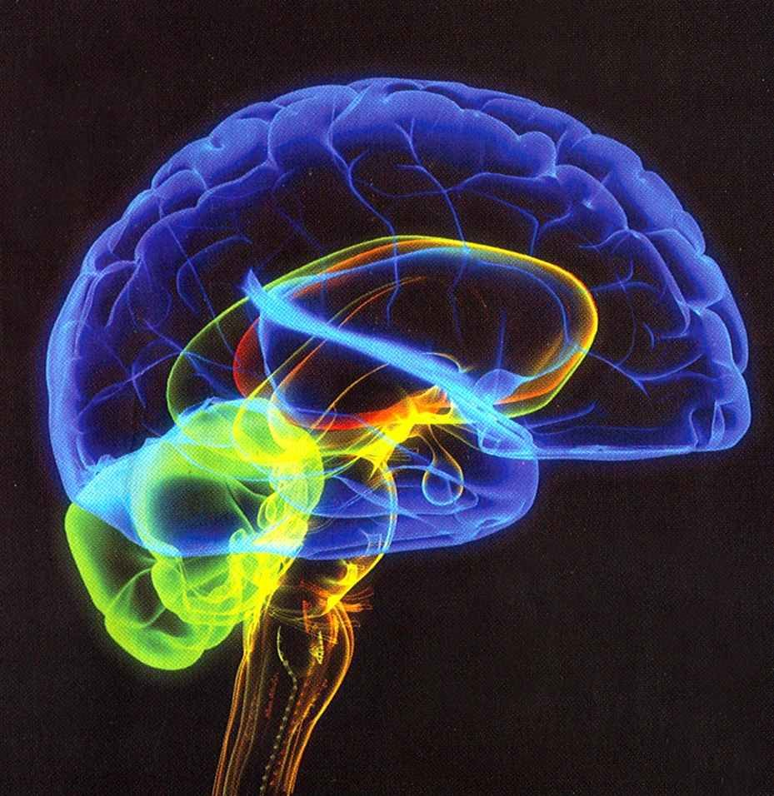

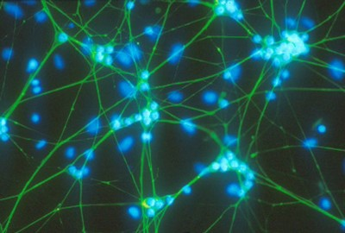
SUNY Neuroscience
Brain Activity Mapping (BAM)
Notes:
An opportunity that may be coming down the pike from Washington on the order of $1 billion in funding is the “brain activity map.” There is great interest in understanding the working of the brain, bringing together diverse research into imaging, nanotechnology, sensors, cognition and other functionality. A member of the Research Council has committed to working with SUNY to help us prepare to compete for funding.

Slide 16
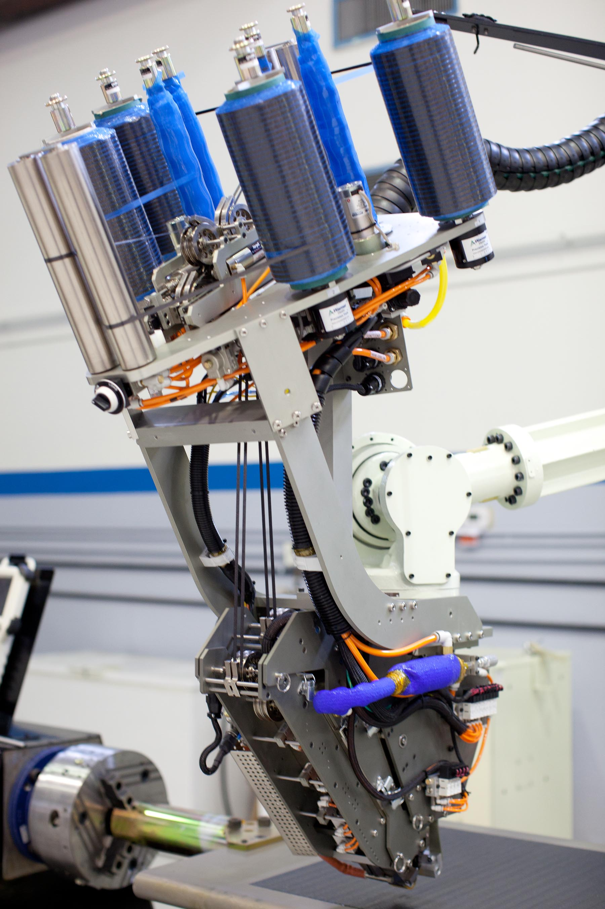
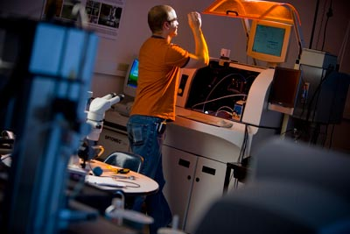


SUNY Materials & Advanced Manufacturing
Notes:
SUNY has great strength in materials and advanced manufacturing. Not only at the College of Nanoscale Science and Engineering but across the system.
We haven’t even announced the networks or really figured out the underpinnings and there is already a buzz about them. I’m moving quickly with the Vice Presidents for Research to identify the faculty that will actually do the important work of standing these networks up. I’m very excited about the prospects for the networks and I think they will have a real impact on society, on the economy and on SUNY itself!

Slide 17





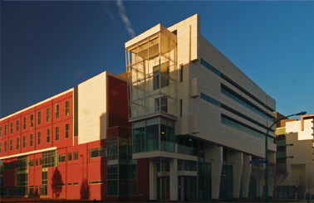
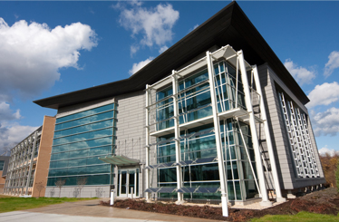

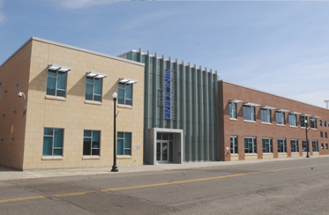

64
Campuses
8
Centers of Excellence
6
Centers for
Advanced Technology
17
Incubators
INFRASTRUCTURE
Notes:
Our infrastructure – it’s everywhere. We want to leverage these assets to submit applications and go after the hot spot money. We are in prime position for us to focus on this as a system and be a national model.
The Brooking Institute last week called for the creation of 20 Advanced Industries Innovation Hubs and five new Energy Innovation Hubs. They'd unite the top research institutions with private industry and government around industries with the most promise for innovation. These centers would tackle the toughest problems and the biggest commercial pay-offs. Brookings calls it a "next economy" model that drives more export growth and produces higher-skilled, better-paying jobs than finance or retail, industries previously tapped to restore the U.S. economy.
This is completely consistent with the approach we are taking at SUNY. We will leverage our assets to compete for Innovation Hot Spot funding, create SUNY Innovation Hubs and bring together critical players in sectors that map to SUNY core competencies. We are in prime position to focus on this as a system and be a national model.

Slide 18
State of the State
Innovation Hot Spots
New York State Innovation Venture Capital Fund
Innovation NY Network
A “New New York”
Notes:
Earlier this month, I attended my first State of State Address.
Focusing on economic development, New York’s 2013 program builds upon the work of the Regional Economic Development Councils as well as partnerships with higher education and strategic work that the RF has contributed.
Declaring New York’s “one-two punch” as “jobs and education”, Governor Cuomo outlined initiatives covering tech transfer, workforce development and energy/clean technology all of which embrace core work of the RF. Over the past several months we have been working closely with the Governor’s staff on several levels, and I am pleased to share that much of what we have been discussing was reflected in yesterday’s address.
First is Tech Transfer— “from Academia to Commercialization.” I am honored to have been selected to serve as one of three lead members of the Governor’s Innovation NY Network. Innovation NY Network will break down barriers to commercialization of academic ideas, and build collaboration among academics, venture capitalists, business leaders, patent lawyers and other professionals and entrepreneurs. It will facilitate and grow the commercialization process and will help advance the transition of SUNY research and innovation from the laboratory to the marketplace.
Together with Innovation NY Network, the Governor outlined other steps to support tech transfer:
Innovation Hot Spots: Ten higher education/private sector high-tech incubators will be selected as “Hot Spots” through a competitive process that fosters innovation by offering inventors and entrepreneurs support to grow their businesses and to be part of a tax-free zone, where start-ups will not be subject to business, real property, and sales taxes, to encourage business growth in New York State.
Innovation Venture Capital Fund: A $50 million Innovation Venture Capital Fund will provide incentives for successful start-ups to stay in the state and grow. Support from the Innovation Venture Capital Fund will help these entrepreneurs make the transition from research and other ideas through prototyping and ultimately to the creation of marketable products.
Second is Workforce Development. - Preparing the Workforce of Today and Tomorrow:
Looking to retool New York's workforce to be prepared for the jobs of today and tomorrow, the Governor proposed steps to re-imagine the SUNY and CUNY community colleges to ensure the state's job training programs produce the trained personnel that businesses need:
Next Generation Job Linkage Program: The Governor outlined a Job Linkage Program that will link community colleges with employers to identify the job, to define the skill, and to provide the training for it. The state will pay for performance by funding colleges based on student job placement.
Third is Making New York the Leader in the Clean Tech Economy: The Governor announced several steps to continue to establish New York as a national leader in building a clean tech economy program:
NY Green Bank: The $1 billion Green Bank will leverage public dollars with a private sector match to spur the clean economy.
Extend NY-Sun Solar Jobs: The program will be expanded at $150 million annually for 10 years to increase solar panel installations for homes and businesses.
Charge NY Program: The Charge NY Program will invest in an electric car network to reduce reliance on fossil fuels by installing a statewide network of charging stations and providing charging infrastructure tax credits.
All of the above touches mission critical work of the RF.
This is an exciting time for New York, SUNY and the RF. The Governor’s State of the State Address packaged all of us together as partners to move New York’s economy forward. We are very much a part of what the Governor described as a “New New York”.
Our participation and mention is testimony to who we are and what we do. It is a loud and clear validation of the New RF.

Slide 19
State of the State
Innovation NY Network
Breakdown barriers
Build collaborations (academics, venture capitalists, business leaders, patent lawyers, other professionals, entrepreneurs)
Facilitate and grow commercialization process
Examine regulations
Organizing members: -Dr. Timothy Killeen, President, Research Foundation for SUNY, Vice Chancellor, State University of New York
-Dr. James Simons, President of Euclidean Capital, Founder and board chair of Renaissance Technologies, LLC.
-Dr. David Skorton, President of Cornell University
Notes:
Culture and regulations can be major barriers to commercialization of academic ideas in New York. To break down the barriers, the Governor proposed creating Innovation NY Network, based in part, on the CONNECT model in San Diego.
We have been tasked with breaking down barriers, build collaborations with academics, venture capitalists, business leaders, patent lawyers, other professionals, entrepreneurs, facilitate and grow the commercialization process, and examine regulations around intellectual property and other regulatory barriers that slow commercialization efforts.

Slide 20
State of the University
“Yet another critical component of keeping SUNY competitive is our robust research portfolio. This past year, SUNY and its strategic partner, the SUNY Research Foundation, supported or created nearly 2,300 new companies through its incubators, tech transfer offices, and in partnership with SUNY’s Small Business Development Centers.”
-Chancellor Nancy L. Zimpher
January 15, 2013
Notes:
I hope you had a chance to watch Chancellor Zimpher’s 2013 State of the University Address.
To all attending and watching, the accomplishments and vision of SUNY were clear and convincing. Supported by programmatic and campus wide achievement, SUNY is indeed a national model with an ambitious agenda.
Referenced in pictures and words throughout was your work, the work of the RF. Cited was our efforts of Operation Excelsior to improve our control environment and safeguard SUNY’s research activity and portfolio; our support and creation of nearly 2,300 new companies through our incubators and tech transfer offices, in partnership with SUNY’s Small Business Development Centers; the launch and mission of SUNY’s Research Council; Innovation Hubs, and our role to serve Governor Cuomo’s Innovation New York Network and “build collaborations between academics, venture capitalists, and business leaders to expedite tech transfer and put New York on an ambitious pathway to more innovations, increased entrepreneurship, and as the Governor says, a ‘New New York.’”

Slide 21
SUNY’s Technology Accelerator Fund (TAF)
Launched in April 2011 to support innovation across the SUNY research community by providing funding for select technologies to accelerate their development and commercialization.
The Technology Accelerator Fund Class of 2013 Spring will make several awards of up to $50,000 to accelerate the development and commercialization of select SUNY technologies. Applications are due March 15, 2013.
www.rfsuny.org/TAF

Slide 22
SUNY’s Entrepreneur in Residence (EIR) Fund
Launched January 2013, the program provides the funds to secure the time and skills of proven, private-sector entrepreneurs who have both startup experience and expertise that is relevant to particular discoveries in the SUNY research portfolio.
Applications are due February 15, 2013
Email EIR@rfsuny.org for more information

Slide 23
SUNY Faculty Research Travel Grant Program
Aims to improve the competiveness of research proposals from SUNY faculty by facilitating interaction with perspective federal sponsors.
Grants travel funds for faculty to meet with program managers at federal funding agencies.
Launch February 2013

