Slide 1
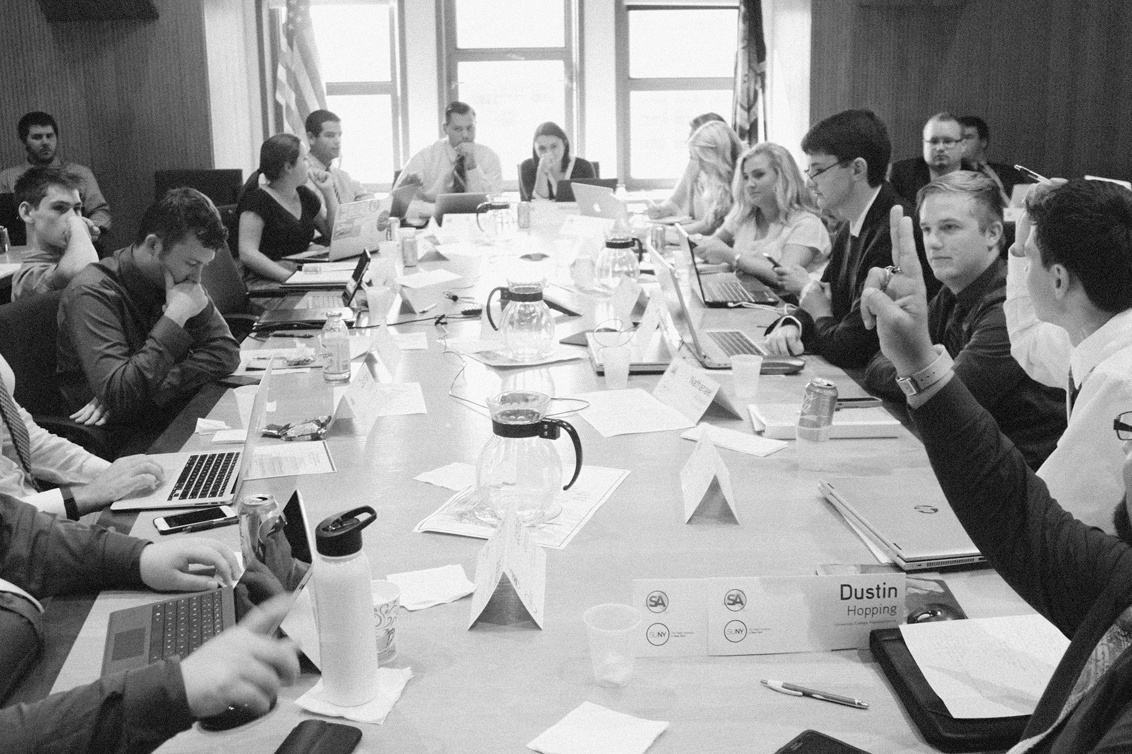
ALL TEXT SHOULD BE ARIAL FONT IN BOLD. DO NOT LEAVE THE DEFAULT CALIBRI.
President’s Report
SUNY Student Assembly, University Faculty Senate
Buffalo State
Saturday, October 24nd 2015

Slide 2


Section titles are always placed on the right and right justified, at the same height as content titles.
Creating a True System of Student Governments
SUNY logo endorsement always stays visible in front of all content, unless the SUNY logo is prominently featured somewhere else on the slide.
Notes:
Creating a True System of Student Governments

Slide 3

Campus Outreach
Town Halls
Administration
Student Leader Meet & Greet
Notes:
We also used SUNY’s blog as a powerful vehicle to distribute a piece from the Chancellor describing her stance on standardized testing and the movement for parents to opt out.
This resulted in many news hits.

Slide 4

External Affairs Committee
Collaboration
Image Reform
Communication

Slide 5

Sustainability Committee
United Nations
Divest from Fossil Fuels
Notes:
Sustainability Committee Divest from Fossil Fuels

Slide 6

Equity and Inclusion Committee
Chief Diversity Officer
New Data Collection Survey
Net Impact Conference
When possible, crop several photos to completely fill the slide.
Notes:
Equity and Inclusion Committee
2015 Net Impact Conference

Slide 7

Advocacy Plan
Strategic
Assistance
Specific
Notes:
Strategic

Slide 8

Predictable Tuition
Task Force
Accountability
Requirements
When possible, crop several photos to completely fill the slide.
Notes:
Predictable Tuition / Accountability / Requirements

Slide 9

New Data Collection Survey
Inclusive
Student Focused
Campus Services
When possible, crop several photos to completely fill the slide.

Slide 10

Fall Conference
Progress through Rebuilding, Reinvention and Forward Thinking
State of the Assembly Address
United Nations
Campus Involvement
Notes:
-Describe what will covered during this address
-Who will be attending

Slide 11
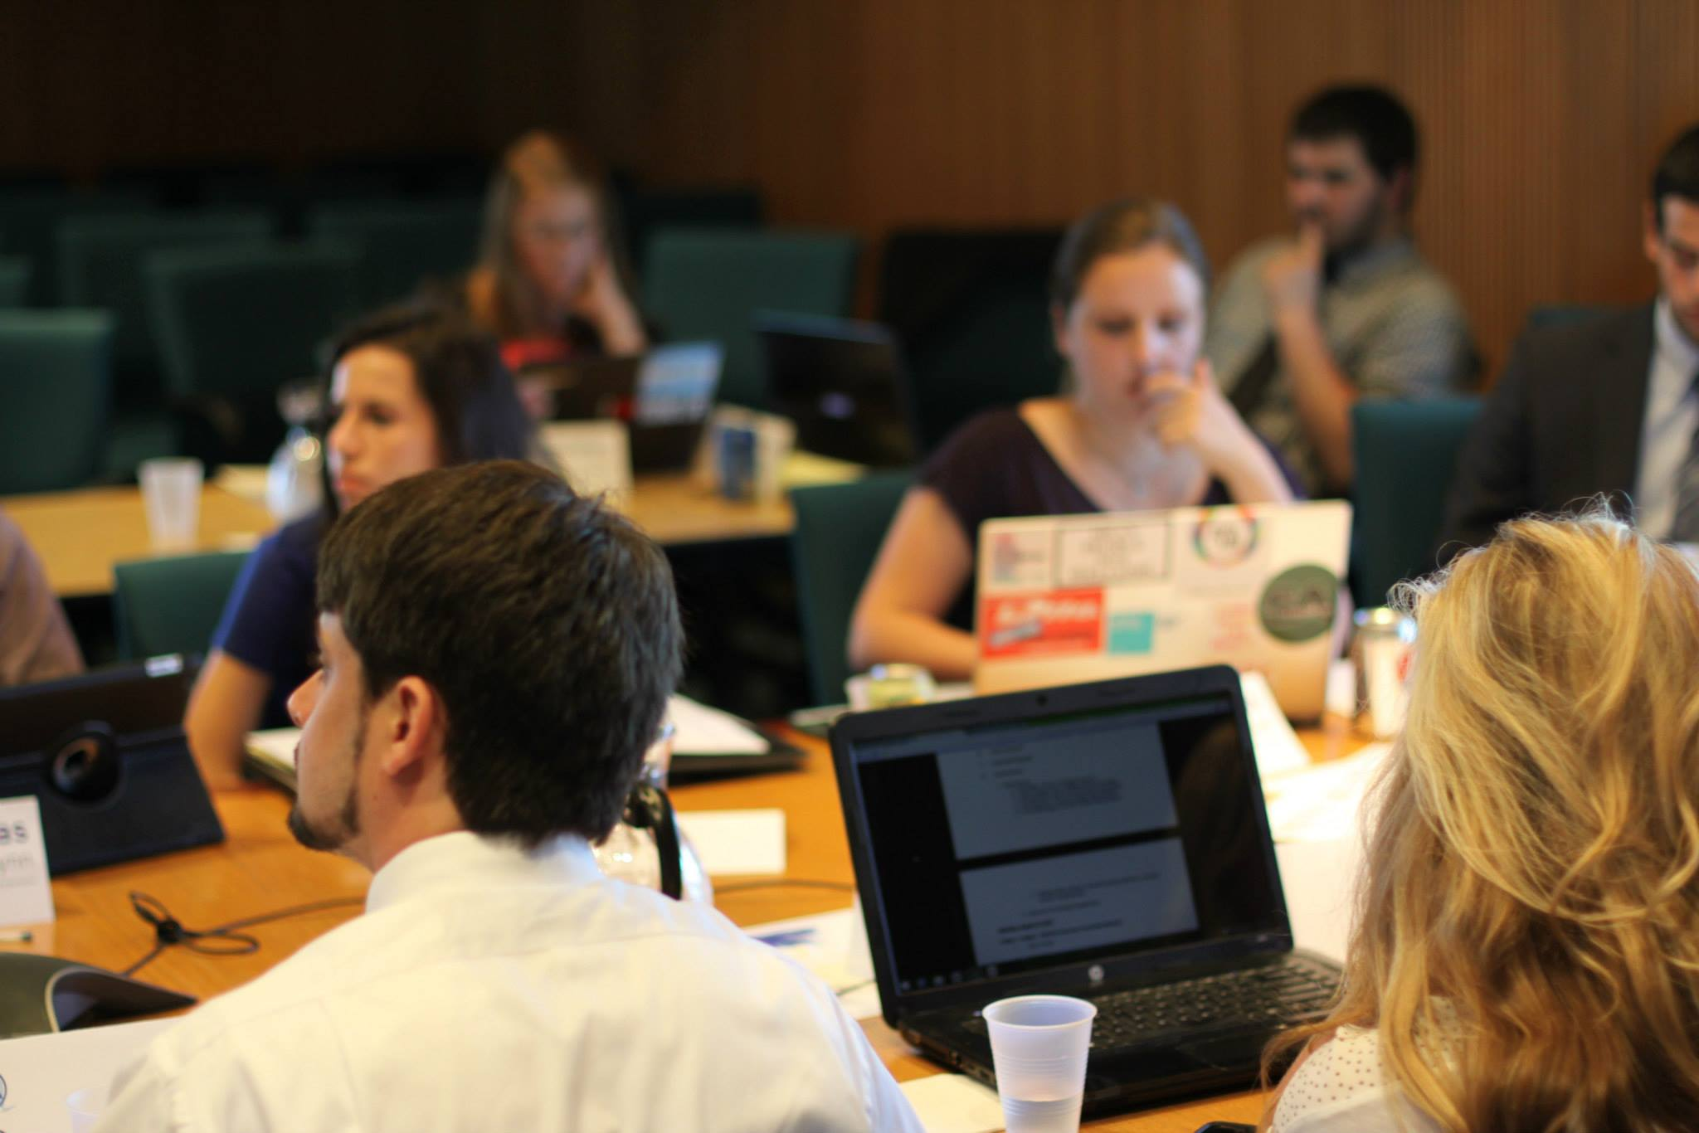
State of the Assembly Address
Informative
Perspective
Open
Notes:
-Describe what will covered during this address
-Who will be attending

Slide 12
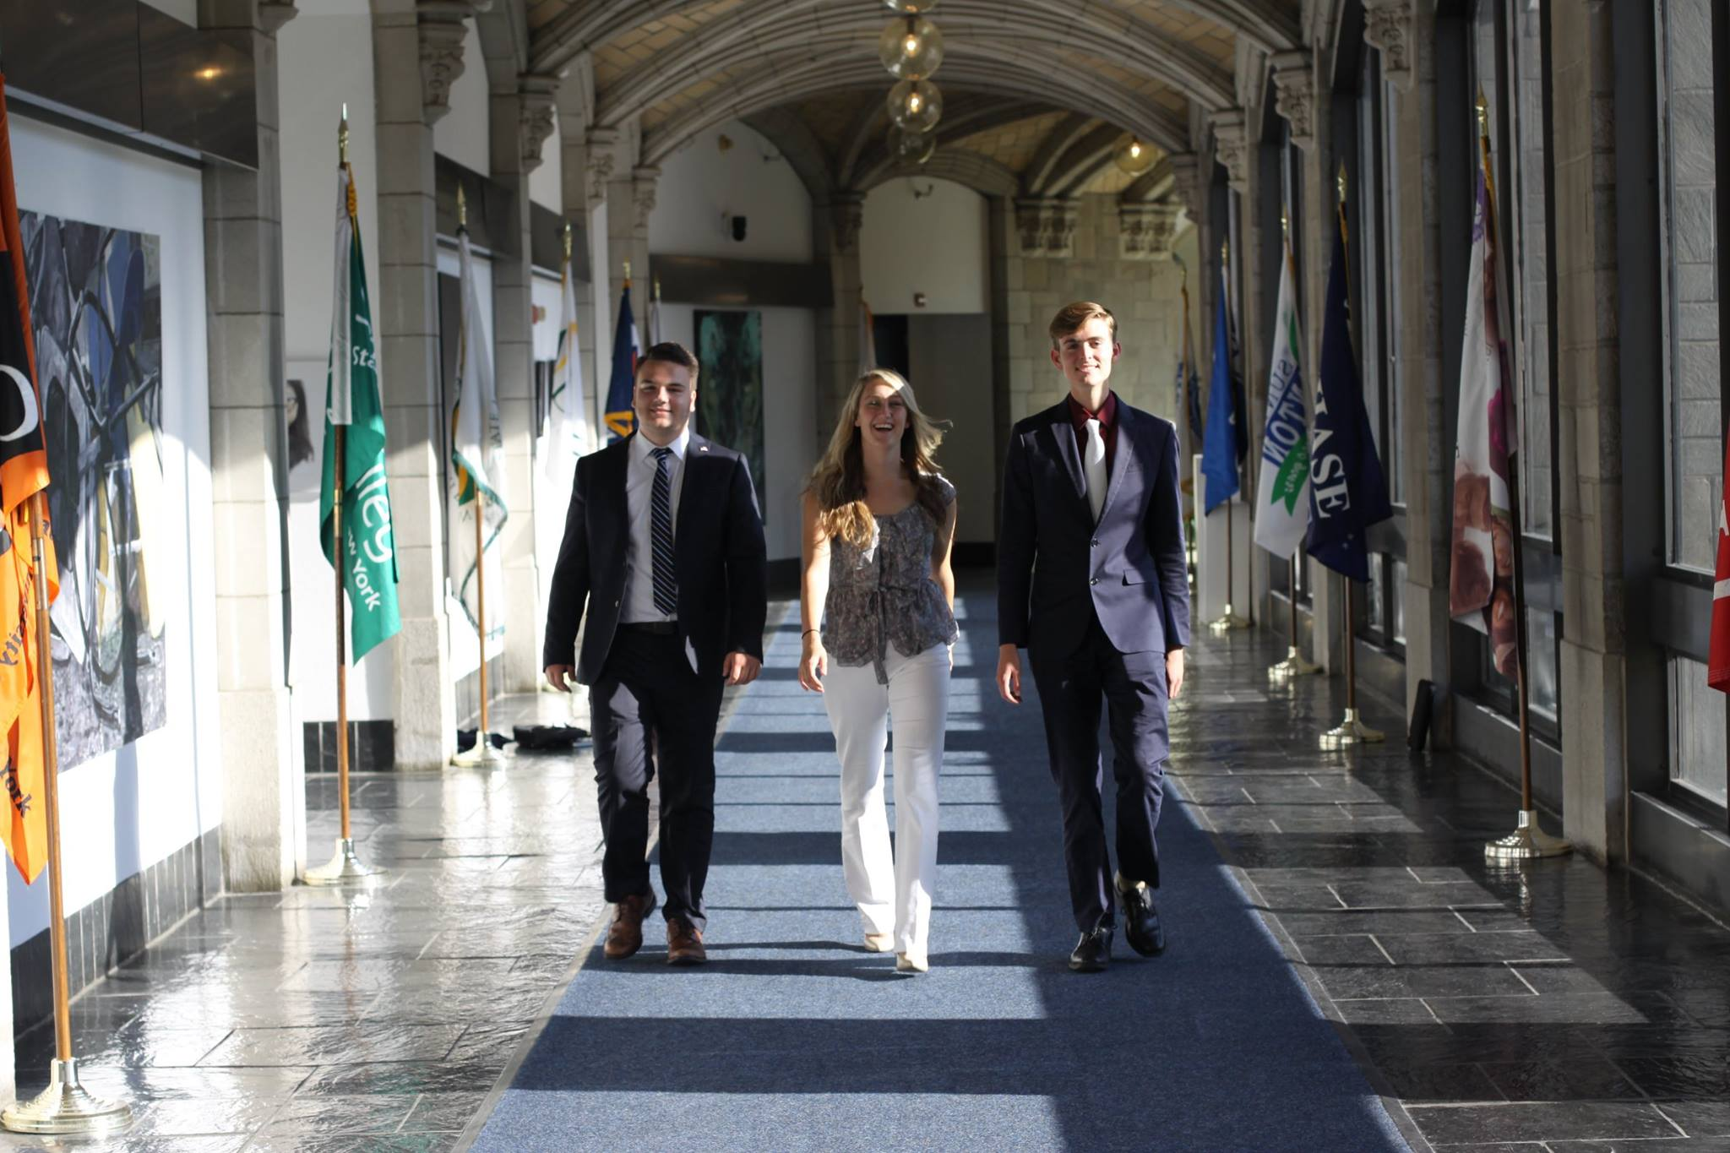

Closing Comments
We would be happy to answer any questions.

