Slide 1

Connecting Students to Careers
Faculty Senate
January 25, 2014
William (Bill) Ziegler
Provost Fellow –SUNY Works
Statewide Co-op Curriculum Coordinator
Associate Professor – Binghamton University
Executive Director – Binghamton University Scholars Program

Slide 2


Slide 3

A 3-way partnership:
Students, Employers, Campuses

Slide 4


Slide 5


Slide 6


Slide 7


Slide 8
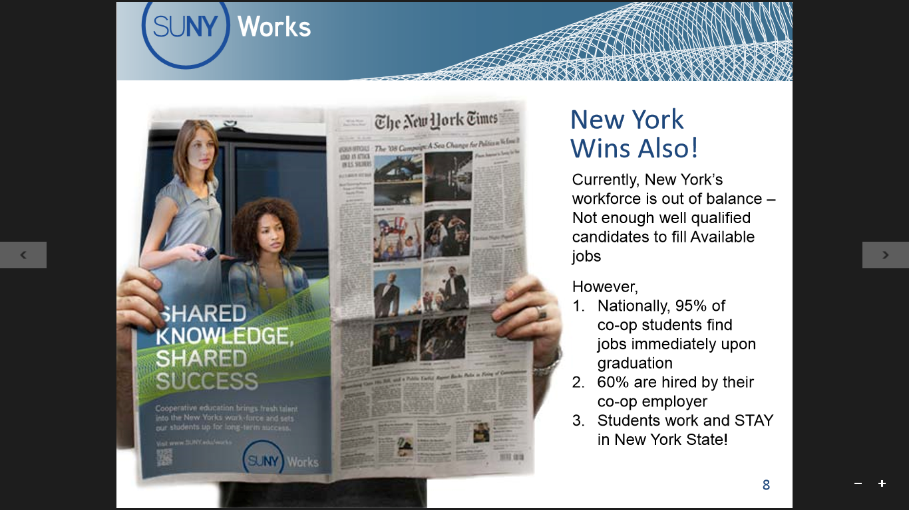

Slide 9
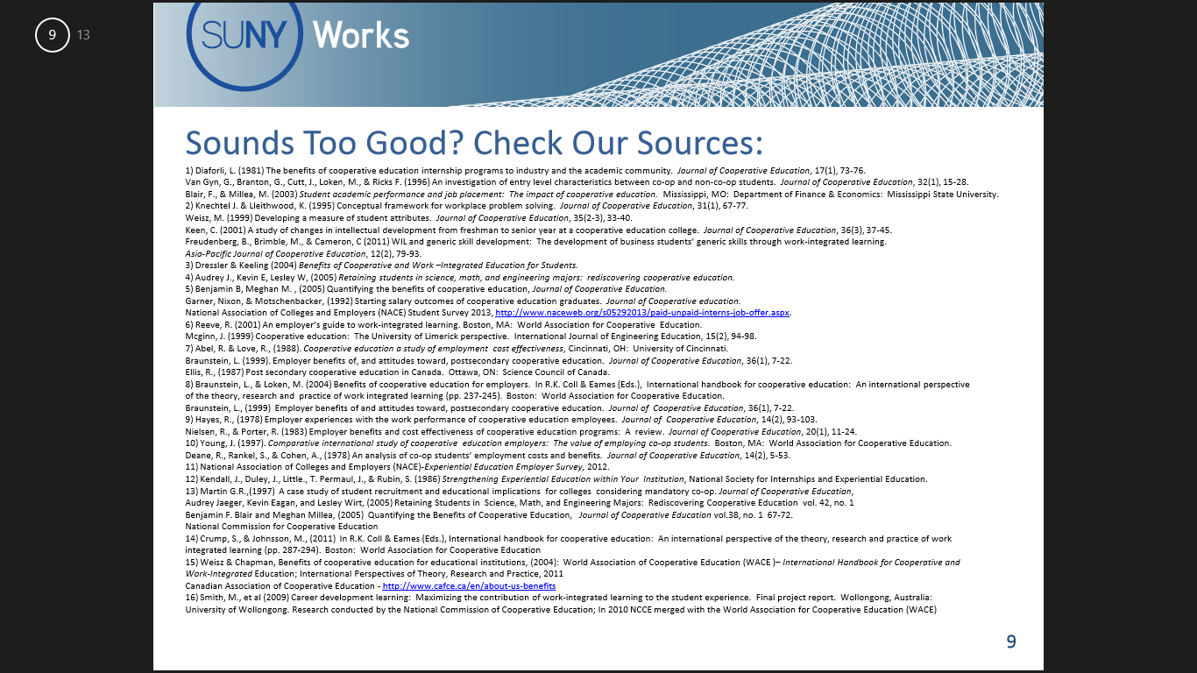

Slide 10


Slide 11
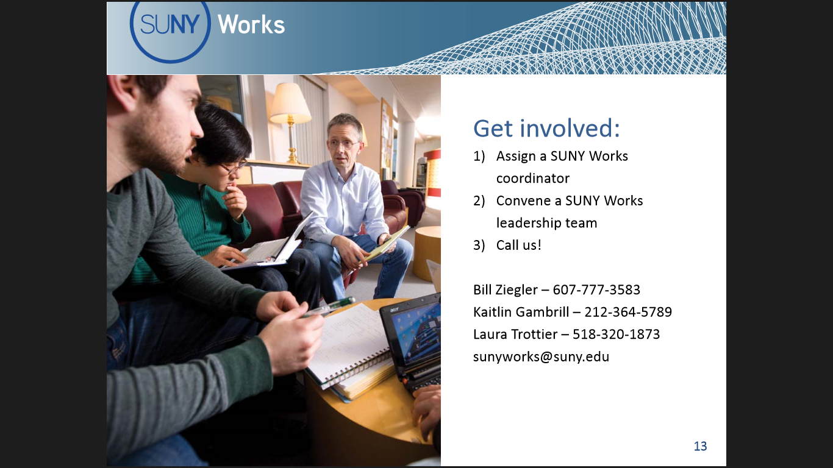
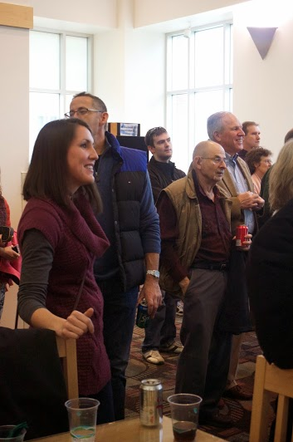
At the President’s Meeting
and
the Chief Academic Officers Meeting
in October 2013
Chancellor Zimpher introduced SUNY Works and requested all SUNY campus presidents to form
SUNY Works Leadership Teams
(details coming up)

Slide 12

Posted on January 13, 2014
ALBANY TIMES UNION
ALBANY TIMES UNION
Posted on January 13, 2014
State University College [sic] of New York Chancellor Nancy Zimpher wants every student to have some sort of on-the-job training by graduation.
So among Zimpher’s announcements [at] her annual State of the University address on Tuesday, will be a plan to expand SUNY Works, a public-private job training program that offers opportunities such as internships and cooperative education to students. Zimpher will establish a Co-Op Task Force of New York business leaders to help the school expand the program and support Gov. Andrew Cuomo’s STARTUP-NY economic development plan. She also plans to personally wrangle [engage 100% of] New York’s Fortune 500 [CEOs] companies to participate in the program.
Already 50,000 SUNY students participate in the program, but Zimpher would prefer that every student at each of the university system’s 64 campuses sign on ……………….

Slide 13
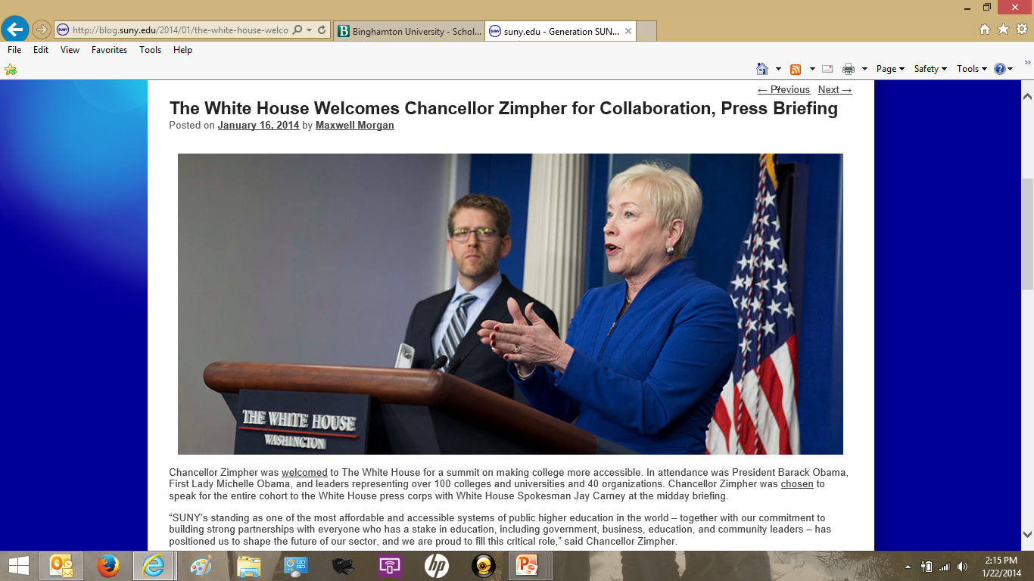
http://youtu.be/tMRhpjRm_Kk

Slide 14
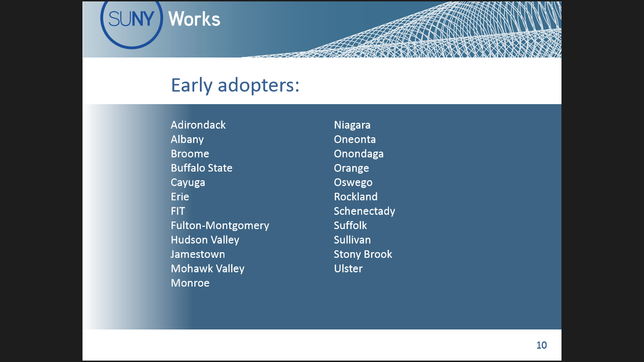

Slide 15
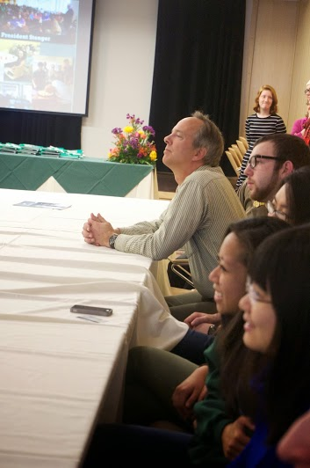
Recognition :
Chancellor Zimpher has offered to support an award structure
to Faculty
[SENATE – any ideas?]
  Departmental level awards
  Campus level awards
  System level awards
  Badging
  Certificate
  Distinguished Academy
  Chancellor Award
  Monetary
  …….

Slide 16
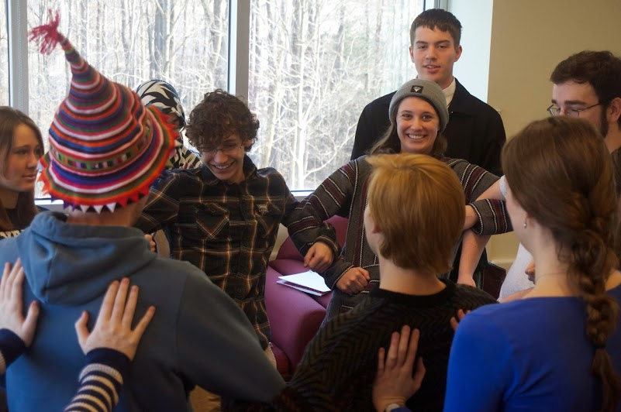
A successful leadership team can include:
Chief Academic Officer or designee
Full/Adjunct Faculty
Students
Employers
Academic Advisors
Admissions
Alumni
High School Guidance Counselors
Institutional Research
Workforce Development
Career Services
…………
Where to from here?
as requested at:
  President’s Meeting
  Chief Academic Officers Meeting
A point-of-contact for SUNY Works on your campus
Development of a SUNY- Works leadership team

Slide 17

We would like some feedback from you:
I would like to email you a copy of this flyer – that asks three questions:
1. Student success stories related to
co-ops and internships
2. Your own rewarding experiences working with student co-ops/interns
3. Would you like to learn more?

Slide 18

What will Success Look Like in the Long Term?
465, 000 Work-Savvy Graduates upon full scale-up!

Slide 19
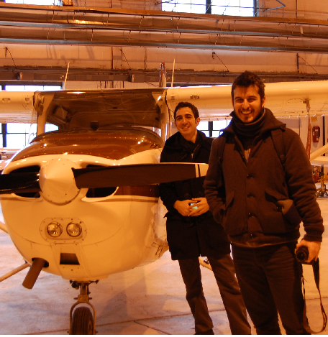
THANK YOU!

