Slide 1
Clearing the Smoke:
Understanding the Implications of Addressing Marijuana When Laws and Regulations Conflict
Eric S. Davidson, Ph.D., MCHES, CSPS
State University of New York
Tuesday, March 26, 2019

Slide 2
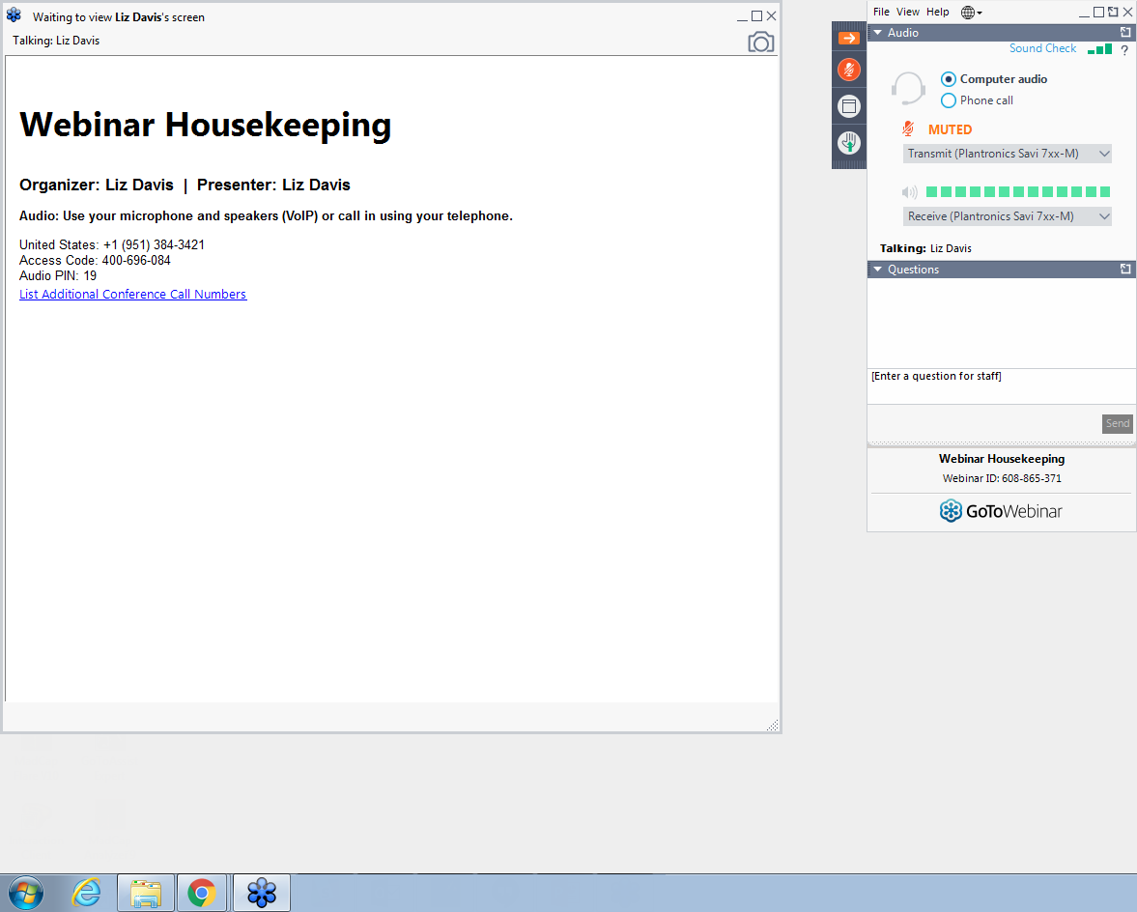
GoToWebinar Housekeeping:
What Attendees See
Notes:
Acquaint your Attendees with what they see on their screen.
To the left is the GoToWebinar Viewer through which they see the presentation.
To the right is the GoToWebinar control panel where they can raise their hand, ask questions and select audio mode.
Note:
The attendee control panel will collapse automatically when not in use by an Attendee. To keep it open, Attendees can click the “View” menu and uncheck “Auto-hide Control Panel”.

Slide 3
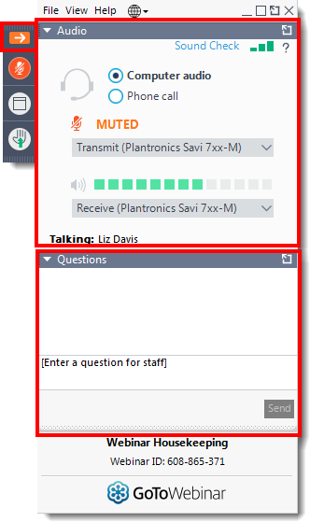
GoToWebinar Housekeeping: Attendee Participation
Your Participation
Open and close your control panel
Join audio:
Choose Mic & Speakers to use VoIP
Choose Telephone and dial using the information provided
Submit questions and comments via the Questions panel
Note: Today’s presentation is being recorded and will be provided within 48 hours.
Notes:
Give Attendees a closer look at the control panel and how they can participate. Text may be adjusted to suit your event needs.
Note: Hand Raising is disabled (see slide 6)
Tip: Add animations to the “call outs” using PowerPoint features to provide step by step instructions.

Slide 4
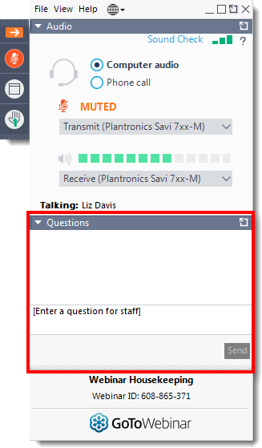
GoToWebinar Housekeeping: Time for Questions
Your Participation
Please continue to submit your text questions and comments using the Questions panel
For more information, please [insert contact information]
Note: Today’s presentation is being recorded and will be provided within 48 hours.
Notes:
Remind Attendees how to ask questions and provide “more info” or support contact. Text may be adjusted to suit your event needs.
Note: Hand Raising is disabled (see slide 7)

Slide 5
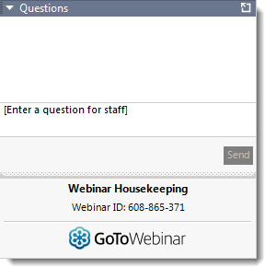

The following slides are redesigned for webinars utilizing hand raising.
Notes:
Copy these “call outs” into your PowerPoint to encourage your Attendees to participate.

Slide 6
GoToWebinar Housekeeping: Attendee Participation
Your Participation
Open and close your control panel
Join audio:
Choose Mic & Speakers to use VoIP
Choose Telephone and dial using the information provided
Submit questions and comments via the Questions panel
Note: Today’s presentation is being recorded and will be provided within 48 hours.
Notes:
Give Attendees a closer look at the control panel and how they can participate. Text may be adjusted to suit your event needs.
Note: Hand Raising is enabled (see slide 3)
Visit the “Options” menu in the Organizer control panel a check to allow attendees to Raise Hands.

Slide 7
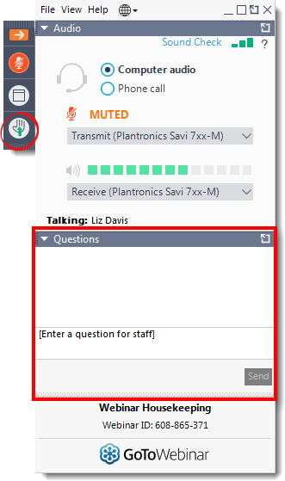
GoToWebinar Housekeeping: Time for Questions
(Use hands for unmuting!)
Your Participation
Please continue to submit your text questions and comments using the Questions panel
Please raise your hand to be unmuted for verbal questions.
For more information, please [insert contact information]
Note: Today’s presentation is being recorded and will be provided within 48 hours.
Notes:
Remind Attendees how to ask questions and provide “more info” or support contact. Text may be adjusted to suit your event needs.
Note: Hand Raising is enabled (see slide 4)
Visit the “Options” menu in the Organizer control panel a check to allow attendees to Raise Hands.

Slide 8
Sponsored in Whole or in Part Through a Grant From the
NYS Office of Alcohol and Substance Abuse Services

Slide 10
Description
States and communities across the nation have passed laws and ordinances allowing medicinal marijuana and decriminalized marijuana. While changes have occurred at local and state levels, federal rules and regulations regarding marijuana have not. This misalignment has created confusion as to how to address the growing changes while remaining compliant with the Drug Free Schools and Campuses Act.

Slide 11
Learning Outcomes
Participants will be able to
Discuss history of Cannabis/Marijuana laws within the United States
Discuss federal laws and regulations which require IHE's to ignore state and local marijuana/cannabis laws
Summarize the American's With Disabilities Act's impact on medicinal marijuana and requests or accommodation
List key components of sample policy statements regarding medicinal and legalized marijuana
Address considerations for addressing off-campus use by employees and students
Summarize how present institutions are addressing the issue on their campus.

Slide 12
History of Cannabis Legalization in the US
1619 –King James I orders every colonist to grow 110 hemp plants for export for fiber (Deitch, 2003).
1839 – Physician William O’Shaughnessy introduces marijuana for medicinal purposes (Gieringer, 1999).
1850 – Marijuana added to US Pharmacopedia as a tx for numerous afflictions (ProCon.Org, 2013).

Slide 13
History of Cannabis Legalization in the US
1906 – Pure Food and Drugs Act – requires labeling of medicine, including marijuana (Hardaway, 2018).
1914 – Harrison Act – required doctors who wished to prescribe narcotics to register w/Fed. Govt. (Hardaway, 2018).
1915 – States begin passing marijuana prohibition laws (Wikipedia, 2016).

Slide 14
History of Cannabis Legalization in the US
1925 – League of Nations Sign Multilateral Treaty Restricting Cannabis/Hashish Use to Scientific and Medical Only Use (ProCon.Org, 2013).
1934 - Uniform State Narcotic Act allowed states to exercise police power in seizing illegal drugs used in illicit trade (Hardaway, 2018).

Slide 15
History of Cannabis Legalization in the US
1937 – Marijuana Tax Act – made possession or transfer of cannabis illegal throughout the US, excluding medical and industrial uses (Hardaway, 2018).
1952 – Boggs Act made first time cannabis possession a minimum offense of 2-10 years with a fine up to $20,000 (Hardaway, 2018).

Slide 16
History of Cannabis Legalization in the US
1970 - Controlled Substances Act – repeals Marijuana Tax Act, creates a single system of control (Hardaway, 2018).
1971 – War on Drugs Begins (ProCon.Org, 2013).
1972 – Shafer Commission Recommends Decriminalizing Marijuana (ProCon.Org, 2013).

Slide 17
History of Cannabis Legalization in the US
1973 – DEA Established ((Hardaway, 2018).
1973 – Oregon first state to decriminalize cannabis (Wikipedia, 2016).
1974 – NIDA becomes sole legal source for marijuana (Wikipedia, 2016).
1976 - Fed. court rules Robert Randall’s use of medical marijuana a necessity (Wikipedia, 2016).

Slide 18
History of Cannabis Legalization in the US
1978 – New Mexico 1st state to pass medical marijuana laws (ProCon.Org, 2013).
1978 – FDA sets up medical marijuana distribution program (ProCon.Org, 2013).
1986 – Anti-Drug Abuse Act – reinstated mandatory prison sentences and the 3 strikes law (Wikipedia, 2016).

Slide 19
History of Cannabis Legalization in the US
1994 – Final decision on 1972 court battle re: Marijuana Scheduling (ProCon.Org, 2013).
1996 – California becomes first state to legalize medical marijuana (ProCon.Org, 2013).
2009 – Ogden Memo – indicated that gov’t resources should not be directed toward prosecuting medical marijuana users who were in clear compliance with state law; focus should be on traffickers. – Seen as a green light for state legalization and commercial dispensaries (Hardaway, 2018).

Slide 20
History of Cannabis Legalization in the US
2010 – 1st Cole memo; differentiated “care givers” from large, scale commercial operations. Removed protections from Ogden Memo (Hardaway, 2018).
2012 – Colorado and Washington legalize the recreational use of marijuana (Hardaway, 2018).
2013 – Colorado and Washington legalize the recreational use of marijuana (ProCon.Org, 2013).

Slide 21
History of Cannabis Legalization in the US
2013 – 2nd Cole Memo. Legalized states should not be a priority as long as they are regulates; stated areas of prosecution (e.g. underage use) Hardaway, 2018).
2014: The Rohrabacher–Farr amendment signed into law; Requires annual renewal, prohibited the Justice Department from interfering with the implementation of state medical cannabis law (Hardaway, 2018).

Slide 22
History of Cannabis Legalization in the US
2018: Sessions rescinds the 2nd Cole Memo (Hardaway, 2018).

Slide 23
A Changing Landscape

Slide 24
Current Legal Landscape
(NORML, 2019)
16 States Allow Medical CBD
  Cannabidiol is one of at least 113 active cannabinoids identified in cannabis
32 States Allow Medical Marijuana
13 states have decriminalized marijuana
10 States passed legalization

Slide 25
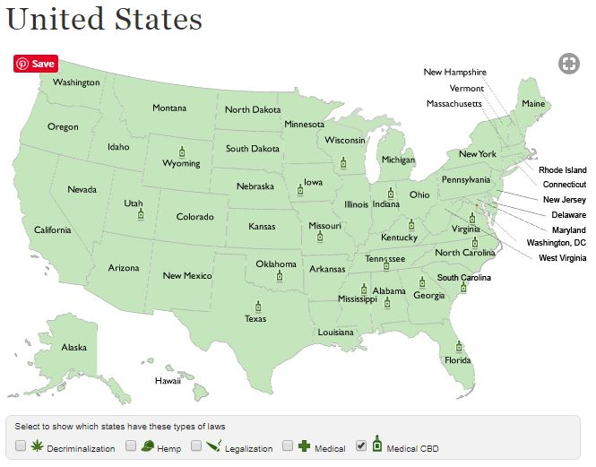
States – Medical CBD
(NORML, 2019)

Slide 26
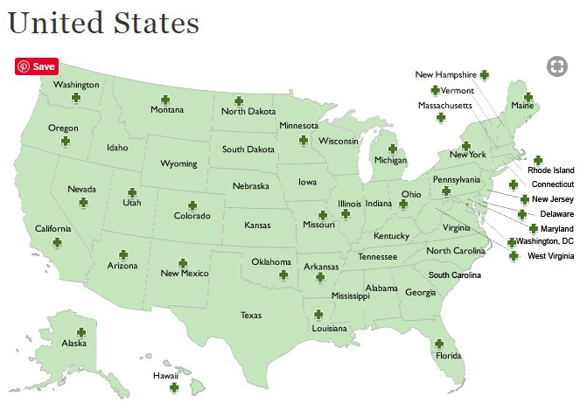
States – Medical Marijuana (NORML, 2019)

Slide 27
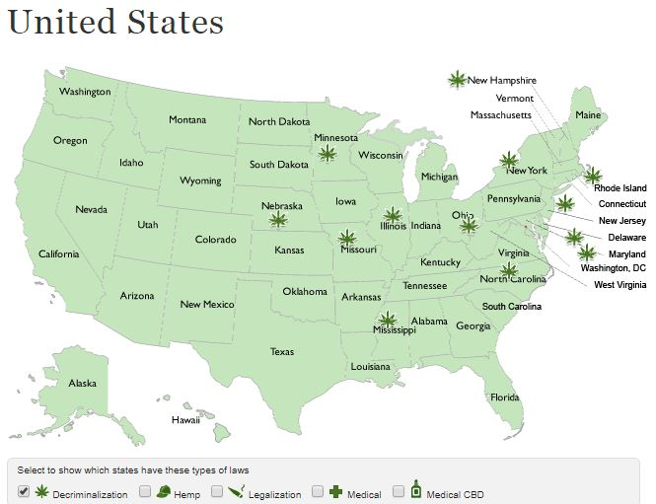
States – Decriminalized
(NORML, 2019)

Slide 28
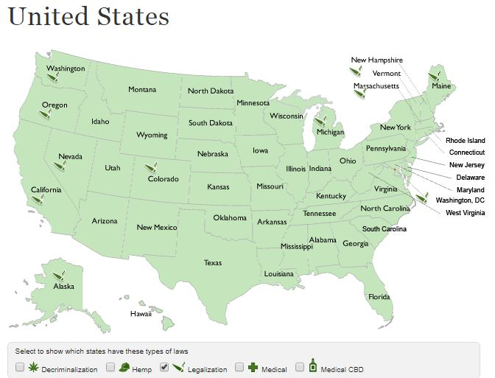
States – Legalized
(NORML, 2019)

Slide 29
Why Are Institutions of Higher Education Required to Ignore State and Local Marijuana Laws?

Slide 30
Simple Answer vs. Complex Answer
Simple Answer
DFSCA
Complex Answer
Controlled Substances Act
Drug-free Work Place Act of 1988
DFSCA of 1989
Americans with Disabilities Act

Slide 31
Controlled Substances Classifications
(USDOJ, 2016)
Controlled Substances Act
Title II of the Comprehensive Drug Abuse Prevention and Control Act of1970
Substances have been added, removed, or transferred from schedule to schedule

Slide 32
Controlled Substances Act of 1970 Classifications
(USDOJ, 2016)
Schedule I
  Have no acceptable medical use in the US
  A lack of accepted safety for use under medical supervision
  A high potential for abuse
Includes heroin, ecstasy, LSD,marijuana/cannabis,

Slide 33
Controlled Substances Act of 1970 Classifications
(USDOJ, 2016)
Schedule II
  A high potential for abuse which may lead to psychological/physical dependence
  Acceptable medical use in the US
  Accepted safety for use under medical supervision
Includes morphine, opium, codeine, oxycodone, methadone, amphetamines (Adderall), methamphetamines,and methylphenidate (Ritalin)

Slide 34
Controlled Substances Act of 1970 Classifications
(USDOJ, 2016)
Schedule III
  Less potential for abuse than substances in schedule I or II
  Abuse may lead to moderate or low physical dependence or high psychological dependance
Includes Tylenol with Codeine, Buprenpohen (Suboxone),anabolic sterois

Slide 35
Controlled Substances Act of 1970 Classifications
(USDOJ, 2016)
Schedule IV
  Lower potential for abuse relative to substances in Schedule III
Includes Xanax, clonazepam, Valium, Halcion

Slide 36
Controlled Substances Act of 1970 Classifications
(USDOJ, 2016)
Schedule V
  Lower potential for abuse relative to substances in Schedule IV
  Consists primarily of preparations containing limited quantities of certain narcotics
Includes Robitussin AC

Slide 37
Controlled Substances Act of 1970 Classifications
(USDOJ, 2016)
Alcohol/Tobacco
  Alcohol is not a controlled substance
  Tobacco is not a controlled substance
Are we attempting to treat marijuana similar to alcohol and tobacco
Will marijuana be reclassified to a lower schedule?
Will marijuana be removed from the classification schedule and become an uncontrolled substance?

Slide 38
The Drug Free Workplace Act of 1988

Slide 39
Drug Free Workplace Act of 1988 Requirements
⁽US Dept of Labor, 2019)
Requires some Federal contractors & Requires all Federal grantees to agree that they will provide drug-free workplaces as a precondition of receiving a contract or grant from a Federal agency

Slide 40
Drug-Free Workplace Act of 1988 Requirements
⁽US Dept of Labor, 2019)
Must maintain a drug-free workplace
Requirements vary depending if contractor/grantee is an individual or organization
Organization requirements are more extensive; comprehensive program to achieve a workplace free of drugs is required.

Slide 41
Drug-Free Workplace Act of 1988
⁽US Dept of Labor, 2019)
Covers both temporary and full-time employees
Students in general, especially those receiving Pell Grants, are required to comply with the act.
Statute does not provide a basis in which educational-related grantees are exempt
An on-going program must be maintained to ensure that employees are aware of their continuing responsibilities
Employers may choose whether or not alcohol and non-prescription drugs are included
Reporting requirements only pertain to convictions of unlawful use, possession, etc. in the workplace.

Slide 42
Drug-Free Workplace Act of 1988 Consequences
(US Dept of Labor, 2019)
Payments for contract or grant activities may be suspended
Contract or grant may be suspended or terminated
Contractor/Grantee may be prohibited from receiving, or participating in any future contracts or grants from any Federal agency for up to a 5 year period.

Slide 43
The Drug Free Schools & Campuses Act of 1989
(Edgar Part 85)

Slide 44
DFSCA Certification Requirements
(Higher Education Center, 2006)
Part 86, the Drug-Free Schools and Campuses Regulations, requires that, as a condition of receiving funds or any other form of financial assistance under any federal program, an institution of higher education (IHE) must certify that it has adopted and implemented a program to prevent the unlawful possession, use, or distribution of illicit drugs and alcohol by students and employees.
Notes:
This is the part that really concerns us.

Slide 45
Edgar 86 Minimum Requirements
(Higher Education Center, 2006)
Development and implementation of a program to prevent the unlawful possession, use or distribution of illicit drugs or alcohol by students and employees.
Annual notification/distribution of substance abuse policy and information to all students, staff and faculty.
Prepare a biennial report on the effectiveness of its alcohol and other drug (AOD) programs and the consistency of policy enforcement
Notes:
1. some refer to document as a policy
typically a variety of policies from number of IHE departments and areas
intended to guide behavior and institutional response
This document intended to educate or inform/describe/notify

Slide 46
Will IHE’s Lose Funding for DFSCA Violations and Marijuana Policy Changes?
(Students for Sensible Drug Policy, 2012)
“Changing drug and alcohol policies on campus has never affected federal funding to institutions of higher education”
  Students for Sensible Drug Policy
  May 2012

Slide 47
Students for Sensible Drug Policy Argument
(Students for Sensible Drug Policy, 2012)
Documentation provided to SSDP from the US Dept of Education indicated that no college had ever lost Title IV eligibility as a result of non-compliance with DFSCA
Federal funding has not been denied to any of the 100+ universitieswho have adopted medical amnesty policies
Federal funding has not been denied to any university in a state with medical marijuana laws

Slide 48
The American Disabilities Act of 1990

Slide 49
ADA – What is It?
(US Dept. of Justice, 2009)
The ADA is a civil rights law that prohibits discrimination against individuals with disabilities in all areas of public life, including jobs, schools, transportation, and all public and private places that are open to the general public.
The purpose of the law is to make sure that people with disabilities have the same rights and opportunities as everyone else.
The ADA gives civil rights protections to individuals with disabilities similar to those provided to individuals on the basis of race, color, sex, national origin, age, and religion.

Slide 50
ADA – What is It?
(US Dept. of Justice, 2009)
5 Sections of the ADA
  Title I: Employment
  Title II: State and Local Govt.
  Title III: Public Accommodations
  Title IV: Telecommunications
  Title V: Miscellaneous Provisions
    Illegal Use of Drugs

Slide 51
What the ADA Says About Illegal Drug Use
Sec. 12114¹⁵
“Qualified individuals with a disability shall not include any employee or applicant who is currently engaging in the illegal use of drugs, when the covered entity acts on the basis of such use.”
A covered entity may prohibit the illegal use of drugs and the use of alcohol at the workplace by all employees
May require conformance with the requirements under the Drug-Free Workplace Act of 1988
Compliance with standards set by the Dept. of Defense, Nuclear Regulatory Commission, and the Dept. of Transportation.

Slide 52
The Intersection of These 4 Federal Laws & Regulations

Slide 53
Summing it Up
Marijuana use is against Federal Law
Controlled Substances Act, DFWP, DFSCA, & ADA all apply to IHE’s particularly those who receive fed. funds.
Applies to all instances of on-campus property and official off-campus events.
Nothing has changed
Unless marijuana becomes an uncontrolled substance, we may still have discrepancy between federal and state law, even if it gets a lower classification.

Slide 54
Legal Proceedings Upholding Federal Laws and Rules

Slide 55
Continuation as a Schedule I Drug (ProCon.Org, 2013)
Nixon indicates that he will not follow recommendation to legalize, if given by Shafer Commission (1971)³
Shafer Commission recommends decriminalizing (1972)³
NORML Petitions to Reschedule to Schedule II(1972)³
DEA holds public hearings (1986)³
US Court of Appeals (DC Circuit) upholds 1972 decision to classify marijuana as a Schedule I drug (1994)³

Slide 56
United States v. Oakland Cannabis Buyers' Cooperative (2001) (ProCon.Org, 2013)
1996 – CA passes Proposition 215, which legalizes marijuana
1998 – US gov’t sues Oakland Cannabis Buyer’s Cooperative
2001 – Supreme Court rules 8-0 no medical necessity exemption to the Controlled Substances Act’s prohibitions on manufacturing and distributing marijuana

Slide 57
Gonzales v. Raich (2005)
(Hardaway, 2018)
Medical marijuana users argued the Controlled Substances Act - which Congress passed using its constitutional power to regulate interstate commerce - exceeded Congress' commerce clause power.
In 2005,U.S. Supreme Court ruled (6-3) that even where individuals and businesses, in accordance with state-approved medical cannabis programs, are lawfully cultivating, possessing, or distributing medical cannabis, such persons are violating federal marijuana laws

Slide 58
Gonzales v. Raich
(Hardaway, 2018)
Commerce Clause of the US Constitution grants fed. Govt. jurisdiction
Cannabis grown for medicinal purposes is indistinguishable from illicit marijuana
Intrastate commerce contributes to interstate commerce

Slide 59
Nicholson & University of Colorado (2008)
(Workman, 2016)
Nicholson suspended and faced criminal charges for possession, 2 ounces in his residence hall.
Nicholson had been designated as a medical marijuana caregiver a sibling
CU dropped charges threat of lawsuit.
CU decided to waive on-campus residence requirement for students with medical marijuana prescriptions.

Slide 60
James v City of Costa Mesa (2012)
(Cain, 2012)
Plaintiffs previously acquired medical marijuana; city prohibited sale of marijuana.
Plaintiffs sued on basis of discrimination under Title II
Finding – ADA could not be used as a means of overcoming discrimination unless marijuana would have been rescheduled

Slide 61
Coats v. Dish Network (2015)
(Join Together, 2015)
Plaintiff argued that Dish Network terminated him as a result his off-work, yet legal by state statues re: marijuana use.
Finding: district, appellate and Colorado Supreme Court upheld ruling that Dish Network has the right to terminate Coats

Slide 62
Policies Regarding Marijuana

Slide 63
Nothing has changed, but the cheese has been moved!

Slide 64
Policy Update
Many IHE’s have not revised or updated their substance abuse policies to highlight and clarify differences between Federal and State laws.
Although “nothing has changed” it probably is wise to make such updates.

Slide 65
Policy Update
When updating policy it is important to:
  Indicate adherence to Federal Laws and Regulations
  Highlight all forms of cannabis use ²³
    Smoked
    Edibles
    Dabs/Shatter/Butane Hash Oils/Wax
    Vaporized/Vaped
    Oils, Sprays, and Tinctures

Slide 66
Policy Update
When updating policy it is important to:
  Inform of enforcement, monitoring, and sanctioning processes for on-campus policy violations
  Inform of enforcement, monitoring, and sanctioning processes for off-campus policy violations
  Clarify IHE’s intent regarding local and state policies
  Educate students, staff, faculty, and families regarding this issue.

Slide 67
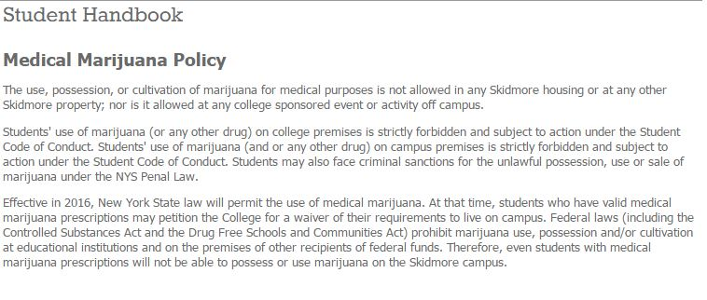
Skidmore College
(Skidmore College, 2019)

Slide 68
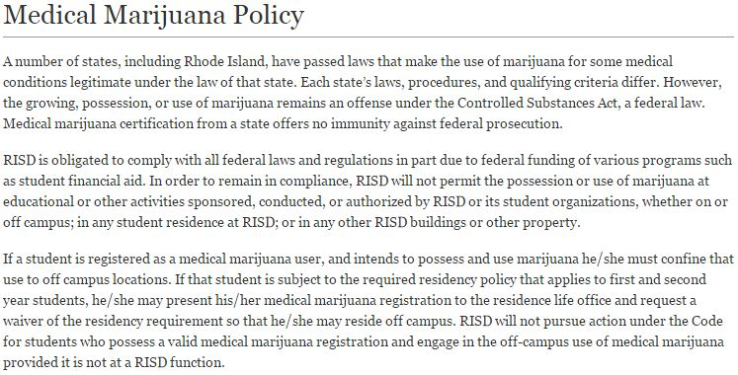
Rhode Island School of Design
(Rhode Island School of Design, 2019)

Slide 69
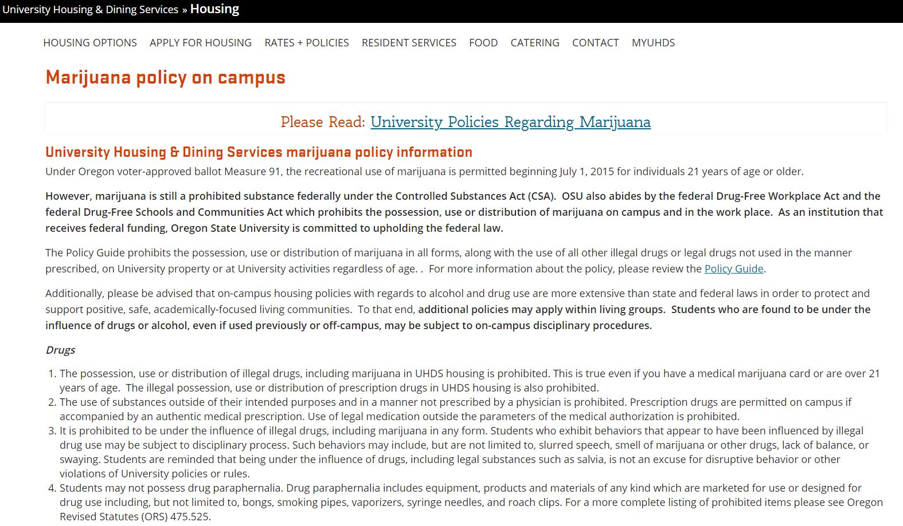
Oregon State University
(Oregon State University, 2019)

Slide 70
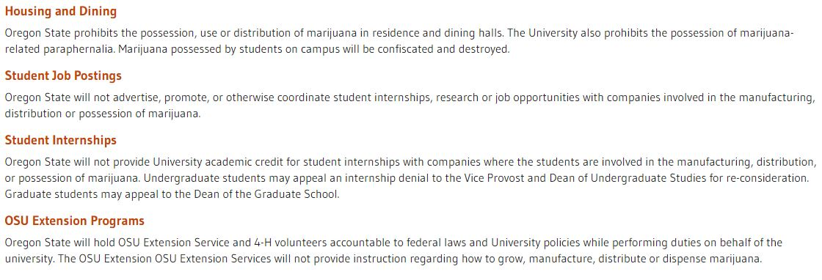
Oregon State University
(Oregon State University, 2016)

Slide 71
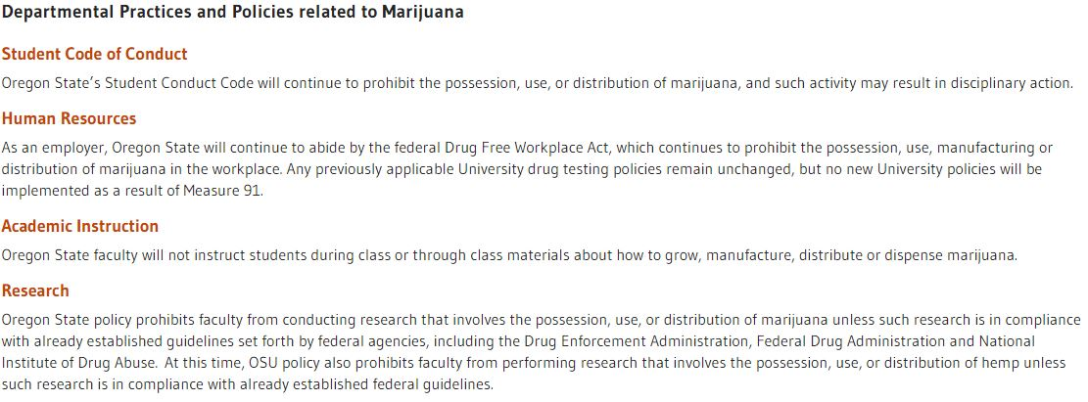
Oregon State University
(Oregon State University, 2016)

Slide 72
Implications Regarding Policy
On-campus residency requirements and accommodations
  Zero tolerance
  Waivers
Medical Clinic - Prescriptions
Communication to current students/families
Communication to prospective and new students/families
Communication to current staff and faculty
Communication to public, guests, camps/conferences
Communication to prospective and new staff and faculty

Slide 73
Implications Regarding Policy
Having your campus do what it says it will do
  Consistent policy monitoring and enforcement on-campus
    Campus Community Members vs. Guests/Public Visiting Campus
    Tobacco-Free/Smoke-Free Campus Policies
  Consistent policy monitoring and enforcement off-campus
Campus Sanctions vs Local/State/Federal Sanctions
Alcohol penalties vs. Marijuana penalties
  Marijuana is a Controlled Substance
  Alcohol and Tobacco are not

Slide 74
Implications Regarding Policy & DFSCA
a program to prevent the unlawful possession, use, or distribution of illicit drugs and alcohol by students and employees.
Marijuana related curriculum/courses
Marijuana and the media
  News coverage
  News advertising

Slide 75
Addressing Marijuana/Cannabis Use through Prevention

Slide 76
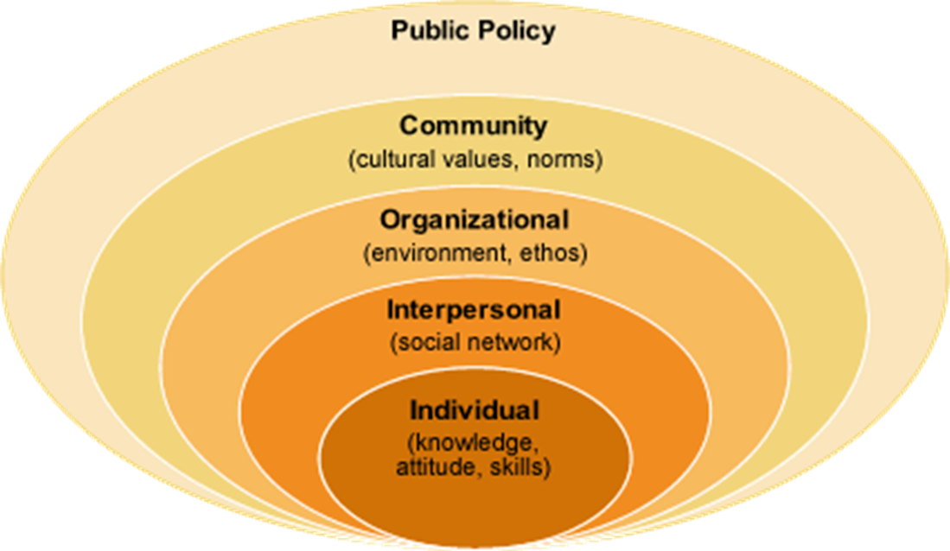
Addressing Marijuana through a Socio-Ecological Framework
(McLeroy et al., 1988)

Slide 77
Socio-Ecological Model
(McLeroy et al., 1988)
Individual
  Characteristics what influence individual behavior (beliefs, attitudes, values, knowledge, expectancies, demographic variables)
Interpersonal
  Formal and informal social networks (family, friends, colleagues, organization members) which influence an individual’s behavior
Organizational
  Intercommunity organizations or social institutions which share values, impact service delivery, and effect attitudes of constituents (RSO’s, Departments, Residence Halls, Clubs, Churches)
Community
  Organizations with a defined service or geographical ares
Public Policy
  Local, state, regional ad national policies, laws, procedures and their enforcement

Slide 78
Individual Interventions
Focus on Harms
  Impaired driving and other impairment issues (HEDAOD, 2019; CADE, 2018)
  Edible versions of cannabis (HEDAOD, 2019)
  Academic Performance (HEDAOD, 2019; CADE, 2018)
  Brain development consequences of heavy us in younger college populations (HEDAOD, 2019)
  Cannabis dependence (CADE, 2018)
Harm Reduction for those over 21 (CADE, 2018)
Screening, Brief Interventions and Referral to Treatment (SBIRT), particularly using the Cannabis Use Disorder Inventory Test Revised (CUDIT-R) (HEDAOD, 2019; CADE, 2018)
Cannabis Abuse Screening and Intervention for College Students (CASICS)CASICS (HEDAOD, 2019; CADE, 2018)
Motivational Enhancement/Interviewing
Marijuana E-CHECKUP TO GO (Colorado State, 2017)
Protective Behavioral Strategies (Pederson et al., 2016)

Slide 79
Interpersonal Interventions
Social Norms Interventions (CADE, 2018)
  Descriptive Norms
  Injunctive Norms (focus on family and friends approval/disapproval)
Social Marketing Interventions (ACE, 2018)
Bystander Intervention (CADE, 2018)

Slide 80
Organizational Interventions
Needs assessment and campus climate survey
Increased training and education for university faculty, staff, and administrators (current trends, culture, use, detection)

Slide 81
Community Interventions
IHE’s need to place DFSCA efforts, particularly regarding marijuana and cannabis use, on par with Title IX, VAWA, Clery and other efforts^{29.}

Slide 82
Public Policy – Data Collection
(IPHA, 2018)
Self-reported use
Marijuana related medical/health service rates
Marijuana related counseling clinic rates
Marijuana related impaired driving and traffic crashes
Perceptions of use and harm
Negative consequences (academic, social, emotional, physical, etc.)
Average THC potency
Marijuana related violations/arrests
Related overdoses/poison control center data
# of individuals completing budtender training

Slide 83
Public Policy – Campus & Local
Smoke-free policies are not enough
Review student conduct and employee policies and make them more clear (NCCPS, 2016).
  E-cigarettes/vapes
  ADA issues
  Employee use, liability risks, IHE risk mgt. efforts
Discussions/partnerships with local, district, and states attorneys regarding off-campus adjudication and sanctioning (IPHA, 2018).
Need for access to practical testing methods (NCCPS, 2016).
Limit the marketing of adult-use marijuana to protect youth and other vulnerable populations (IPHA, 2018).
Levy local taxes (IPHA, 2018).

Slide 84
Public Policy – Campus & Local
Limit the number and density of adult-use marijuana retailers
Only allow specialized business model to keep out of outlets as bars, grocery stores, convenience stores
Prominent warning signs on key negative health and social aspects in retail outlets
Budtender training, similar to responsible beverage service training

Slide 85
Public Policy – State
(IPHA, 2018)
States should invest substantial investment in prevention, education and health promotion prior to first stores opening
Budtender training, similar to responsible beverage service training
Warning labels should be required on product packages and any allowed marketing message
Product packaging and labeling must help prevention accidental ingestion
Types of products (cannabis infused beverages, flavored combustibles, pre-rolls with flavored paper) should be limited
Invest generated revenues into programs and initiatives that protect health

Slide 86
Public Policy – National
(NCCPS, 2016)
Need for a standard at national level regarding what is and what is not impairment
Need for a uniform reporting standard for IHE’s
Need for national research on long-term and short term effects and outcomes of marijuana use
Advocate that marijuana offenses be separated as its own drug reportable category in Clery reporting.

Slide 87
Questions?

Slide 88
References/Sources
American Council on Education (2018). Cannabis and the College Campus: Considering the Impact on Students in a Changing Legal Climate. https://www.higheredtoday.org/2018/11/13/cannabis-college-campus-considering-impact-students-changing-legal-climate/ Retrieved 3/24/19.
Coalition of Colorado Campus Alcohol and Drug Educators - NASPA. (2018). Higher education cannabis prevention toolkit. Retrieved from https://www.naspa.org/images/uploads/events/Higher_Education_Cannabis_Toolkit.pdf Retrieved 3/17/19
Colorado State. (2017). https://chhs.source.colostate.edu/intervention-shows-promise-reducing-heavy-marijuana-use-among-college-students/ Retreived 3/24/19
Deitch, R. (2003). Hemp-American history revisited. New York City: Algora Publishing

Slide 89
References/Sources
Gieringer, D.H. (1999). The forgotten origins of cannabis prohibition in California. Contemporary Drug Problems, 26(2).
Hagan Cain, R. (2012). Ninth circuit denies rehearing in medical marijuana ADA challenge. Retrieved 10/2/15 from http://blogs.findlaw.com/ninth_circuit/2012/11/ninth-circuit-denies-rehearing-in-medical-marijuana-ada-challenge.html
Hardaway,R.M. (2018). Marijuana politics: Uncovering the troublesome history and social costs of criminalization. Santa Barbara, CA: Praeger.
Higher Education Center (2006). Complying with the Drug-Free Schools and Campuses Regulations, Edgar Part 86. Retreived 4/7/2016 from http://www.higheredcompliance.org/resources/resources/dfscr-hec-2006-manual.pdf

Slide 90
References/Sources
Higher Education Center for Alcohol Other Drug. (2019). Cannabis. https://hecaod.osu.edu/campus-professionals/prevention/cannabis Retrieved 3/24/19
Illinois Public Health Institute. (2018). Protecting public health and promoting equity in adult-use marijuana legalization in Illinois: Recommendations for policy makers. http://iphionline.org/wp-content/uploads/2018/12/Public-Health-Equity-Framework-Paper-FINAL_formatted.pdf. Retrieved 1/16/19.
Join Together.(2015). Court rules employees can be dismissed if they use marijuana off the job. Retreived 10/2/15 from http://www.drugfree.org/join-together/court-rules-employees-can-dismissed-use-marijuana-job/
McLeroy KR, Bibeau D, Steckler A, Glanz K. An ecological perspective on health promotion programs. Health Education Quarterly. 1988;15(4):351–377.

Slide 91
References/Sources
Meacham MC, Paul MJ, & Ramo DE. (2018). Understanding emerging forms of cannabis use through an online cannabis community: An analysis of relative post volume and subjective highness ratings. Drug Alcohol Depend, 188.
National Center for Campus Public Safety (2016). The effects of marijuana legalization and decriminalization on campus safety at institutions of higher education. https://www.nccpsafety.org/our-work/emerging-issues-forums/the-effects-of-marijuana-legalization-and-decriminalization-on-campus-safet Retreived 3/22/19.
NORML (2019). State Info. Retrieved March 26, 2019 from http://norml.org/states
Oregon State University. (2016). University policies regarding marijuana. http://main.oregonstate.edu/university-policies-regarding-marijuana Retreived 4/6/16

Slide 92
References/Sources
Oregon State University. (2019). Marijuana policy campus. https://uhds.oregonstate.edu/housing/marijuana-policy-campus Retrieved 3/26/19.
Pederson, E.R., Hummer, J.F., Rinker, D.V., Traylor, Z.K. & Neighbors, C. (2016). Measuring protective behavioral strategies for marijuana use among young adults. Journal of Studies of Alcohol and Drugs, 77(3). pp.s 441-450.
ProCon.Org (2013). Historical Timeline: History of Marijuana as Medicine – 2900 BC to Present. Retreived 4/5/2016 from http://medicalmarijuana.procon.org/view.timeline.php?timelineID=000026
Rhode Island School of Design. (2019) Medical marijuana policy. https://policies.risd.edu/student-life/medical-marijuana-policy/ Retrieved 3/26/19

Slide 93
References/Sources
Oregon State University. (2019). Marijuana policy campus. https://uhds.oregonstate.edu/housing/marijuana-policy-campus Retrieved 3/26/19.
Pederson, E.R., Hummer, J.F., Rinker, D.V., Traylor, Z.K. & Neighbors, C. (2016). Measuring protective behavioral strategies for marijuana use among young adults. Journal of Studies of Alcohol and Drugs, 77(3). pp.s 441-450.
ProCon.Org (2013). Historical Timeline: History of Marijuana as Medicine – 2900 BC to Present. Retreived 4/5/2016 from http://medicalmarijuana.procon.org/view.timeline.php?timelineID=000026
Rhode Island School of Design. (2019) Medical marijuana policy. https://policies.risd.edu/student-life/medical-marijuana-policy/ Retrieved 3/26/19

Slide 94
References/Sources
Skidmore College. (2019). Marijuana Policy. https://www.skidmore.edu/health-services/policies/marijuanapolicy.php Retreived 3/26/19
Students for Sensible Drug Policy. (2012). The Drug-Free Schools and Communities Act: Why Changing Campus Drug and Alcohol Policies Doesn’t Mean an End to Federal Funding. Retrieved 4/7/2016 from http://ssdp.
US Dept of Labor. (2016). Drug-free workplace advisor: Frequently asked questions. Retrieved 4/7/2016 from http://webapps.dol.gov/elaws/asp/drugfree/screenfq.htm
US Dept. of Justice (2009). ADA Amendments Act of 2008. Retrieved on 4/7/2016 from http://www.ada.gov/pubs/adastatute08.pdf

Slide 95
References/Sources
US Dept. of Justice Office of Diversion Control. (2016). Controlled substance schedules. Retrieved 4/5/16 from www.deadiversion.usdoj.gov/schedules
US Dept. of Labor. Drug-Free Workplace Advisor. https://webapps.dol.gov/elaws/asp/drugfree/require.htm Retrieved 3/24/19
Wikipedia (2016). Legal history of cannabis in the United States. Retrieved 4/5/16 from https://en.wikipedia.org/wiki/Legal_history_of_cannabis_in_the_United_States
Workman, T. Medical marijuana: Implications for campus policy. Retrieved 4/7/2016 from http://www.academia.edu/1677626/Medical_Marijuana_Implications_for_University_Policy

Slide 96
Eric’s Contact Information
Eric S. Davidson, Ph.D., MCHES, CSPS
Director, Illinois Higher Education Center
Eastern Illinois University
600 Lincoln Avenue
Charleston, IL 61920
217/581-2019
esdavidson@eiu.edu

